Slide 1

WEB FORMS
HTML WITH PHP
TEXT BOX
TEXT AREA
LIST BOX
CHECK BOX
RADIO BOX
HIDDEN FIELDS
Notes:
NITTTR, BHOPAL

Slide 2
GET Argument
The GET method passes arguments from one page to the next as part of the Uniform Resource Locator query string.
GET appends the indicated variable names and values to the URL designated in the ACTION attribute with a question-mark separator and submits the whole thing to the processing agent
ADVANTAGES
It constructs the actual new and differentiable URL query strings.
User can book-mark this page. The result of forms using the POST method are not bookmarkable.

Slide 3
GET Argument
Disadvantage
The GET method is not suitable for logins because the user name and password are fully visible on screen as well as potentially stored in the client browsers memory as at visited page.
Every GET submission is recorded in the web server log, data set included.
GET method assigns data to a server environment variable, the length of URL is limited.

Slide 4
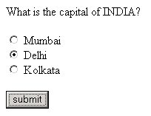
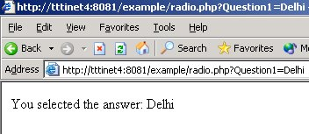
Use of GET Argument
Radio.html
Radio.php

Slide 5
Use of GET Argument
<html>
<head><title></title></head>
<body>
<form method=“GET” action="radio.php">
What is the capital of INDIA?
<br>
<br>
<input name="Question1" type="radio“
value="Mumbai">
Mumbai
<br> CONT ..
<input name="Question1" type="radio" value="Delhi">
Delhi
<br>
<input name="Question1" type="radio" value="Kolkata">
Kolkata
<br>
<br>
<input type="submit" value="submit">
</form>
</body>
</html>
Radio.html

Slide 6
Use of GET Argument
<html>
<head><title></title></head>
<body>
<?php
echo "You selected the answer: $_GET[Question1]";
?>
</body>
</html>
Radio.php

Slide 7
POST arguments
POST is the preferred method of form submission today, particularly in non- indempotent uses, such as adding information to a database.
No visible change to the URL will results according to the different data submission.
Advantages
It is more secure than get because user entered information is never visible in the URL query string, in the server log or on screen.
There is a much larger limit on the amount of data that can be passed (a couple of K/bites rather than a couple of hundred characters.

Slide 8
POST arguments
Disadvantages
The result at a given movement cannot be book-marked.
This method can be incompatible with certain firewall setups, which strip the form data as a security measures.

Slide 9
$_POST
$_POST is a superglobal array.
This array is available to a script at anytime no matter what the scope.
Anything submitted via the POST method is available in the $_POST array.
Index of the $_POST array is the name we gave to the HTML form element.
A form element being a button, textbox, checkbox, etc, that is what the index of the $_POST array will be in order to access the data from that element.
The $_POST array is only available in PHP versions 4.1.0 and later.
In earlier version, you will need to use the $HTTP_POST_VARS array.
The $HTTP_POST_VARS array works the same as the $_POST array, except it is not a
superglobal. That is, it is not available in all scopes. In fact, if register_globals is turned
off in your php.ini you will need to put "global $HTTP_POST_VARS;" at the top of the
form.php script for it to work.

Slide 10
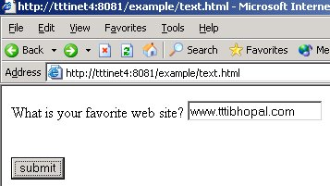
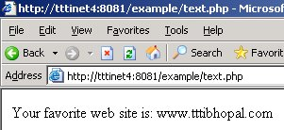
Use of Text Box
Text.html
Text.php

Slide 11
Text.html
<html>
<head><title></title></head>
<body>
<form method="POST" action="text.php">
What is your favorite web site?
<input name="WebSites" type="text">
<br>
<input type="submit“ value="submit">
</form>
</body>
</html>

Slide 12
Text.php
<html>
<head><title></title></head>
<body>
Your favorite web site is:
<?php
echo $_POST['WebSites'];
?>
</body>
</html>

Slide 13
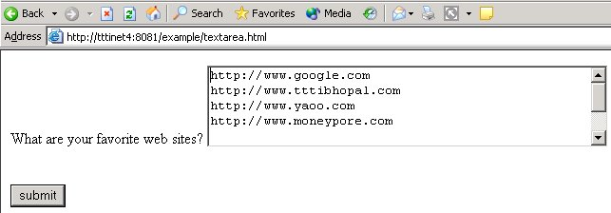
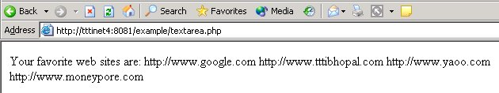
Use of TextArea
Textarea.html
Textarea.php

Slide 14
Textarea.html
<html>
<head><title></title></head>
<body>
<form method="POST" action="textarea.php">
What are your favorite web sites?
<textarea name="WebSites" cols="50" rows="5">
http://
http://
http://
http://
</textarea>
<br>
<br>
<br>
<input type="submit" value="submit">
</form>
</body>
</html>

Slide 15
Textarea.php
<html>
<head><title></title></head>
<body>
Your favorite web sites are:
<?php
echo $_POST['WebSites'];
?>
</body>
</html>

Slide 16
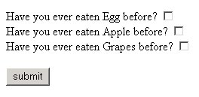
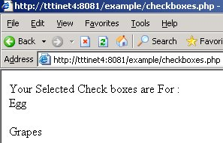
Use of CHECKBOXES
checkboxes.html
checkboxes.php

Slide 17
checkboxes.html
<html>
<head><title></title></head>
<body>
<form method="POST" action="checkboxes.php">
Have you ever eaten Egg before?
<input name="Choice1" type="checkbox" value="Egg">
<br>
Have you ever eaten Apple before?
<input name="Choice2" type="checkbox" value="Apple">
<br>

Slide 18
checkboxes.html
Have you ever eaten Grapes before?
<input name="Choice3" type="checkbox" value="Grapes">
<br>
<br>
<input type="submit" value="submit">
</form>
</body>
</html>

Slide 19
checkboxes.php
<html>
<head><title></title></head>
<body>
Your Selected Check boxes are For :
<br>
<?php
echo "$_POST[Choice1]<br>";
echo "$_POST[Choice2]<br>";
echo "$_POST[Choice3]<br>";
?>
</body>
</html>

Slide 20
Use of RADIO Button
Radio.html
Radio.php

Slide 21
Use of Radio Button
<html>
<head><title></title></head>
<body>
<form method=“GET” action="radio.php">
What is the capital of INDIA?
<br>
<br>
<input name="Question1" type="radio“
value="Mumbai">
Mumbai
<br> CONT ..
<input name="Question1" type="radio" value="Delhi">
Delhi
<br>
<input name="Question1" type="radio" value="Kolkata">
Kolkata
<br>
<br>
<input type="submit" value="submit">
</form>
</body>
</html>
Radio.html

Slide 22
Radio.php
<html>
<head><title></title></head>
<body>
<?php
echo "You selected the answer: $_GET[Question1]";
?>
</body>
</html>

Slide 23
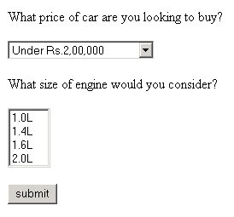
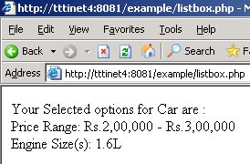
Use of LIST BOX
listbox.html
listbox.php

Slide 24
listbox.html
<html>
<head><title></title></head>
<body>
<form method="POST" action="listbox.php">
What price of car are you looking to buy?
<br>
<br>
<select name="Price">
<option>Under Rs.2,00,000</option>
<option>Rs.2,00,000 - Rs.3,00,000</option>
<option>Rs.3,00,000 - Rs.5,00,000</option>
<option>Over Rs.5,00,000</option>
</select>
<br>

Slide 25
listbox.html Cont….
What size of engine would you consider?
<br>
<select name="EngineSize[]" multiple>
<option>1.0L</option>
<option>1.4L</option>
<option>1.6L</option>
<option>2.0L</option>
</select>
<br>
<br>
<input type="submit" value="submit">
</form>
</body>
</html>

Slide 26
listbox.php
$Choice0 = $_POST['EngineSize'][0];
$Choice1 = $_POST['EngineSize'][1];
$Choice2 = $_POST['EngineSize'][2];
$Choice3 = $_POST['EngineSize'][3];
echo "<br>Engine Size(s): $Choice0";
echo "$Choice1";
echo "$Choice2";
echo "$Choice3";
?>
</body>
</html>
<html>
<head><title></title></head>
<body>
Your Selected options for Car are :
<br>
<?php
echo "Price Range: $_POST[Price]";

Slide 27
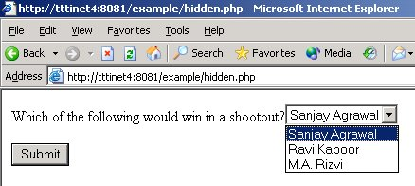
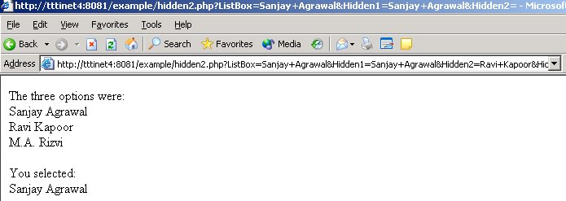
Use of Hidden fields
hidden.php
Hidden2.php

Slide 28
hidden.php
<html>
<head></head>
<body>
<?php
$Message1=“Sanjay Agrawal";
$Message2=“Ravi Kapoor";
$Message3=“M.A. Rizvi";
echo "<form method='GET' action='hidden2.php'>";
echo "Which of the following would win in a shootout?";
echo "<select name='ListBox'>";
echo "<option>$Message1</option>";
echo "<option>$Message2</option>";

Slide 29
hidden.php
echo "<option>$Message3</option>";
echo "</select><br><br>";
echo "<input type='hidden' name='Hidden1' value='$Message1'>";
echo "<input type='hidden' name='Hidden2' value='$Message2'>";
echo "<input type='hidden' name='Hidden3' value='$Message3'>";
echo "<input type='submit' value='Submit'>";
echo "</form>";
?>
</body>
</html>

Slide 30
hidden2.php
<html>
<head><title></title></head>
<body>
<?php
echo "The three options were:<br>";
echo "$_GET[Hidden1]<br>";
echo "$_GET[Hidden2]<br>";
echo "$_GET[Hidden3]<br>";
echo "<br>You selected:<br>";
echo "$_GET[ListBox]";
?>
</body>
</html>

Slide 31
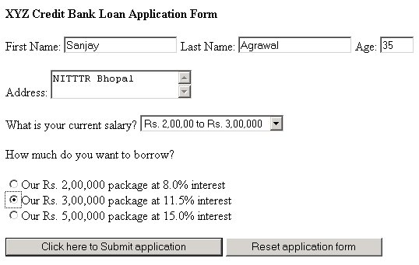
loan.html

Slide 32
loan.html
<html>
<head><title></title></head>
<body>
<b>XYZ Credit Bank Loan Application Form</b>
<form method="POST" action="loan.php">
First Name:
<input name="FirstName" type="text">
Last Name:
<input name="LastName" type="text">
Age:
<input name="Age" type="text" size="3">
<br>
<br>
Address:
<textarea name="Address" rows=“4” cols=“40”>
</textarea>
Cont…

Slide 33
loan.html Cont… 2
<br>
<br>
What is your current salary?
<select name="Salary">
<option value=200000>Under Rs. 2,00,000</option>
<option value=250000>Rs. 2,00,00 to Rs. 3,00,000</option>
<option value=350000>Rs. 3,00,000 to Rs. 4,00,000</option>
<option value=500000>Over Rs. 5,00,000 </option>
</select>
<br>
<br>
Cont…

Slide 34
loan.html Cont…. 3
How much do you want to borrow?<br><br>
<input name="Loan" type="radio" value='100000'>Our Rs. 2,00,000 package at 8.0% interest
<br>
<input name="Loan" type="radio" value='500000'>Our Rs. 3,00,000 package at 11.5% interest
<br>
<input name="Loan" type="radio" value='1000000'>Our Rs. 5,00,000 package at 15.0% interest
<br>
<br>
<input type="submit" value="Click here to Submit application">
<input type="reset" value="Reset application form">
</form>
</body>
</html>

Slide 35
loan.php
<html>
<head><title></title></head>
<body>
<b>XYZ Credit Bank Loan Application Form</b>
<br>
<br>
<?php
$SalaryAllowance = $_POST['Salary']/2;
$AgeAllowance = 100/$_POST['Age‘];
$LoanAllowance = $SalaryAllowance * $AgeAllowance;
echo "Loan wanted:$_POST[Loan]<br>";

Slide 36
loan.php
echo "Loan amount we will allow:$LoanAllowance<br><br>";
if ($_POST['Loan'] <= $LoanAllowance) echo "Yes, $_POST[FirstName] $_POST[LastName], we are delighted to accept your application";
if ($_POST['Loan'] > $LoanAllowance) echo "Sorry, $_POST[FirstName] $_POST[LastName], we cannot accept your application at this time";
?>
</body>
</html>

Slide 37
Formatting of Numbers
we can format the number with specifying whether to display the digits with decimal or without decimal or number of digits to display after the decimal or to round off.
We can place comma ( ,) after a group of thousands.
We can use other symbols in place of comma (,) for thousands and we also can replace (.) dot with symbol of our choice to be used as decimal.
Using PHP number_format function we can do all these formatting.

Slide 38
Formatting of Numbers
Examples:
$number=2512589.66785;
echo "Number = $number ";
echo " No. after formatting = ".number_format($number);
The above line will display 2,512,590 ( without decimal and rounded)
echo "<br> The value after formating = ".number_format($number,3);
This Will display 2,512,589.668 ( with comma symbol after each thousand and 3 digits after decimal rounded )

Slide 39
Formatting of Numbers
echo "<br> The value after formating = ".number_format($number,3,"#",":");
This Will display 2:512:589#668 ( with : after each thousand and # as decimal symbol )

