Slide 1



Task 3: YouTube Songs Analysis with PowerBI
Name: Meet Mukesh Vaghasiya
Profile: Data Analyst Intern
Batch: MIP-DA-03

Slide 2

Project Overview
Explore the YouTube song dataset to reveal insights into music consumption patterns.
Conduct statistical analysis to identify trends, correlations, and patterns within the data.
Present findings to enhance understanding of music preferences and engagement on YouTube.
Uncover correlations between variables to gain deeper insights into music consumption behavior.
Contribute to a comprehensive understanding of YouTube's role in shaping music trends and preferences.

Slide 3
Dataset Description
[YouTube Songs Dataset]
video_id: Unique identifier for each YouTube video.
channelTitle: Title of the YouTube channel publishing the song.
title: Title of the YouTube song video.
description: Description provided for the YouTube song video.
tags: Tags associated with the YouTube song video.
publishedAt: Date and time when the YouTube song video was published.
viewCount: Number of views received by the YouTube song video.
likeCount: Number of likes received by the YouTube song video.
favoriteCount: Number of times the YouTube song video has been marked as a favorite.
commentCount: Number of comments posted on the YouTube song video.
duration: Duration of the YouTube song video.
definition: Video definition or quality (e.g., HD, SD).
caption: Availability of captions for the YouTube song video.

Slide 4

Tools Used
PowerBI is an end-to-end enterprise business intelligence tool. It supports various layouts and connects with many data sources, offering flexibility in data presentation and analysis.

Slide 5
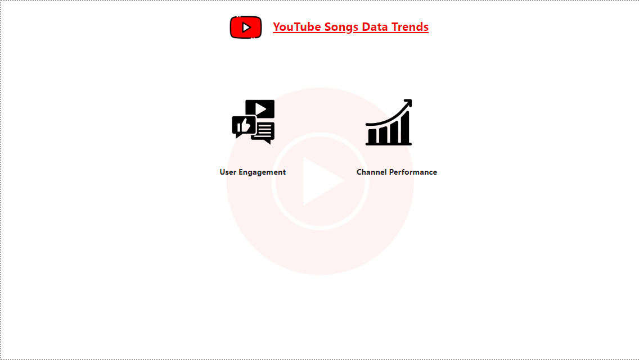
Creating Dashboard
Click here to go to the User Engagement Dashboard
Click here to go to the Channel Performance Dashboard
Home Page

Slide 6
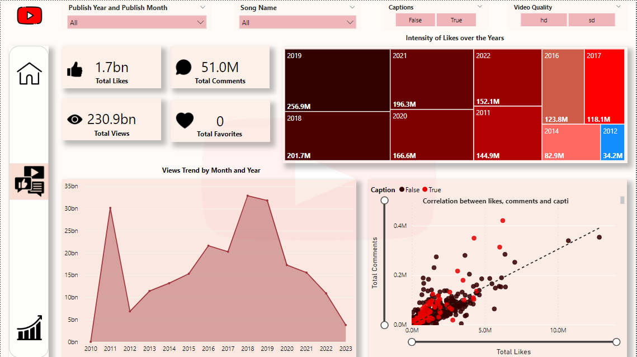
Dashboard
User Engagement Page

Slide 7
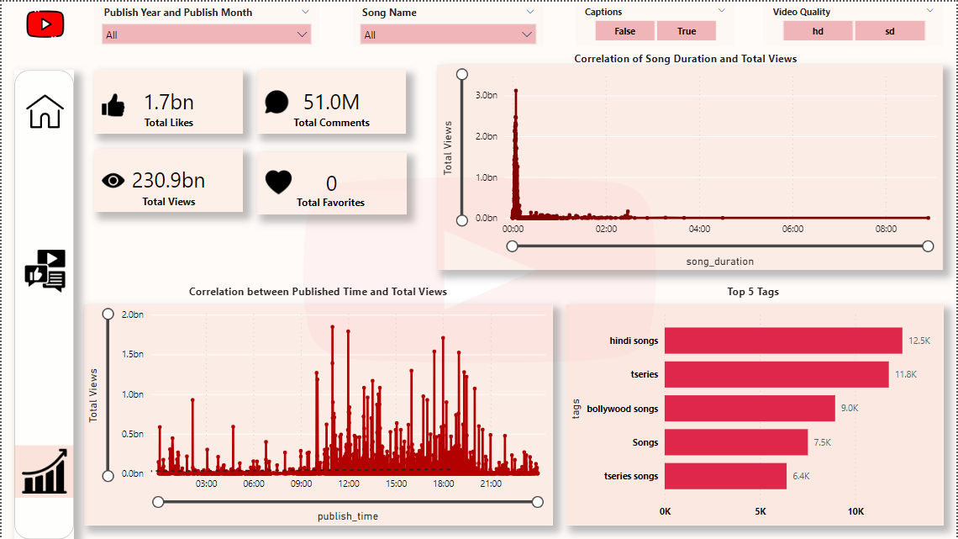
Dashboard
Channel Performance Page

Slide 8
Insights
1. In terms of likes on videos, 2019 recorded the highest count at 256.9 million, trailed by 2018 with 201.7 million and 2021 with 196.3 million.
2. Hindi songs emerge as the top tags on the songs, closely followed by T-Series and Bollywood songs.
3. The dataset indicates that 2018 and 2019 witnessed the highest engagement in terms of views and likes.
4. There's a noticeable trend of increased video viewership between 9 am and 9 pm.
5. Shorter videos, typically around 4-6 minutes in length, tend to attract more viewers, whereas longer videos extract less viewership.
6. Videos without captions tend to be preferred by viewers.
These insights offer valuable information for understanding the trends and impact within the realm of YouTube songs analysis, providing a comprehensive view of viewer preferences and engagement patterns over time.

Slide 9
Thank You!

