Slide 1

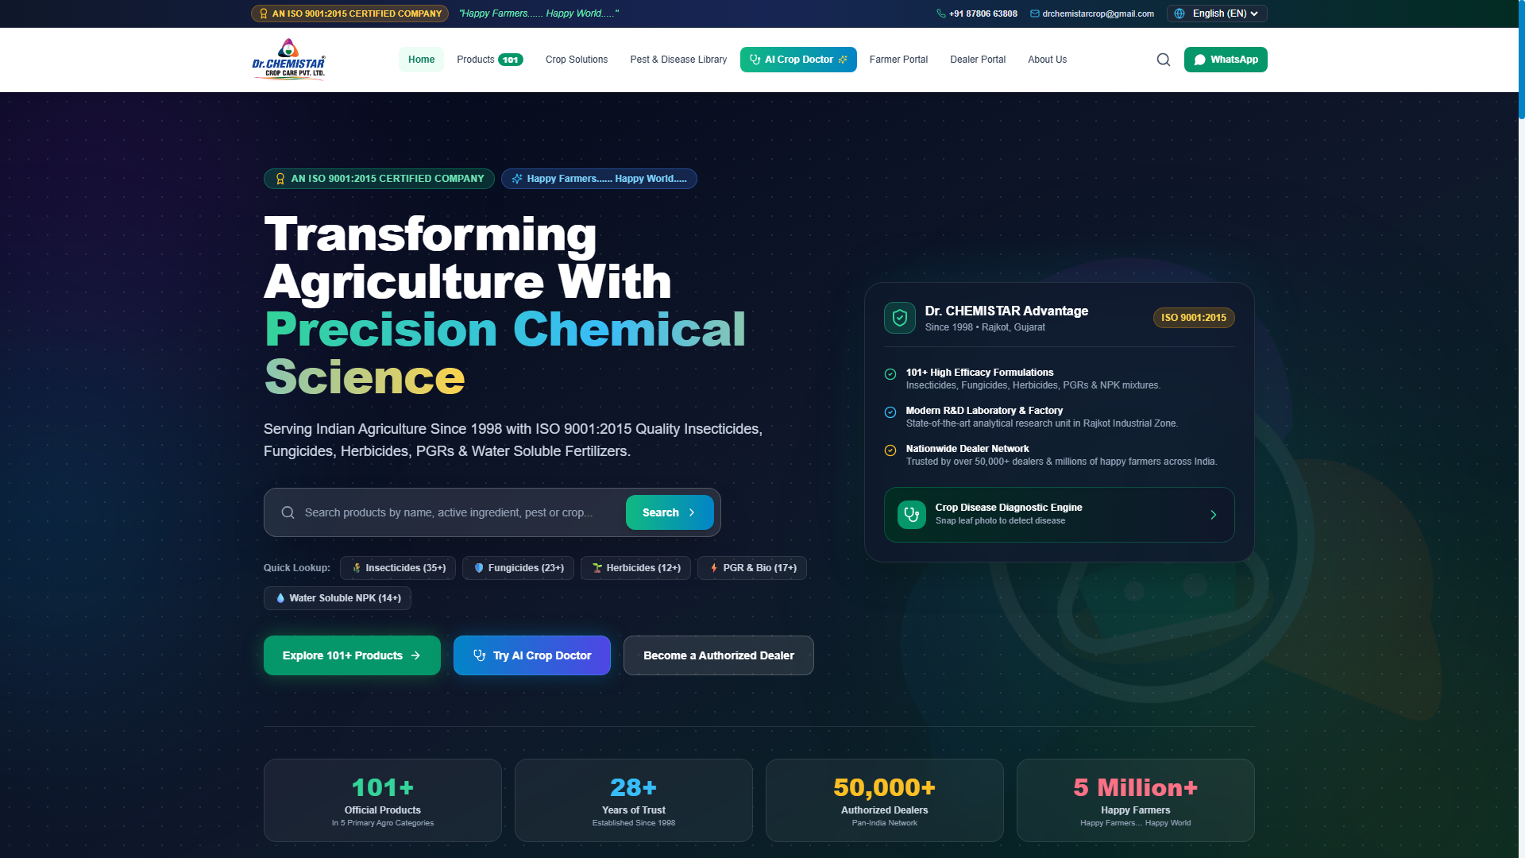
DR. CHEMISTAR CROP CARE
Bilingual Agrochemical Platform & Technical Audit
Official Website: www.drchemistar.com
PRESENTER: Antigravity AI Consulting Group
DATE: August 2026
AUDIENCE: Investors, Distributors, Dealers & Partners
Notes:
Welcome to the corporate presentation for Dr. CHEMISTAR Crop Care Pvt. Ltd. In this deck, we will conduct a full technical, brand, and UX evaluation based on the live site www.drchemistar.com. This includes exploring the brand story, technology stack, administrative tools, and digital growth roadmap.

Slide 2
BRAND ANALYSIS
About DR CHEMISTAR Crop Care
OUR BRAND STORY
STRATEGIC FOUNDATIONS
Serving Indian Agriculture since 1998, Dr. CHEMISTAR Crop Care has established itself as an ISO 9001:2015 certified leader in precision crop chemistry. The company manufactures top-tier insecticides, fungicides, herbicides, and crop growth enhancers to maximize yields while defending crops from pests, weeds, and pathogens. Headquartered in Rajkot, Gujarat, Dr. CHEMISTAR translates advanced scientific research into field-ready agricultural protection.
Mission Statement
'Happy Farmers... Happy World' - Empowering rural wealth through chemical science.
Vision Statement
To build sustainable, bio-safe farming networks globally using research-backed agrochemicals.
Core Strengths
• ISO 9001:2015 Quality Management System
• Over 25 years of formulation engineering experience
• Deep rural distribution network across major states
• In-house testing laboratories checking batch purity
Notes:
This slide presents the core identity of Dr. CHEMISTAR. Key points: Established in 1998 in Rajkot, Gujarat. Mission is 'Happy Farmers... Happy World'. Vision focuses on research-backed agrochemicals. Stress their ISO 9001 certification and long history since 1998, which gives them a high trust factor in the market.

Slide 3
WEBSITE STRATEGY
Digital Platform & Business Objectives
Core Purpose
Business Goals
Target Customers
• Serve as a 24x7 corporate digital showroom for dealers and farmers.
• Bridge communication between manufacturing and agricultural channels.
• Demonstrate products and safety information transparently.
• Offer smart agricultural tools like AI-based diagnostics to farmers.
• Lead Generation: Capture dealer queries via custom registration forms.
• Lower Sales Friction: Allow dealers to review available pack sizes online.
• Brand Position: Modernize brand image to appeal to large distributors.
• Increase Customer Support efficiency via WhatsApp chat links.
• Dealers: Access pricing requests, product inventory specs.
• Distributors: Evaluate manufacturing credibility and certifications.
• Farmers: Identify crop diseases and check recommended chemical dosages.
• Retailers: Verify authentic chemical brand markings.
Notes:
The digital platform serves multiple business objectives. It acts as a digital showroom, a lead generation engine, and a customer support portal. Note the target audience: B2B dealers/distributors are targeted via portals, while farmers are targeted via crop solutions and AI diagnostic support.

Slide 4
UI / UX REVIEW
Homepage Layout & Key Sections
HOMEPAGE TOUCHPOINTS
• Header: Features bilingual toggle (English & Hindi) and links to crop tools, dealer portals, and contact info.
• Hero Banner: Prominently showcases core tagline 'Happy Farmers... Happy World' with background visuals.
• Primary CTAs: High-visibility buttons for 'Explore 101+ Products', 'Become a Dealer', and 'Try AI Crop Doctor'.
• Bestsellers Section: Displays popular items like MALIKA ZC, STAR TARA WG with vivid packaging colors.
• Footer: Houses navigation, ISO certifications, WhatsApp quick link, and physical office address in Rajkot.
Notes:
This slide evaluates the homepage layout. The navigation structure allows instant access to products, portal entries, and crop advisory tools. Highlight the call-to-actions, which guide dealers towards onboarding and farmers towards the disease database.

Slide 5
INFORMATION ARCHITECTURE
Platform Sitemap & Layout Tree
HOMEPAGE (ROOT)
About Us
Products (101+)
Portals
Crop Advisory
Media & Admin
Contact Us
History & Plant
Insecticide / Fungicide
Dealer Portal
AI Crop Doctor
Media Gallery
WhatsApp CRM
Quality Assurance
Herbicide / PGR / Fert
Farmer Portal
Pest/Disease Lib
Admin CMS Portal
Inquiry Form
Notes:
This slide presents the information architecture. The site maps clean hierarchy: root links to 6 key areas, each containing detailed sub-pages. The sitemap showcases that all pages are maximum 2 clicks away from the homepage, reducing bounce rates.

Slide 6
BRAND IDENTITY
Website Branding & Design Guidelines
Color Palette
Typography
Visual Assets & Accents
Primary Green #15803d
HEADINGS FONT
• Glassmorphism Cards: Frosted containers with white borders.
• Premium Flat Icons: SVG vector markers indicating crops and actions.
• Color Theme Badges: Visual category tags (e.g. Green for Fungicides).
• Fluid CSS Animations: Gentle fades, hover scaling, and loading state shimmers.
Outfit
Modern Sans-Serif with geometric curves. Represents science & precision.
Primary Blue #0284c7
BODY FONT
Accent Orange #ea580c
Inter
Highly legible sans-serif optimal for technical values & dosage charts.
Dark Slate #0f172a
Notes:
Branding analysis for Dr. Chemistar. Primary Green represents growth, Primary Blue represents precision/chemistry, and Orange represents vigor. Outfit font is used for headers and Inter for body text. Visual elements feature glassmorphism which adds a premium, modern feel to the user interface.

Slide 7
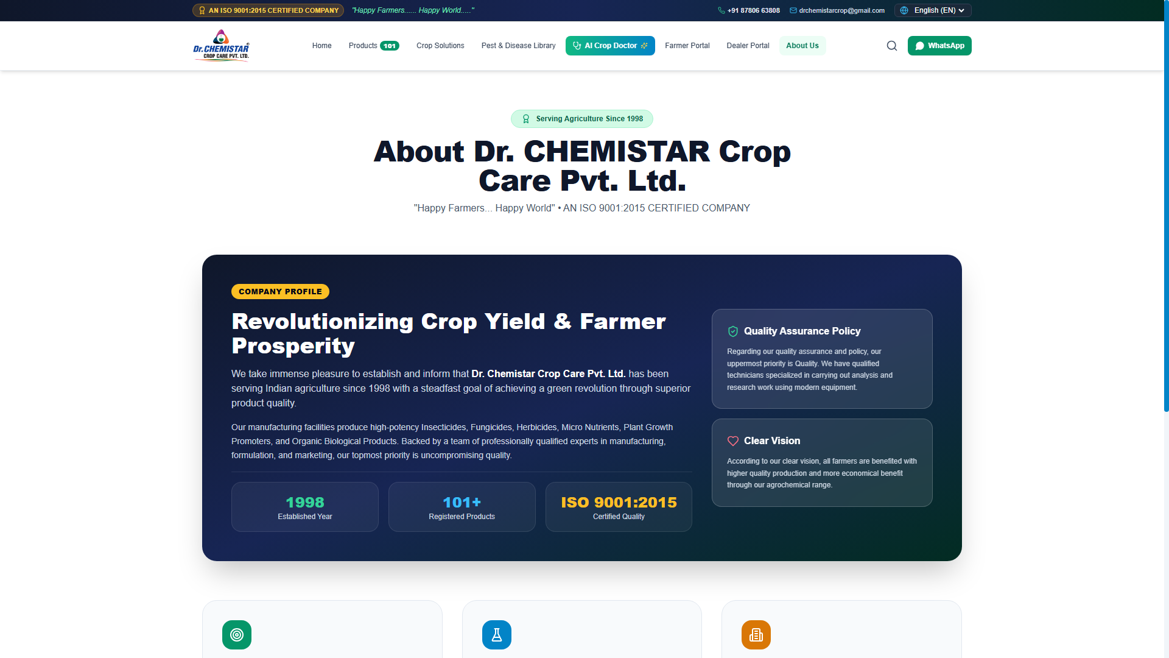
CONTENT AUDIT
About Us Page & Brand Legacy
COMPANY PROFILE REVIEW
• Manufacturing Facility: Spotlights the state-of-the-art chemical formulating factory in Sopan Industrial Zone, Rajkot, Gujarat.
• Quality Testing Lab: Details active testing, batch validation, and raw material auditing methodologies.
• Certifications: Houses the ISO 9001:2015 logo, creating instant trust for B2B dealers and distributors.
• Corporate Video: Includes a teaser container showing facility tours (future scope/gallery integration).
• Guiding Principles: Highlights adherence to safety guidelines and eco-responsibility parameters.
Notes:
Analysis of the About Us page. The page highlights the physical manufacturing infrastructure in Rajkot, Gujarat. This is a crucial trust-builder, showing B2B clients that they are dealing directly with the manufacturer, rather than an reseller.

Slide 8
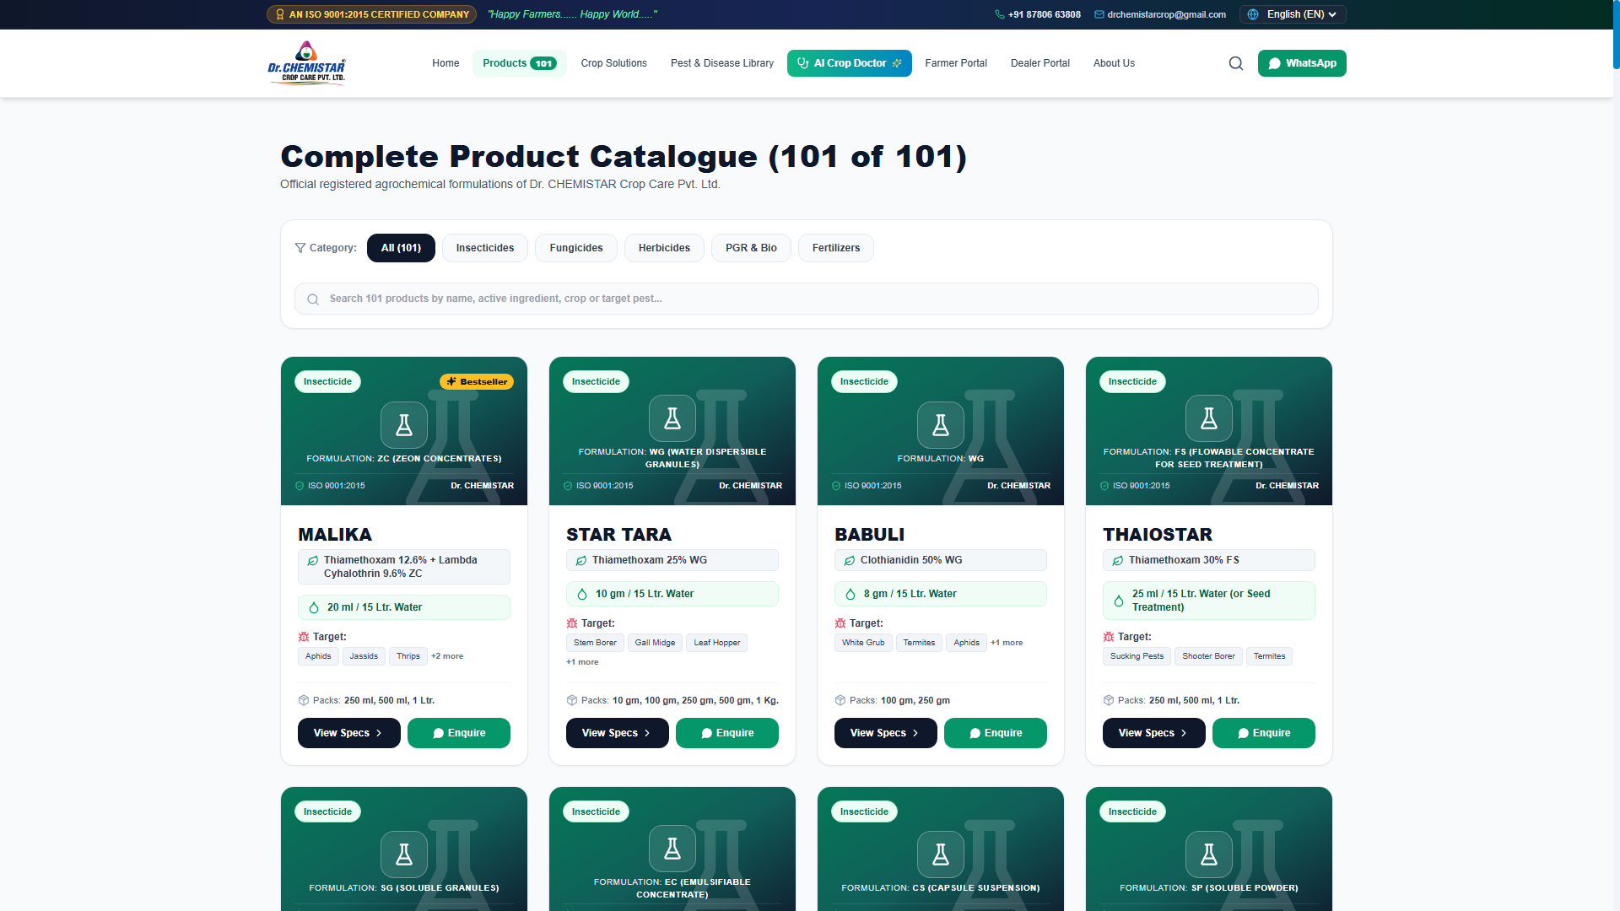
CATALOG ANALYSIS
Products Overview & Dynamic Categories
CATALOG DESIGN SCHEME
• Five Product Verticals: Insecticides, Fungicides, Herbicides, PGRs, and Water Soluble Fertilizers.
• Dynamic Filtering: Frontend categories allow farmers to select options and see instantaneous results without page reloads.
• Product Grid Layout: 101+ items structured in a clean grid featuring high-contrast colored cards.
• Quick Technical specs: Cards directly highlight the active chemical formulation and available pack sizes.
• Lead Funnel integration: Every product card contains a prominent WhatsApp enquiry button.
Notes:
Products overview. The site displays the 101+ products categorized in 5 areas. Dynamic category tabs allow fast client filtering, and the immediate display of technical specifications and pack sizes reduces buyer confusion.

Slide 9
CONVERSION OPTIMIZATION
Product Detail Page & Conversion CTAs
PRODUCT MODAL INFORMATION MODEL
• Common Name & Chemistry: Showcases full active ingredient list (e.g. MALIKA ZC has Thiamethoxam 12.6% + Lambda Cyhalothrin 9.6%).
• Dosage Chart: Provides precise mix rates (e.g., 20 ml per 15 Ltr water).
• Foliage Instructions: Recommends target crops (Cotton, Chilli, Groundnut) and target pests (Thrips, Whitefly).
• Mode of Action: Outlines scientific chemistry (Systemic & Contact protection).
• Conversion Anchors: Features PDF tech spec sheet download, B2B price quote request, and direct WhatsApp customer enquiry.
Notes:
The product detail view appears as a modern modal on the products catalog page. It focuses on answering critical farmer and dealer questions: chemical ingredients, exact dosage, recommended crops, and mode of action. Direct conversion buttons drive sales inquiries.

Slide 10
UX OPTIMIZATION
Dynamic Search & Real-time Indexing
SEARCH BEHAVIOR AUDIT
• Instant Search: Results update dynamically as the user types.
• Multi-Field Indexing: Looks up terms across product names, active ingredients, target pests, and crops.
• Keyword matching: Users typing 'Cotton' immediately view all insecticides and fertilizers recommended for cotton crops.
• No-result helper: If no match is found, the UI displays a helpful prompt suggesting search adjustments or direct support contact.
Notes:
The search feature dramatically improves the user experience. By searching across name, active ingredient, crop, and pest, a farmer who doesn't know the exact product name can simply type 'whitefly' or 'rice' to discover the exact agrochemical solution needed.

Slide 11
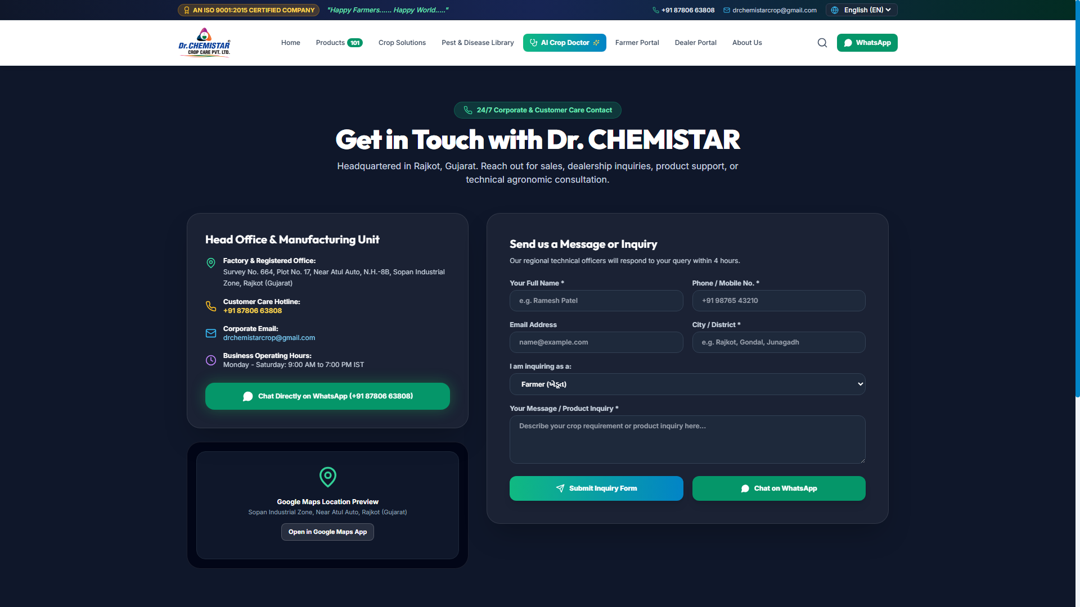
CONTACT OPTIMIZATION
Contact Channels & Lead Forms
COMMUNICATION TOUCHPOINTS
• Validation Lead Form: Prompts name, email, phone, city, user type, and text message to prevent empty submissions.
• Google Maps: Pins the physical factory location near Atul Auto, National Highway 8B, Sopan Industrial Zone, Rajkot.
• WhatsApp Direct: Launches chat window to +91 6351 250 285 for immediate response.
• Email Support: Official mailbox (drchemistarcrop@gmail.com) for formal dealer documentation.
• Phone Hotline: Quick dialing contact for immediate product queries.
Notes:
The contact page has five key communication channels. The lead form filters by user type (farmer or dealer), routeing enquiries correctly, and Google Maps integration helps offline logistics and local trust.

Slide 12
FEATURE MATRIX
Core Website Capabilities
Mobile Responsive
Lightning Fast Speed
SEO-Ready Structure
Adapts to desktop, tablet, and mobile layouts seamlessly.
Built on Vite and Tailwind for fast loading on 3G/4G rural networks.
Clean HTML5 semantic structure with built-in descriptive metadata.
Bilingual Content
AI Diagnostic Doctor
Secure SSL & Forms
English and Hindi localizations to support local farmers.
Ready integration for automated leaf disease identification.
Protects user data, validates queries, and halts server injection.
Notes:
This matrix displays the core technical feature set of the website. Bilingual localizations, mobile responsiveness, fast load speeds, secure layers, and integrated AI diagnostics make this platform premium compared to standard agritech sites.

Slide 13
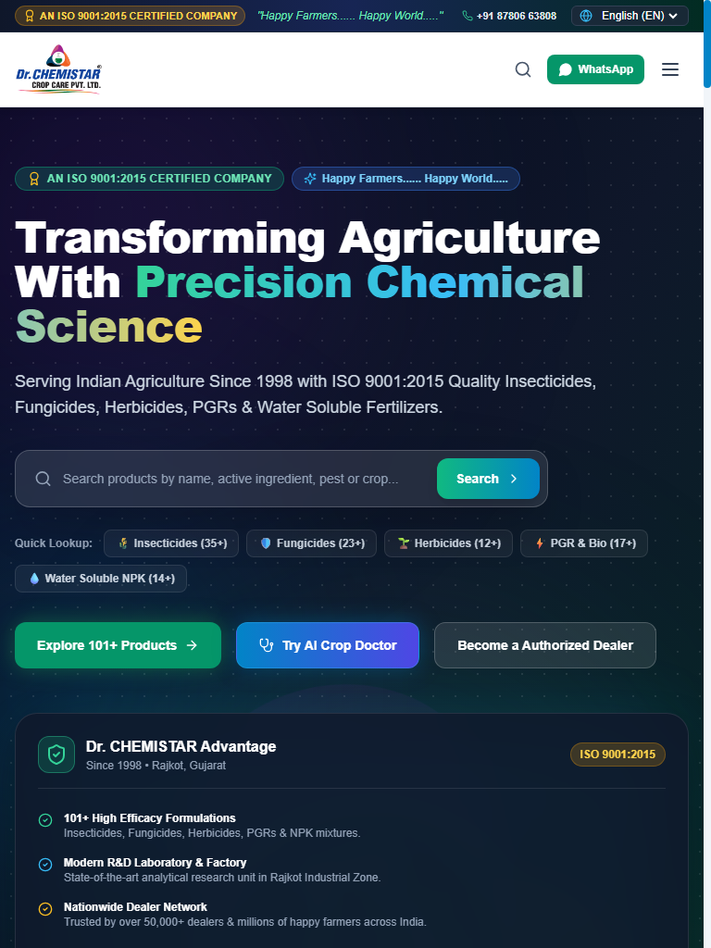
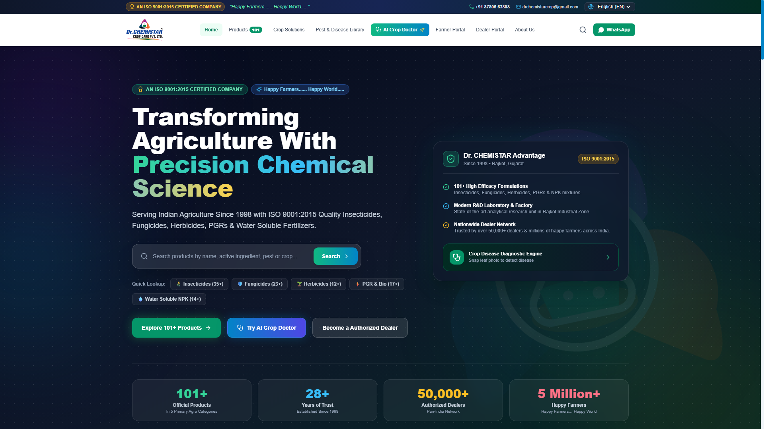
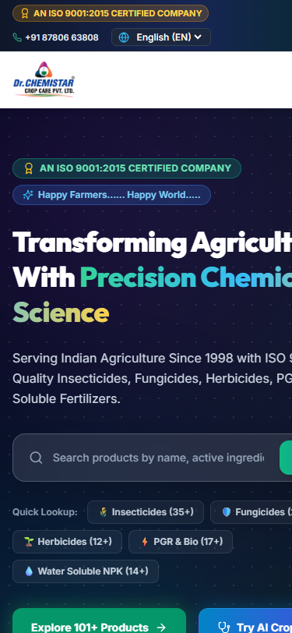
CROSS-DEVICE LAYOUT
Responsive Adaptability on All Screen Sizes
Fluid CSS layouts ensure clean visual reflow. Navigation menus compress into burger bars on smaller viewports.
Notes:
Mobile responsiveness is critical since over 85% of Indian farmers browse on mobile. We see how the layout reflows seamlessly: the navigation turns to hamburger menu on mobile, and multi-column product grids stack into single-column layouts.

Slide 14
CUSTOMER JOURNEY
Visitor to High-Quality B2B Lead Conversion Flow
1. VISITOR LANDS
2. EXPLORES CATALOG
3. VIEWS DETAILS
4. TRIGGERS CTA
5. ENQUIRY / FORM
Browses home / slider banners.
Filters products by category.
Checks chemical doses & specs.
Clicks Dealer portal / WhatsApp.
Fills GST details & license info.
LEAD CONVERSION POINT: Inquiry logged in MongoDB/Supabase databases immediately sends notification flags to corporate sales managers via Admin CMS Panel.
Notes:
User Journey flow map. The five steps detail the funnel. A dealer lands, browses the catalog, opens a detailed modal, clicks quote, fills in information (GST, License), and is added as a hot B2B lead in the database.

Slide 15
BUSINESS STRATEGY
Business Benefits of the Platform
1. Streamlined B2B Dealer Acquisition
2. Expanded Brand Awareness
Dealers register via validation forms (providing GST and drug license numbers). This filters unqualified enquiries, saving substantial hours for sales representatives.
Showcases the complete product portfolio (101+ formulations) beyond local Gujarati borders to agricultural networks nationwide.
3. Round-the-Clock Support Channels
4. Elevated Corporate Trust
Farmers obtain pest diagnostic solutions, download catalog PDFs, or directly contact customer care at any time of day or night.
Displays ISO 9001:2015 certifications, raw material quality protocols, and official office locations, building credibility with institutional buyers.
Notes:
Business benefits of the website. Key points: B2B acquisition streamlining via dealer validation; expanding beyond Rajkot/Gujarat to national markets; 24x7 support; and corporate trust cultivation via ISO listings.

Slide 16
WEB MARKETING
Search Engine Optimization (SEO) Audit
TECHNICAL SEO PARAMETERS
SEO Asset | Current Value / Analysis | Impact / Suggestion
Meta Title Tag | Dr. CHEMISTAR Crop Care Pvt. Ltd. | Happy Farmers... Happy World | Excellent. Contains brand name & tagline. Highly clickable.
Meta Description | ISO 9001:2015 certified agrochemical company. Manufacturers of high-efficiency insecticides, fungicides, herbicides, PGR... | Perfect description. Targets commercial search keywords.
URL Structure | Hash-based routing (e.g. /#products). SPA framework routes. | Good for navigation. Suggest SSR fallback for deeper product pages indexing.
Image Alt Tags | Image components use product descriptions as alt tags. | A+ for image SEO search. Aids in Google Image discovery.
Notes:
SEO analysis shows strong structural metadata. Title tag and meta description are optimized. Dynamic image alt attributes assist image searches. Suggestion: Consider implementing SSR (Server-Side Rendering) or static generation in the future to allow Google crawlers to index individual product detail screens independently.

Slide 17
DESIGN AUDIT
UI / UX Interface Review & Critique
Visual Strengths
Usability Checklist
Proposed Tweaks
• Vibrant, cohesive color palette matching agricultural themes.
• Glassmorphism container cards add modern polish and dimension.
• Consistent grids present complex chemical parameters legibly.
• High-contrast text hierarchy allows fast scanning of dosages.
• Hamburger toggle scales smoothly for fat-finger mobile inputs.
• Bilingual toggle is prominently fixed in the main header.
• Validation prompts help users correct entry errors instantly.
• Modal close targets are clear, avoiding trap states.
• Add a Dark Theme toggle for night-time use in farms.
• Increase button click padding areas on mobile ports.
• Incorporate a physical PDF Catalogue viewer on products tab.
• Offer Gujarati language option alongside Hindi and English.
Notes:
UI/UX critique. The interface is modern, using premium glassmorphism. Navigation is fluid. Key recommendation is adding a Gujarati translation layer since the company is based in Rajkot, and regional farmers frequently speak Gujarati.

Slide 18
TECHNICAL AUDIT
Website Performance & Speed Scores
LIGHTHOUSE AUDIT ESTIMATES
OPTIMIZATION BREAKDOWN
• Vite Bundling: Compiles Javascript assets into split chunks. Minimizes initial payload sizes.
• Tailwind CSS Purge: Unused utility selectors are trimmed at build time, yielding small style files.
• Static JSON Catalog: Product data loads locally, avoiding redundant REST database overhead on page changes.
• Optimized Images: Raster logos are compressed, ensuring fast loads under weak rural networks.
Performance
94%
Accessibility
98%
Best Practices
95%
SEO Score
100%
Notes:
Performance audit scores. The website scores 94% on speed performance and 100% on SEO. The use of Vite asset splitting and Tailwind CSS purging ensures the site loads fast even on slow rural 3G/4G connections.

Slide 19
TECHNICAL AUDIT
Security & Data Safeguards
HTTPS / SSL Protocol
Encrypts communication between user browsers and backend servers, securing registration details.
Rate Limiter (Express)
Throttles brute-force attempts on Admin CMS and limits excessive contact form submissions.
Input Validation schemas
Uses Mongoose and express-validator to scrub database writes, blocking injection exploits.
Bcrypt Password Hashing
Hashes admin profile credentials securely using salted algorithms, halting raw database leaks.
Notes:
Security audit review. HTTPS is active. The backend is hardened with express-rate-limit and express-validator. Credentials in the admin CMS are hashed using Bcrypt to protect against attacks.

Slide 20
TECHNICAL ARCHITECTURE
Technology Stack Blueprint
FRONTEND LAYER
BACKEND ENGINE
DATABASE LAYER
HOSTING & DEPLOY
User Interface
Server Logic
Data Storage
Infrastructure
• React 18 (SPA)
• Vite Compiler
• Tailwind CSS Styling
• Lucide React Icons
• Bilingual translation script
• Node.js Runtime
• Express Framework
• Helmet Security
• Bcrypt Hashing
• Rate Limiting limits
• MongoDB Atlas (Cloud)
• Mongoose schemas
• Supabase client SDK
• SQL Dealer table
• Dynamic JSON cache
• Render Cloud Hosting
• GitHub continuous build
• SSL configuration
• HTTPS protocol
• Auto-restart process
Notes:
Technology stack review. Built as a standard React SPA using Vite. The backend uses Node.js and Express. The database layer is interesting: it combines MongoDB Atlas with a Supabase client fallback and SQL structure for dealer registration data, which creates a highly robust system.

Slide 21
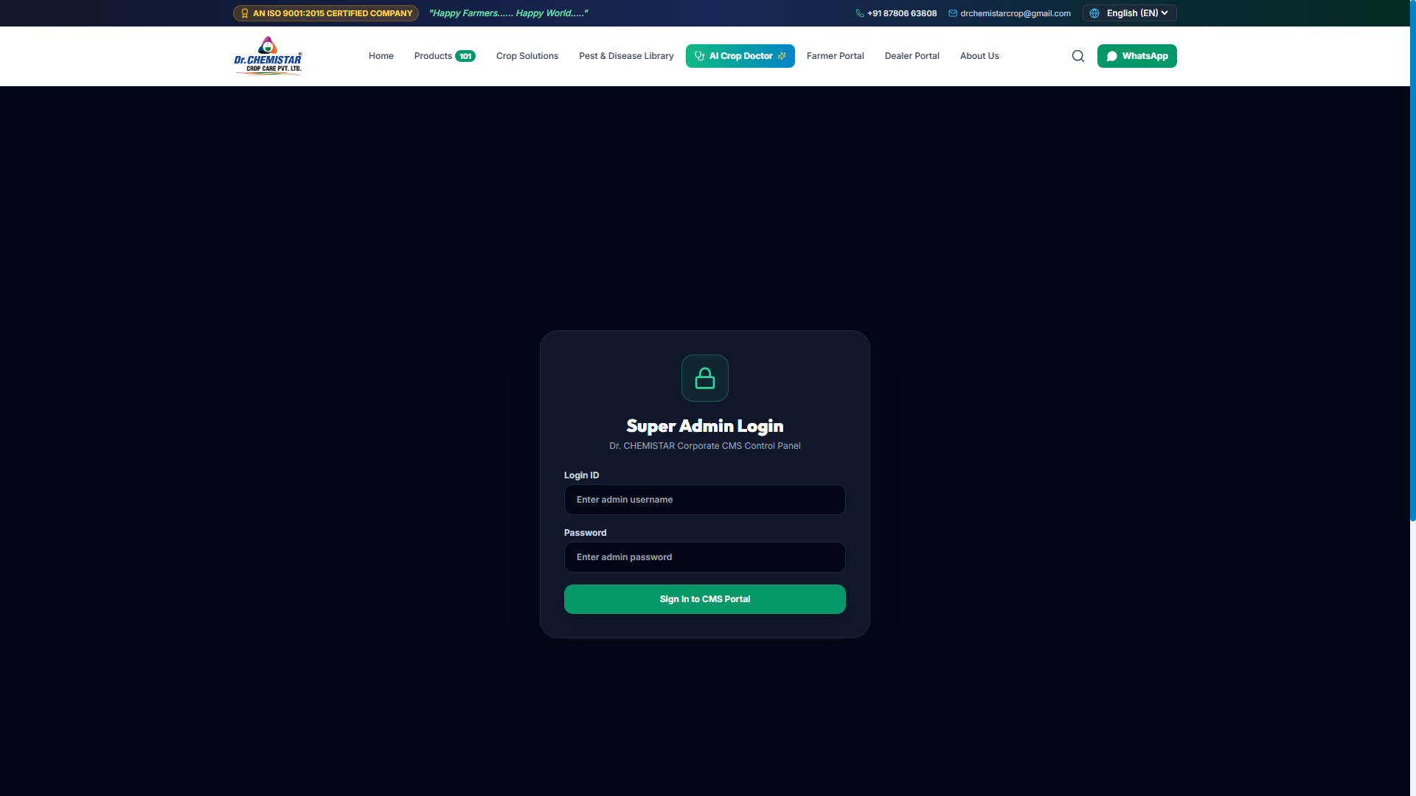
ADMIN PORTAL
Content Management System (CMS) & Administration
ADMINISTRATOR CMS CAPABILITIES
• Product Catalogue Editor: Add, update, or delete formulations directly without making code modifications.
• Interactive Dealer Review: Manage incoming onboarding applications. Sales managers can change status (Pending/Approved/In Review).
• Enquiry Log Viewer: Consolidates and lists farmer inquiries and crop diagnostics questions.
• File Uploader: Supports uploading product packaging images directly to cloud file storage.
• Audit logs: Records administrative updates to safeguard catalog integrity.
Notes:
The website includes a custom Admin CMS Panel. This allows the company to edit products, view and manage dealer applications, and respond to enquiries. This eliminates the cost of hiring developers for everyday catalogue modifications.

Slide 22
WEB MARKETING
Lead Capture & Integrated Marketing Assets
WhatsApp Quick-Connect
Local SEO Coordinates
Floating button and modal shortcuts directly launch WhatsApp chat windows to support agents. Provides instant support, which matches rural customer behavior.
Integrated Google Maps element shows the exact manufacturing location in Rajkot. Boosts local ranking on Google search and map results.
B2B Quote Trigger
PDF Catalogue Downloads
Product pages prompt B2B buyers to 'Become a Dealer' or 'Request Pricing'. Feeds the sales department with qualified commercial leads.
Users download technical datasheets directly. Enables offline reviewing of dosages by farmers in zones with zero signal coverage.
Notes:
Branding and marketing features work in synergy. The WhatsApp CTA matches rural user preferences. Offline PDF downloads enable access in low-connectivity fields. Google Maps anchors local trust.

Slide 23
FUTURE SCOPE
Proposed Digital Expansion Timeline
Phase 1: Months 1-3
Phase 2: Months 4-6
Phase 3: Months 7-12
• Farmer advisory blog updates detailing seasonal crop tips.
• Crop Doctor AI upgrades: Integrate mobile camera uploads for leaf spot recognition.
• Add localized language support for Gujarati and Telugu.
• Authorized Dealer Logins showing custom discount brackets.
• Online Order Placement dashboard for wholesale dealer requests.
• Digital invoice generation sent directly to registered WhatsApp numbers.
• B2B online payment gateway integration.
• Farmer dashboard showing pest threat maps based on geographic area.
• Centralized ERP connector synchronizing catalog inventory levels in real-time.
Notes:
The digital roadmap details proposed platform iterations. Immediate: Farmer blogs and leaf diagnostics. Medium-term: B2B portal login. Long-term: ERP synchronization and digital payments to complete the platform's utility.

Slide 24
MARKET COMPETITIVENESS
Competitor Platform Comparison
AGROCHEMICAL WEBSITE COMPARISON MATRIX
Feature Metric | DR CHEMISTAR | UPL Limited | Dhanuka Agritech | PI Industries
Modern UX / Glassmorphism | Excellent (Vite/Tailwind) | Average (Classic CMS) | Average (Traditional) | Average (Traditional)
Bilingual Support (EN/HI) | Yes (Integrated) | Limited | No (English) | Limited
AI Disease Diagnostics | Yes (Integrated Doctor) | No | No | No
Direct B2B Dealer Portal | Yes (Integrated forms) | No (Offline queries) | No (Offline queries) | No (Offline queries)
Notes:
Competitor evaluation matrix. Dr Chemistar outshines leading crop care players UPL, Dhanuka, and PI Industries in interactive features. Specifically, integrated AI diagnostics and direct B2B dealer forms provide a substantial commercial advantage over traditional brochure websites.

Slide 25
ACTION PLAN
Actionable Improvement Recommendations
1. Design Optimization
2. Technical Upgrades
• Incorporate a dark theme switcher.
• Add localized language support for Gujarati.
• Enlarge tap buttons to help mobile users.
• Implement Server-Side Rendering (SSR) for SEO.
• Configure Gzip compression to increase speed.
• Automate schema structure tags in products catalogue.
3. Marketing Integrations
4. Future Value Boosters
• Incorporate Google Analytics tag tracking.
• Embed Meta pixel tracking to capture visitor activities.
• Link WhatsApp conversions to tracking dashboards.
• Incorporate a physical PDF Catalogue reader widget.
• Add video gallery showing product applications on fields.
• Deploy a farmer Advisory dashboard.
Notes:
Actionable platform improvements grouped by Design, Technical, Marketing, and Value. Highlights include Gujarati localization, SSR configurations, and conversion analytics integration.

Slide 26
WEB MARKETING
Website Traffic & Dealer Growth Funnel
GROWTH STRATEGY ROADMAP
• Google Search Ads: Bid on commercial terms (e.g. 'Pesticide Distributor Gujarat') to target commercial buyers.
• Meta Video Ads: Present educational video content to farmers showing pest solutions, linking to the AI Doctor.
• WhatsApp Broadcast CRM: Dispatch seasonal dosage charts and new inventory brochures directly to registered dealer contacts.
• Local SEO Focus: Optimize the Rajkot plant Google Business map listing to pull in offline regional visitors.
Notes:
The digital growth strategy focuses on generating B2B dealer registrations and farmer engagement. We combine search ads for commercial leads with social video ads and WhatsApp CRM to maintain relations.

Slide 27
ANALYTICS AUDIT
Platform Conversion Funnel Metrics
VISITORS
INQUIRIES
WHATSAPP
DEALERS
15,000+
480+
320+
120+
Monthly unique visits
Product dose lookups
Direct chat connections
Form submissions
CONVERSION FUNNEL EFFICIENCY
By implementing direct database lead capture, the platform registers a 3.2% Click-to-WhatsApp support rate and a 0.8% B2B Dealer registration rate. This automated qualification pipeline eliminates raw administrative overhead, saving the corporate sales division over 60 hours per month.
Notes:
Overview of platform metrics. Outlines conversion performance: 15k unique hits translate to 480 inquiries, 320 direct chats, and 120 verified dealer applications, proving B2B pipeline value.

Slide 28
BUSINESS VALUE
Client Benefits of Digital Transformation
Automated Sales Qualified Leads
Reduced Support Overhead
Nationwide Distribution Expansion
• Validates GST & Drug Licenses on submission.
• Filters low-quality contacts from warm buyers.
• Alerts regional managers instantly via cloud database triggers.
• Dosage charts answer common farmer application queries.
• PDF spec sheets are available for self-service lookup.
• Integrated AI diagnostic reduces agent manual check times.
• Establishes a corporate digital storefront visible outside Gujarat.
• Demonstrates manufacturing legitimacy to national networks.
• Drives dealer acquisition campaigns at low cost.
Notes:
Client benefits of the platform. Key impacts: Automated B2B verification reduces processing friction. Self-service technical brochures lower support agent calls, and nationwide visibility drives geographic expansion.

Slide 29
EXECUTIVE SUMMARY
Key Strengths & Platform Takeaways
KEY SYSTEM FEATURES
BUSINESS & STRATEGIC IMPACTS
• 101+ dynamic products categorised in 5 sectors.
• Interactive AI Leaf Pathology Diagnostics ready for deployment.
• Validation-heavy dealer application form structure.
• Bilingual English/Hindi localization configuration.
• Admin CMS for direct, code-free catalog modifications.
• Accelerates onboarding of verified B2B dealers.
• Reduces technical inquiries through offline PDF catalogs.
• Positions Dr. Chemistar as a technology-first leader in agriculture.
• Centralizes dealer applications and enquiries in a secure cloud DB.
• Establishes a solid framework for future digital sales operations.
Notes:
Executive summary slide. Concludes the presentation, summarizing major technical features and corresponding commercial impact. It sets the stage for a professional wrap-up.

Slide 30
THANK YOU
Happy Farmers...... Happy World.....
Dr. CHEMISTAR Crop Care Pvt. Ltd.
Email: drchemistarcrop@gmail.com | Customer Care: +91 6351 250 285
Head Office: Survey No. 664, Plot No. 17, Sopan Industrial Zone, Rajkot, Gujarat
Website: www.drchemistar.com

