Slide 1



Sales Record Under Guidance of Internal Guide Dr. Dharmendra Patel by Meet Patel (17BCA061) Akshay Ramnani (17BCA094) Kartavya Vadera (17BCA114)

Slide 2
Project Profile

Slide 3
Project Name: Sales Record
Type of Application: Mobile Application
Project Description: This application is a generalized system designed for any mobile phone company. It helps to track sales of the company in a particular zone and to maintain employee details of the company. By going through the flow, application helps to take attendance of employees, assign targets, salary summary, leave management, daily work and track employee and also generate respective reports with security.
Team Size: 3
Front End: Android Studio
Back End: MySQL, XAMPP (Version 3.2.2)
Tools used: MS-Office (2019), Photoshop

Slide 4
Scope of System

Slide 5
It is a mobile based application designed for any mobile phone company.
This application includes following features:
Insert, update and delete any employee of a company.
Auto fill attendance, leave management, target status, salary summary, routine task, track employee, resigning request.
Generate different types of reports.

Slide 6
Use Case Diagram

Slide 7
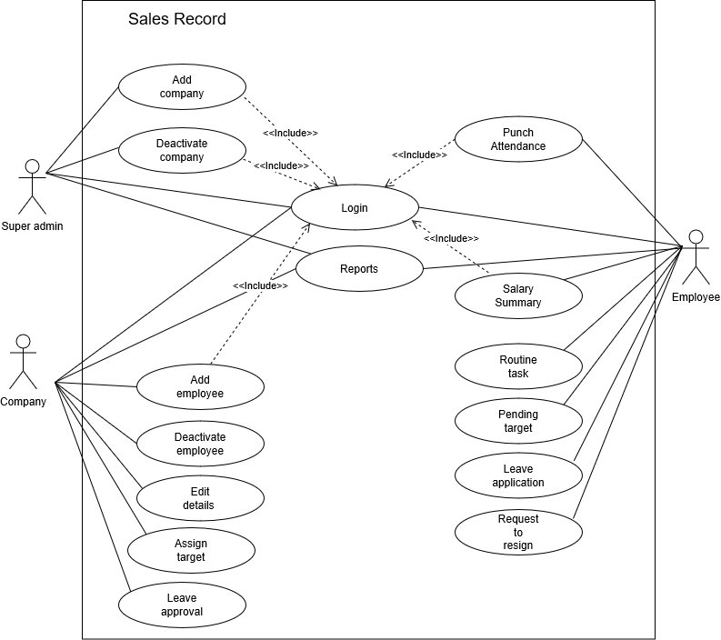

Slide 8
Activity Diagram
Actor: Super Admin

Slide 9
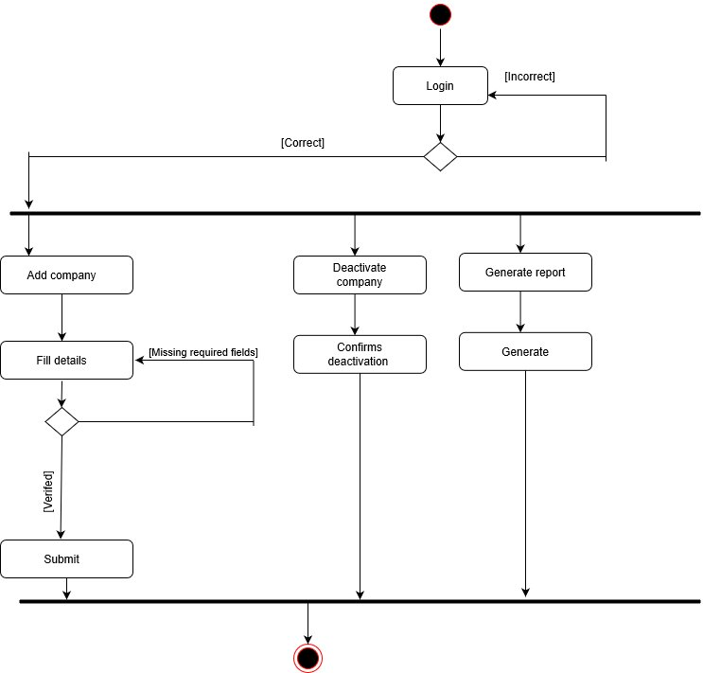

Slide 10
Activity Diagram
Actor: Company

Slide 11
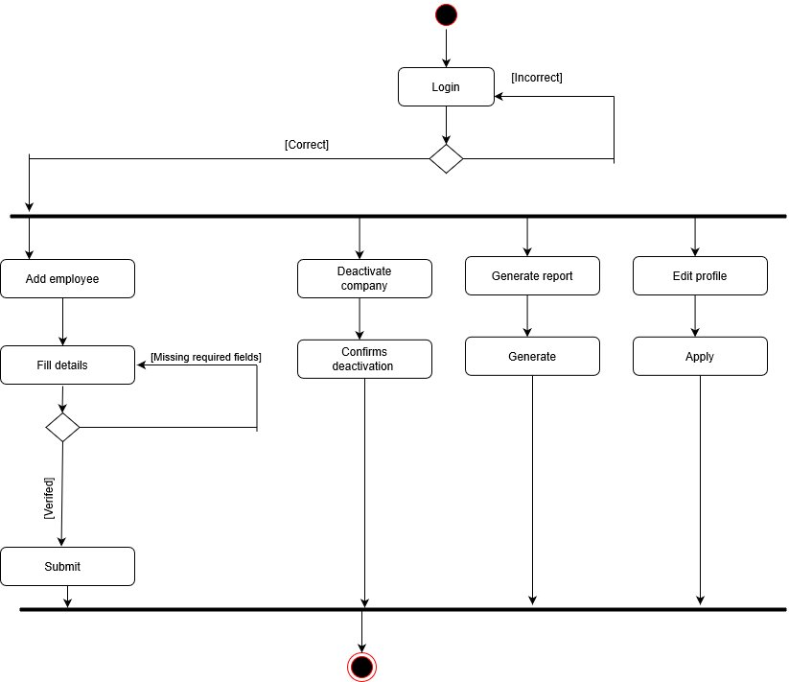

Slide 12
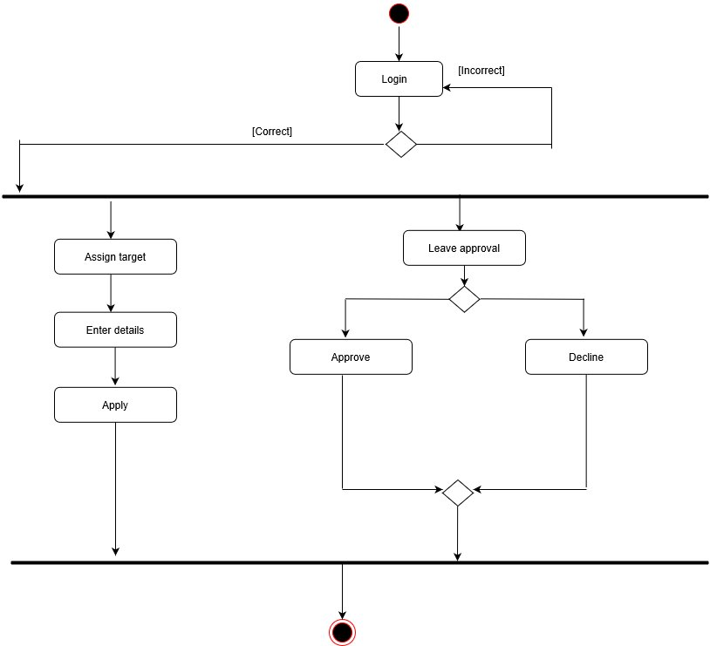

Slide 13
Activity Diagram
Actor: Employee

Slide 15
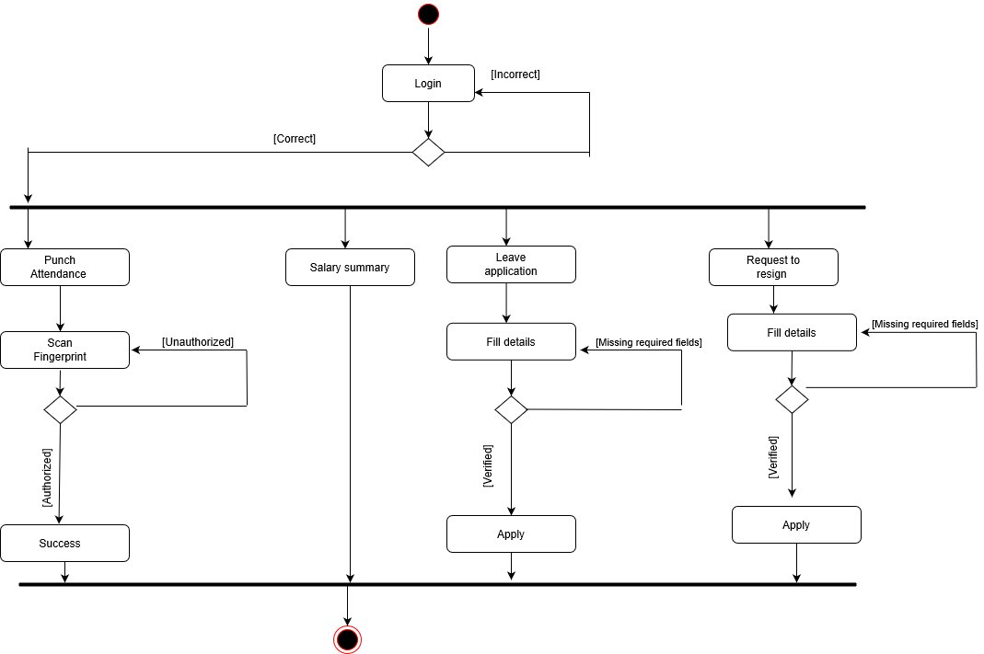

Slide 16
Test Cases

Slide 17
Test case no | Field | Actual value | Expected outcome | Actual outcome | Remarks
1 | Company_id |  | It should generate error message | It has been generated an error | Successful
2 | Company_password | 1234 | It should generate error message | It has been generated an error | Successful
3 | Company_password | 123456 | Checks the credentials and logged in successfully | Checks the credentials and allow to logged in | Successful
4 | Company_name | A&M Records | Valid name, allows to registration | Allowed to registration | Successful
5 | Company_email | abc@gmail | It should generate error message | It has been generated an error | Successful
6 | Company_email | abc@gmail.com | Valid email, allows to registration | Allowed to enter data | Successful

Slide 18
Test case no | Field | Actual value | Expected outcome | Actual outcome | Remarks
7 | Company_mobile1 | 1231b1@ | It should generate error message | It has been generated an error | Successful
8 | Company_mobile1 | 9976325678 | Valid data, allows to enter data | Allowed to enter data | Successful
9 | Emp_name | abc@1 | It should generate error message | It has been generated an error | Successful
10 | Emp_name | Kartavya | Valid data, allows to enter data | Allowed to enter data | Successful
11 | Emp_dob | 15/02/2022 | It should generate error message | It has been generated an error | Successful
12 | Emp_dob | 11/07/1999 | Valid data, allows to enter data | Allowed to enter data | Successful

Slide 19
Future Enhancement

Slide 20
Multiple employees’ registration at a time
Inter – employee communication
Employee’s load adjustment

Slide 21
References

Slide 22
Google play store [For existing system]
[For employee registration form]
https://www.123formbuilder.com/free-form-templates/Company-Registration-Form-2861029/
[For company registration form]
https://www.123formbuilder.com/free-form-templates/New-Employee-Registration-Form-2375089/
[For solution of quires]
https://stackoverflow.com/
[For drawing UML diagrams]
https://app.diagrams.net/
[For logos]
https://www.flaticon.com/

Slide 23
Thank You..

