Slide 1
ESC101: Fundamentals of Computing
Basics of C Syntax,
Printing Outputs (printf)
Piyush Rai

Slide 2
Announcements
Sent a form to specify if you want to appear for AT Screening Test
Fill it only if you want to appear for the test
Sent forms to specify if you want to attend special sessions in Hindi and special session on computer usage
Be careful when referring to the books: Old editions of some books may be using slightly outdated syntax of C at some places
Gottfried 2nd edition doesn’t use return 0; at the end of main() function
Not a big reason to worry but be careful. In class, we will use the latest syntax

Slide 3
C Syntax
Syntax is basically the rules of how the alphabet/symbols
defined for C language are used to write C programs
Just like the grammar of a language!

Slide 4
C Syntax: The “Alphabet” of C
C programs can be written using the following alphabet
A B .... Z
a b .... z
0 1 .... 9
Space . , : ; ‘ $ “
# % & ! _ { } [ ] ( ) |
+ - * / =

Slide 5
C Syntax: Variables and Constants
Most C programs consist of variables or constants with some name
The value of each variables or constant is stored at some location in the computer’s main memory (RAM)
A variable’s value can be changed during execution of the program
A constant’s value cannot be changed during execution of the program
More on naming conventions/rules later
firstName, age, height, streetAddress, valueOfPi

Slide 6
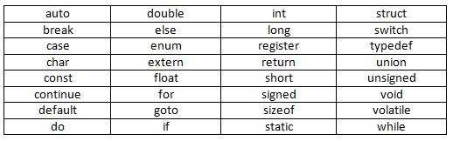
C Syntax: C Keywords
Seen so far
C language has a set of 32 keywords
These keywords have special meaning
Can’t use keywords for other purposes (e.g., can’t use them to declare variable names, constant values, or function names)
Prutor shows keywords in a different color

Slide 7
C Syntax: Keywords Usage
# include <stdio.h>
int main(){
int main = 3;
printf(“%d”, main);
return 0;
}
# include <stdio.h>
int main(){
int return = 3;
printf(“%d”, return);
return 0;
}
This WILL work
Reason: main is not a keyword
But not recommended
This will NOT work
Reason: return is a keyword

Slide 8



Advice: Try to Write Code that looks Pretty ☺
Very important in industry - large groups collaborate
Important even for solo projects - maintenance
Will learn several good coding habits over time (such as Commenting, Indentation, Code-structuring)
#include<stdio.h>
int main(){
int a = 1;
int b = 2;
int c;
c = a + b;
printf(“Result is %d”,c);
return 0;
}
#include<stdio.h>
int main(){
int a = 1;
int b = 2;
int c;
c = a + b;
printf(“Result is %d”,c);
return 0;
}
#include<stdio.h>
int main(){
int a = 1;
int b = 2;
int c;
c = a + b;
printf(“Result is %d”,c);
return 0;
}
Prutor does it automatically when you write your code
(try writing code in Prutor)
This is good indentation

Slide 9
The printf Function
A function used for printing the outputs of the C program
Prints the outputs in a format specified by us
We have already seen some simple examples of usage of printf
printf(“Welcome to ESC101”);
printf(“Result is %d”, c);
%d is used to print the value of an integer
An integer

Slide 10
Introducing Mr. C (or Mr. Compiler)
Will sometimes use this fictional character to refer to the C compiler (or our Prutor system)
Sometimes it will mean the screen of the computer that shows us the program’s output

Slide 11
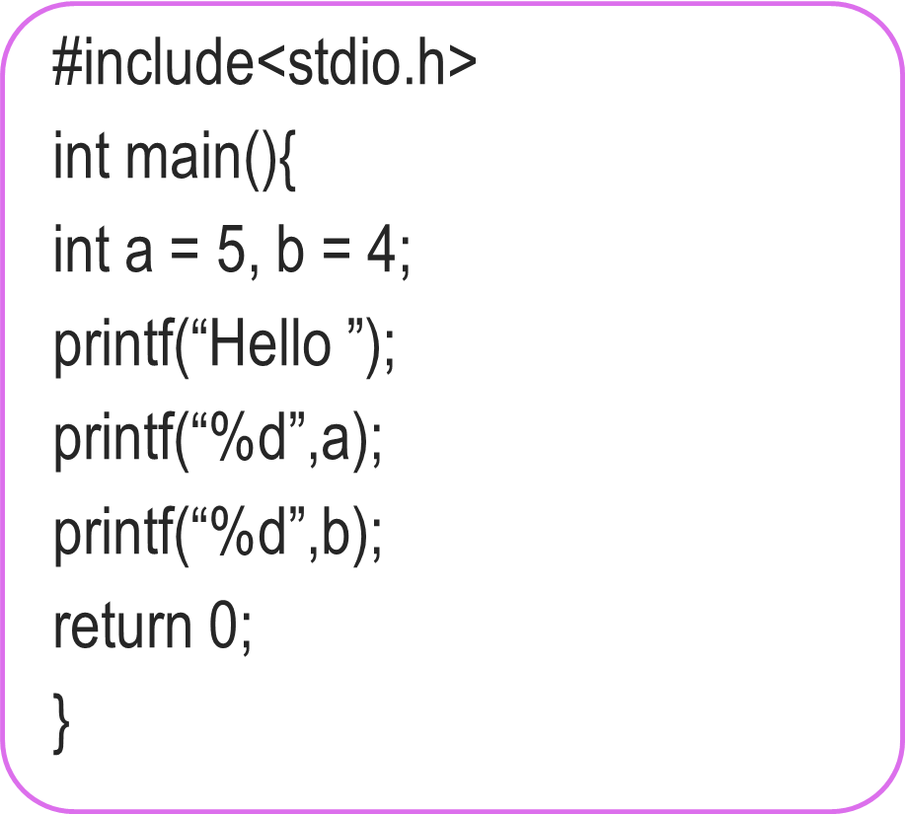


True Power of printf
We have seen how to make Mr. C
Say things like “Welcome to ESC101”
Tell us the value of an integer variable
Don’t be afraid to experiment
#include<stdio.h>
int main(){
int a = 5, b = 4;
printf(“Hello”);
printf(“%d”,a);
printf(“%d”,b);
return 0;
}
No, you can make him speak again and again
Can he speak only once?
Hello54
Hello 54

Slide 12
True Power of printf
We have seen how to make Mr. C
Say things like “Welcome to ESC101”
Tell us the value of an integer variable
Okay, lets see in detail
I am confused ☹
#include<stdio.h>
int main(){
int a = 5, b = 4;
printf(“Hello %d %d”,a,b);
return 0;
}
Yes, very powerful ones!
Any shorthands?
Hello 5 4

Slide 13
How printf Works?
How we must speak to mr. compiler
How we usually speak to a human
printf(“Hello %d %d”,a,b);
Please write the English word Hello, followed by a space, followed by the value of an integer, followed by a space followed by the value of another integer.
By the way, the first integer to be written is a and the second integer to be written is b.
Format string
Format string tells me how to print things, and then I am told what to print
Mr. C likes to be told beforehand what all we are going to ask him to do!
printf follows this exact same rule while telling Mr. C what to print

Slide 14

True Power of printf
Can also use printf to directly print the value of an expression
int main(){
int a = 3;
int b = 2;
printf(“Sum of a and b = %d”, a+b);
return 0;
}

Slide 15
Summary: The syntax of printf
Note: In some cases,
there will be no such list.
Example: printf(“Hello”);
printf(format string, list of things to print);
Example (already seen)
printf(“Hello %d %d”, a,b);
Important: Format string must have format specifiers for all things we wish to print in the exact same order as those things appear in the list of things
Can Mr. C print integers only?
Of course NOT. ☺
Wait for next week’s lectures

Slide 16
Some Fun with printf
If I see \n, I will start printing on a new line
Can I print different things on separate lines?
What if I wish to print the character “ (inverted quotes)?
What if I wish to print the character % (percentage sign)?
Hello
5
4
printf(“Hello\n%d\n%d”,a,b);
printf(“\“Hello\““);
If I see \”, I will print “
“Hello”
If I see %%, I will print %
printf(“90%% marks“);
90% marks

Slide 17
Some Fun with printf
To print on new line, use \n
To print the character \ (backslash) use \\
To print a tab character (a longer space) use \t
Allows us to print very nicely formatted output ☺
More examples in labs – till then, have fun on your own
printf(“To print on new line, use \\n”);
\n, \” called escape sequences since they “escape” the normal rules
printf(“Very\tNice“);
Very Nice
Experiment with them to get comfortable

Slide 18

Fun with Integers
Operation | C Code | a | b | c
Addition | c = a + b; | 5 | 4 | 9
Subtraction | c = a – b; | 4 | 5 | -1
Multiplication | c = a * b; | -2 | -4 | 8
Division | c = a / b; | 7 | 2 | 3
Remainder | c = a % b; | 7 | 2 | 1
Be careful: in math we often write z = 2xy
Mr C will not like it.
He will want z = 2 * x * y;
Also be careful about division and remainder
7 / 2 is actually 3.5 but since c is an integer variable, it just stores 3. Remainder is 1
Experiment on your own – will revisit these very soon
Oh! So Mr. C allows us to use constants too in expressions?
Not everything needs to be stored in a variable
Yes. The command c = 2 + b;
makes sense to me
printf(“%d %d”,a,10);
is fine too ☺
Come to the lab and give it a try!

Slide 19
Life beyond Integers
Lots of fun possible with integers alone
However, the box storing integers is actually not very big
Can only store integers between -2,147,483,648 and 2,147,483,647
Also, what about real numbers (fractions etc)
How to ask Mr C to work with a real number?
How to ask Mr C to print a real number?
Later classes: long, float, double, long double
C designers were really nice with names ☺

Slide 20
Emoticons from Flaticon, designed by Twitter
https://www.flaticon.com/packs/smileys-and-people-9 Licensed under CC BY 3.0

