Slide 1
ESC101: Fundamentals of Computing
scanf (continued) and
Data Types in C
Piyush Rai

Slide 2
Announcements
Lab today for B4, B5, B6, B13
Prutor accounts: Hopefully everyone now has a working Prutor account (accessible via your CC email id and CC password)
If not, please arrive at the lab early (by 1:45pm) and we will create your account on the spot
Another useful reference book on C
“Let Us C” by Yashavant Kanetkar (edition 16 or later)
For most lectures, I will mention section-based readings from Gottfried and Kanetkar (you can use just one of these books)

Slide 3
Reading Inputs: The scanf function
Programs that don’t take inputs from user can be boring ☺
We saw programs to add two numbers but both had to be written into code
Also called “hardcoding” the inputs
A bit like a calculator which can only add 5 and 4 ☺
To add 6 and 9, write a new calculator ☹
Can’t we ask Mr C to request us for the numbers when he is executing our requests i.e. at runtime?
YES, by taking input from the user using scanf function

Slide 4
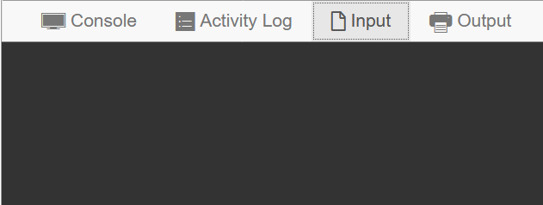

Example: Adding Two User-provided Numbers
#include <stdio.h>
int main(){
int a, b;
scanf(“%d”, &a);
scanf(“%d”, &b);
printf(“%d”, a + b);
return 0;
}
3
8
a
b
Thanks. Let me get back to work
11
Please give me input
11

Slide 5
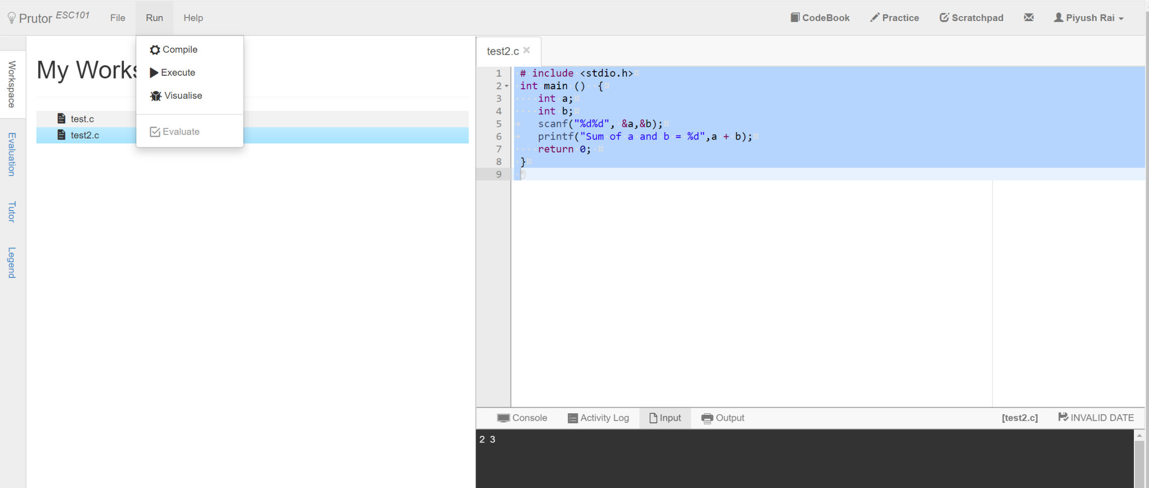
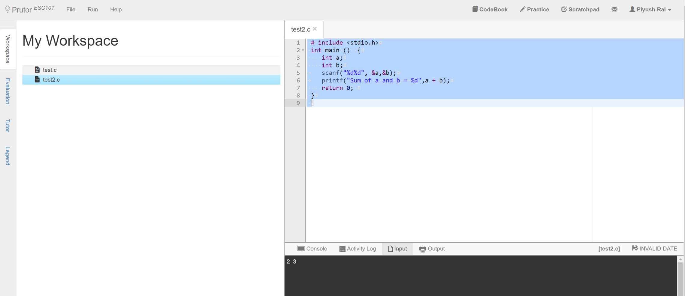
scanf: Some Words of Caution
In Prutor, input has to be specified before “Execute”

Slide 6




scanf: Some Words of Caution
Both work! Experiment!
In Prutor, input has to be specified before “Execute”
Please be very careful about this common mistake
Will explain what this & symbol means, in a few weeks
Yes, in printf they are different but in scanf, both look like whitespaces to me
Space, Tab, Newline are called whitespace characters since they are invisible ☺
scanf(“%d”,a);
scanf(“%d”,&a);
TAB
SPACE
NEWLINE
Why? Space is not same as newline 😐
Huh! What is a whitespace?

Slide 7



Taking Multiple Inputs using a Single scanf
#include <stdio.h>
int main(){
int a, b;
scanf(“%d%d”, &a, &b);
printf(“%d”, a + b);
return 0;
}
3
8
Help!!!
a
b
You entered only one integer
All look the same to me
11
11
Okay okay
Input please
Thanks

Slide 8
How does scanf work ?
How we must speak to mr. compiler
How we usually speak to a human
scanf(“%d%d”, &a, &b);
Please read one integer. Ignore all whitespace (spaces,tabs,newlines) after that till I write another integer. Read that second integer too.
Store value of the first integer in a and value of second integer in b.
Format string
Format string tells me how you will write things, and then I am told where to store what I have read
Remember Mr. C likes to be told beforehand what all we are going to ask him to do!
Scanf follows this exact same rule while telling Mr. C how to read

Slide 9
How does scanf work ?
Be a bit careful since Mr C is a bit careless in this matter
He treats all whitespace characters the same when integers are being input
scanf will never print anything
Use printf to print and scanf to read
Try out what happens with the following
My advice to you is to take input one at a time in the beginning ☺ Try out acrobatics in free time
Hmm … you are going to write the English word Hello followed by space followed by an integer. I will store the value of that integer in a
scanf(“Hello %d”,&a);
scanf(“%d %d”,&a,&b);
scanf(“%dHello%d”,&a,&b);
scanf(“%d,%d”,&a,&b);
scanf(“\“%d%d\“”,&a,&b);
scanf(“%d\n%d”,&a,&b);
scanf(“%d\t%d”,&a,&b);

Slide 10
Data Types in C
(have already seen int – for integers)

Slide 11
Basic Data Types in C
Int: %d specifier
Integers like 156, -3, etc
float (short form of “floating point number”) and double: %f specifier
Real numbers like 3.14, 2.0, -1.3, etc
double is like float but has larger range
char (short form of “character”): %c specifier
Single letter (a-z or A-Z), single digit, or single special character
A char is always enclosed in inverted single commas
Some examples: ‘a’, ‘A’, ‘2’, ‘$’, ‘=‘
These basic data types can also be used with a modifier
Modifiers change the normal behaviour of a data type (e.g., its range of values) and memory storage space required (more on next slides)

Slide 12
Type Modifiers in C
signed (used with int, float/double, char)
signed means the data type can have positive and negative values
int, float/double, char are signed by default (no need to write ‘signed’)
unsigned (used with int, char)
unsigned means the data type can have only take positive values
short (used with int)
short means it uses only half of the memory size of a normal int
long (used with int)
long means it uses twice the memory size of a normal int
Can store a larger range of values of that type

Slide 13
Various C Data Types without/with Modifiers
int (signed int)
%d
unsigned int
%u
short int (short)
%d
long int (long)
%ld
short unsigned
%u
long unsigned
%lu
Yes, multiple modifiers also allowed
float
%f
double
%lf
long double
%Lf
char
%c
unsigned char
%u

Slide 14
int
Can store integers between -2,147,483,648 and 2,147,483,647
#include <stdio.h>
int main(){
int a;
scanf(“%d”, &a);
printf(“My first int %d”, a);
return 0;
}
Range: -2^31 to (2^31)-1
signed int uses 32 bits
(4 bytes, 8 bits = 1 byte)
on recent compilers)
%d
a
Integer arithmetic applies to integers +, -, /, *, %, ()
Have worked with them a lot so far

Slide 15
long int (usually written just long)
Really long – can store integers between
-9,223,372,036,854,775,808 and 9,223,372,036,854,775,807
Range: -2^63 to (2^63)-1
long int uses 64 bits
on recent compilers
#include <stdio.h>
int main(){
long a; //long int also
scanf(“%ld”, &a);
printf(“My first long int %ld”, a);
return 0;
}
a
Integer arithmetic applies to long int as well +, -, /, *, %, ()
Try them out on Prutor
How does long work with int int + long, int * long?
Will see in next class…
%ld

Slide 16


float
float uses 32 bits (4 bytes).
Why this range for double?
Will see reason later
int, long allow us to store, do math formulae with integers
float allows us to store, do math formulae with reals
#include <stdio.h>
int main(){
float a;
scanf(“%f”, &a);
printf(“My first real %f”, a);
return 0;
}
Very large range ± 3.4e+38
Arithmetic operations apply to float as well +, -, /, *, ()
Try them out on Prutor
a
%f
What happened to remainder %?
I remember. Remainders make sense for integers, not for real numbers
☺ Did you ever do remainders with real numbers in school?

Slide 17
double
Double can also handle real numbers but very large ones
Similar relation to float as long has to int
#include <stdio.h>
int main(){
double a;
scanf(“%f”, &a);
printf(“My first real %f”, a);
return 0;
}
Very large range ± 1.79e+308
Arithmetic operations apply to double as well +, -, /, *, ()
There is something called long double as well
Use %Lf to work with long doubles
Try these out on Prutor
a
%lf works too!

Slide 18
char
Basically, a char is a symbol
Internally stored as an integer between -128 and 127 (if signed char) or between 0 and 255 (if unsigned char)
#include <stdio.h>
int main(){
char a = ‘p’;
printf(“My first char %c\n”, a);
printf(“ASCII value of %c is %d”,a,a);
return 0;
}
Char constants enclosed in ‘ ’
Integer arithmetic applies to char as well +, -, /, *, %, ()
Case sensitive ‘a’, ‘A’ different
Various usages (e.g., in arrays of characters – strings), will see more later
‘p’
%c
a
This Will print the ASCII value (integer) of this character

Slide 19
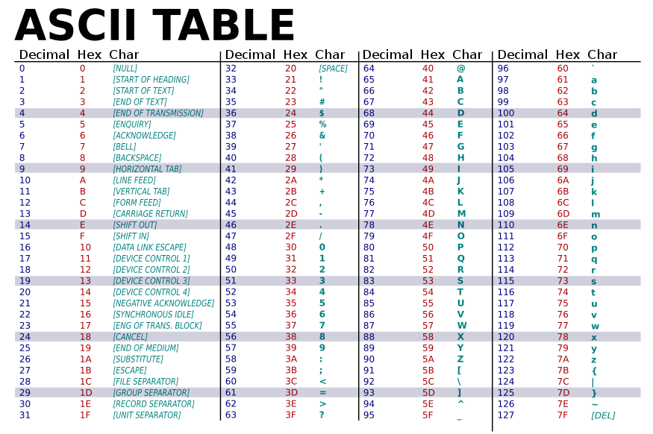
American Standard Code for Information Interchange
\t
\n

Slide 20
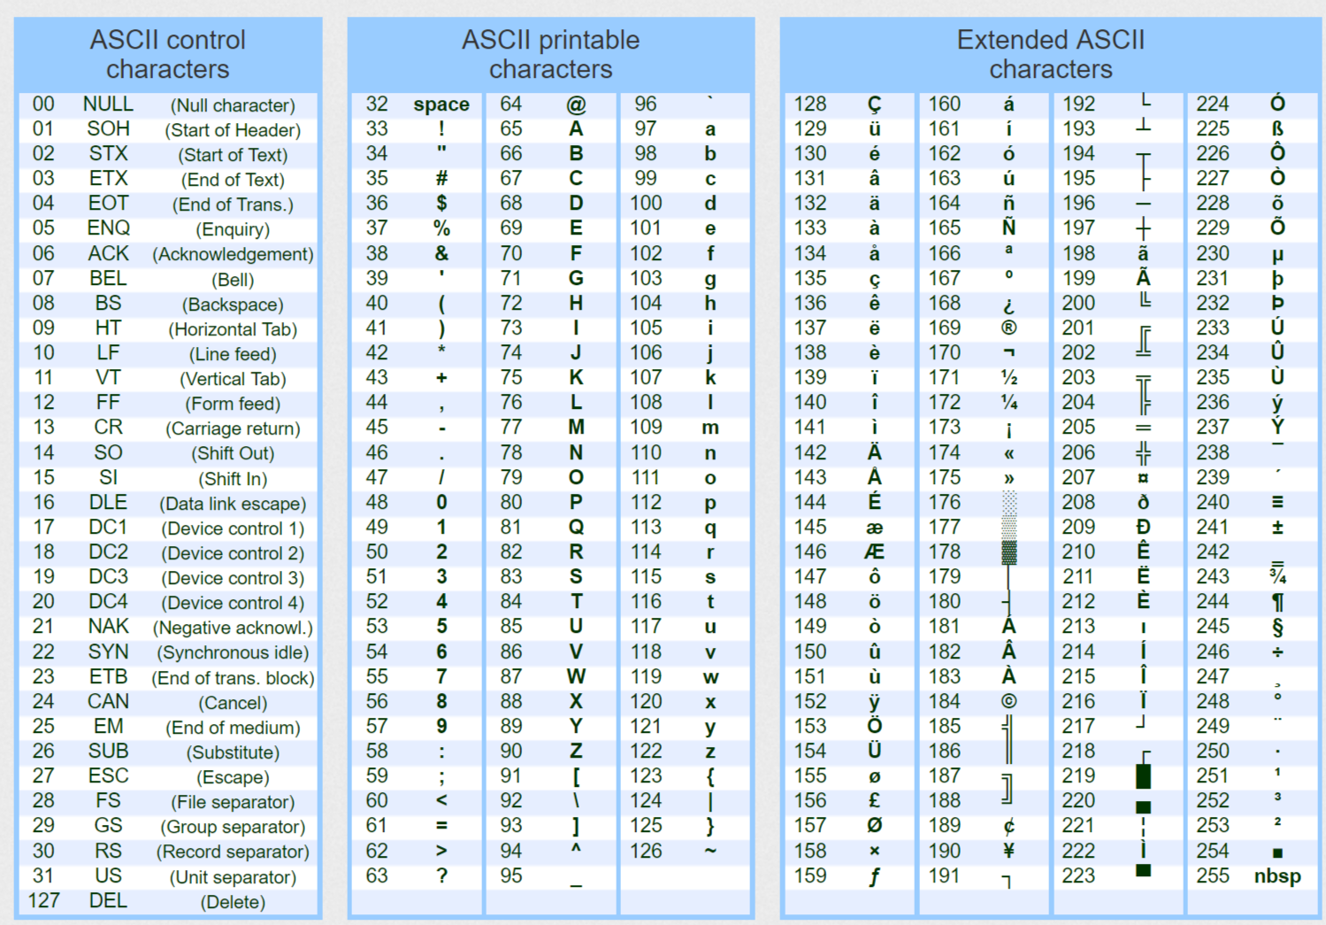
ASCII Table with Extended Characters

Slide 21
Mixing Types in C Expressions
We can have C expression with variables/constants of several types
Certain rules exist that decide the type of the final value computed
Demotion and Promotion are two common rules
During demotion/promotion, the RHS value doesn’t change, only the data type of the RHS value changes to the data type of LHS variable
int a = 2/3; // a will be 0 (no demotion/promotion)
float a = 2/3; // a will be 0.0 (RHS is int with value 0, promoted to float with value 0.0)
int a = 2/3.0; // a will be 0 (RHS is float with value 0.66, becomes int with value 0)
float a = 2/3.0; // a will be 0.66 (RHS is float with value 0.66, no demotion/promotion)
int a = 9/2; // a will be 4 (RHS is int with value 4, no demotion/promotion)
float a = 9/2; // a will be 4.0 (RHS is int with value 4, becomes float with value 4.0)

Slide 22
Next Class
Will look at more details of various data types
How to mix data types carefully in expressions
Example: Mixing int and long
Common errors we make when we use multiple types
How to typecast variable into another type

