Slide 1
ESC101: Fundamentals of Computing
Expressions and Operators in C
Piyush Rai

Slide 2
Announcements
Section number confusion?
It seems Pingala shows a changed section number for some students
Continue with same section number that we assigned you for ESC101 initially (that’s how your lab days and tutorial sessions are determined)
Rescheduled labs
Monday -> Saturday (2pm-5pm)
Thursday -> Sunday (2pm – 5pm)
No additional make-up labs if you can’t come on Saturday/Sunday
Minor Quiz 1 graded. Week-2 lab will be graded soon
AT screening results by end of this week

Slide 3
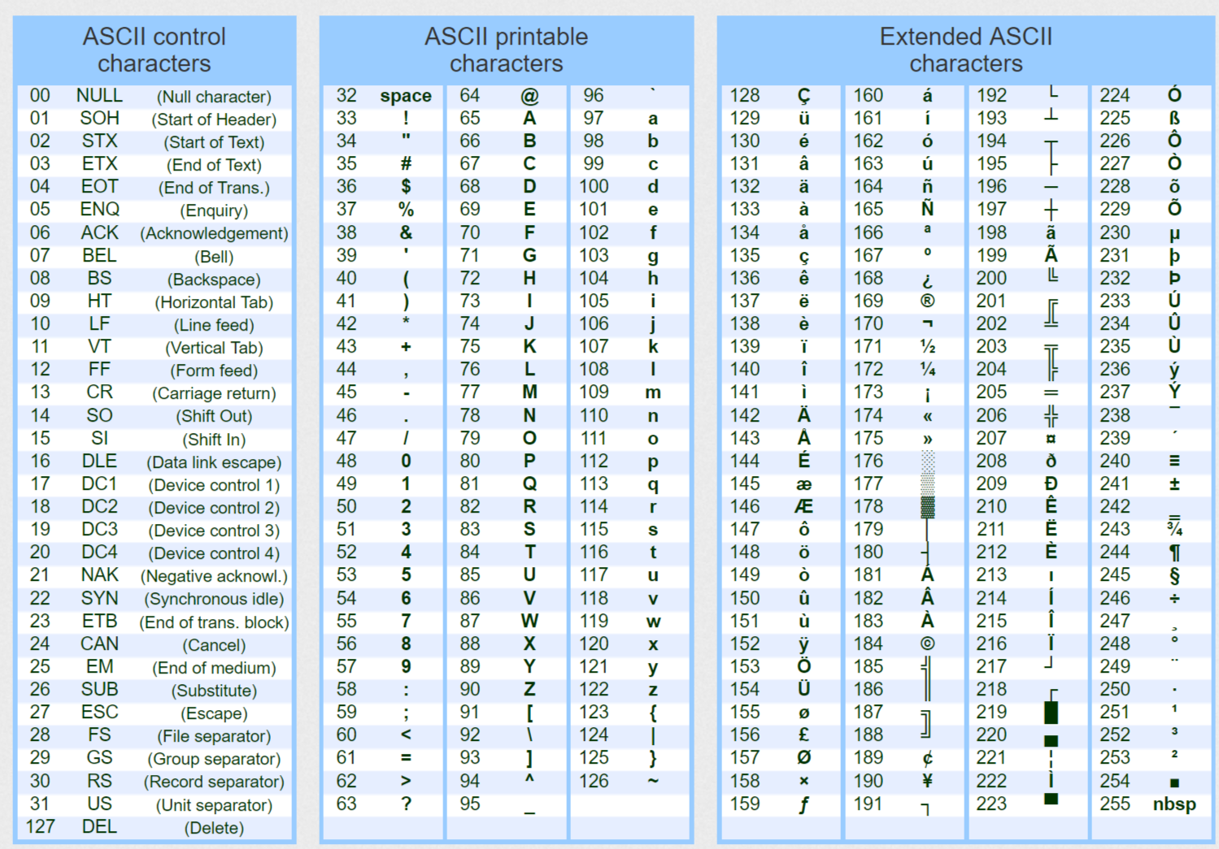

characters and ASCII codes
And notebooks are allowed in quiz/exam ☺
No need to remember ASCII Codes
(usually – at least for this course)
Thanks, table designers!
A helpful fact
Alphabets are located sequentially
Digits are located sequentially

Slide 4

Arithmetic on char data type
Note: When printing a char using printf, the quote symbols ‘ ‘ are not shown
Each char is associated with an integer value (its ASCII code)
Example: char ‘A’ to ’Z’ are associated with integers 65 to 90
Refer to the ASCII table for the code (int) of each char (no need to remember by heart). signed char range: -128 to 127, unsigned char range is 0 to 255
Note: When giving char input for scanf, we don’t type the quote symbols ‘ ‘
Try in Prutor and see yourself
#include <stdio.h>
int main(){
int x = ‘B’ - ‘A’ + 2;
printf(“x = %d\n”, a);
char y = 68;
printf(“y = %c”,y);
printf(“y = %d”,y);
return 0;
}
#include <stdio.h>
int main(){
char x = 128;
printf(“x = %d\n”, x);
char y = -130;
printf(“y = %d\n”,y);
return 0;
}
First number from the negative side
3
-128
D
Second number from the positive side
126
What if x and y are unsigned char ?
68
128 and -130 are out of the range of signed char

Slide 5

Expressions in C
pow is a function in math.h
(power function)
x = y*y + z*z (= y² + z²)
We use math formulae all the time in physics, chem, math
a = b / 5
x = y * y + z * z
x = (int)(pow((double)y, 2.0) + pow((double)z, 2.0))
Mr C calls these formulae expressions
x = y * y + z * z is an expression for Mr C
y * y + z * z is also an expression for Mr C
y * y is also an expression for Mr C
z * z is also an expression for Mr C
Oh! So two expressions can be added together to get another expression!
It sure is!
It sure is!
Yes, take two expressions and do operations like addition, multiplication, or assignment (=) with them and a new expression will emerge
So is z an expression?
So is 5 an expression?

Slide 6
Expressions and Operators
Expressions in C consist of one or more variables/constants
An expression contains one or more operators, such as
c = a + b - 2;
Operators in C can be one of the following type
Arithmetic
Unary
Relational and logical
Assignment
Conditional
Yes.☺
But I will tell you some other interesting things about them and other operators
I think I have already seen/used Arithmetic and Assignment operators in previous lectures/labs!

Slide 7
Arithmetic operators
Already seen. Operate on int, float, double (and char)
Op | Meaning | Example | Remarks
+ | Addition | 9+2 is 11
 |  | 9.1+2.0 is 11.1
- | Subtraction | 9-2 is 7
 |  | 9.1-2.0 is 7.1
* | Multiplication | 9*2 is 18
 |  | 9.1*2.0 is 18.2
/ | Division | 9/2 is 4 | Integer division
 |  | 9.1/2.0 is 4.55 | Real division
% | Remainder | 9%2 is 1 | Only for int
Notes:
- -9%10 = -9; -10%10=0; So % computes the remainder with the positive part and then adds the negative sign.

Slide 8
Unary operators
Operator
- | Negative of an expression
++/-- | Increment/decrement a variable
sizeof | Output memory box size for a variable
type (examples: int, float, double, etc) | Type-casting

Slide 9
Unary Operators - Negative
Operators that take only one argument (or operand)
-5
-b
Observe that – is both an arithmetic and unary operator
Meaning depends on context
This is called overloading

Slide 10
Unary operators – increment and decrement
Increment (++) increases a variable by 1
Decrement (--) decreases a variable by 1
++variable is the pre-increment operator
Means increment, then use
variable++ is the post-increment operator
Means use, then increment
Likewise, the -- can be pre/post decrement
Note: The variable’s value will change for the rest of the program
Work with all data types
int main(){
char a = ‘A’; float b = 3.31;
printf("%c\t%f\n",++a,b++);
printf("%c\t%f",--a,b--);
return 0;
}
B 3.31
A 4.31

Slide 11
Unary operators - sizeof
Syntax
sizeof var
sizeof(type)
Returns size of the operand in bytes
sizeof(char) will return 1
sizeof(float) will (mostly) return 4
Very useful when you are porting programs across computers

Slide 12
Unary operators - typecast
Syntax
(type) var, for example – (int) a, (float) a, etc
We have already seen this
What will be the output of this program?
Size is 8
Size is 1
C
int main(){
double a = 67.2;
printf("size is %d\n", sizeof a); printf("size is %d\n", sizeof((char) a)); printf("%c", (char) a);
return 0;
}

Slide 13
Precedence Rules for Unary Operators
Precedence rules tell us the order in which the operators will be applied in any C expression
Unary ops are above arithmetic ops, only below brackets
If a is 1 and b is 2, what will a + -b be evaluated as?
What about this program?
Bracket has the highest precedence
-1
3
int main(){
int a = 1; int b = 2;
printf("%d", a + - + - b);
return 0;
}
Note +x is x

Slide 14
Associativity Rules for Unary Operators
Associativity rules tell us how the operators of same precedence are grouped (e.g., a+b+c will be evaluated as (a+b)+c, not a+(b+c))
For unary operators, the associativity is from right to left
Important to remember this
Most other operators’ associativity is left to right (e.g., + operator)
What will this program print?
-2
int main(){
int a = 1;
printf("%d", - ++a);
return 0;
}

Slide 15
Relational Operators
Compare two quantities
Work on int, char, float, double…
Result is 0 or 1
Operator | Function
> | Strictly greater than
>= | Greater than or equal to
< | Strictly less than
<= | Less than or equal to
== | Equal to
!= | Not equal to
1 means condition true, 0 means false

Slide 16
Relational Operators: Some Examples
Rel. Expr. | Result | Remark
3>2 | 1
3>3 | 0
‘z’ > ‘a’ | 1 | ASCII values used for char
2 == 3 | 0
‘A’ <= 65 | 1 | 'A' has ASCII value 65
‘A’ == ‘a’ | 0 | Different ASCII values
(‘a’ – 32) == ‘A’ | 1
5 != 10 | 1
1.0 == 1 | AVOID | May give unexpected result due to approximation
Avoid mixing int and float values while comparing. Comparison with floats is not exact!

Slide 17
Relational Operators: Another Example
Problem: Input 3 positive integers. Print the count of inputs that are even and odd.
Do not use if-then-else
INPUT
10
5
3
OUTPUT
Even=1
Odd=2
int a; int b; int c;
int cEven; // count of even inputs
scanf(“%d%d%d”, &a,&b,&c); // input a,b,c
// (x%2 == 0) evaluates to 1 if x is Even,
// 0 if x is Odd
cEven = (a%2 == 0) + (b%2 == 0) + (c%2 == 0);
printf(“Even=%d\nOdd=%d”, cEven, 3-cEven);

Slide 18
Assignment Operator
Basic assignment (variable = expression)
Variant | Meaning
Var += a | Var = Var + a
Var -= a | Var = Var – a
Var *=a | Var = Var *a
Var /=a | Var = Var/a
Var %=a | Var = Var%a

Slide 19
Precedence of Assign Operators
Always the last to be evaluated
x *= -2 *(y+z)/3
x = x*(-2*(y+z)/3)
Seldom need to worry about it

Slide 20

Operator Precedence
Earlier the ASCII table. Now this table? Have to memorize this??
Operators | Description | Associativity
(unary) + - | Unary plus/minus | Right to left
* / % | Multiply, divide, remainder | Left to right
+ - | Add, subtract | Left to right
< > >= <= | less, greater comparison | Left to right
== != | Equal, not equal | Left to right
= | Assignment | Right to left
HIGH
No. ☺
Write it in your notebook
LOW
Example: a + b – c * d % e /f
(a+b) - (((c *d ) % e) / f)
Notes:
Operators on the same line have the same PRECEDENCE (relative ranking).
Associativity= direction of processing.
Unary ops have higher precedence than binary.

Slide 21
Logical Operators
Logical Op | Function | Allowed Types
&& | Logical AND | char, int, float, double
|| | Logical OR | char, int, float, double
! | Logical NOT | char, int, float, double
Remember
value 0 represents false.
any other value represents true. Compiler returns 1 by default

Slide 22
Logical Operators: Truth Table
“E” for expression
E1 | E2 | E1 && E2 | E1 || E2
0 | 0 | 0 | 0
0 | Non-0 | 0 | 1
Non-0 | 0 | 0 | 1
Non-0 | Non-0 | 1 | 1
E | !E
0 | 1
Non-0 | 0

Slide 23
Logical Operators: Some Examples
Expr | Result | Remark
2 && 3 | 1
2 || 0 | 1
‘A’ && ‘0’ | 1 | ASCII value of ‘0’≠0
‘A’ && 0 | 0
‘A’ && ‘b’ | 1
! 0.0 | 1 | 0.0 == 0 is guaranteed
! 10.05 | 0 | Any real ≠ 0.0
(2<5) && (6>5) | 1 | Compound expr

Slide 24
Logical Operators: Precedence and Associativity
NOT has same precedence as equality operator
AND and OR are lower than relational operators
OR has lower precedence than AND
Associativity goes left to right
2 == 2 && 3 == 1 || 1==1 || 5==4
1 && 0 || 1 || 0
0 || 1 || 0
1 || 0
1

Slide 25
Operator Precedence for various operators
Note: Precedence of brackets () are above every other operator
Note: This list doesn’t include some other operators that we have not yet seen
Operators | Description | Associativity
unary + unary - | Unary plus/minus | Right to left
* / % | Multiply, divide, remainder | Left to right
+ - | Add, subtract | Left to right
< > >= <= | Relational operators | Left to right
== != | Equal, not equal | Left to right
&& | And | Left to right
|| | Or | Left to right
= | Assignment | Right to left
HIGH
INCREASING
LOW
Notes:
Operators on the same line have the same PRECEDENCE (relative ranking).
Associativity= direction of processing.
Unary ops have higher precedence than binary.

