Slide 1
ESC101: Fundamentals of Computing
Programs with Loops,
The while and do-while Loops
Piyush Rai

Slide 2
Announcements
Major Quiz 1 tomorrow (L-20, 12:00-12:50). Instructions already shared
Regrading request deadline for Lab 3, Lab 4, and Minor Quiz 2: Sept 1, 11:59pm
Must write your name on answer sheets (minor/major quizzes/exams)
Your responsibility. If you miss, it makes it very hard/impossible for us to locate it

Slide 3
Recap: for Loop
Brackets essential if you want me to do many things while looping
General form of the for loop
Initialization expression is executed only once
for(init_expr; stopping_expr; update_expr){
statement1;
statement2;
...
}
statement3;
statement4;
...
What this piece of code means?
1. First do what is told in initialization expression
2. Then check the stopping expression
3. If stopping expression is true
Execute all statements inside braces
Execute update expression
Go back to step 2
Else stop looping and execute rest of code

Slide 4
int i;
float rsum = 0.0; // sum of reciprocals
for (i=1; i<=4; i=i+1) {
rsum = rsum + (1.0/i);
}
printf(“sum of reciprocals is %f”, rsum);
i
rsum
1
0.0
2
3
4
5
2.0833333..
1.833333..
1.0
1.5
rsum = 1 + 1/2 + 1/3 + 1/4
Evaluate init_expr; i.e., i=1;
Evaluate test_expr i.e., i<=4 TRUE
Enter body of loop and execute.
Execute update_expr; i=i+1; i is 2
Evaluate test_expr i<=4: TRUE
Enter body of loop and execute.
Execute i=i+1; i is 3
Evaluate test_expr i<=4: TRUE
Enter body of loop and execute.
Execute i=i+1; i is 4
Evaluate test_expr i<=4: TRUE
Enter body of loop and execute.
Execute i=i+1; i is 5
Evaluate test_expr i<=4: FALSE
Exit loop & jump to printf
sum of reciprocals is 2.083333

Slide 5
The for Loop: More on its syntax..
Many forms possible for the init/stopping/update expressions. Some examples:
for (i=1;i <= 10; i+=2)
for (i=1;i <= 64; i*=2)
init_expr can also be before the start of for loop
update_expr can also be inside the body of for loop
for (i=-5,i <= 10; i++)
for (i=10;i >= 0; i--)
Learn more by practicing ☺
for (i=1;i <= 10; i++){
for(j=1; j<= i; j++){
}
}
for (i=1,j=2;i <= 10 && j <= 20; i++,j=j+2)
Multiple loop counter variables for the init/ stopping/update expressions
Inner loop’s counter can depend on outer loop counter’s current value

Slide 6


The while loop
Brackets essential if you want me to do many things while looping
General form of a while loop
So what is the difference between for and while?
while(stopping_expr){
statement1;
statement2;
...
}
statement3;
statement4;
...
In general not much – it is a matter of style. Often we use while when we don’t exactly know how many iterations will loop run (but usually it can be done with for loop too)
What this piece of code does?
1. First check the stopping expression
2. If stopping expression is true
Execute all statements inside braces
Go back to step 2
Else stop looping and execute rest of code

Slide 7
The while loop in action..
int a;
scanf(“%d”, &a); /* read into a */
while ( a != -1) {
scanf(“%d”, &a); /*read into a inside loop*/
}
INPUT
4
15
-5
-1
-3
??
4
15
-5
-1
Trace of memory
location a
One scanf is executed every time body of the loop is executed.
Every scanf execution reads one integer.

Slide 8


The do-while loop
Brackets essential if you want me to do many things while looping
Notice additional semi-colon
General form of a do-while loop
do{
statement1;
statement2;
...
}while(stopping_expr);
statement3;
statement4;
...
When to use do-while instead of while?
Yet another minor quiz question
What this piece of code does?
First execute statements inside braces
Then check stopping criterion
2. If stopping expression is true
Execute all statements inside braces
Go back to step 2
Else stop looping, execute rest of code

Slide 9
The use of do-while
Notice proper indentation for while and do-while loops
The do-while loop is executed at least once
Example: read integers till you read the number -1 and …
while and do-while equally powerful, sometimes one looks prettier, easier to read than the other
int num, sum = 0;
scanf(“%d”, &num);
while(num != -1){
sum += num;
scanf(“%d”, &num);
}
printf("%d",sum);
int num, sum = 0;
do{
scanf(“%d”, &num);
if(num != -1)
sum += num;
}while(num != -1);
printf("%d",sum);

Slide 10
Some more examples, tips, and
guidelines on using loops

Slide 11
Properly Divide Task into Subtasks
1
1 2
1 2 3
1 2 3 4
...
1 2 3 4 ... 10
Consider printing the pattern shown on right
Step 1: Divide problem into smaller tasks that are very similar and have to be repeated
Often, more than one way may seem possible. Not all may be implementable
For this problem, column-wise printing will be hard. But row-wise printing seems like an implementable idea. Row i can be printed using the following for loop
Can repeat the above for i = 1 to i = 10 using an outer loop
for(i=1;i<=10;i++){
for(j = 1; j <= i; j++)
printf(“%d ”, j);
printf(“\n”);
}
Example of
nested for
for(j = 1; j <= i; j++)
printf(“%d ”, j);
printf(“\n”);

Slide 12
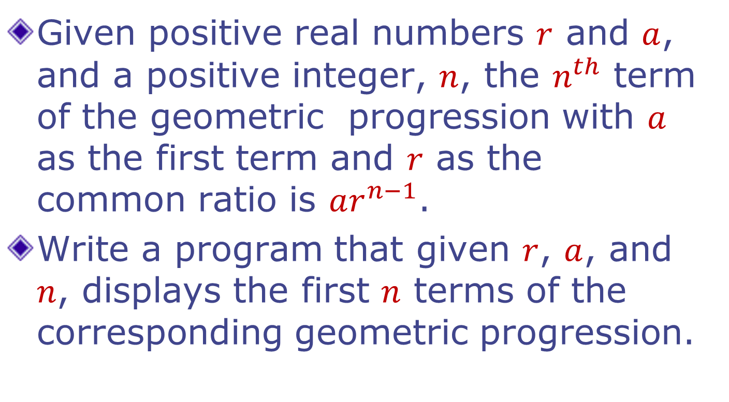
Order of statements is important

Slide 13
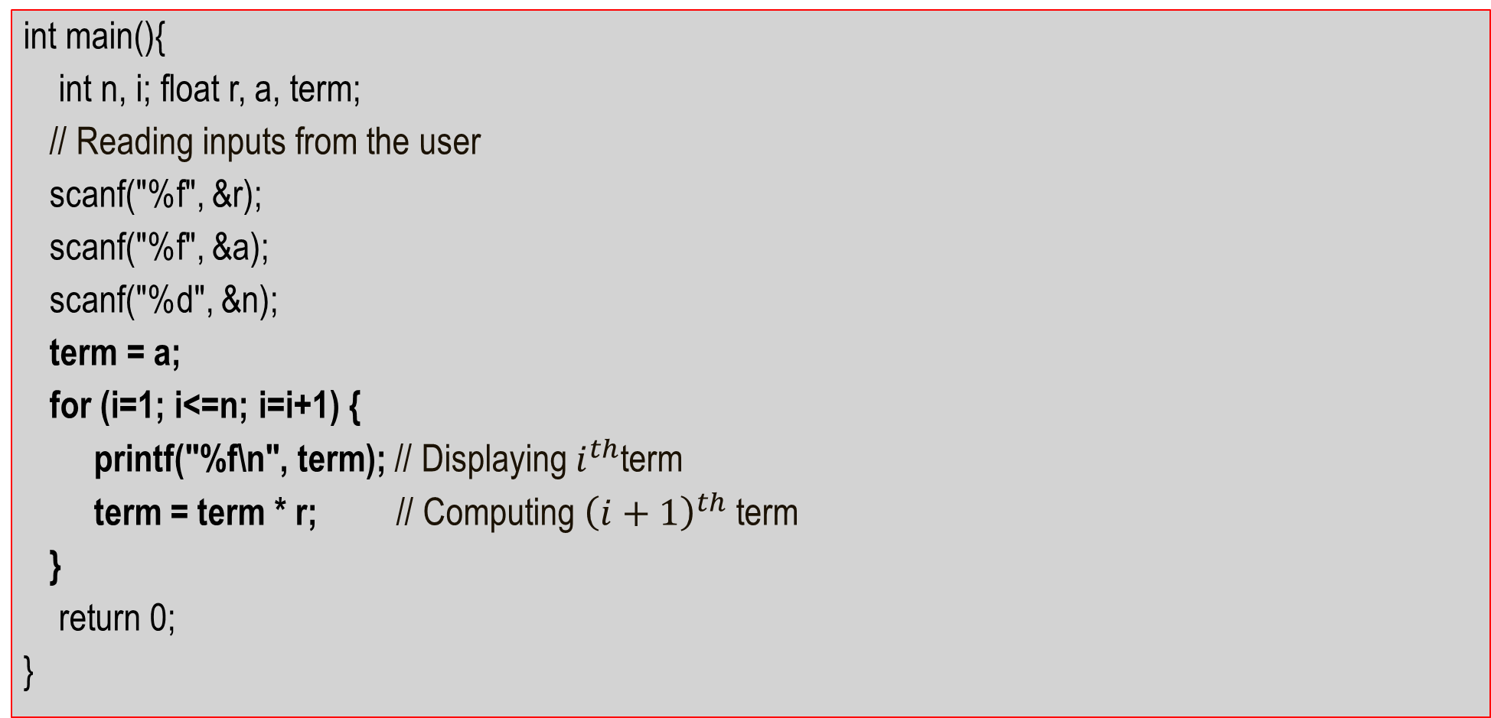
Order of statements is important
int main(){
int n, i; float r, a, term;
// Reading inputs from the user
scanf("%f", &r);
scanf("%f", &a);
scanf("%d", &n);
term = a;
for (i=1; i<=n; i=i+1) {
printf("%f\n", term); // Displaying $i^{th}$term
term = term * r; // Computing ${\left(i+1\right)}^{th}$term
}
return 0;
}

Slide 14

Order of statements is important
int main(){
int n, i; float r, a, term;
// Reading inputs from the user
scanf("%f", &r);
scanf("%f", &a);
scanf("%d", &n);
term = a;
for (i=1; i<=n; i=i+1) {
term = term * r;
printf("%f\n", term);
}
return 0;
}
Careful: Changing the order of statements changes the meaning of the program.
Computation of
$a, ar, …,ar^{n−1}$ (previous program)
$ar, ar^{2},…,ar^{n}$ (this program)

Slide 15
The break keyword
If we did not have break, infinite loop!
Allows us to stop executing a loop and exit immediately
Even if the stopping condition is still true
Can be used inside a for loop, while loop, do-while loop
When to use break
Avoid if possible
Can make code error-prone and hard to read
Used when one stopping condition not enough
Or sometimes to make code more elegant
Allows us to avoid specifying a stopping condition
Note: Here, the else not even needed since Mr C. neglects all remaining statements in loop body upon encountering break;
int num, sum = 0;
while(1){
scanf(“%d”, &num);
if(num == -1) break;
sum += num;
}
printf("%d",sum);
int num, sum = 0;
while(1){
scanf(“%d”, &num);
if(num == -1) break;
else sum += num;
}
printf("%d",sum);

Slide 16
A fancy for loop using break
If we did not have break this would have been an infinite loop since no stop_expr
init_expr;
for(;;){
if(!(stop_expr)) break;
statement1;
statement2;
...
upd_expr;
}
statement3;
statement4;
for(init_expr; stop_expr; upd_expr){
statement1;
statement2;
...
}
statement3;
statement4;
Remember, the order is stop_expr → body → update → stop_expr → …

Slide 17
The continue keyword
Allows us to skip the rest of the statements in body of the loop
Upon encountering continue, Mr C thinks that body of loop is over
Loop not exited (unlike break)
If we say continue in for loop, update_expr evaluated, then stop condition checked
If we say continue in while or do-while loop, then stop condition checked
In all cases, rest of body not executed
Read 100 integers and print sum of only positive numbers
int sum = 0, i, num;
for(i = 1; i <= 100; i++){
scanf("%d", &num);
if (num < 0){
continue;
}
sum += num;
}

Slide 18


Careful using break, continue
Much better, always updates counter whether skipping the sum+=num step using continue or not
If we have a sequence of 100000 negative numbers, it will read all of them even though we wanted to read only first 100 numbers – continue statement skipping counter update
If there are nested loops, a break inside the inner loop will apply only to the inner loop, same with continue
Be careful not to create an infinite loop using continue if you bypass any update steps.
int i = 0, sum = 0, num;
while (i < 100){
i++;
scanf(“%d”, &num);
if (num < 0) continue;
sum += num;
}
int i = 0, sum = 0, num;
while (i < 100){
scanf(“%d”, &num);
if (num < 0) continue;
sum += num;
i++;
}
for (i = 0; i < 100; i++){
for (j = 0; j < 100; j++){
if (…) break;
}
statement1;
}
statement2
for (i = 0; i < 100; i++){
for (j = 0; j < 100; j++){
if (…) continue;
}
statement1;
}
statement2

Slide 19
Careful using break, continue
Excessive use of break and continue can make your program error-prone, and hard for you to correct
If you have 10 break statements inside the same loop body, you will have a hard time figuring out which one caused your loop to end ☹
If you have 10 continue statements inside the same loop body, you will have a hard time figuring out why body statements are not getting executed.
Should not misuse break, continue - used in moderation these can result in nice, beautiful code
We will see some elegant alternatives to break, continue

Slide 20
Break and Continue: Summary
Break helps us exit loop immediately
In for loops, even update_expr or stop_expr not checked – just exit
In while, do-while loops, even stop_expr not checked – just exit
Continue helps us skip the rest of the body of loop
In for loops, after Mr C receives a continue statement, he evaluates the update_expr (if it’s inside for() part), then checks the stop_expr and so on …
In while loops, after Mr C receives a continue statement, he checks the stop_expr
Loop not exited just because of continue, stop_expr still controls exit
Warning: Break legal only in body of loops and switch
Illegal inside body of if, if-else statements
Warning: Continue legal only in body of loops
Illegal inside body of if, if-else, switch statements

Slide 21
Can we avoid break and continue?
Yes. Use “flag” (next class - Monday)
Will also start looking at arrays

