Slide 1
ESC101: Fundamentals of Computing
Flags, Variable Scope Rules,
and Introduction to Arrays
Piyush Rai

Slide 2
Announcements
Minor Quiz 3 graded, Major Quiz 1 almost graded
Scores will be released by tomorrow
Regrading deadline will be 1 week from the day of release of marks
Same policy for regrading of weekly labs

Slide 3
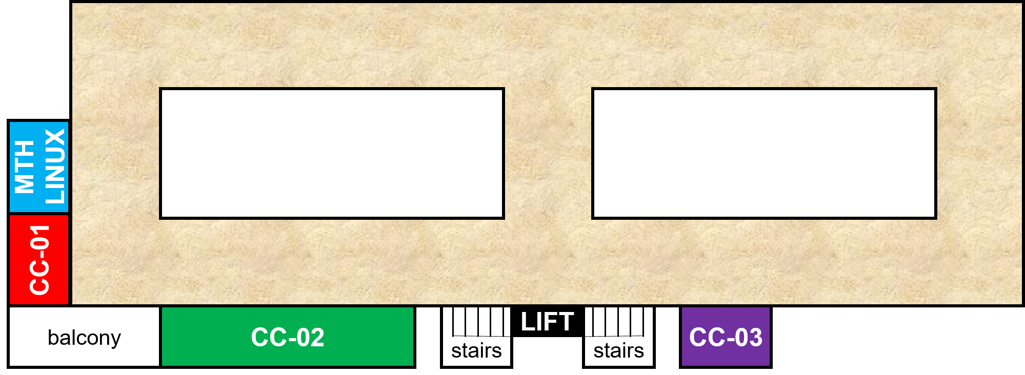
Mid-sem Lab Exam: September 8 (Sunday)
Morning exam (Wed, Thu batches)
10:30 AM - 1:30 PM – starts 10:30 AM sharp
CC-01: B9, {B14 even roll numbers}
CC-02: B7, B10, B11
CC-03: B12
MATH-LINUX: B8, {B14 odd roll numbers}
Afternoon exam (Mon, Tue batches)
2 PM - 5 PM – starts 2 PM sharp
CC-01: B1, {B2 even roll numbers}
CC-02: B4, B5, B6
CC-03: B3
MATH-LINUX: B13, {B2 odd roll numbers}

Slide 4
Mid-sem Lab Exam: September 8 (Sunday)
Go see your room during this week’s lab
Be there 15 minutes before your exam time
Cannot switch to another session (morning to afternoon or vice-versa)
Syllabus – till loops (no arrays)
Open handwritten notes – However, NO printouts, photocopies, slides, websites, mobile phone, Ipad
USE OF ANY OF ABOVE WILL BE CONSIDERED CHEATING
Prutor CodeBook will be unavailable during lab exam
Exam will be like labs - marks for passing test cases
Marks for writing clean indented code, proper variable names, a few comments – illegible code poor marks

Slide 5

Major Quiz 1: Operator Confusion ☺
Set A and B, problem 5.2 (increment and decrement operators)
“post” have larger precedence than “pre”
Increment has larger precedence than decrement
Pre has right to left associativity
Post has left to right associativity
We will give you credit if you have a reasonable answer (e.g., assumed both pre and post to have same precedence, but correct otherwise)
a = a++ + ++a + --a ;
b = b++ + --b + ++b;
a = --a + a++ + ++a ;
b = b++ + --b + ++b + a;

Slide 6
Recap: Break and Continue
In nested loops, break and continue from the inner-most loop
Use break; to exit a loop (or switch) immediately
Use continue; to skip rest of the body of loop and start next iteration
Warning: Break legal only in body of loops and switch
Illegal inside body of if, if-else statements (unless already in a loop or switch)
Warning: Continue legal only in body of loops
Illegal inside body of if, if-else, switch statements (unless already in a loop)
while(1){
scanf(“%d”, &num);
if(num == -1) break;
sum += num;
}
printf("%d",sum);
for(i = 1; i <= 100; i++){
scanf("%d", &num);
if (num < 0){
continue;
}
sum += num;
}

Slide 7


How to break without using break ?
Example: Take a number, if it is even print “Even”, if it is also divisible by 5, print “Divisible by 10” as well, on a different line
Several ways to solve this problem. One wrong way is given below
What if I want to skip the rest of the body of the if?
What are flags?
int num = 20;
if(num %2 == 0){
printf(“Even”);
if(num % 5 != 0) break;
printf(“\nDivisible by 10”);
}
Trying to ‘break’
from this ‘if’
Reason: break does not make sense to me inside if or if-else
THIS PROGRAM WILL NOT COMPILE
Use flags

Slide 8
Flags
CRITICAL: Always initialize your flags
Flags NOT A KEYWORD – they are a programming style
As name suggests, they signal important happenings
Can be used to avoid using break
Can also be used to avoid using continue in loops
Flags can be integer, long variables – usually 0/1
You can give your flag any legal, sensible name you want
int num = 20;
int flag = 0; // Assume not div by 5
if(num %2 == 0){
printf(“Even”);
if(num % 5 == 0) flag = 1;
if(flag)
printf(“\nDivisible by 10”);
}
If you don’t initialize and num is not multiple of 5, flag may contain garbage value
Could have also named this flag isDivBy5 – more descriptive name
Note: Could also avoid flag by using if(num%5==0){printf(“Divisible by 10”);} but using flag is a better practice in larger programs

Slide 9
Scope rules for variables
Scope defines the regions in program where a variable is “visible”
A pair of opening and closing curly braces creates a “block”
Can re-declare a variable with same name if the name hasn’t been declared earlier in the same block. This variable will be visible until this block ends
More on scope rules when we discuss functions
int main(){
int a = 0;
int b = 2;
printf(“%d”,b);
return 0;
}
int main(){
int a = 0;
int b = 2;
if(a==0){
int b = 1;
printf(“%d”,b)
}
printf(“%d”,b)
return 0;
}
This b is visible only in the red region
Visible everywhere in the whole block of the program within { and }
Will print 1
This b is a different variable than the outer b. Visible only within the green region
Will print 2

Slide 10
Arrays
Dictionary meaning of the word array
arr-ay: noun
1. a large and impressive grouping or organization of things: He couldn't dismiss the array of facts.
2. regular order or arrangement; series: an array of figures.

Slide 11
How to store lots of values of same type?
We have seen many data types so far
int, float, char, etc.
We can use a variable to store a single value of some data type, e.g.,
int x = 2; // variable x stores one integer value
float x = 2.3; // variable x stores a one float value
char x = ‘c’; // variable x stores one char value
What if we want to store several values, all of same data type?
Example 1: Marks of all ESC101 students in Major Quiz 1 (all floats)
Example 2: Roll numbers of all ESC101 students (all int)
Example 3: Final grade of all ESC101 students (all char)

Slide 12
How to store lots of values of same type?
Consider storing Major Quiz 1 marks of all ESC101 students
This is very time consuming, inelegant, and boring
Arrays provide a better and more efficient way of doing such things
float marks1, marks2, marks3, .... ,marks500;
scanf(“%f”, &marks1);
scanf(“%f”, &marks2);
...
scanf(“%f”, &marks500);

Slide 13
Arrays
Not a new data type but a “data structure” (a collection of variables)
Enables storing multiple values of the same data type
Specification/declaration of an array needs the following
A data type (data type of values to be stored; all must be of same type)
A name (same naming convention as variables)
A size (how many values to be stored)
An example of array declaration:
float marks[500];
Data type
Size is an integer in square brackets
Name
Size

Slide 14
Arrays: Basic Syntax
In some other languages (such as Python), array indexing starts with 1
Each value within the array is called “element” of the array
Each element is accessed using a non-negative integer-valued index
First index is 0 (index of first element)
Last index is array size minus one (index of last element)
Syntax to access/use each element of the array
name_of_array[index]
For example:
marks[0] is the first element of an array named marks
marks[1] is the second element of array marks
marks[499] is the last element of array marks
Index is an integer in square brackets

Slide 15
Arrays: Basic Syntax
Array index needs to be within limits (0 to array size - 1)
For an array declared as marks[500]
Index -1 is invalid (may give segmentation fault, also known as “segfault”)
Index 510 is invalid (may give segfault)
Index 500 is also invalid (recall that 499 is the index of last element)
Array index need not be a constant integer,
Can also be a variable/expression (but only int)
Example: marks[i] or marks[2*i + 1] where i is an integer
Never use a float/double as index

Slide 16
Arrays: Storage in memory
Array name is like street name, index is like house number ☺
A single variable (int/float/char etc) is stored in a single box in memory
An array is stored in several consecutive boxes in memory (number of these boxes is equal to the size of the array)
More on storage of arrays when we study Pointers
int a = 2;
float b = 3.2;
2
3.2
a
b
float marks[500];
marks[0]
marks[1]
marks[2]
marks[499]

Slide 17
Array: Declaration and Initialization
Array elements are comma separated
Can be initialized at time of declaration itself
Can be partly initialized as well
However, if not initialized in same line with declaration, have to be initialized one by one!
int a[6] = {3,7,6,2,1,0};
a
3
7
6
2
1
0
int a[6] = {3,7,6};
a
3
7
6
int a[6];
a = {3,7,6,2,1,0};
int a[6];
a[2] = 6;

Slide 18
Array: Declaration and Initialization
Can be initialized at time of declaration itself
Can be partly initialized as well
Over initialization may crash
Better way to initialize is the following
Warning: uninitialized arrays contain garbage, not zeros
int a[6] = {3,7,6,2,1,0};
a
3
7
6
2
1
0
int a[6] = {3,7,6};
a
3
7
6
int a[6] = {1,2,3,4,5,6,7,8,9};
I will figure out how much space needed
No need to specify the array size during declaration
int a[] = {1,2,3,4,5,6,7,8,9};

Slide 19
Next Class: More on arrays..
Other ways of initializing arrays
Example programs using arrays
Array of characters (they are special – also known as “string”)

