Slide 1
ESC101: Fundamentals of Computing
Introduction to Pointers
Piyush Rai

Slide 2
Announcements
Midsem theory exam grading going on. Scores expected by tomorrow
Minor Quiz 4 and 5 scores are also expected by tomorrow
Lab exam grading would take another week to finish
Lab of Oct 2 (Wednesday) pre-poned to Sept 29 (Sunday)

Slide 3
Pointers

Slide 4


The sizeof various variable types
8 bits make a byte
char takes 1 byte = 8 bits
Max value in a char is 127 = 2^{(8 – 1)}-1
int/float takes 4 bytes = 32 bits
Max value in int is 2,147,483,647 equal to 2^{(32 – 1)}-1 – verify
long/double takes 8 bytes = 64 bits
Max value in long is 9,223,372,036,854,775,807 equal to 2^{(64 – 1)}-1 – verify
=
Because, for signed variables, one bit is reserved for storing the sign
=
Why is max value for all these variables always 2^{(k – 1)}-1 and not 2^{k} -1 when there are k bits getting used?
=

Slide 5
How Mr C stores variables
000000
000001
000002
000003
000004
000005
000006
000007
000008
000009
000010
000011
000012
000013
000014
000015
000016
000017
000018
000019
000020
…
He has a very long chain of bytes
Each byte has a non-negative "address”
Each address (which is also a number) is stored
using 8 bytes (=64 bits)
Some addresses are reserved for Mr. C
Others can be used by us for variables, e.g.,
So there can be a total 2⁶⁴-1 possible addresses in memory
char c; // stored at 000004
int a; // stored at 000005
double d; // stored at 000009

Slide 6
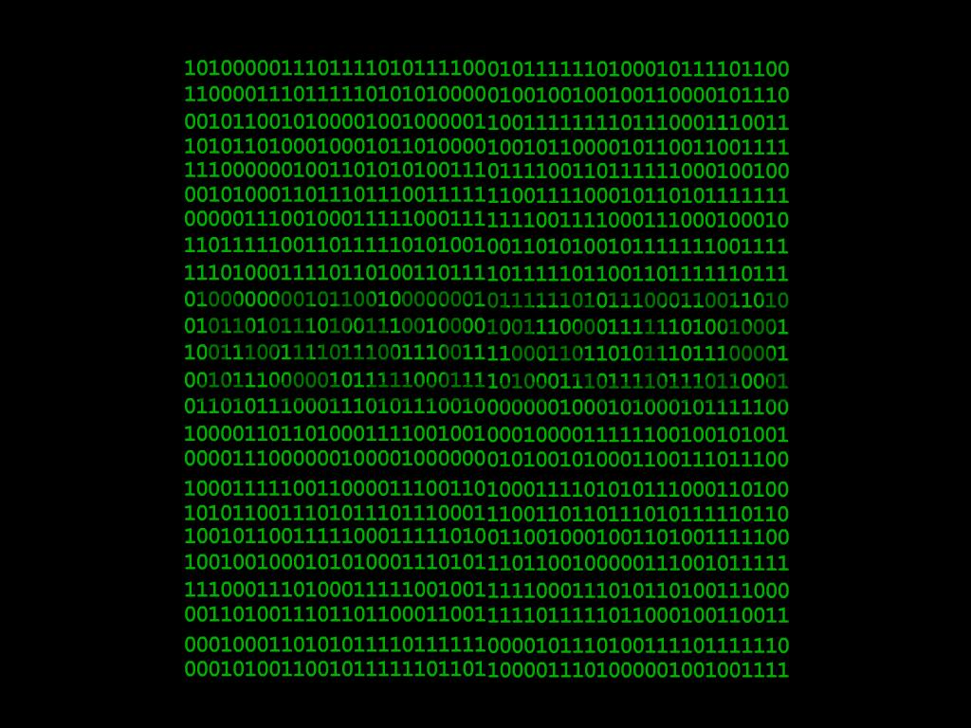
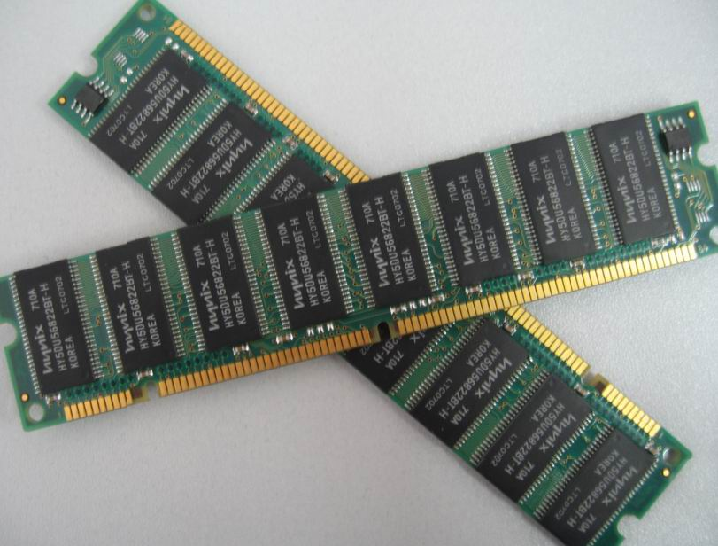
Controlling/managing memory

Slide 7
Pointers
A pointer is just an address and needs 8 bytes to store
Pointers enable us to store/manage memory addresses
In some sense Mr C manages a ridiculously huge array!
Pointers can allow us to write very beautiful code but it is a very powerful tool – misuse it and you may suffer ☺

Slide 8

Our first pointer
Whew! Lets begin.
42
How we speak to mr. compiler
How we usually speak to a human
int *ptr; means ptr is a pointer to an integer
#include <stdio.h>
int main(){
int a = 42;
int *ptr;
ptr = &a;
printf("%d", *ptr);
return 0;
}
a is an int variable, value 42
ptr is a pointer that will store address to an int variable
Please store address of a in ptr
Please print the value of the int stored at the address in ptr
Can also have pointes to char, long, float, double
42
000023
All these envelope-like boxes take 8 bytes
000023
000027
a
ptr
a is stored at internal location 000023
int takes 4 bytes to store

Slide 9
Pointers with printf and scanf
Pointers contain addresses, so to print the address itself, use the %ld format since addresses are 8 byte long
To print value at an address given by a pointer, first dereference the pointer using * operator
Scanf requires the address of the variable where input is to be stored. Can pass it the referenced address
or else pass it a pointer
printf("%d", *ptr);
scanf("%d", &a);
scanf("%d", ptr);

Slide 10
Pointers
Can have pointers to a char variable, int variable, long variable, float variable, double variable
Can have pointers to arrays of all kinds of variables
All pointers stored internally as 8 byte non-negative integers
NULL pointer – one that stores address 00000000
Named constant NULL can be used to check if a pointer is NULL
Do not confuse with NULL character '\0' – that has a valid ASCII value 0
NULL character is actually used to indicate that string is over
WARNING: NULL pointers may be returned by some string.h functions e.g. strstr
Do not try to read from/write to address 00000000
Reserved by Mr C or else the operating system
Doing so will cause a segfault and crash your program/even your computer

Slide 11
Pointers and Arrays
int a[6] = {3,7,6,2,1,0};
How many boxes in memory will be created for the above
declaration + initialization? SEVEN
3
7
6
2
1
0
000025
Name of box
a
a[0]
a[1]
a[2]
a[3]
a[4]
a[5]
Address of box
000017
000025
000029
000033
000037
000041
000045
In case of arrays, the name of the array is the pointer to the first element of the array
Also note that a and a[0] need not be at adjacent addresses in memory (but often are)

Slide 12
Pointers and Arrays
Note: Though figure shows them as taking one byte, actually, being pointers (addresses), c and a each would take 8 bytes to store
000000
000001
000002
000003
000004
000005
000006
000007
000008
000009
000010
000011
000012
000013
000014
000015
000016
000017
000018
000019
000020
000021
000022
000023
…
If we declare an array, a sequence of addresses get allocated
Names c and a are actually pointers, c stores the address of c[0], a stores address of a[0]
c[0] is stored at address 000005, c[1] at address 000006, c[2] at 000007 and so on
a[0] is stored at address 000011, a[1] at address 000015 (int takes 4 bytes), a[2] at address 000019, and so on
c
c[0]
c[1]
c[2]
c[3]
c[4]
0 0 0 0 0 1 0 1
char c[5];
c is pointer, the whole c[5] denotes the array
a is pointer, the whole a[3] denotes the array
int a[3];
a
a[0]
a[1]
a[2]
0 0 0 0 1 0 1 1

