Slide 1
ESC101: Fundamentals of Computing
Pointers (wrap-up)
and Introduction to Functions
Piyush Rai

Slide 2

Recap: Array of Pointers
Can use array of char pointers to store many (i.e., an array of) strings
An array of (say char) pointers can be created in two ways
- Use a static array declaration char *ptrArr[3]; and then initialize each of the 3 pointers ptrArr[0], ptrArr[1], and ptrArr[2] using malloc or as static arrays
- Use a dynamic array declaration as a pointer to pointers
char **ptrArr = (char **)malloc(3*sizeof(char *));
and then initialize each of the 3 pointers ptrArr[0], ptrArr[1], and ptrArr[2] using malloc or as static arrays
Just like name of array is a pointer
Name of array of pointers is also a pointer of pointer

Slide 3
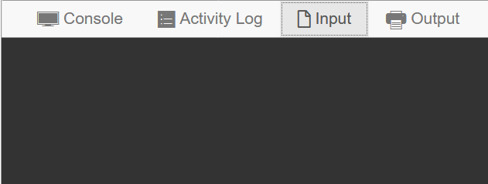
Array of Pointers ➔ Arrays of Arrays
char **ptrArr = (char**)malloc(3*sizeof(char*));
for(i = 0; i < 3; i++)
ptrArr[i] = (char*)malloc((i+1)*sizeof(char));
scanf("%c", &ptrArr[2][1]);
printf("%c", ptrArr[2][1]);
for(i = 0; i < 3; i++)
free(ptrArr[i]);
free(ptrArr);
X
ptrArr[0]
ptrArr[0][0]
ptrArr[1]
ptrArr[1][0]
ptrArr[1][1]
ptrArr
X
X
ptrArr[2]
ptrArr[2][0]
ptrArr[2][1]
ptrArr[2][2]

Slide 4
Accessing Elements in Array of Pointers/Arrays
Rest assured, the same rules apply as do with pointers
ptrArr[0], ptrArr[1], ptrArr[2] are all arrays of chars
How to access individual elements of these arrays?
Two ways to access index 2 element of str: str[2], *(str+2)
Apply exact same rule ☺: ptrArr[2][2], *(ptrArr[2]+2) both give index 2 element of the array ptrArr[2]
Note that ptrArr[1] does not have 3 elements so ptrArr[1][2] may cause segfault!
char *ptrArr[3], str[3];
for(i = 0; i < 3; i++)
ptrArr[i] = (char*)malloc((i+1)*sizeof(char));

Slide 5
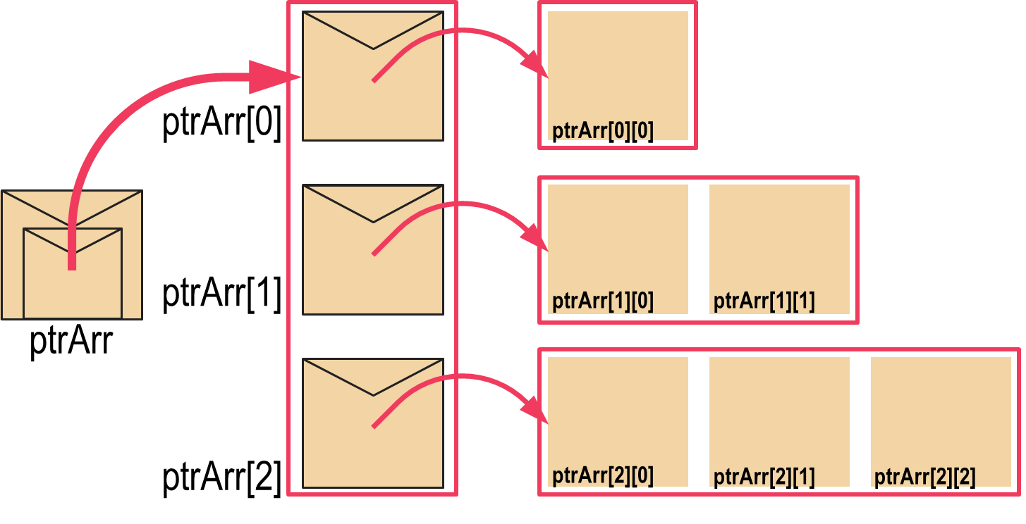



Accessing Elements in Array of Pointers/Arrays
Don’t write ptrArr++ illegal!
Even str++ illegal!
However, I can write char* qtr = str; qtr++; Now qtr points to str[1]
Rest assured, the same rules apply as do with pointers
You can show-off your skills by cool array access tricks ☺
Remember that str is a pointer to str[0]
In the same way, ptrArr is also a pointer to ptrArr[0] (which is an array)
str + 2 gives address of str[2]
ptrArr + 2 also gives address of ptrArr[2] (pointers take 8 bytes) – same rules!
We can access index 2 of the third array in many ways ptrArr[2][2],*(ptrArr[2] + 2),*(*(ptrArr + 2) + 2),(*(ptrArr+2))[2]
char *ptrArr[3], str[3];
for(i = 0; i < 3; i++)
ptrArr[i] = (char*)malloc((i+1)*sizeof(char));
I can also write char** rtr = ptrArr; rtr++; Now rtr points to ptrArr[1]
Don’t worry. we won’t ask exam questions on int (*ptr)[5];
I will ask questions on pointers to pointers, array of pointers, etc though
Just one potentially confusing notation in C
int *ptr[5]; is an array of 5 pointers to int but
int (*ptr)[5] is a single pointer to an array of 5 ints ☹

Slide 6


2D Arrays: Revisited (Pointer’s view)
int mat[3][5]; // note: 2D array name mat is also a pointer to pointer (int ** )
Declares a matrix (2D array) with 3 rows 5 columns
Rows numbered 0, 1, 2. Columns numbered 0, 1, 2, 3, 4
Element at row-index i and column-index j is an int variable
Can access it using several ways mat[i][j],*(mat[i] + j),*(*(mat + i) + j),(*(mat + i))[j]
Careful! **(mat + i +j) ≠ *(*(mat + i) + j) ≠ *(*mat + i + j)
Not that much actually – let me show you the differences
This looks exactly like the way we access an array of pointers/arrays – what is the difference?

Slide 7
2D arrays vs Array of pointers
2D Arrays
Array of Pointers
Number of elements in each row is the same
All elements of 2D array are located contiguously in memory
Easier to initialize
Very convenient ☺
Different arrays can have different number of elements – more flexibility
Elements of a single array are contiguous but different arrays could be located far off in memory
Have to be initialized element by element
More power, responsibility
int mat[3][5] = { {1,2}, {3}, {4,5,6},{7,8,9,10,11},{-1,2,3,4}};

Slide 8
Memory layout of 2D arrays
000000
000001
000002
000003
000004
000005
000006
000007
000008
000009
000010
000011
000012
000013
000014
000015
000016
000017
000018
000019
000020
000021
000022
000023
…
char str[3][4] = {"Hi","Ok","Bye"};
str[0][0]
str[0][1]
str[0][2]
str[0][3]
str[1][0]
str[1][1]
str[1][2]
str[1][3]
str[2][0]
str[2][1]
str[2][2]
str[2][3]
H
i
\0
\0
O
k
\0
\0
B
y
e
\0
Location of the str pointer not shown
First all elements of row 0 stored in continuous sequence
Then without breaking sequence, all elements of row 1 stored and so on
char* ptr = *str; // ptr points to str[0][0]
ptr += 4; // ptr now points to str[1][0]
ptr += 4; // ptr now points to str[2][0]
ptr += 1; // ptr now points to str[2][1]

Slide 9
Layout of array of pointers
000000
000001
000002
000003
000004
000005
000006
000007
000008
000009
000010
000011
000012
000013
000014
000015
000016
000017
000018
000019
000020
000021
000022
000023
…
char **str = (char**)malloc(3*sizeof(char*));
str[0] = (char*)malloc(4*sizeof(char));
str[1] = (char*)malloc(4*sizeof(char));
str[2] = (char*)malloc(4*sizeof(char));
str
0 0 0 0 0 1 0 1
str[0]
str[1]
str[2]
0 0 0 0 1 0 0 1
0 0 0 0 1 1 1 1
0 0 0 1 0 1 1 0
str[0][0]
str[0][1]
str[0][2]
str[0][3]
Element within a single array always stored in sequence
Different arrays may be stored far away from each other
str[1][0]
str[1][1]
str[1][2]
str[1][3]
str[2][0]
str[2][1]
str[2][2]
str[2][3]

Slide 10
Functions

Slide 11
We have seen functions before
main() is a special function. Execution of program starts from the beginning of main()
scanf(…), printf(…) are standard input-output library functions
sqrt(…), pow(…) are math functions in math.h

Slide 12
Writing our own functions..
A standard program for max of two numbers
int max (int a, int b) {
if (a > b)
return a;
else
return b;
}
We or someone else may have already written this “max” function and tested well (so very little chance of error)
int main () {
int x;
int a,b;
scanf(“%d%d”,&a,&b);
if(a>b)
x = a;
else
x = b;
printf(“%d”,x);
return 0;
}
int main () {
int x;
int a,b;
scanf(“%d%d”,&a,&b);
x = max(a, b);
printf(“%d”,x);
return 0;
}
A program with
our own function

Slide 13
int max (int a, int b) {
if (a > b)
return a;
else
return b;
}
2 arguments
a and b,
both of type int.
(formal args)
Return Type
Function Name
int main () {
int x;
x = max(6, 4);
printf(“%d”,x);
return 0;
}
Body of the
function, enclosed
inside { and }
(mandatory)
returns an int.
Call to the function.
Actual args are 6 and 4.
13

Slide 14


The Anatomy of a C Function
How we must speak to mr. compiler
How we usually speak to a human
int isUpperAlpha(char x){
int a = (x >= 'A') && (x <= 'Z');
return a;
}
isUpperAlpha is a function that takes in a character (let us call that character x) as input and gives an integer as output
Upon receiving input, please create an integer variable a and store 1 in a if input is upper case alphabet else store 0 in a
Please output the value of a to whomever used this function
Yes you can! But you have to be a bit clever about doing so
We will teach you 3 ways to return more than one output in this course ☺
Programmers often call the process of giving inputs to a function as passing arguments to the function
Name of function: isUpperAlpha
Arguments: one character
Return type: integer
Inputs to a function are called its arguments
A function returns its output
☹ So I cant write a function that returns 2 integers – say x and y coordinates?
A function may have many inputs but only one output

Slide 15
Why use functions?
Break up complex problem into small sub-problems.
Solve each of the sub-problems separately as a function, and combine them together in another function.
The main tool in C for modular programming.

Slide 16
Functions help us write compact code
Example : Maximum of 3 numbers
int main(){
int a, b, c, m;
/* code to read
* a, b, c */
if (a>b){
if (a>c) m = a;
else m = c;
}
else{
if (b>c) m = b;
else m = c;
}
/* print or use m */
return 0;
}
int max(int a, int b){
if (a>b)
return a;
else
return b;
}
int main() {
int a, b, c, m;
/* code to read
* a, b, c */
m = max(a, b);
m = max(m, c);
/* print or use m */
return 0;
}
This code
can scale
easily to
handle
large
number
of inputs
(e.g.: max
of 100
numbers!)

Slide 17
Other benefits of writing functions
Code Reuse: Allows us to reuse a piece of code as many times as we want, without having to write it.
Think of the printf function!
Procedural Abstraction: Different pieces of your algorithm can be implemented using different functions.
Distribution of Tasks: A large project can be broken into components and distributed to multiple people.
Easier to debug: If your task is divided into smaller subtasks, it is easier to find errors.
Easier to understand: Code is better organized and hence easier for an outsider to understand it.

Slide 18
Other benefits of writing functions
Allows you to think very clearly
E.g. if you want to do something if the integer n is a prime number or if it is divisible by 11
Write the body of the if condition without worrying about primality testing etc and then define the functions later ☺
You can break your code into chunks – called modules
Each module handled using a separate function
E.g. in this case, primality testing is one module, checking for divisibility by 11 is another module
if(isPrime(n) || isDivby11(n)){
…
}
Writing code that has modules is a type of modular programming – it is the the industry standard!

