Slide 1
ESC101: Fundamentals of Computing
Macros and Recursion
Piyush Rai

Slide 2
Macros in C
Marcos are defined outside functions
Macros are handled by the C pre-processor (not compiler)
All marco statements begin with # (like #include)
Can use macros to also define constants using #define, e.g.,
#define PI 3.14159 (note that no “=“ between name and value)
The macro maps an input sequence to an output sequence before the program has compiled (PI mapped to 3.14159 in the above example)

Slide 3
Macros in C
Object/constant-like macros
#define BUFFER_SIZE 1024
Pre-defined macros in C, e.g. __DATE__ , __TIME__ etc (note there are two underscores each before and after)
Function-like macros
#define min(X, Y) ((X) < (Y) ? (X) : (Y))
x = min(a,b) will be expanded to
x = ((a) < (b) ? (a) : (b))
Before compilation

Slide 4
Macros in C: Be Careful
Macro is a simple copy-paste
Without parentheses, can make operator precedence betray your code’s logic
#define SQR(x) (x*x)
int main() {
int a, b=3;
a = SQR(b+5);
printf("%d\n",a);
return 0;
}
23

Slide 5
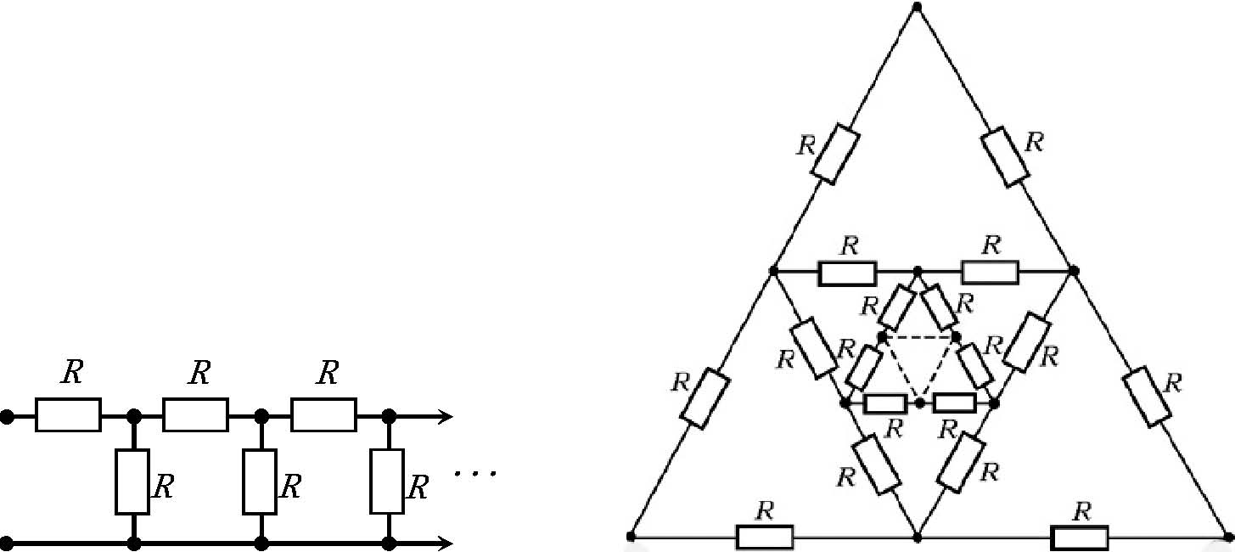
Recursion

Slide 6
Recursion
Process of solving a problem using solutions to “smaller” versions of the same problem!
You have already encountered recursion in mathematics
Factorial function is defined in terms of factorial itself!
Proof by induction is basically a recursive proof
Claim: 1 + 2 + 3 + … + n = n(n+1)/2
Proof: Base case: for n = 1 true by inspection
Inductive case: (1 + … + n) = (1 + … + n-1) + n = (n-1)n/2 + n = n(n+1)/2 ☺
Notice that we need a base case and recursive case
In case of factorial, fac(0) was the base case.
This is true when writing recursive functions in C language as well
We used the proof for the case n-1 to prove the case n

Slide 7
Mutual Recursion
Two functions calling each other in a recursive fashion
Even(n) = (n == 0) || Odd(n-1)
Odd(n) = (n != 0) && Even(n-1)
Note: The above example is not the most efficient way
to check if a number of even or add but just an illustrastion
of mutual recursion ☺

Slide 8
About Recursion
fac(n) = n*fac(n-1);
Recursion can allow us to write very elegant code
Very easy to understand what is going on by just reading function definition
Sometimes you can just “copy” the function definition into code ☺
Careful: do not forget to write down the base case
Will go into something like an infinite loop if you forget the base case
May end up exceeding time and memory limits on Prutor
Will get a TLE/runtime error message on Prutor
Careful: problems that can be solved using recursion can always be solved using loops too
Fundamental result in computer science: Church-Turing thesis
Disadvantage: loop solutions sometimes very difficult to write and read
Advantage: loop solutions can be much faster (at least in compiled languages like C) than the recursion solution

Slide 9
Recognizing Recursion
Sometimes it is very easy to see that the problem can be solved using recursion – example factorial, Fibonacci
Sometimes it is harder to see that recursion can be used to solve the problem – example gcd, partition
No small set of golden rules on how to find out when and if a problem can be solved using recursion ☹
Need to look at the problem carefully and see if it can be solved using smaller versions of the same problem
Will see several examples of this in ESC101. More examples in advanced courses e.g. ESO207, CS345

Slide 10
Example 1: Factorial
1
int fact(int a){
if(a == 0) return 1;
return a * fact(a - 1);
}
int main(){
printf("%d", fact(1+1));
}
1
fact()
a
0
0
1
1
fact()
a
2
main()
2
1
2
1
fact()
2
2
a

Slide 11

Example 1: Factorial
See how many clones got created!
int fact(int a){
if(a == 0) return 1;
return a * fact(a - 1);
}
int main(){
printf("%d", fact(2*3));
}
Creating each clone takes time and memory
This is why recursive programs can be a bit slower – be careful
fact(0)
= 1
fact(1)
fact(2)
fact(3)
1 = 1
1 = 2
2 = 6
720
= 1 * fact(0)
= 2 * fact(1)
= 3 * fact(2)
main()
fact(6)
fact(5)
fact(4)
= 6 * fact(5)
120 = 720
= 5 * fact(4)
24 = 120
= 4 * fact(3)
6 = 24

Slide 12
Factorial: The Flow
long int factorial(int n){
if(n==0)
return 1;
else
return(n*factorial(n-1));
}
main()
main()
120
F(5)
F(5)
24
F(4)
F(4)
6
F(3)
F(3)
2
F(2)
1
F(2)
F(1)
1
F(1)
Values returned in reverse order
F(0)

Slide 13


Example 2: Fibonacci Numbers
Imagine the number of clones to calculate fib(100). Challenge: don’t imagine – find out ☺
Wasted effort too!
fib(1) calculated twice
fib(2) calculated 3 times
fib(3) calculated twice
Explosion of clones!
There are two base cases for Fibonacci numbers
The first Fibonacci number is defined to be 0
The second Fibonacci number is defined to be 1
Recursive case: for n > 2, n-th Fibonacci number is the sum of the previous two Fibonacci numbers
I could have easily solved this problem using a for loop – much faster and no clones
That’s why we were warned. Recursion allows neat code but sometimes can be slower
int fib(int n){
if(n == 1) return 0;
if(n == 2) return 1;
return fib(n-1) + fib(n-2);
}
int main(){
printf("%d", fib(5));
}
fib(5)
fib(4)
fib(3)
fib(3)
fib(2)
fib(2)
fib(1)
fib(2)
fib(1)

Slide 14
Attack of the Clones
fib(1) calculated 3 times
fib(2) calculated 5 times
fib(3) calculated 3 times
fib(4) calculated 2 times
fib(6)
fib(5)
fib(4)
fib(4)
fib(3)
fib(3)
fib(2)
fib(3)
fib(2)
fib(2)
fib(1)
fib(2)
fib(1)
fib(2)
fib(1)

Slide 15
Recursion vs Iteration
Write a function to compute
the n-th Fibonacci number
The recursive program is closer to the definition and easier to read.
int fib(int n)
{
int first = 0, second = 1;
int next, c;
if (n <= 1)
return n;
for ( c = 1; c < n ; c++ ) {
next = first + second;
first = second;
second = next;
}
return next;
}
But very very inefficient
int fib(int n)
{
if ( n <= 1 )
return n;
else
return fib(n-1) + fib(n-2);
}

Slide 16
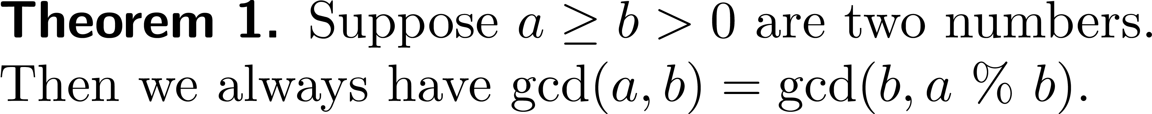
Greatest common divisor
Sometimes recursion can make code faster too ☺
One of the fastest algorithms for computing gcd is called the Euclid’s algorithm and it defines gcd recursively!
Note that since a % b is always less than b, this indeed defines gcd in terms of gcd on “smaller” inputs
What is the base case here?
When b divides a i.e. when a % b = 0, then we have gcd(a, b) = b ☺

Slide 17
GCD using Recursion
int gcd(int a, int b){
if(a < b)
return gcd(b, a);
if(a % b == 0)
return b;
return gcd(b, a % b);
}
The base case

Slide 18
Partitions
Partitions of a number are the different ways in which we can write the number as a sum of smaller numbers
For example, the partitions of 4 are
1 + 1 + 1 + 1
1 + 1 + 2
1 + 3
2 + 2
4
We can generate partitions of n using partitions of n-1 ☺
Need to be a bit careful to ensure that we do not repeat partitions i.e. we do not write both 1 + 3 and 3 + 1 since they are the same partition
Note that these are all the partitions of 3
Easy way of ensuring this – make sure that numbers are writing in increasing order so that 3 + 1 is disqualified

