Slide 1
ESC101: Fundamentals of Computing
Data Structures (Wrap-up),
Dynamic Programming
Piyush Rai

Slide 2
Announcements
Major Quiz 2 on Nov 4 (Monday), L-20, 12pm-1pm
Arrive at least 10 mins earlier
Logistics/instructions: Same as Major Quiz 1
Syllabus: Up to (including) Oct 30 lecture, focus more on syllabus covered after major quiz 1
Regrading requests (lab/quizzes/exams): We will settles all pending requests by end of next week

Slide 3
Recap: Linked Lists
Pro tip: Although not necessary, sometimes helpful to keep the tail pointer for singly linked list as well
Can store both head and tail in a struct (like for we did for a doubly linked list)
tail
Singly Linked List
head
4
2
1
-2
NULL
head
NULL
tail
Doubly Linked List
4
2
7
-1
NULL

Slide 4
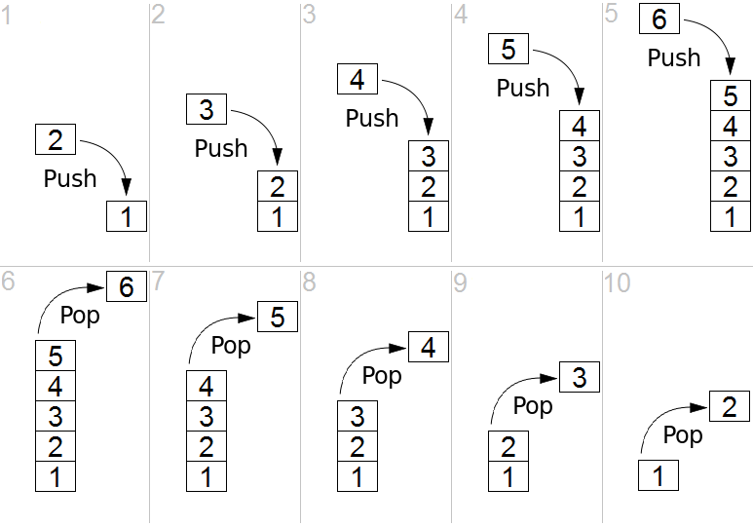
Recap: Stack
A “last in first out” (LIFO) data structure
We saw how to implement it using arrays
Figure: www.faceprep.in

Slide 5
Implementing stack using Linked List
head
2
1
-2
NULL
Push 4,8 in stack: insert_front(4, head);
insert_front(8, head);
head
8
4
2
1
-2
NULL
Pop from stack: val = head->data;
delete(head,NULL);
head
4
2
1
-2
NULL
isEmpty function: return !head ;
Notes:
- constant-time operations in a stack with a linked-list.

Slide 6
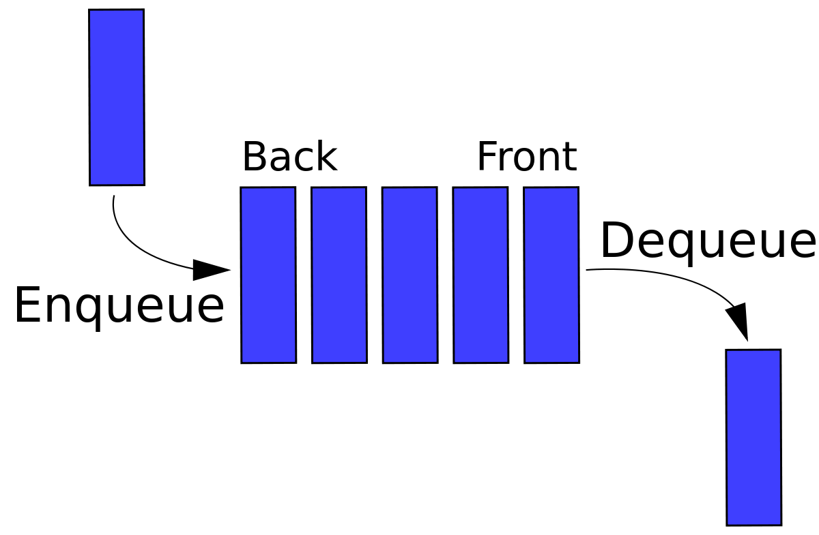
Queue
A linear data structure where addition happens at one end (`back') and deletion happens at the other end (`front')
First-in-first-out (FIFO)
Only the element at the front of the queue is accessible at any point of time
Operations:
Enqueue: Add element to the back
Dequeue: Remove element from the front
IsEmpty: Checks whether the queue is empty or not.
Just like stacks, we can implement a queue using arrays or using linked lists
Queue using arrays is easy but somewhat unnatural to implement (e.g., requires moving elements by one location forward after each dequeue operation)

Slide 7
Queue using Linked List
tail
head
2
1
-2
NULL
Enqueue 4: //make a node pnew with data=4
insert_after_node(tail, pnew);
tail
head
2
1
-2
4
NULL
Dequeue: val = head->data;
delete(head,NULL);
tail
head
1
-2
4
NULL
isEmpty function: return !head ;
Notes:
- constant-time operations in a queue with a doubly-linked-list.

Slide 8

root
Binary Tree
4
1
7
NULL
-1
3
13
NULL
NULL
NULL
NULL
NULL
NULL
(i) pointer to left child node
(ii)
data
(iii) pointer to right child node
Each node has 3 fields
Defining Binary Tree and declaring it
Three types of nodes
Root node
Internal nodes
Leaf nodes (left and right subtrees are NULL)
typedef struct _btnode *Btree;
struct _btnode {
int data;
Btree left;
Btree right;
};
Btree root;
Notes:
Discuss the efficiency of search, if the data is kept sorted.
A very practical data structure!

Slide 9
Building a Binary Tree
Given some numbers, we can build a binary tree with each number being at one of the nodes (internal nodes or leaf nodes)
Many ways to build the tree
How we build it depends on how we want to organize the numbers in this tree. But in general
Decide which number will be at the root node, use a structure to store the number and pointers (initially NULL) to left and right subtrees
Send each subsequent number along the left or right branch

Slide 10
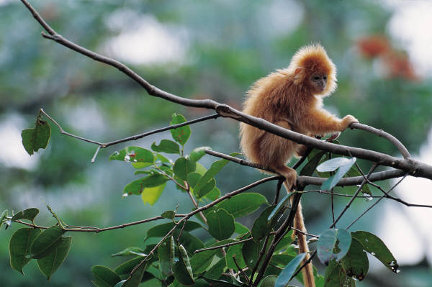
Traversing a Binary Tree
We won’t discuss building the binary tree. Suppose we are given an already built tree
Traversal: Visit each node in the binary tree exactly once
Easy to traverse recursively
Three common ways of visit
inorder: left, root, right
preorder: root, left, right
postorder: left, right, root

Slide 11
Inorder Traversal
root
4
1
7
NULL
-1
3
13
NULL
NULL
NULL
NULL
NULL
NULL
void inorder(tree t)
{
if (t == NULL) return;
inorder(t->left);
printf(“%d ”, t->data);
inorder(t->right);
}
Result
-1
1
3
4
7
13
Notes:
Discuss the efficiency of search, if the data is kept sorted.
A very practical data structure!

Slide 12
Preorder Traversal
root
4
1
7
NULL
-1
3
13
NULL
NULL
NULL
NULL
NULL
NULL
void preorder(tree t)
{
if (t == NULL) return;
printf(“%d ”, t->data);
preorder(t->left);
preorder(t->right);
}
Result
4
1
-1
3
7
13
Notes:
Discuss the efficiency of search, if the data is kept sorted.
A very practical data structure!

Slide 13
Postorder Traversal
root
4
1
7
NULL
-1
3
13
NULL
NULL
NULL
NULL
NULL
NULL
void postorder(tree t)
{
if (t == NULL) return;
postorder(t->left);
postorder(t->right);
printf(“%d “, t->data);
}
Result
-1
3
1
13
7
4
Notes:
Discuss the efficiency of search, if the data is kept sorted.
A very practical data structure!

Slide 14
Dynamic Programming
Notes:
Discuss the efficiency of search, if the data is kept sorted.
A very practical data structure!

Slide 15


A Motivating Problems: Coin Collection
You have an n x n grid.
Each cell has certain number of coins.
Grid cells are indexed by (i,j),
0 <= i,j <= n-1
For example, here is a 3x3 grid of coins:
 | 0 | 1 | 2
0 | 5 | 8 | 2
1 | 3 | 6 | 9
2 | 10 | 15 | 2

Slide 16
Coin Collection: Problem Statement
 | 0 | 1 | 2
0 | 5 | 8 | 2
1 | 3 | 6 | 9
2 | 10 | 15 | 2
You have to go from cell (0, 0) to (n-1, n-1).
Whenever you pass through a cell, you collect all the coins in that cell.
You can only move right or down from your current cell.
Goal: Collect the maximum number of coins.

Slide 17
Consider the example grid
5 | 8 | 2
3 | 6 | 9
10 | 15 | 2
There are many ways to go from (0,0) to (n-1,n-1)
5 | 8 | 2
3 | 6 | 9
10 | 15 | 2
5 | 8 | 2
3 | 6 | 9
10 | 15 | 2
5 | 8 | 2
3 | 6 | 9
10 | 15 | 2
Total = 35
Total = 25
Total = 31
5 | 8 | 2
3 | 6 | 9
10 | 15 | 2
5 | 8 | 2
3 | 6 | 9
10 | 15 | 2
5 | 8 | 2
3 | 6 | 9
10 | 15 | 2
Total = 30
Total = 26
Total = 36
Max = 36

Slide 18
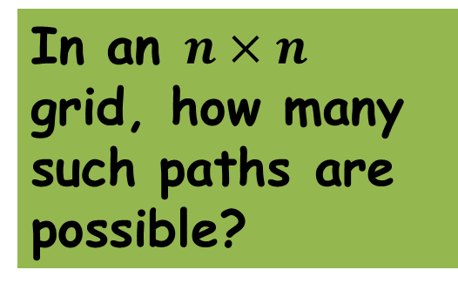
Building a Solution
We cannot afford to check every possible path (using brute force approach) and find the maximum.
Why?
Too many paths
(2n choose n) actually which
is bigger than even 2^n ☹
Instead we will iteratively try to build a solution.
In an $n×n$ grid, how many such paths are possible?

Slide 19
Solution Idea
Consider a portion of
the matrix
What is the maximum number of coins that I can collect when I reach the brown cell?
This number depends only on the maximum number of coins that I can collect when I reach the two green cells!
Why? Because I can only come to the blue cell via one of the two green cells.

Slide 20
Solution Idea
Max-coins (browncell) =
max(Max-coins (greencell-1),
Max-coins (greencell-2))
+ No. of coins (browncell))

Slide 21

Solution Idea
Let a(i,j) be the number of coins in cell (i,j)
Let coin(i,j) be the maximum number of coins collected when travelling from (0,0) to (i,j).
Then,
coin(i,j) = max(coin(i,j-1), coin(i-1,j)) + a(i,j)
Great. Seems like I can try recursion to solve this
Sure but let’s use a non-recursive way (“dynamic programming” to solve the above recurrence which will work too. Try the recursive approach at home ☺

Slide 22
A Non-recursive Implementation
Use an additional two dimensional array, whose (i,j)-th cell will store the maximum number of coins collected when travelling from (0,0) to (i,j).
Fill this array one row at a time, from left to right.
When the array is completely filled, return the (n-1, n-1)-th element.

Slide 23
Implementation: Boundary Cases
To fill a cell of this array, we need to know the information of the cell above and to the left of the cell.
What about elements in the top most row and left most column?
Cell in top row: no cell above
Cell in leftmost column: no cell on left
Before starting with the other elements, we will fill these first.

Slide 24
Boundary cases
Unique path for cells on the boundary.
Add entries along the arrows.
Then fill the rest of the matrix.

Slide 25
Comparison
We had two strategies:
Brute force (required more than 2^n operations)
Dynamic programming (at most 3-4 operations per cell and n^2 cells)
n | 2 | 5 | 8 | 15 | 20
BF(> 2^n) | 4 | 32 | 128 | 32768 | 1048576
DP(< 4 n^2) | 16 | 100 | 256 | 900 | 1600

Slide 26
int max(int a, int b){
if (a>b) return a;
else return b;
}
int main(){
int m[100][100],i,j,n;
scanf("%d", &n);
for (i=0; i<n; i++)
for (j=0; j<n; j++)
scanf("%d", &m[i][j]);
printf("%d\n", coin_collect(m,n));
return 0;
}

Slide 27
int coin_collect(int a[][100], int n){
int i,j, coins[100][100];
coins[0][0] = a[0][0]; //initial cell
for (i=1; i<n; i++) //first row
coins[0][i] = coins[0][i-1] + a[0][i];
for (i=1; i<n; i++) //first column
coins[i][0] = coins[i-1][0] + a[i][0];
for (i=1; i<n; i++) //filling up the rest of the array
for (j=1; j<n; j++)
coins[i][j] = max(coins[i-1][j], coins[i][j-1])
+ a[i][j];
return coins[n-1][n-1]; //value of last cell
}

Slide 28
Dynamic programming (DP) vs Recursion
In DP, we start from the trivial sub-problem and move towards the bigger problem. In this process, it is guaranteed that the sub-problems are solved and their results stored before solving the bigger problems
DP is somewhat similar to recursion but in DP the results of the smaller subproblems are stored explicitly for easy access later on
Usually, anything that can be solved using DP can be solved using recursion and vice-versa
More details in later courses such as Data Structures and Algorithms

Slide 29
Next Week (after major quiz 2 on Monday..)
Algorithms for doing sorting
Analyzing time complexities of various algorithms

