Slide 1
ESC101: Fundamentals of Computing
Sorting (Wrap-up),
Hashing, File I/O
Piyush Rai

Slide 2

Recap: Quicksort - The Partition Technique
Given array $int a\left[N\right]$ and any element of the array $p$ (called pivot)
Create a new array $int b\left[N\right]$ which is arranged as follows $\left[elements of a≤p, p, elements of a≥p\right]$
The left and right halves not sorted yet (but can call quicksort on them again)
$𝒪$(N log N) complexity on average. No need to merge (unlike merge sort)
9
1
9
4
2
1
2
7
5
8
3
5
2
1
4
8
1
2
1
2
2
1
3
8
4
5
8
5
7
4
9
9

Slide 3

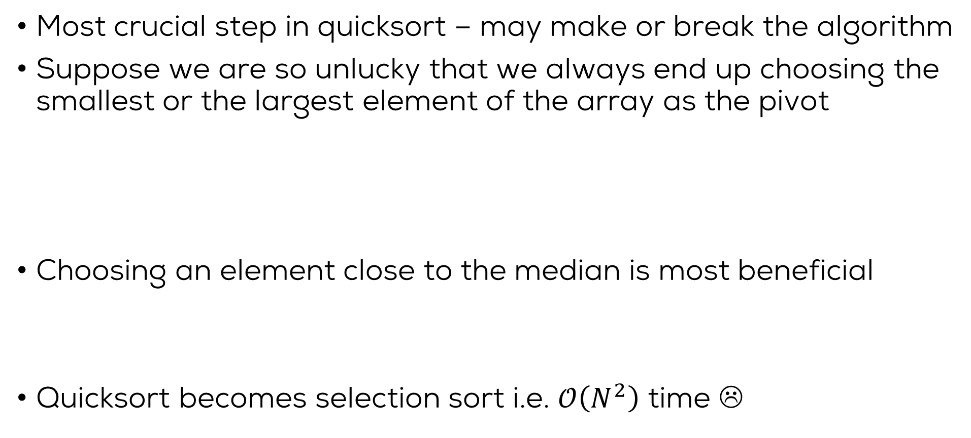
Choice of Pivot
Ironically, if the array is already sorted and we use end elements as pivots, then quicksort takes $𝒪\left(N^{2}\right)$ time ☹
Most crucial step in quicksort – may make or break the algorithm
Suppose we are so unlucky that we always end up choosing the smallest or the largest element of the array as the pivot
Choosing an element close to the median is most beneficial
Quicksort becomes selection sort i.e. $𝒪\left(N^{2}\right)$ time ☹
9
1
8
4
2
1
2
7
5
8
3
5
2
1
4
8
1
2
1
2
2
1
3
8
4
5
8
5
7
4
8
9

Slide 4
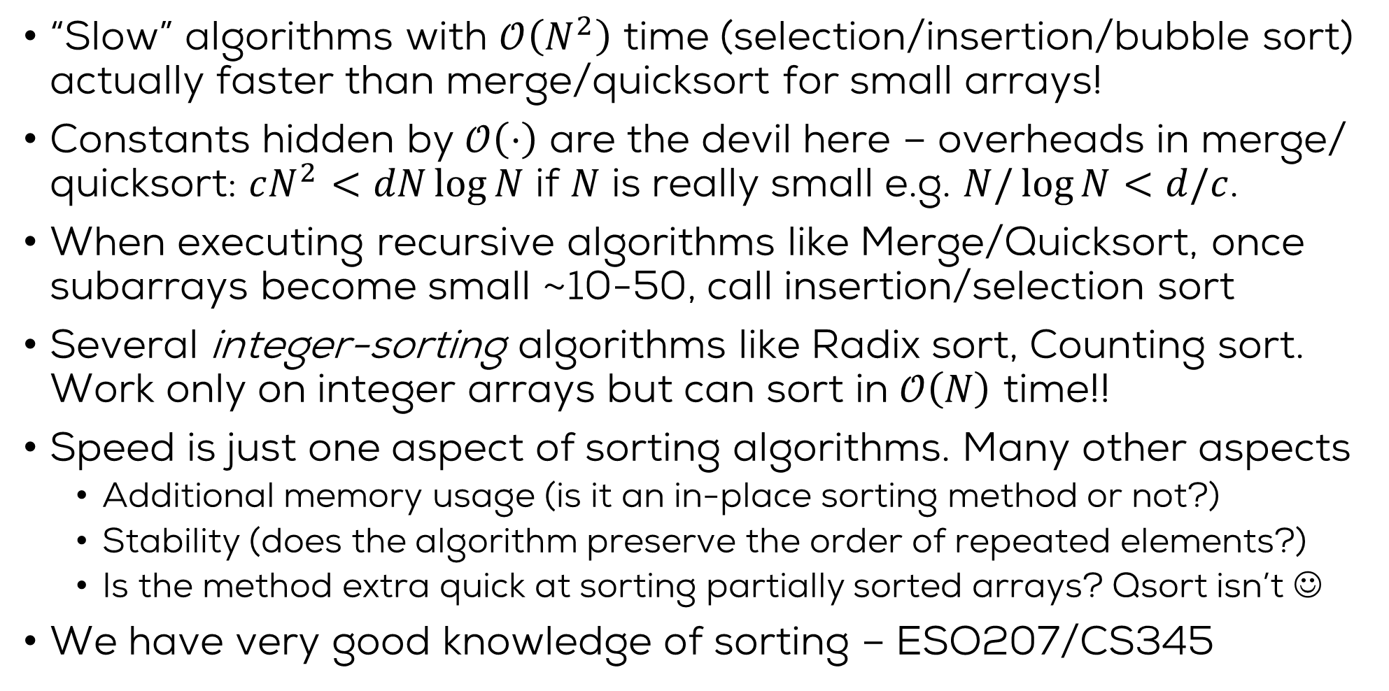
Some folklore wisdom
“Slow” algorithms with $𝒪\left(N^{2}\right)$ time (selection/insertion/bubble sort) actually faster than merge/quicksort for small arrays!
Constants hidden by $𝒪\left(⋅\right)$ are the devil here – overheads in merge/ quicksort: $cN^{2}<dN\log{N}$ if $N$ is really small e.g. $N/\log{N}<d/c$.
When executing recursive algorithms like Merge/Quicksort, once subarrays become small ~10-50, call insertion/selection sort
Several integer-sorting algorithms like Radix sort, Counting sort. Work only on integer arrays but can sort in $𝒪\left(N\right)$ time!!
Speed is just one aspect of sorting algorithms. Many other aspects
Additional memory usage (is it an in-place sorting method or not?)
Stability (does the algorithm preserve the order of repeated elements?)
Is the method extra quick at sorting partially sorted arrays? Qsort isn’t ☺
We have very good knowledge of sorting – ESO207/CS345

Slide 5
Search: Revisited

Slide 6

Hashing for Very Fast Search
Hashing is a method to search an element in an array in constant time
“Constant time” also denoted as O(1) – means time taken does not depend on number of elements N in the array (unlike like binary/brute force search)
Since we can search in constant time, can also update/delete in constant time
Basic idea: Use a “hash table” to store the elements
The hash table is just like an array
Index of each element to be stored is calculated using the element’s value
To search the element, compute its index and directly find it at that index
This can be done in constant time (if index can be found in constant time) ☺

Slide 7

Hash Function
Index is computed using a hash function
Hash function uses the element’s value to compute its index
An example of a simple hash function is the modulo operator
index = value % number_of_slots
Value | Index = Value % No. of Slots
26 | 26 % 10 = 6
70 | 70 % 10 = 0
18 | 18 % 10 = 8
31 | 31 % 10 = 1
54 | 54 % 10 = 4
93 | 93 % 10 = 3
To search for an element, say 93, we simply apply
the hash function again: 93%10 = 3
and can find the index of this element in constant time ☺

Slide 8
A potential problem - collisions
What if more than multiple elements get mapped to the same index?
Yes, a very real problem. ☺

Slide 9
A potential problem - collisions
What if more than multiple elements get mapped to the same index?
Yes, a very real problem. ☺
Consider the previous hash table
Suppose we wish to insert 60. Its index = 60%10 = 0 => clash with 70 ☹
Some hash functions are good in the sense that the indices they generate are uniformly distributed (so less collision - desirable for good hash functions)
Despite that, we may still have collisions and we need to handle that

Slide 10
Linear Probing
Linear Probing is a simple technique to handle collisions
The idea: Keep searching for the “next available” free index
Assume the first index P that we get is not free. Then compute
If the new index P is free, store the element there, else repeat the above
Suppose we wish to insert 60 in this table, 60%10 = 0, but 0 if not free
Try P = (P+1)%10 = (0+1)%10 = 1, but index 1 is also not free (31 there)
Let’s try P = (P+1)%10 = (1+1)%10 = 2. Index 2 is free. Store 60 at that index
When searching for 60, we won’t find it in first attempt but in third attempt
P = (P+1) % number_of_slots

Slide 11
Hashing: Some final thoughts..
A very very useful technique
We have only scratched the surface – the basic idea of hashing
More advanced hashing methods exist
Better methods to avoid collisions
Better and cheap to compute hashing functions
Discussion of these is beyond the scope of ESC101

Slide 12
File Input/Output

Slide 13
Files
What is a file?
Collection of bytes stored on secondary storage like hard disks (not RAM which is primary storage).
Any addressable part of the file system in an operating system can be a file.
includes such strange things as /dev/null (nothing), /dev/usb (USB port), /dev/audio (speakers), and of course, files that a user creates (/home/don/input.txt, /home/don/Esc101/lab12.c)

Slide 14
File Access
3 files are always connected to a C program :
stdin : the standard input, from where scanf, getchar(), gets() etc. read input from
stdout : the standard output, to where printf(), putchar(), puts() etc. output to.
stderr : standard error console.

Slide 15
File handling in C
Open the file for reading/writing etc.: fopen
return a file pointer
pointer points to an internal structure containing information about the file:
location of a file
the current position being read in the file, etc.
FILE* fopen (char *name, char *mode)
Read/Write to the file
int fscanf(FILE *fp, char *format, …)
int fprintf(FILE *fp, char *format, …)
int fputs(const char* str, FILE *fp)
Close the File.
int fclose(FILE *fp)
Compared to scanf and printf – a new (first) argument fp is added

Slide 16
Opening Files
FILE* fopen (char *name, char *mode)
The first argument is the name of the file
can be given in short form (e.g. “inputfile”) or the full path name (e.g. “/home/don/inputfile”)
The second argument is the mode in which we want to open the file. Common modes include:
“r” : read-only. Any write to the file will fail. File must exist.
“w” : write. The first write happens at the beginning of the file, by default. Thus, may overwrite the current content. A new file is created if it does not exist.
“a” : append. The first write is to the end of the current content. File is created if it does not exist.

Slide 17
Opening Files
If successful, fopen returns a file pointer – this is later used for fprintf, fscanf etc.
If unsuccessful, fopen returns a NULL.
It is a good idea to check for errors (e.g. Opening a file on a CDROM using “w” mode etc.)
Closing Files
An open file must be closed after last use
allows reuse of FILE* resources
flushing of buffered data (to actually write!)

Slide 18
File I/O: Example
Write a program that will take two filenames, and print contents to the standard output. The contents of the first file should be printed first, and then the contents of the second.
The algorithm:
Read the file names.
Open file 1. If open failed, we exit
Print the contents of file 1 to stdout
Close file 1
Open file 2. If open failed, we exit
Print the contents of file 2 to stdout
Close file 2

Slide 19
int main()
{
FILE *fp; char filename1[128], filename2[128];
scanf(“%s”, filename1);
scanf(“%s”, filename2);
fp = fopen( filename1, "r" );
if(fp == NULL) {
fprintf(stderr, "Opening File %s failed\n", filename1);
return -1;
}
copy_file(fp, stdout);
fclose(fp);
fp = fopen( filename2, "r" );
if (fp == NULL) {
fprintf(stderr, "Opening File %s failed\n", filename2);
return -1;
}
copy_file (fp, stdout);
fclose(fp);
return 0;
}

Slide 20
The Program: copy_file
void copy_file(FILE *fromfp, FILE *tofp)
{
char ch;
while ( !feof ( fromfp ) ) {
fscanf ( fromfp, "%c", &ch );
fprintf ( tofp, "%c", ch );
}
}

Slide 21
Some other file handling functions
int feof ( FILE* fp );
Checks whether the fp has reached EOF – that is, the EOF chracter has been encountered. If EOF is found, it returns nonzero. Otherwise, returns 0.
int ferror ( FILE *fp );
Checks whether the error indicator has been set for fp. (for example, write errors to the file.)

Slide 22
Some other file handling functions
int fseek(FILE *fp, long int offset,
int origin);
To set the current position associated with fp, to a new position = origin + offset.
Origin can be:
SEEK_SET: beginning of file
SEEK_CURR: current position of file pointer
SEEK_END: End of file
Offset is the number of bytes.
int ftell(FILE *fp)
Returns the current value of the position indicator of the stream.

Slide 23
Opening Files: More modes
There are other modes for opening files, as well.
“r+” : open a file for read and update. The file must be present.
“w+” : write/read. Create an empty file or overwrite an existing one.
“a+” : append/read. File is created if it doesn’t exist. The file position for reading is at the beginning, but output is appended to the end.

Slide 24
File I/O example
#include <stdio.h>
int main () {
FILE * fp = fopen("file.txt","w+");
fputs("This is tutorialspoint.com", fp);
fseek( fp, 7, SEEK_SET );
fputs(" C Programming Language", fp);
fclose(fp);
int c;
fp = fopen("file.txt","r");
while(1) {
c = fgetc(fp);
if( feof(fp) ) break;
printf("%c", c);
}
fclose(fp);
return 0;
}
This is C Programming Language

