Slide 1
ESC101: Fundamentals of Computing
Solving Numerical Problems using Programming, Conclusion
Piyush Rai

Slide 2
Plan for today
Methods for solving numerical problems, such as
Finding the (approximate) square root of a number
Finding the root (zero) of an arbitrary function
Both will be based on a generalization of the binary search method
Some concluding thoughts

Slide 3
Finding Square Roots
The Babylonian Method

Slide 4
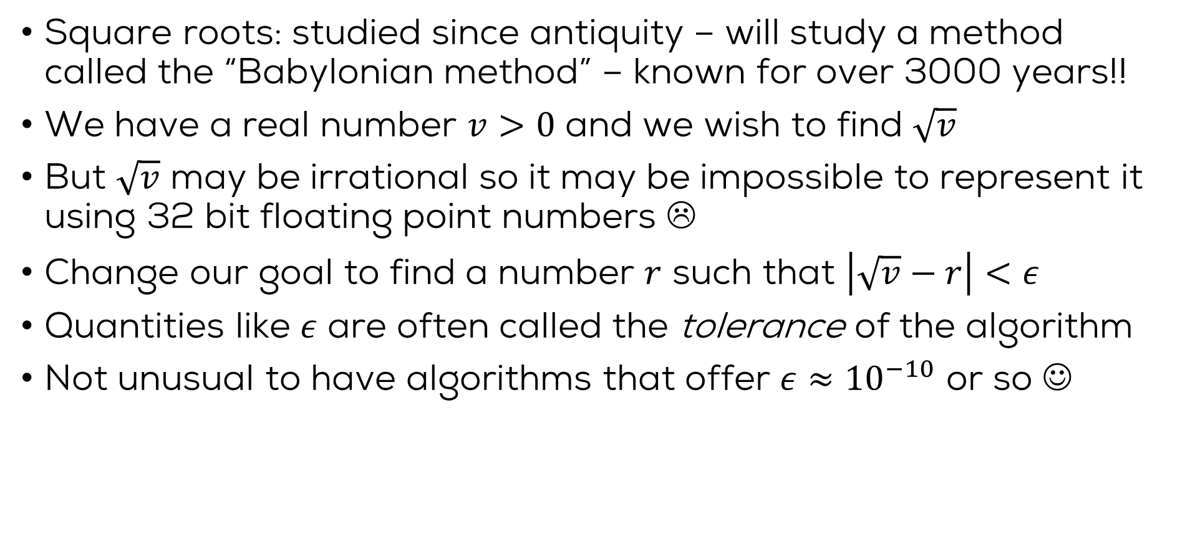
The trick of the Babylonians
Square roots: studied since antiquity – will study a method called the “Babylonian method” – known for over 3000 years!!
We have a real number $v>0$ and we wish to find $\sqrt{v}$
But $\sqrt{v}$ may be irrational so it may be impossible to represent it using 32 bit floating point numbers ☹
Change our goal to find a number $r$ such that $\left|\sqrt{v}−r\right|<ε$
Quantities like $ε$ are often called the tolerance of the algorithm
Not unusual to have algorithms that offer $ε≈{10}^{−10}$ or so ☺

Slide 5
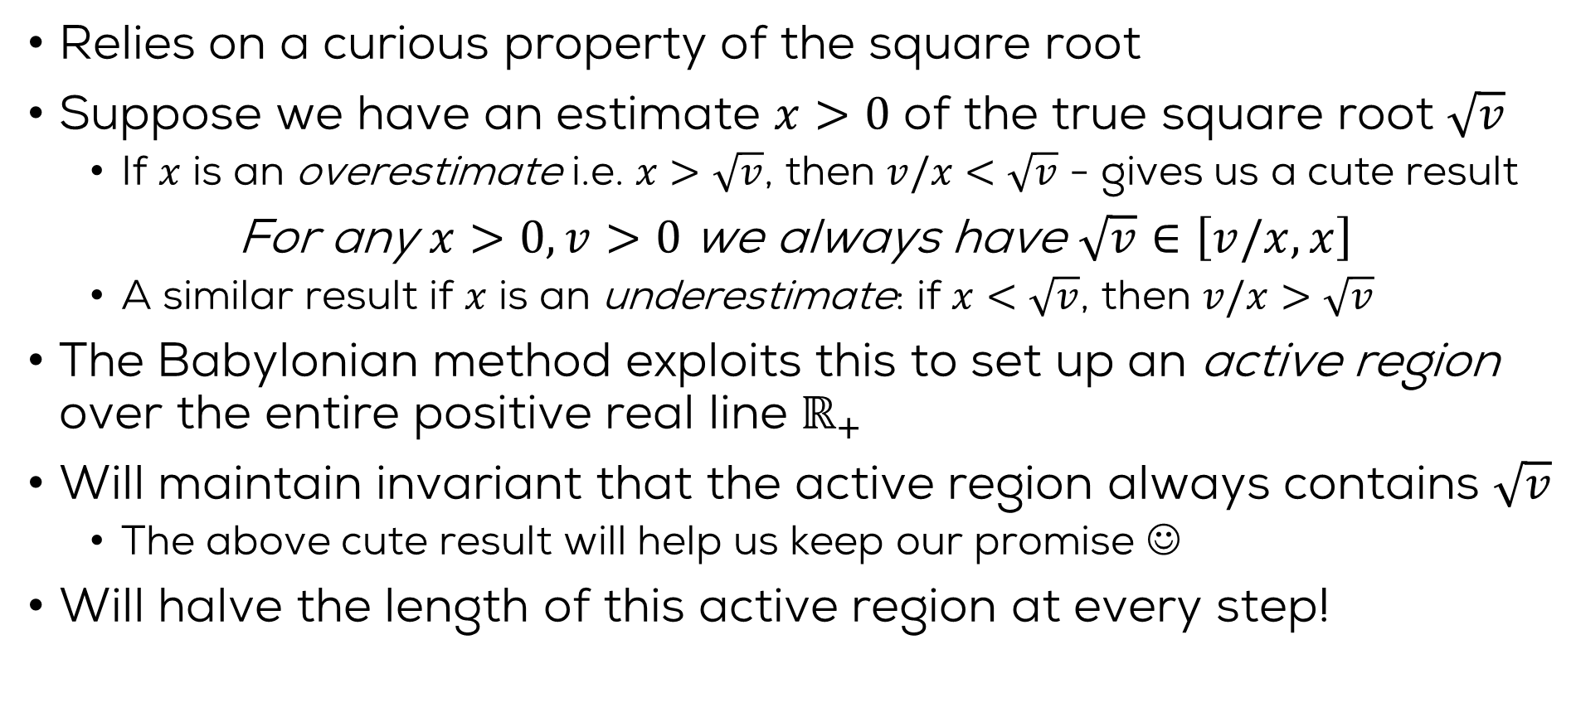
The trick of the Babylonians
Relies on a curious property of the square root
Suppose we have an estimate $x>0$ of the true square root $\sqrt{v}$
If $x$ is an overestimate i.e. $x>\sqrt{v}$, then $v/x<\sqrt{v}$ - gives us a cute result
For any $x>0,v>0$ we always have $\sqrt{v}∈\left[v/x,x\right]$
A similar result if $x$ is an underestimate: if $x<\sqrt{v}$, then $v/x>\sqrt{v}$
The Babylonian method exploits this to set up an active region over the entire positive real line $ℝ_{+}$
Will maintain invariant that the active region always contains $\sqrt{v}$
The above cute result will help us keep our promise ☺
Will halve the length of this active region at every step!

Slide 6


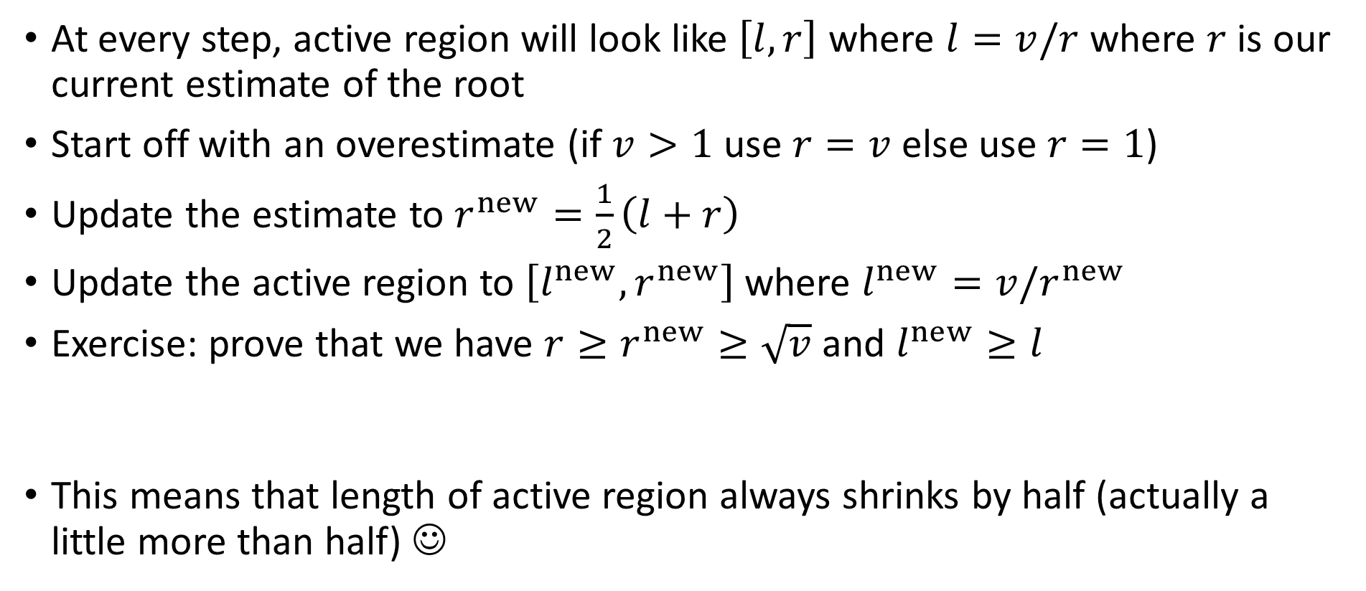



The Babylonian Method
$$v=16$$
1.88
3.08
5.19
8.5
3.86
4.13
3.997
4.002
1 2 3 4 5 6 7 8 9 10 11 12 13 14 15 16 17 18
At every step, active region will look like $\left[l,r\right]$ where $l=v/r$ where $r$ is our current estimate of the root
Start off with an overestimate (if $v>1$ use $r=v$ else use $r=1$)
Update the estimate to $r^{new}=\frac{1}{2}\left(l+r\right)$
Update the active region to $\left[l^{new},r^{new}\right]$ where $l^{new}=v/r^{new}$
Exercise: prove that we have $r≥r^{new}≥\sqrt{v}$ and $l^{new}≥l$
This means that length of active region always shrinks by half (actually a little more than half) ☺
$$l$$
$$l^{new}$$
$$r^{new}$$
$$r$$

Slide 7
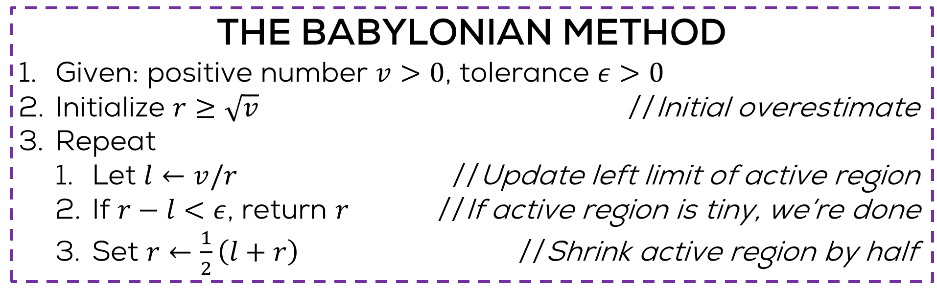
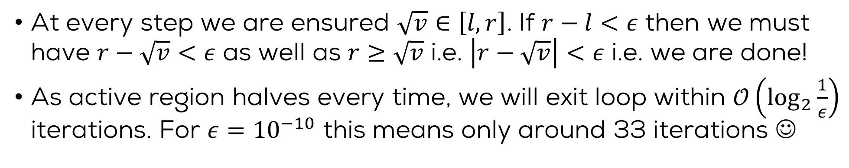

The Babylonian Method
THE BABYLONIAN METHOD
Given: positive number $v>0$, tolerance $ε>0$
Initialize $r≥\sqrt{v}$ //Initial overestimate
Repeat
Let $l←v/r$ //Update left limit of active region
If $r−l<ε$, return $r$ //If active region is tiny, we’re done
Set $r←\frac{1}{2}\left(l+r\right)$ //Shrink active region by half
Several algorithms exist for finding square roots. If you are interested, check out www.youtube.com/watch?v=Bwt5EZEb1Ns
Actually, a more careful analysis can show that the method takes only $𝒪\left(\log{\log{\frac{1}{ε}}}\right)$ iterations – wow!
At every step we are ensured $\sqrt{v}∈\left[l,r\right]$. If $r−l<ε$ then we must have $r−\sqrt{v}<ε$ as well as $r≥\sqrt{v}$ i.e. $\left|r−\sqrt{v}\right|<ε$ i.e. we are done!
As active region halves every time, we will exit loop within $𝒪\left(\log_{2}{\frac{1}{ε}}\right)$ iterations. For $ε={10}^{−10}$ this means only around 33 iterations ☺

Slide 8
Finding Roots of Functions
The Bisection Method

Slide 9
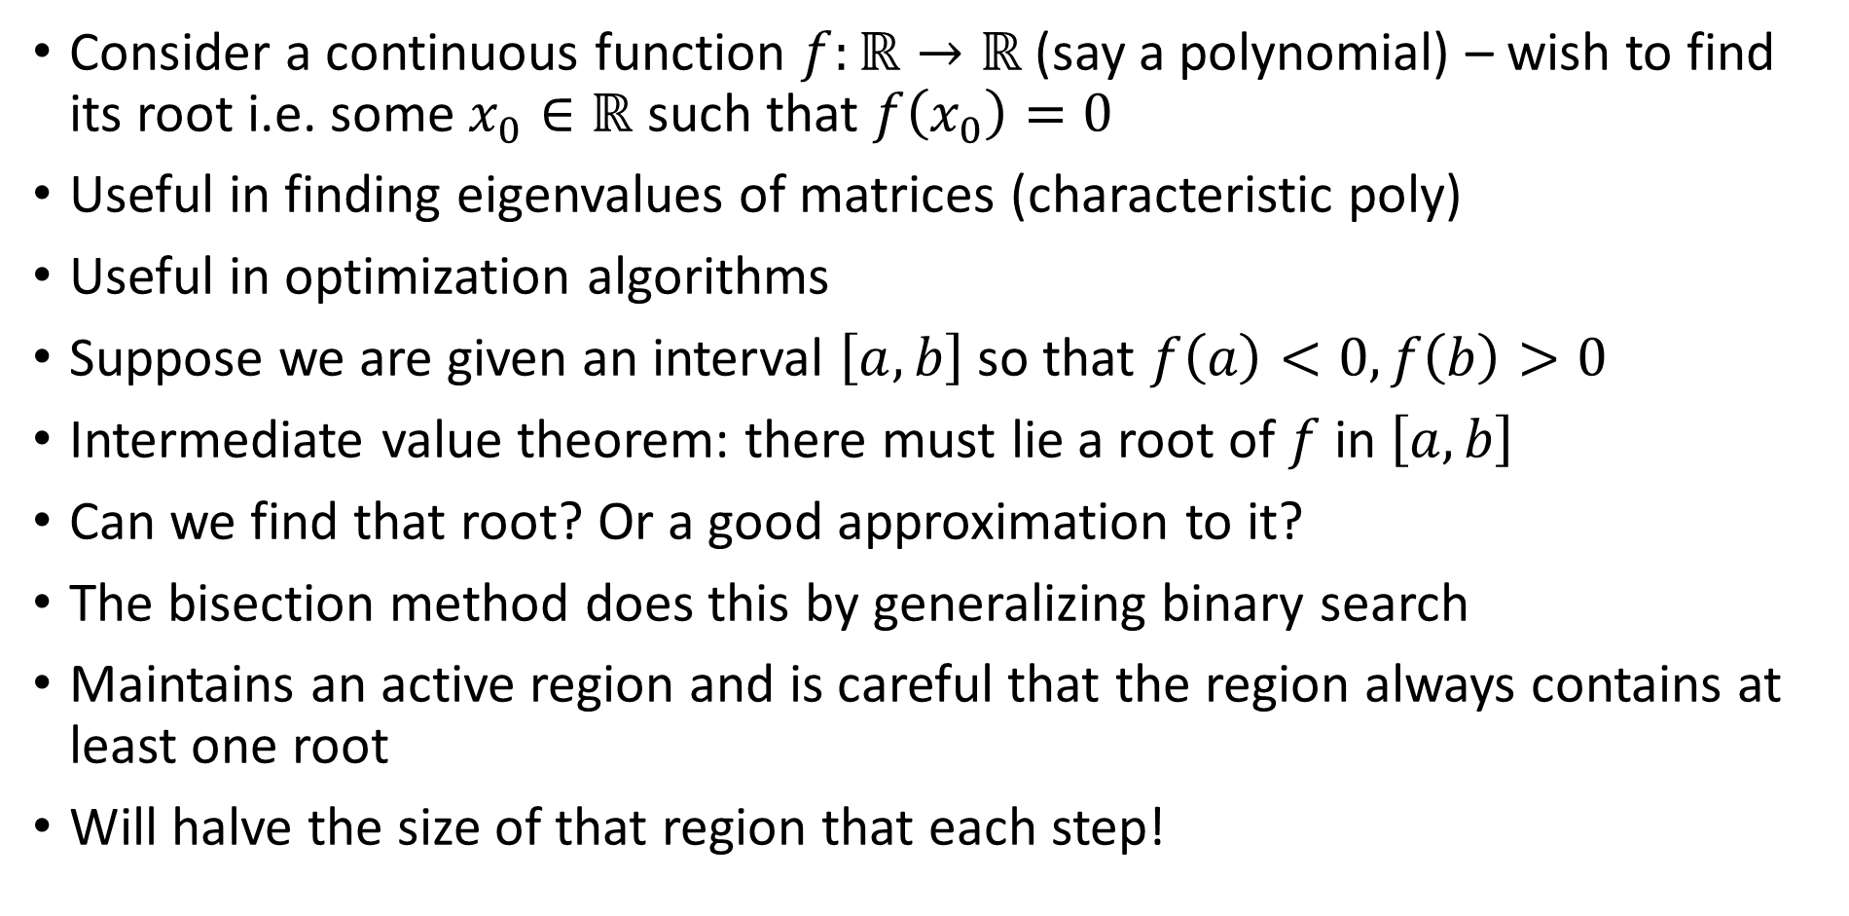
The Bisection Method
Consider a continuous function $f:ℝ→ℝ$ (say a polynomial) – wish to find its root i.e. some $x_{0}∈ℝ$ such that $f\left(x_{0}\right)=0$
Useful in finding eigenvalues of matrices (characteristic poly)
Useful in optimization algorithms
Suppose we are given an interval $\left[a,b\right]$ so that $f\left(a\right)<0,f\left(b\right)>0$
Intermediate value theorem: there must lie a root of $f$ in $\left[a,b\right]$
Can we find that root? Or a good approximation to it?
The bisection method does this by generalizing binary search
Maintains an active region and is careful that the region always contains at least one root
Will halve the size of that region that each step!
Okay so suppose we want to find any one of those many roots ☺
Wait – this only tells us that there exist an odd number of roots in this interval – there may be more than one root

Slide 10

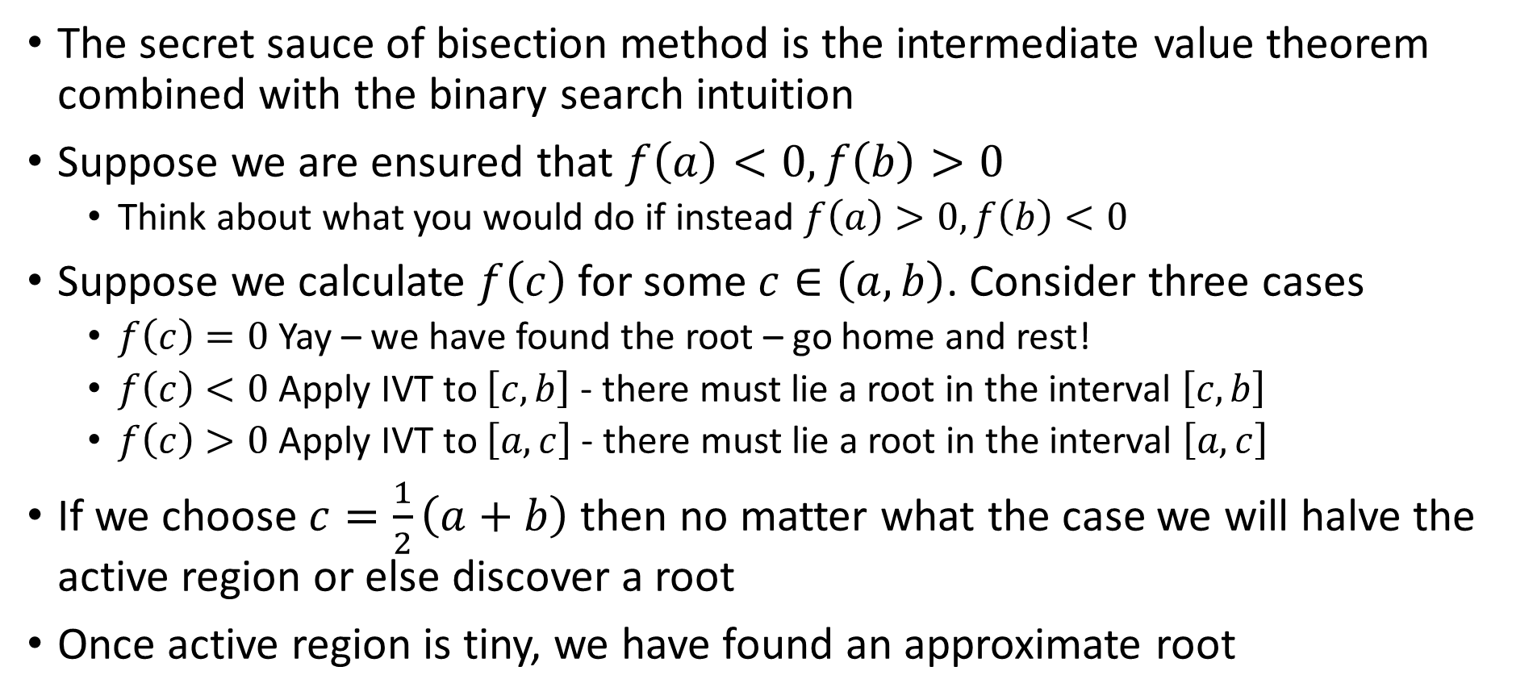
The Bisection Method
The secret sauce of bisection method is the intermediate value theorem combined with the binary search intuition
Suppose we are ensured that $f\left(a\right)<0,f\left(b\right)>0$
Think about what you would do if instead $f\left(a\right)>0,f\left(b\right)<0$
Suppose we calculate $f\left(c\right)$ for some $c∈\left(a,b\right)$. Consider three cases
$f\left(c\right)=0$ Yay – we have found the root – go home and rest!
$f\left(c\right)<0$ Apply IVT to $\left[c,b\right]$ - there must lie a root in the interval $\left[c,b\right]$
$f\left(c\right)>0$ Apply IVT to $\left[a,c\right]$ - there must lie a root in the interval $\left[a,c\right]$
If we choose $c=\frac{1}{2}\left(a+b\right)$ then no matter what the case we will halve the active region or else discover a root
Once active region is tiny, we have found an approximate root
Actually all this tells us that $\left[c,b\right]$ contains an odd number of roots and $\left[a,c\right]$ contains an even (possibly 0) number of roots

Slide 11

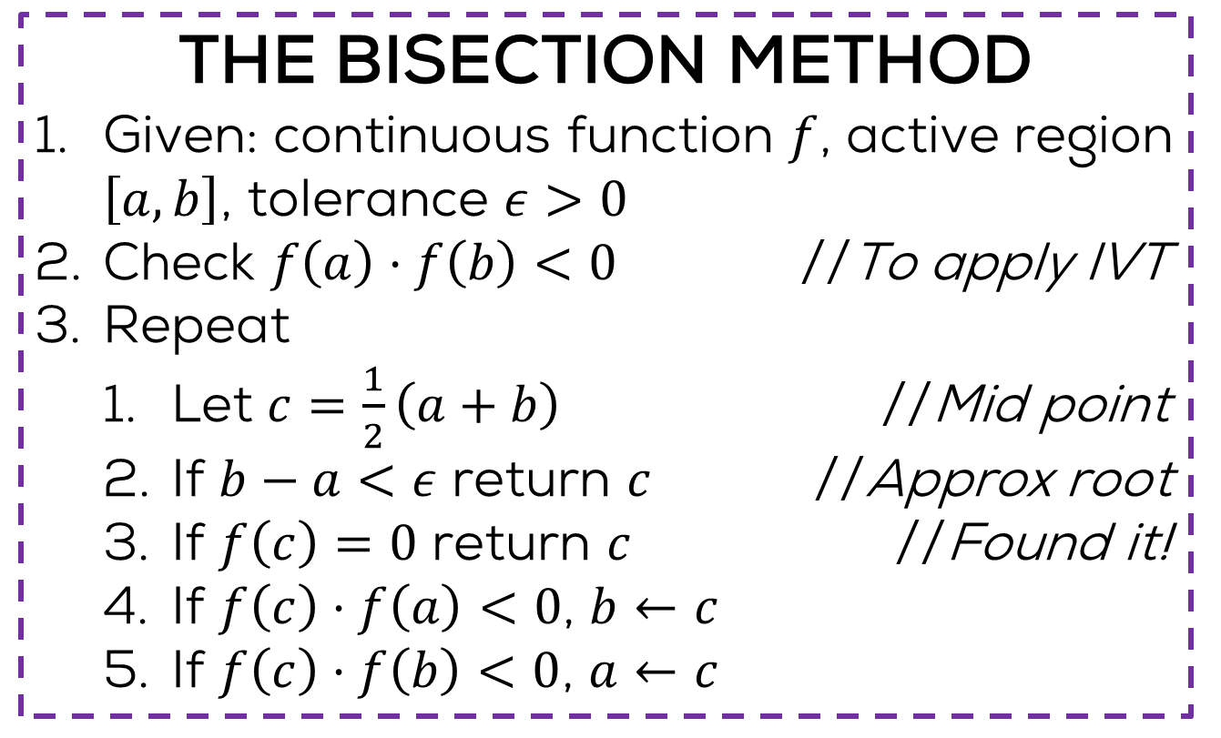

The Bisection Method
THE BISECTION METHOD
Given: continuous function $f$, active region $\left[a,b\right]$, tolerance $ε>0$
Check $f\left(a\right)⋅f\left(b\right)<0$ //To apply IVT
Repeat
Let $c=\frac{1}{2}\left(a+b\right)$ //Mid point
If $b−a<ε$ return $c$ //Approx root
If $f\left(c\right)=0$ return $c$ //Found it!
If $f\left(c\right)⋅f\left(a\right)<0$, $b←c$
If $f\left(c\right)⋅f\left(b\right)<0$, $a←c$
Some of these intuitions extend to higher dimensions. If you are interested, check out www.youtube.com/watch?v=b7FxPsqfkOY
Can you show that this method stops in $𝒪\left(\log{\frac{1}{ε}}\right)$ iterations?
Can you find the square root of numbers using this method? Hint $f\left(x\right)=x^{2}−v$

Slide 12
Finding Roots of Functions
The Newton Raphson Method

Slide 13

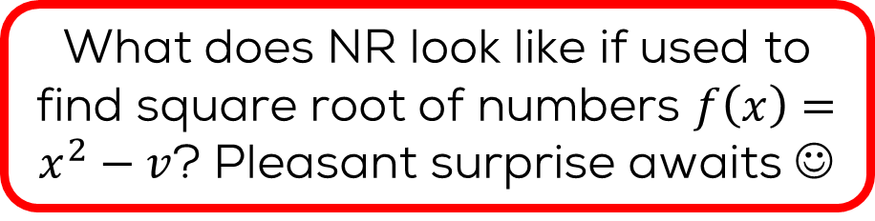


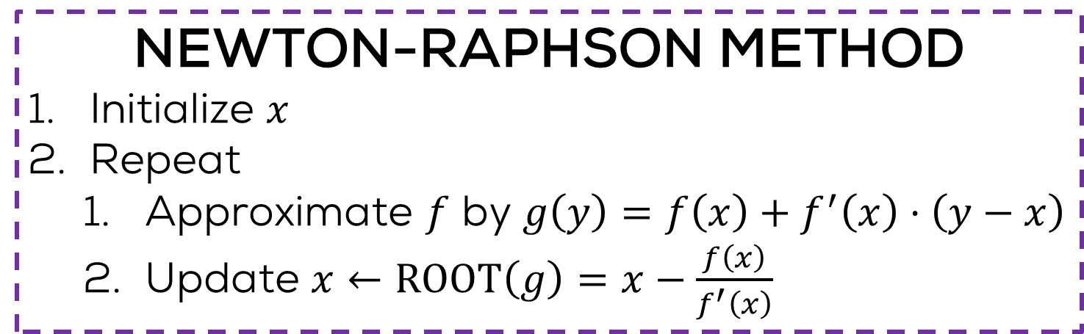
The Newton-Raphson Method
Finding roots of linear functions is easy $f\left(x\right)=ax+b$, $x_{0}=\frac{−b}{a}$
But my function is nonlinear ☹
Take a linear approximation to it
Also check out the secant method and the Regula Falsi method (do not require derivative calculation)
What does NR look like if used to find square root of numbers $f\left(x\right)=x^{2}−v$? Pleasant surprise awaits ☺
How does one do that?
Many ways e.g. Taylor’s expansion
NEWTON-RAPHSON METHOD
Initialize $x$
Repeat
Approximate $f$ by $g\left(y\right)=f\left(x\right)+f^{′}\left(x\right)⋅\left(y−x\right)$
Update $x←\text{ROOT}\left(g\right)=x−\frac{f\left(x\right)}{f^{′}\left(x\right)}$
No guarantees in general. Depends a lot on initialization
Tangent to $f$ at $x$
Where tangent intersects x axis

Slide 14
Wrapping up ESC101..
Some concluding notes..

Slide 15
Working in Linux Environment
Can store your stuff in files
File names have extensions telling us what kind of a file it is
Files that store C programs often have names that end with .c for example hello.c, pointers.c etc
Files that store images often have names that end with .jpg or .png or .bmp
Files that store videos often have names that end with .avi or .mp4
Files that store PHP programs (another language) end with .php
Files that store SQL commands (another language) end with .sql
.c, .jpg, .avi, .php are the extensions that tell us what that file stores
Files arranged in folders/directories
Directories can contain files as well as other directories
Directories are used to organize your files neatly

Slide 16
Moving Around Directories
pwd (print working directory) – print name of the directory you are currently sitting inside
ls (list) – print all files and directories inside current directory
ls -al (list all with nice list format) – same as ls but with more details and a more neat format
cd <dirname> (change directory) – move to the directory with name dirname
cd .. (change to parent directory) – move to the directory that contains the current directory
cd ~ (jump to home directory) – jump directly to home directory no matter what the current working directory

Slide 17
Directories and Files
mkdir <newdir> (make directory) create a directory with name newdir. Make sure a directory with this name does not already exist
rmdir <olddir> (remove directory) delete the directory with name olddir. Make sure olddir exists and is empty (i.e. does not contain any files or folders)
You can create .c files using your favorite editor e.g. gedit, vi, emacs, vim, nano, kate etc
rm <filename> remove the file with name filename
rm –r <dirname> remove the directory dirname (and all that it contains), recursively, even if the directory is not empty. WARNING: use with care.

Slide 18
Creating and Running C programs
Write C programs exactly as we did on Prutor
Have to work with the gcc compiler now (unless you install the clang compiler yourself)
Warning: gcc does not give as helpful warning messages
Some differences may exist between gcc and clang
Major difference: need to give input after running code (in Prutor, input was given before executing code)
Your microprocessor cannot run C programs directly. It can only run what is known as an executable file

Slide 19
Compilation and Execution
Suppose your C program is in the file test.c
To compile the C program type gcc test.c
It will create an executable file called a.out
Can execute that file by typing ./a.out
If you want to give the executable a nice name, use the following command gcc –o myname test.c
An executable called myname will get created
Can execute that file by typing ./myname

Slide 20
C files and Executable Files
#include <stdio.h>
int main(){
int a = 2, b = 3, c;
c = a + b;
printf("%d\n", c);
return 0;
}
400526: 55 push %rbp
400527: 48 89 e5 mov %rsp,%rbp
40052a: 48 83 ec 10 sub $0x10,%rsp
40052e: c7 45 f4 02 00 00 00 movl $0x2,-0xc(%rbp) ; Mr C is doing a = 2 here (in hexadecimal)
400535: c7 45 f8 03 00 00 00 movl $0x3,-0x8(%rbp) ; Mr C is doing b = 3 here (in hexadecimal)
40053c: 8b 55 f4 mov -0xc(%rbp),%edx
40053f: 8b 45 f8 mov -0x8(%rbp),%eax
400542: 01 d0 add %edx,%eax ; Mr C is doing c = a + b here
400544: 89 45 fc mov %eax,-0x4(%rbp)
400547: 8b 45 fc mov -0x4(%rbp),%eax
40054a: 89 c6 mov %eax,%esi
40054c: bf f4 05 40 00 mov $0x4005f4,%edi
400551: b8 00 00 00 00 mov $0x0,%eax
400556: e8 a5 fe ff ff callq 400400 <printf@plt> ; Mr C is calling the printf function here
40055b: b8 00 00 00 00 mov $0x0,%eax
400560: c9 leaveq
400561: c3 retq
400562: 66 2e 0f 1f 84 00 00 nopw %cs:0x0(%rax,%rax,1)
400569: 00 00 00
40056c: 0f 1f 40 00 nopl 0x0(%rax)
Your microprocessor cannot execute a C program so I convert your C program to an executable

Slide 21
Linux and Windows
On Linux systems, gcc compiler will always be available
Can install clang too if you own that machine
On Windows, can install gcc via the Cygwin or the MinGW routes
https://sourceforge.net/projects/tdm-gcc/
Can install Clang on Windows too
http://releases.llvm.org/download.html
However, easier to install Visual Studio on Windows
https://visualstudio.microsoft.com/vs/community/

Slide 22
Explore More..
Interpreted languages such as Python (very popular nowadays)
Object-oriented programming (e.g., C++, Java)

Slide 23
Pursue your Interest
If interested in problem solving – take up competitive programming
https://www.hackerrank.com/
https://leetcode.com/
https://www.codechef.com/
https://www.geeksforgeeks.org/
http://codeforces.com/
Many application areas require heavy programming
Fluid dynamics (AE, CHE), Particle accelerators (PHY), Data Analysis (MTH, CSE), Wireless communications (EE), Optimization (IME, ECO, MTH, CSE)
Several applications within CSE
Architecture, Operating Systems, Compilers, Theory, Algorithm Design, Databases, Web Programming, Machine Learning and AI, and many more

Slide 24
No More Prutor after a few days
Prutor logins for all of us will be disabled a few days after the grades are declared – will warn you beforehand!
New logins will be created for your friends in A batch
Need to start using other compilers like gcc
Can keep using Clang as well (need to install it though) – gcc is always available on Linux computers
Windows computers need to install a compiler (VS etc)

Slide 25
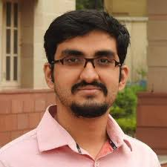

















Acknowledgements – Tutors

Slide 26
Acknowledgements – TAs
THEORY TAs
Naman Jain
Raghav Garg
Siddhant Sarkar
Sarthak Agrawal
Saisha Narang
Saiteja Utpala
Putrevu Venkata Sai Charan
Jenil Mewada
Sharad Shukla
Ankit Sharma
Harikrishnan Balagopal
Rahul Kumar Singh
THEORY TAs
Saurabh Kumar
Sunil Pratap Singh
Vikash Kumar
Apoorva Jain
Pratik Kumar
Aakash
Akavarapu Venkata Satya Durga Sai Mahesh
Yashika Verma
Rahul Ninaji Pakhare
Neelu Shivprakash Kalani
Shiwam Singh
Anuj Saini
Anuj Mishra
Sristi Jaiswal
LAB TAs
Aakrati Jain
Aayush Rajput
Abhay Raj Singh Yadav
Abir Mukherjee
Aditya Narhari Kadu
Akhil S
Amit Negi
Amiya Tripathi
Anupam Agrawal
Anuraag Kansara
Anurag Maithani
Ashish Kumar
LAB TAs
Ashish Ranjan Yadav
Prashant Nagabhai Piprotar
Avesh Kumar Agrawal
Ayush Nagal
Banwari Lal
Chayan Dhaddha
Kumud Gupta
Fahad Mohmedisuf Shaikh
Hemant Sadana
Kagitha Gopi
Kuldeep Kumar Solanki
Kusum Bunkar
Abhishek Jaiswal

Slide 27
Acknowledgements – TAs
LAB TAs
Karishma Satchidanand Laud
Lavlesh Mishra
Deepak Mohan
Deepesh Chaudhari
Dheeraj Kumar Pant
Don Ignatius Cyriac
Drashti Pathak
Ekansh Kushwah
Harshad Suresh Narayane
Harshal Haresh Rohit
LAB TAs
Jay Raj Singh
Nancy Rameshchandra Garala
Debdan Bhandari
Manikant Singh
Nilesh Uddhav Kothavade
Manish Patel
Mayank
Jaydeep Meda
Naveen M V
Chaman Jangra
Niraj Ramagyan Singh
LAB TAs
Niravkumar Hasmukhbhai Panchal
Paramanand Kumar
Pathare Chaitanya Sanjay
Prakhyat Shankesi
Priyank Singh
Ashwani Bhat

Slide 28
Acknowledgements – Staff Members
Prutor Admin: Mr. Nitin Kumar Singh
CC staff members: Mr Gopesh Tiwari, Mr Soumitri Mishra
NCL staff members: Mr Awanish Kumar
CSE Office staff members: Mr Prashant Kumar Sahu, Mr Rajesh Kumar, Mr Ranjan Kumar, Mr Anubhav Kumar Arya, Mr Amit Kumar Bharti

Slide 29
Acknowlegements
Prutor Team: Prof. Karkare, Umair
Previous instructors: Prof. Purushottam Kar, Prof. Swaprava Nath, Prof. Nisheeth Srivastava, Prof. Rajat Mittal (Hindi lectures), Prof. Sumit Ganguly, and other previous instructors of ESC101
The current material of ESC101 has benefitted immensely thanks to the efforts of the previous instructors
Piazza: The 24/7 (almost ☺ ) QA forum
Gradescope: Helpful for grading massive classes

Slide 30



ESC101 is just a beginning…
Have fun computing and
thinking programmatically..
Mr. C signing off.. Thanks!

