Slide 1
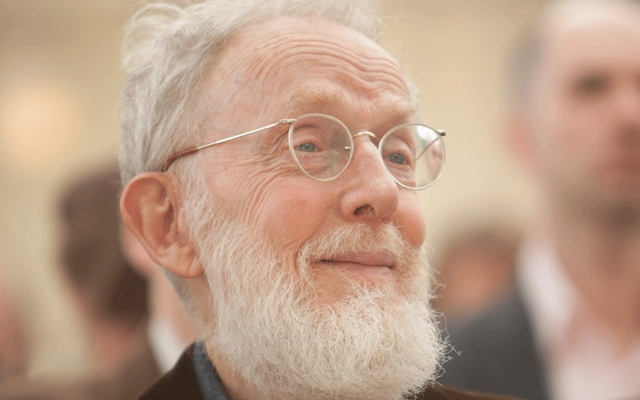
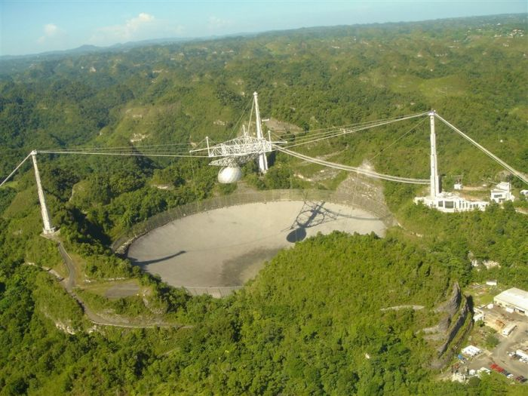
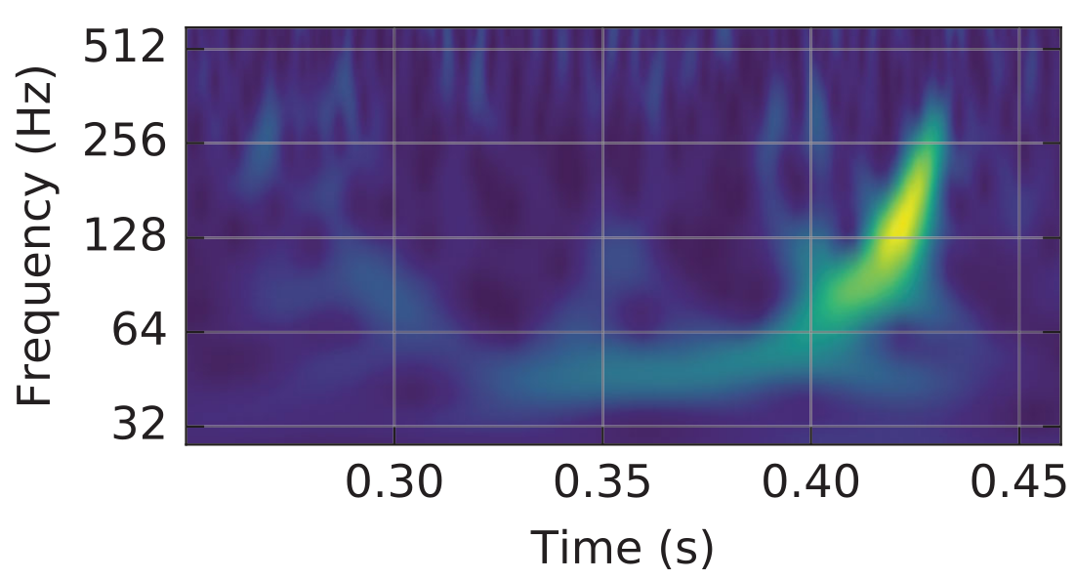
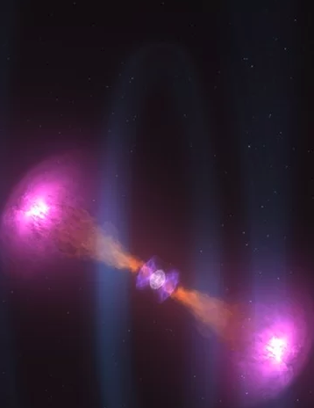
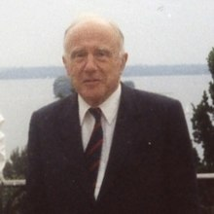
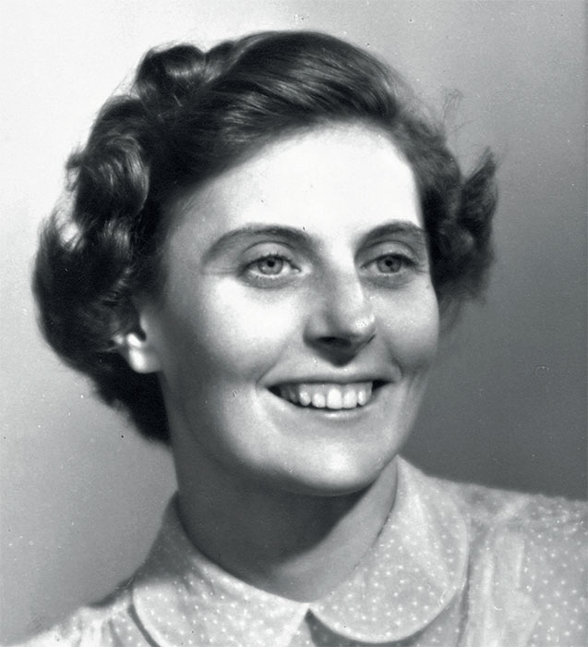
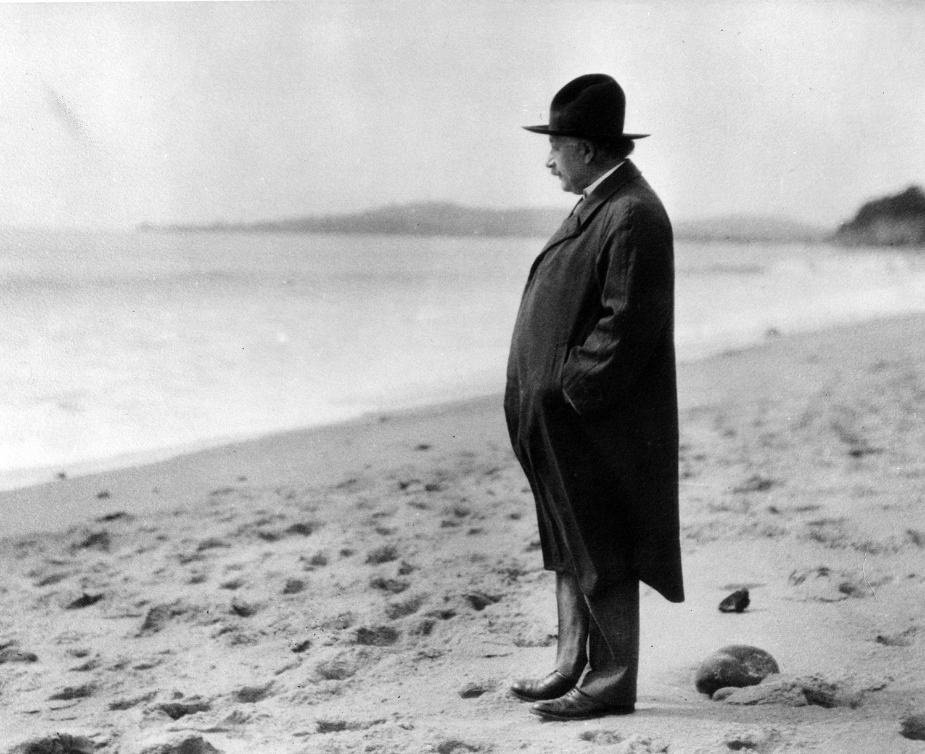
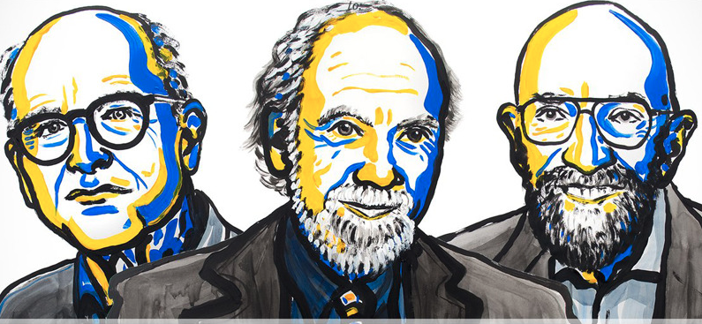
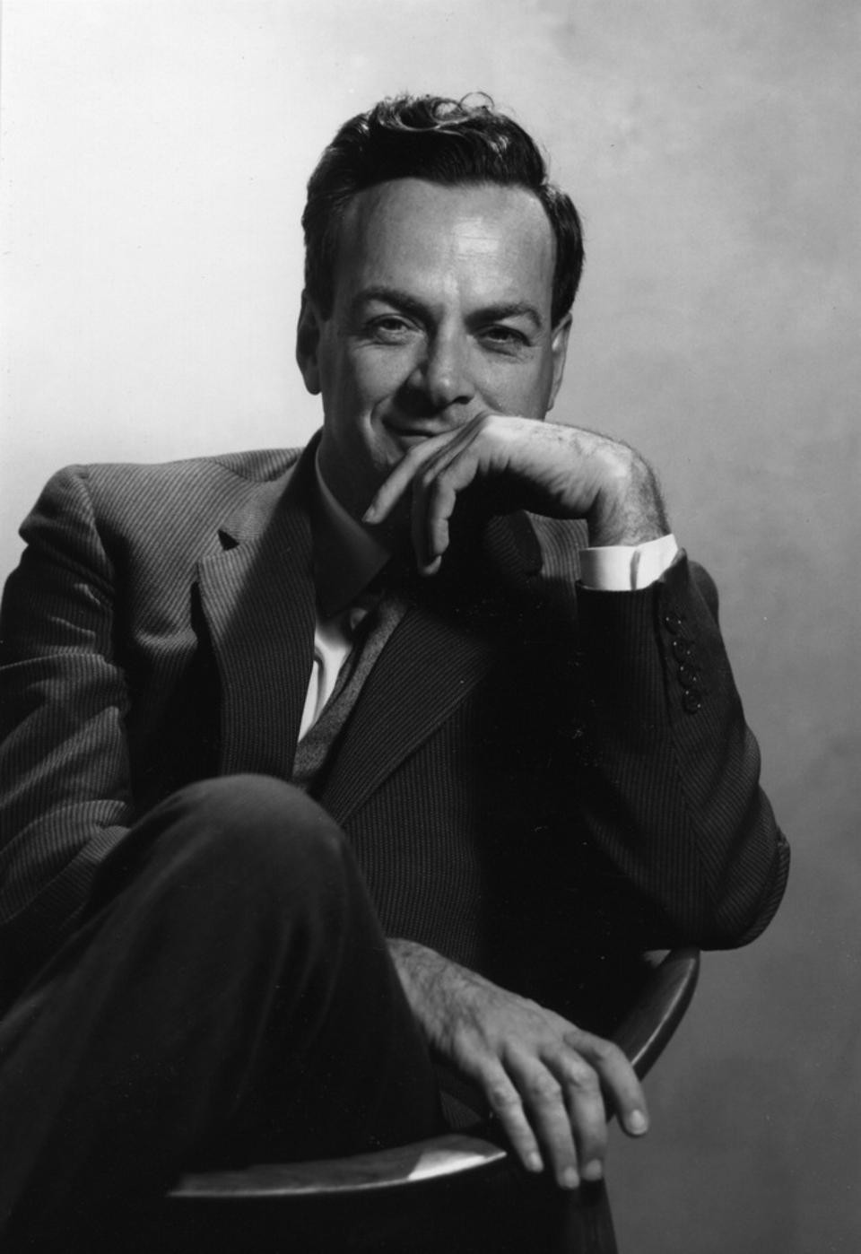
The 100 Year Journey to GW170817
Mohammed Chamma
Nov 2nd 2017

Slide 2
Outline
Are gravitational waves measurable? (1916-1974)
  Einstein+Rosen (1936)
  Chapel Hill Conference (1957)
  Hulse-Taylor Binary (1974)
The LIGO Project (1984)
Design, Sensitivity, Calibration and Validation of LIGO
First Direct Detection of Gravitational Waves: GW150914
  Chirp Mass
  Search Algorithms
Summary+References

Slide 3
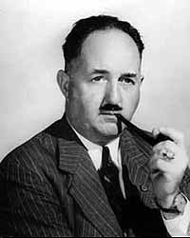
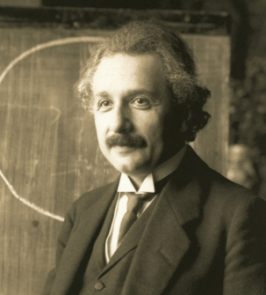
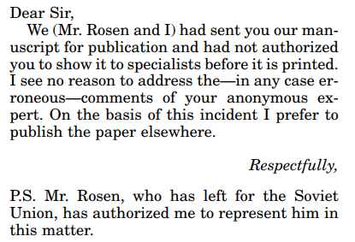
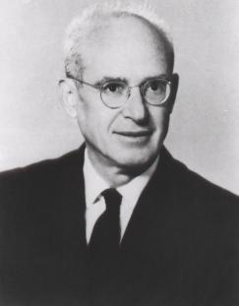
Einsten and Rosen (1916-1936)
“Together with a young collaborator, I arrived at the interesting result that gravitational waves do not exist, though they had been assumed a certainty to the first approximation. This shows that the nonlinear field equations can show us more, or rather limit us more, than we have believed up till now.”
- Albert Einstein to Max Born
Einstein predicted gravitational waves, then unpredicted them with Nathan Rosen: gravitational waves are mathematical artifacts and carry no energy (1936)
Submitted to a smaller journal when Einstein was hit with referee comments and never submitted to Physical Review again. Peer review was new to Einstein.
H.P. Robertson was the anonymous reviewer and ultimately correct.
Einstein eventually changed the conclusions of the paper, Rosen did not agree even into the 1970s.
H.P Robertson with his magnificent pipe
Albert Einstein
Nathan Rosen

Slide 4
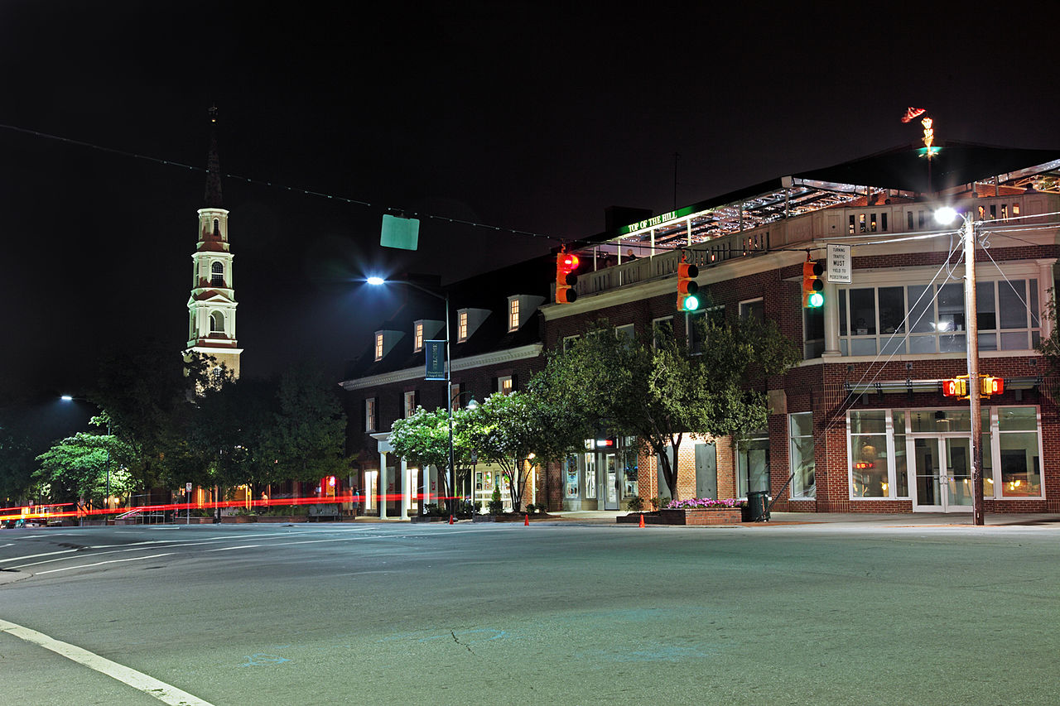
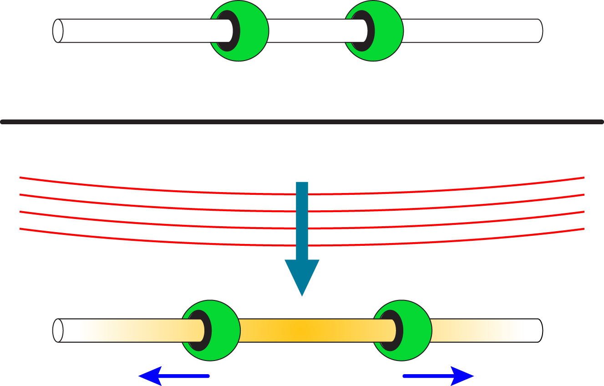
The Chapel Hill Conference (1957)
First Conference on Gravitation: The Role of Gravitation in Physics – arranged by Cécile DeWitt
  Invite-only: attendees included J. Wheeler, R. Feynman, F. Pirani, H. Bondi, N. Rosen
  Transcripts and proceedings available online
  Largely concerned with quantizing gravity: gravitational waves could mean gravitons
Sticky Bead Argument:
  Thought experiment mentioned by Richard Feynman, expressed mathematically by Felix Pirani’s work
  A wave passing through a rod with beads on it will move the beads, heating the rod. So the gravitational wave must have energy.
  Atomic forces in the rod resist the influence of the wave
Chapel Hill, North Carolina

Slide 5
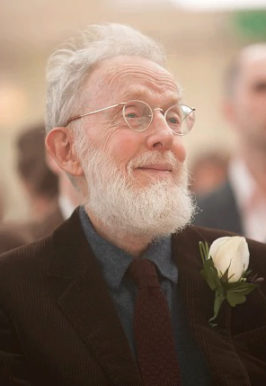
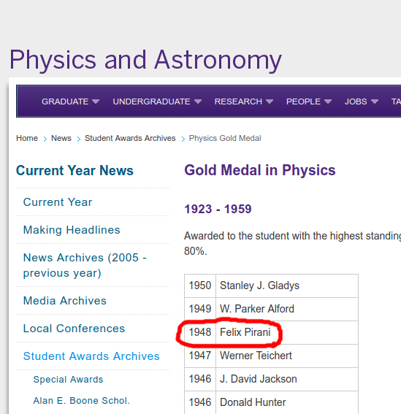

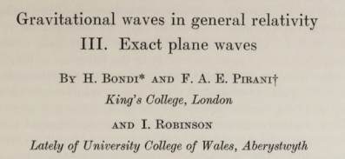
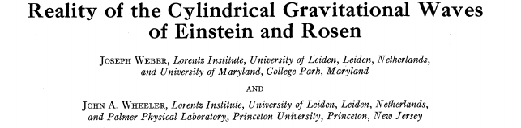
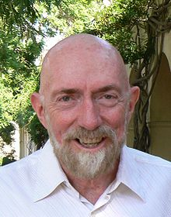
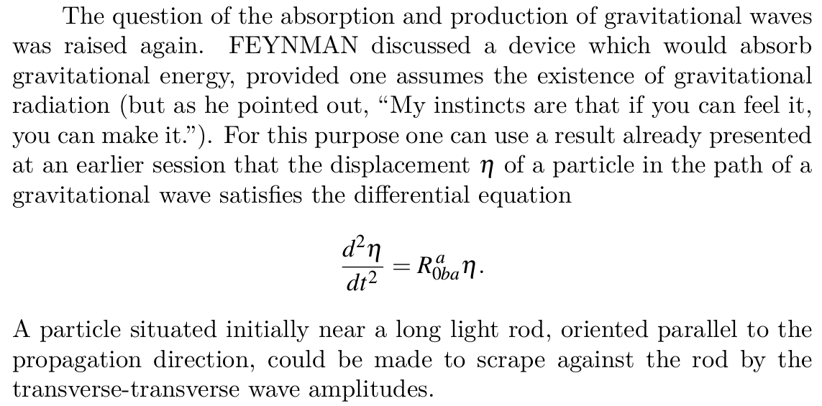
The Chapel Hill Conference (1957): Impact
Several papers immediately published :
Richard Feynman
Felix Pirani
John Wheeler
Kip Thorne
The sticky bead argument and ensuing literature convince physicists – except for N. Rosen
John A. Wheeler was the doctoral advisor of Kip Thorne who would later co-found the LIGO Project
Cécile M. DeWitt
Report from the 1957 Chapel Hill Conference

Slide 6
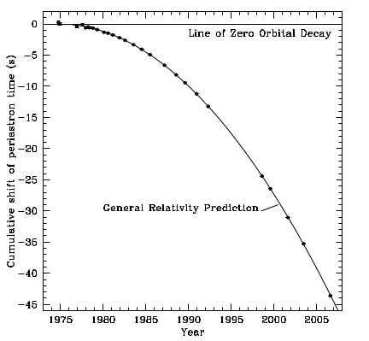
First Indirect Evidence: Hulse-Taylor Binary (1974)
Pulsar orbitting another Neutron Star
  Pulses every 59ms, with a systematic variation that repeated every 7.75 hours
  The 7.75hr period decreases slightly over time
  This is explained as orbital energy being emitted by gravitational waves
  Will collide in 300 million years
  Nobel Prize 1993
Arecibo: 305m radio dish in Puerto Rico used to make the observations

Slide 7
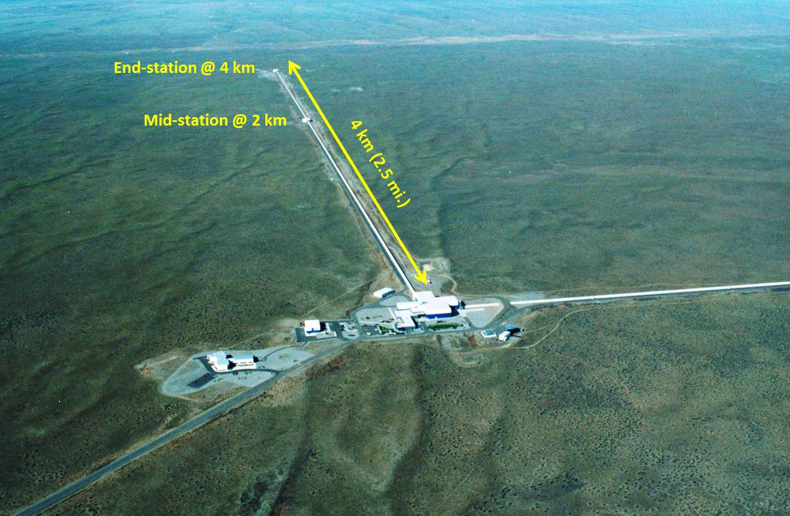
The LIGO Project
Detections (GWYYMMDD) | Type
GW150914 | Black Hole Merger
GW151226 | Black Hole Merger
GW170104 | Black Hole Merger
GW170814 w/ Virgo | Black Hole Merger
GW170817 w/ everything | Neutron Star Merger
Founded in 1984
  Based on theoretical work and designs by Kip Thorne and Rainer Weiss
  Plagued by no progress. NSF threatens to pull funding. Lab directors fired and replaced by Barry Barish in 1994
  Full design sensitivity in 2020
Detections
  All detections have been mergers of compact objects (black holes, neutron stars)
  The most recent detection was the first to have follow-up in other wavelengths: a huge amount of new information

Slide 8
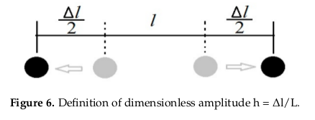
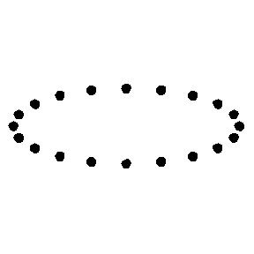
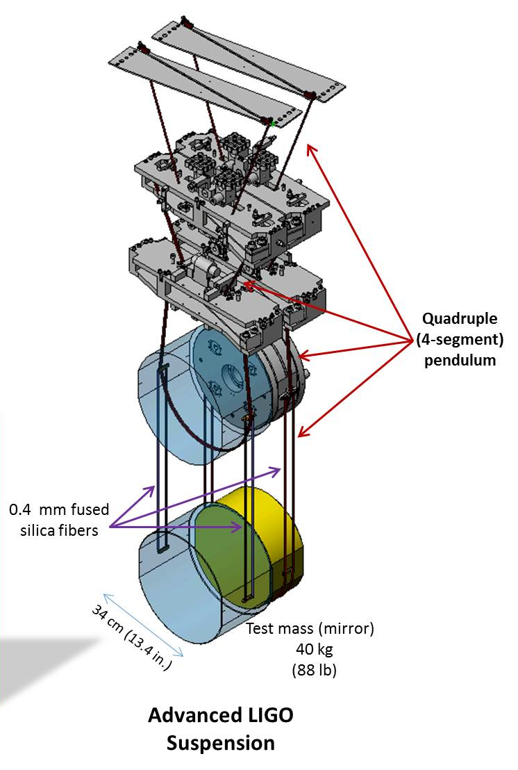
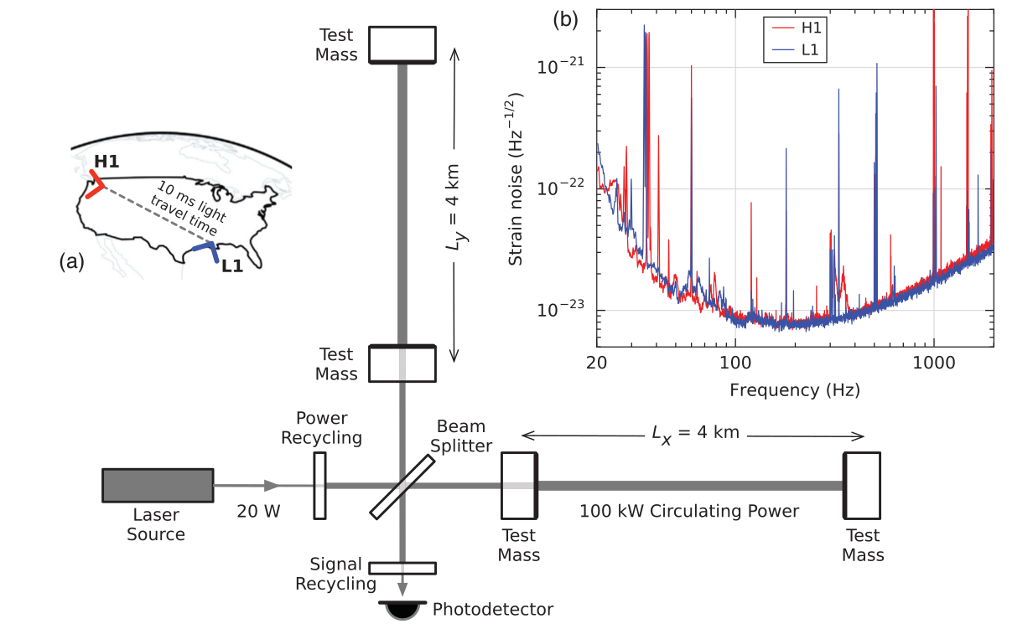
LIGO Design
Michelson Interferometer with extra steps:
  If the path length of the laser light changes, a dimming/brightening is observed at the photodetector
  Huge suspended mirrors are nudged by gravitational waves
  Problem: Huge suspended mirrors are nudged by pretty much everything else too
Effect of transverse-transverse waves on a ring of test particls

Slide 9
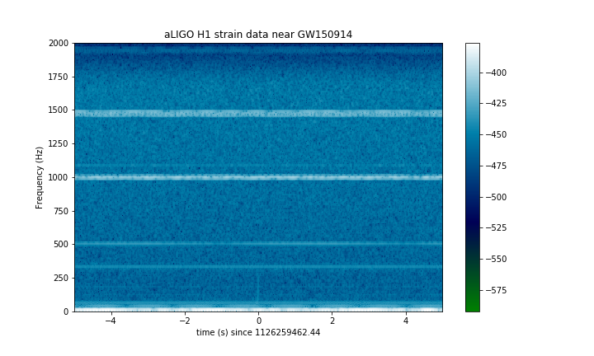
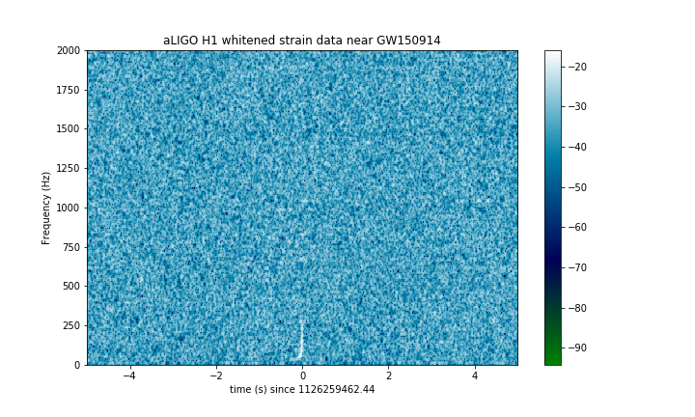
LIGO Sensitivity
Crazy:
  Can measure changes in length equivalent to 1/10000th the width of a proton
  As sensitive as if the distance from the sun to Proxima Centauri changed by the width of a hair!
Source of Noise:
  Weather, traffic, sound, AC power lines, cosmic rays, literally anything
  Detectors are equipped with seismometers, accelerometers, microphones, magnetometers, radio receivers, weather sensors, AC-power line monitors and cosmic-ray detectors.
  These detectors feed into the stability pendulum to actively reduce noise

Slide 10

LIGO Calibration and Validation
The photodetector response to strain is calibrated by injecting a known laser pulse: the radiation pressure is enough to move the mirrors
An “event” is a signal detected at both detectors within 10ms –the intersite propagation time
  Data from both sites are timestamped using GPS and atomic clocks
Impossible to measure true background since no way to shield from GWs
  Background is estimated by shifting the data from one detector in time and counting how many “events” the software thinks there is – these are fake events
Events are also ranked based on how strongly the waveforms correlate:
Ec: Energy of cross-correlated waveforms
En: Noise energy

Slide 11
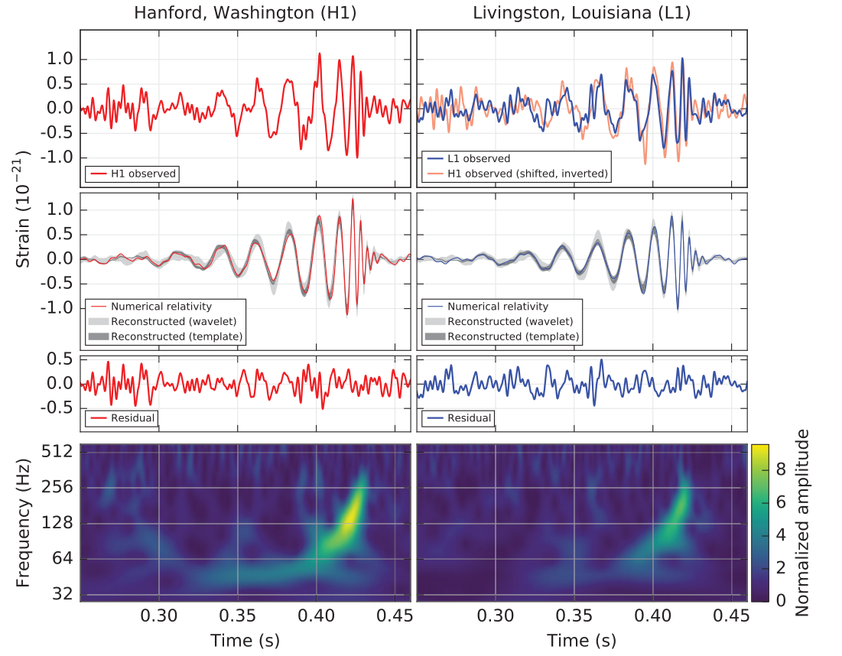
GW150914
First announced detection
Black Hole Merger:
  Primary: 36 M⊙
  Seconday: 29 M⊙
  Final Mass: 62 M⊙
  GW Energy: 3 M⊙
Arrived at Hanford 6.9ms after Livingston
Highest ranked event by far over the 16 day observing period
Notes:
Second row is three models:
* numerical relativity simulation using inferred parameters
* 90% likelihood from binary black hole templates
* 90% likelihood from linear combination of waves (no astrophysical model here)

Slide 12


Chirp Mass: GW150914
Component Masses: The gravitational wave depends on the mass of the two components. Measuring frequency and the change in frequency of the wave gives an estimate of the total mass: chirp mass
GW150914 had a chirp mass of 30 M⊙
Eyeball:
  f = 150Hz
  df/dt = 128Hz / 0.01s
  Gives total mass of 63 M⊙ –not bad!
To get mass of components you need to model the waveform

Slide 13
Summary
After general relativity there was much debate about the existence of gravitational waves – debate that was resolved by the Chapel Hill Conference and the Hulse+Taylor discovery
LIGO is insane: extremely sensitive, robust suite of enviromental sensors and algorithms for validating events
The first multi-wavelength observation (GW170817) of a gravitational wave event gives a huge amount of information for study
When full design sensitivity is reached in 2020 LIGO will be sensitive enough to study deviations in waveforms from general relativity: new theory of gravity?

Slide 14

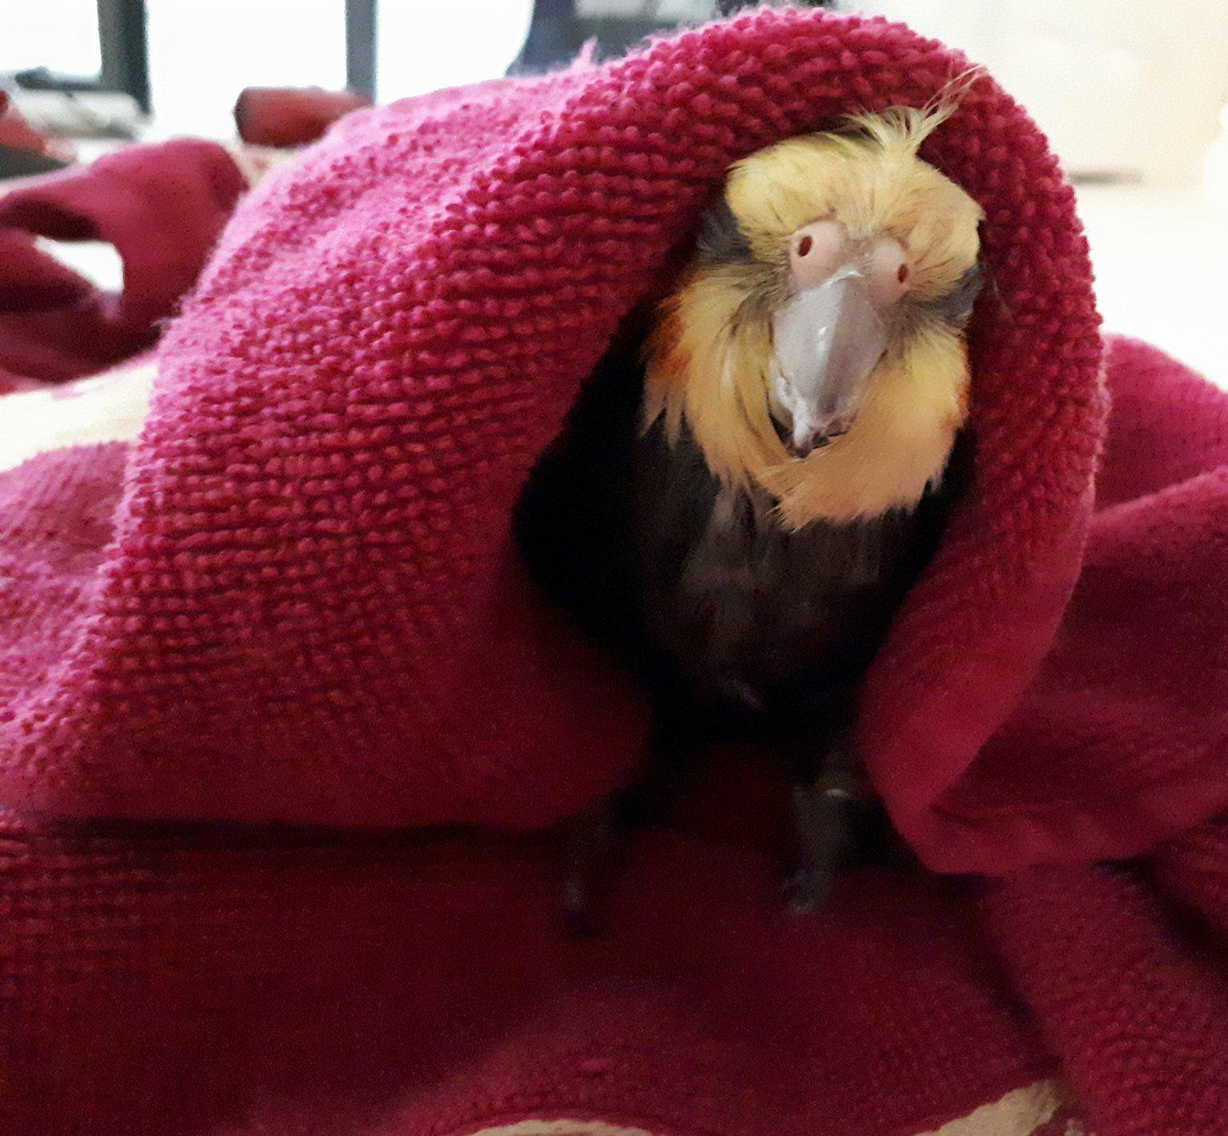
References
These slides: https://github.com/mef51/LIGOSeminar/raw/master/ligo_talk.pdf
Chirp Mass: http://theoretical-physics-digest.wikia.com/wiki/Chirp_Mass
Report from the 1957 Chapel Hill Conference. Cécile M. Dewitt and Dean Rickles. 2011. http://www.edition-open-sources.org/sources/5/
B.P. Abbott et al. Observation of Gravitational Waves from a Binary Black Hole Merger, PRL 116, 061102 (2016)
B.P. Abbott et al. GW170817: Observation of Gravitational Waves from a Binary Neutron Star Inspiral, PRL 119, 161101 (2017)
J.L. Cervantes-Cota et al. A Brief History of Gravitational Waves. Universe 2016, 2(3), 22. http://www.mdpi.com/2218-1997/2/3/22

Slide 15
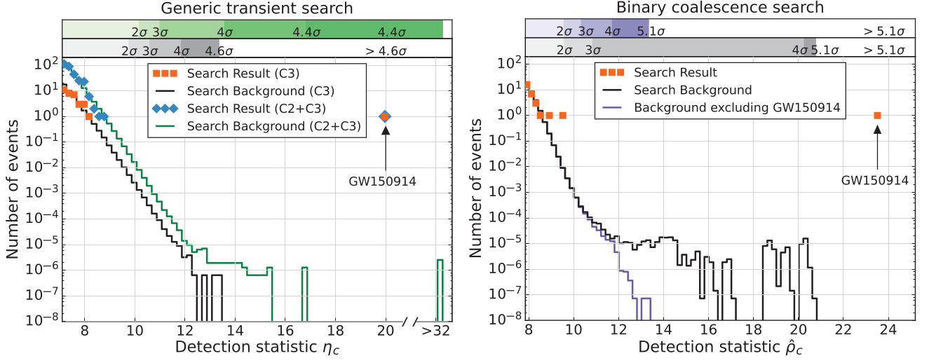
LIGO: Searching for Events
Generic Transient Search:
  Ignorant of waveforms, searches for short signal spikes of any kind
Binary Coalescence Search:
  Events are matched against 250,000 waveform templates from numerical general relativity
Notes:
Search Classes:
C1: known noise transients
C2: all remaining events
C3: events with frequency that increases in time

