Slide 1
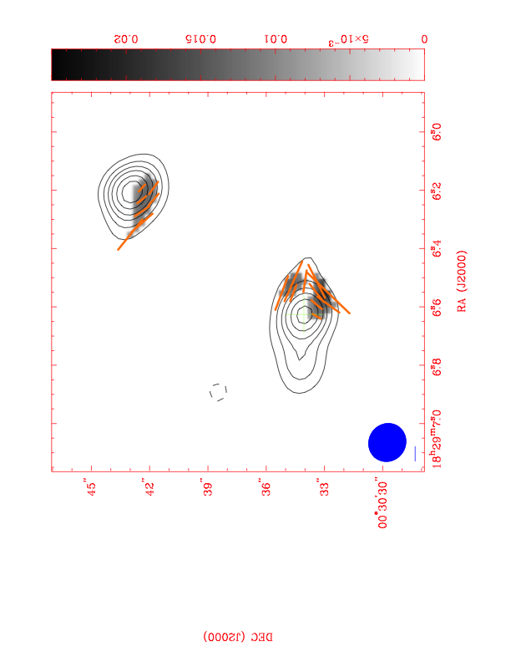
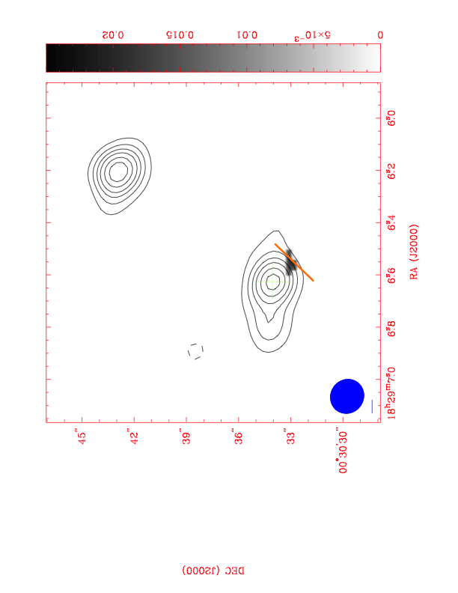
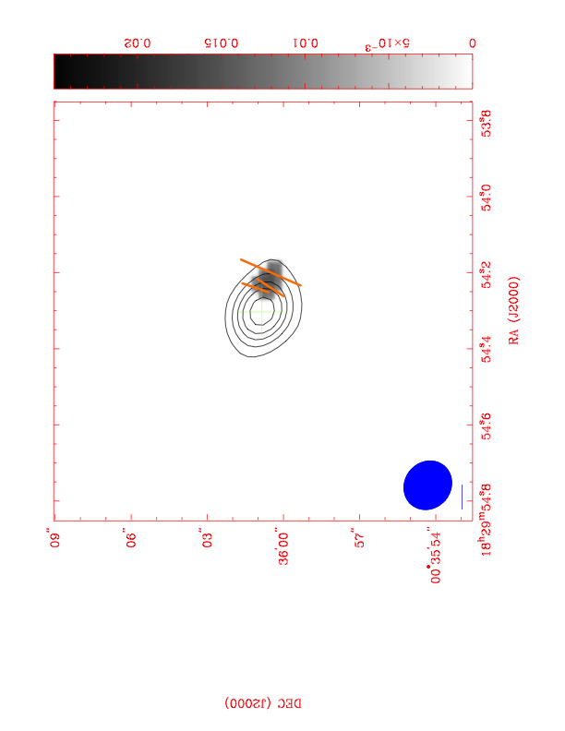
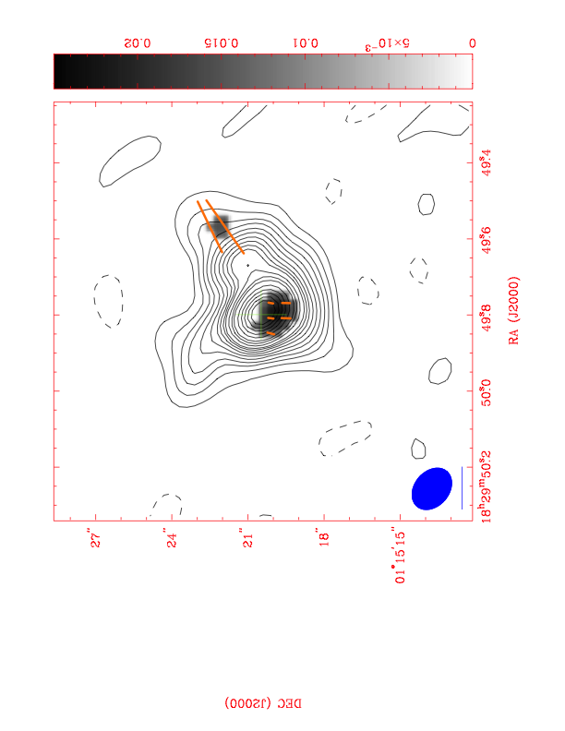
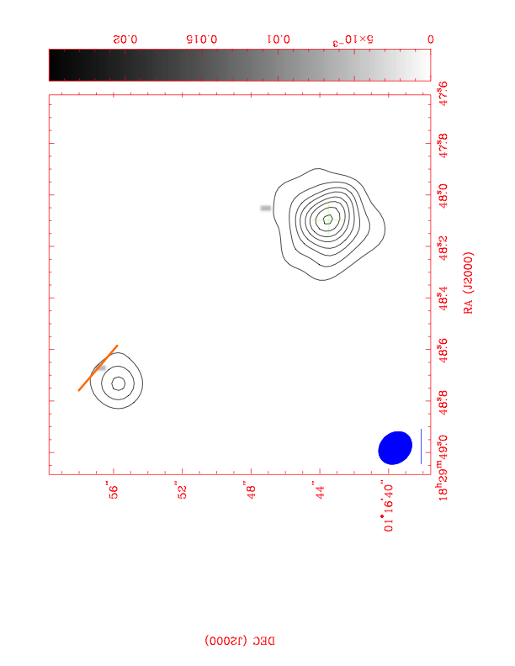
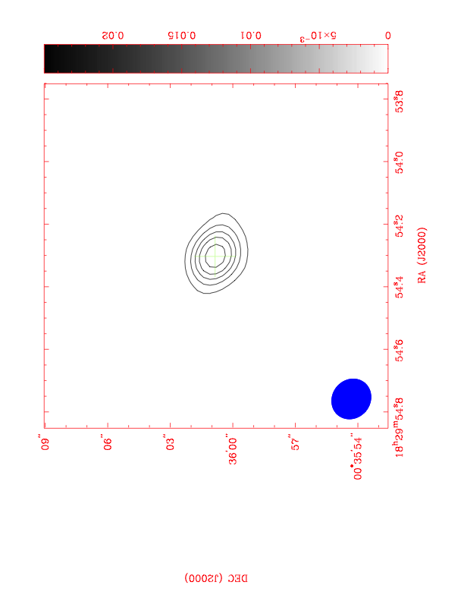
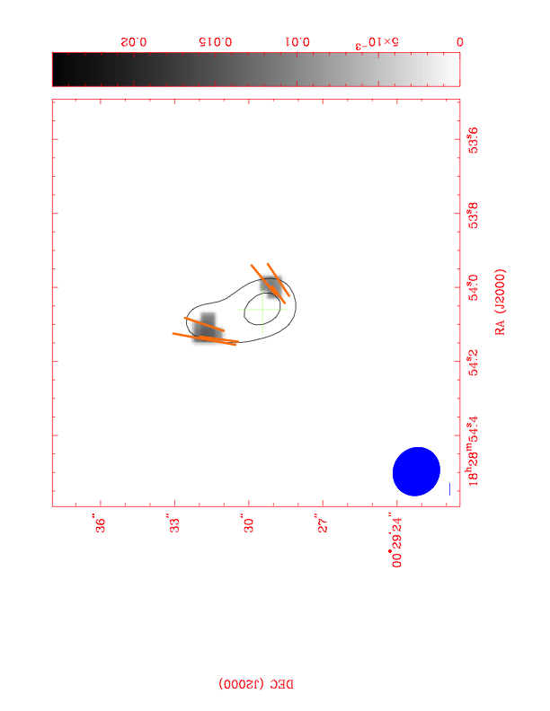
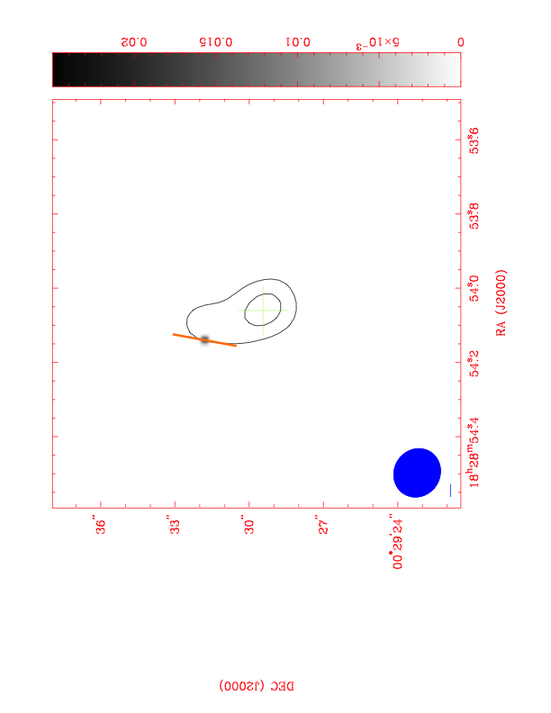
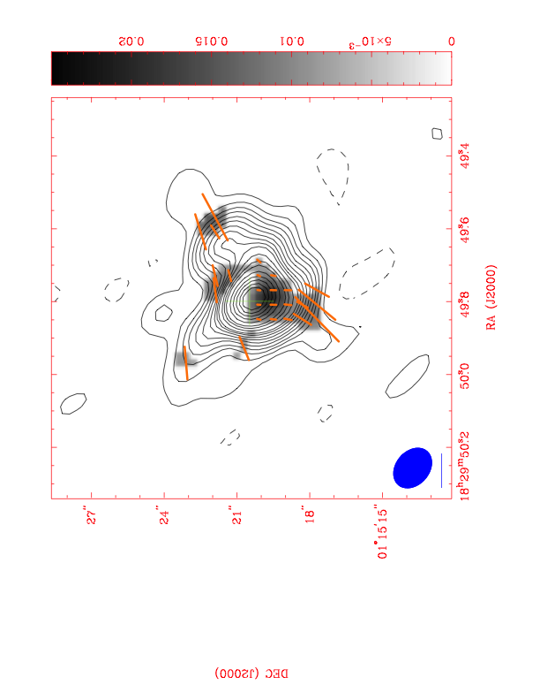
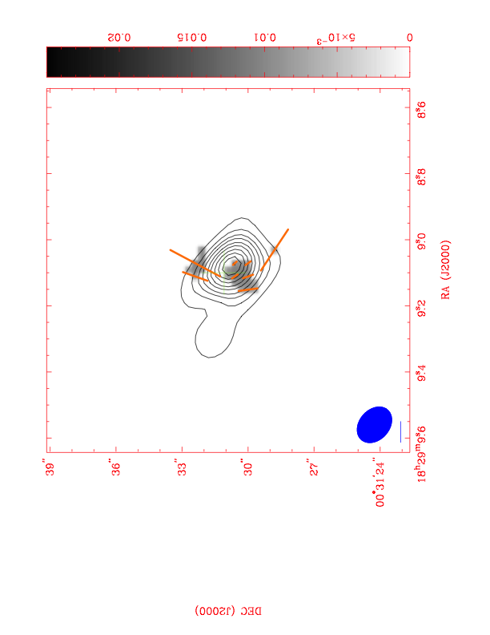
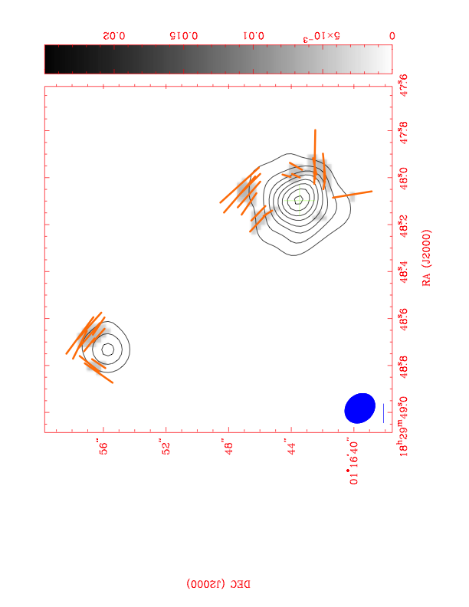
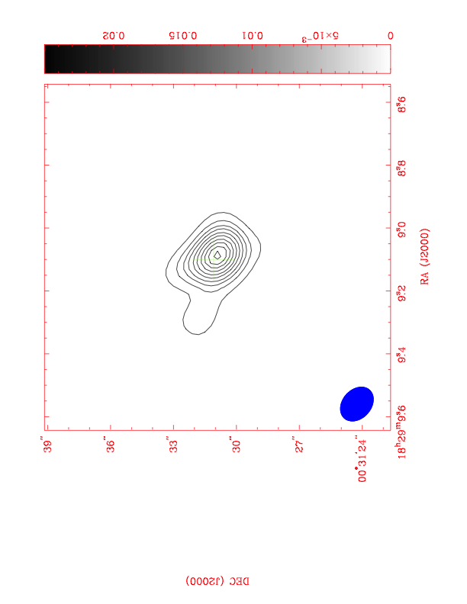
SMC 1
SMC 6
SMC 7
SMC 8
Pol = 6mJy/Bm
StkI = 0.10Jy/Bm
Flux = 0.15Jy
Pol = 12mJy/Beam
StkI = 0.41Jy/Beam
Flux = 0.78Jy
Pol = 21mJy/Beam
StkI = 2.10Jy/Beam
Flux = 4.38Jy
Pol = 15mJy/Beam
StkI = 0.08Jy/Beam
Flux = 0.15Jy
Pol = 6 mJy/Beam
StkI = 0.31y/Beam
Flux = 0.84Jy
SMC 11
Pol = 14mJy/Bm
StkI = 0.24Jy/Bm
Flux = 0.31Jy
SMC 15
Pol = 16mJy/Beam
StkI = 0.20Jy/Beam
Flux = 0.22Jy
Pol = 18mJy/Bm
StkI = 0.22Jy/Bm
Flux = 0.42Jy
SMA 2011B-A016 Com 2012A-A001 Ext. Maps at 2 and 3-σ pol cutoff (σ~4mJy/B, Beam~2”)

