Slide 1
What's at the Center of SNR RCW103?
Unresolved since 1974

Slide 2
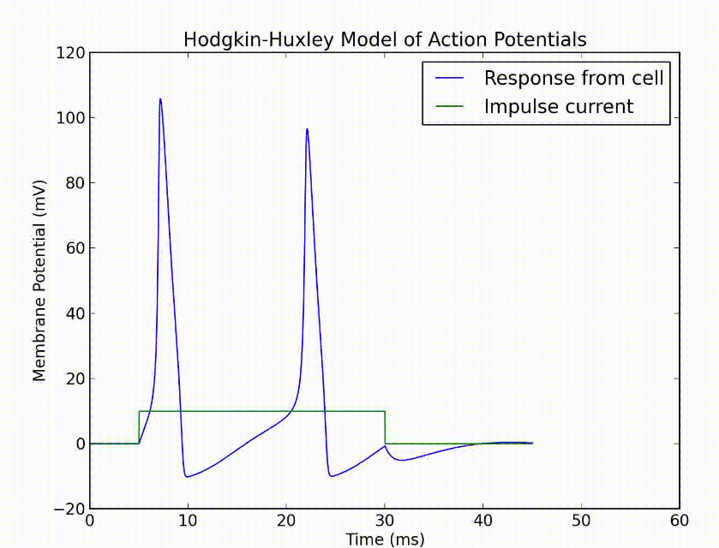

Slide 3
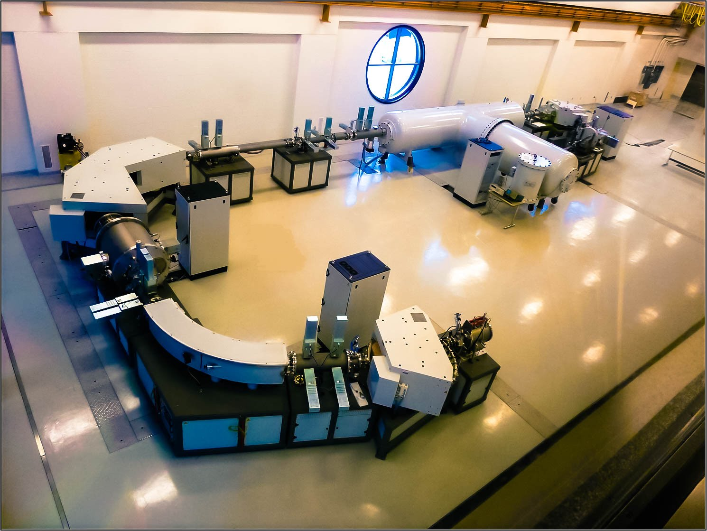

Slide 4
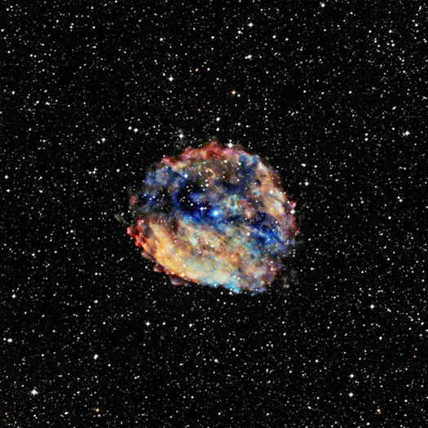
RCW103

Slide 5
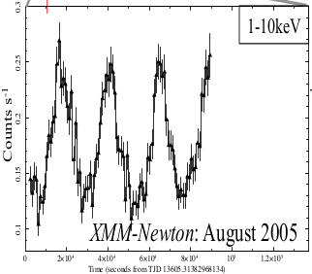
RCW103

Slide 6
So what new evidence would shed light on how to classify this object (1E 1613)?

Slide 7
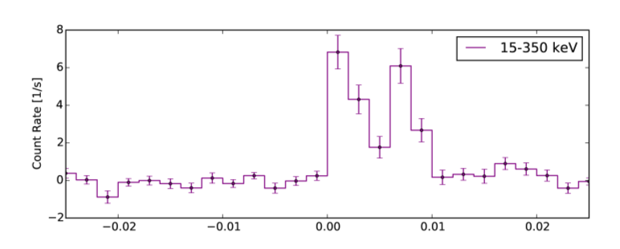

Slide 8
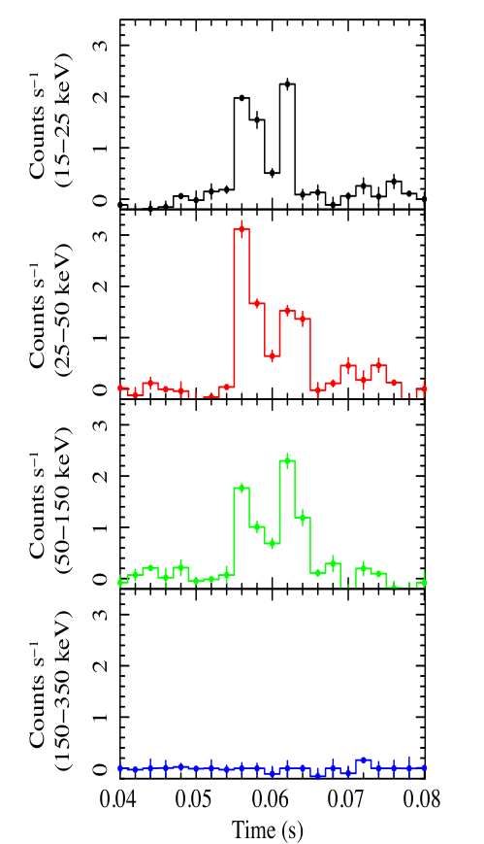

Slide 9
How is this lightcurve collected? Is there really a burst here?

Slide 10
Xray Astronomy

Slide 11
Xray Astronomy
Opaque to Atmosphere

Slide 12
Xray Astronomy
Opaque to Atmosphere
Pass through lenses at normal incidence

Slide 13
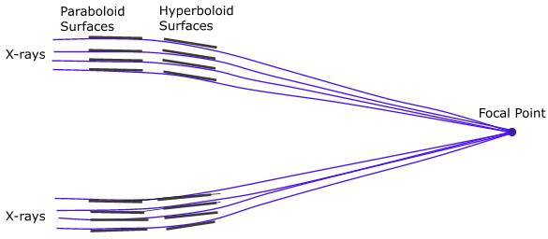
Xray Astronomy
Grazing Incidence Optics
Wolter Type Telescope

Slide 14
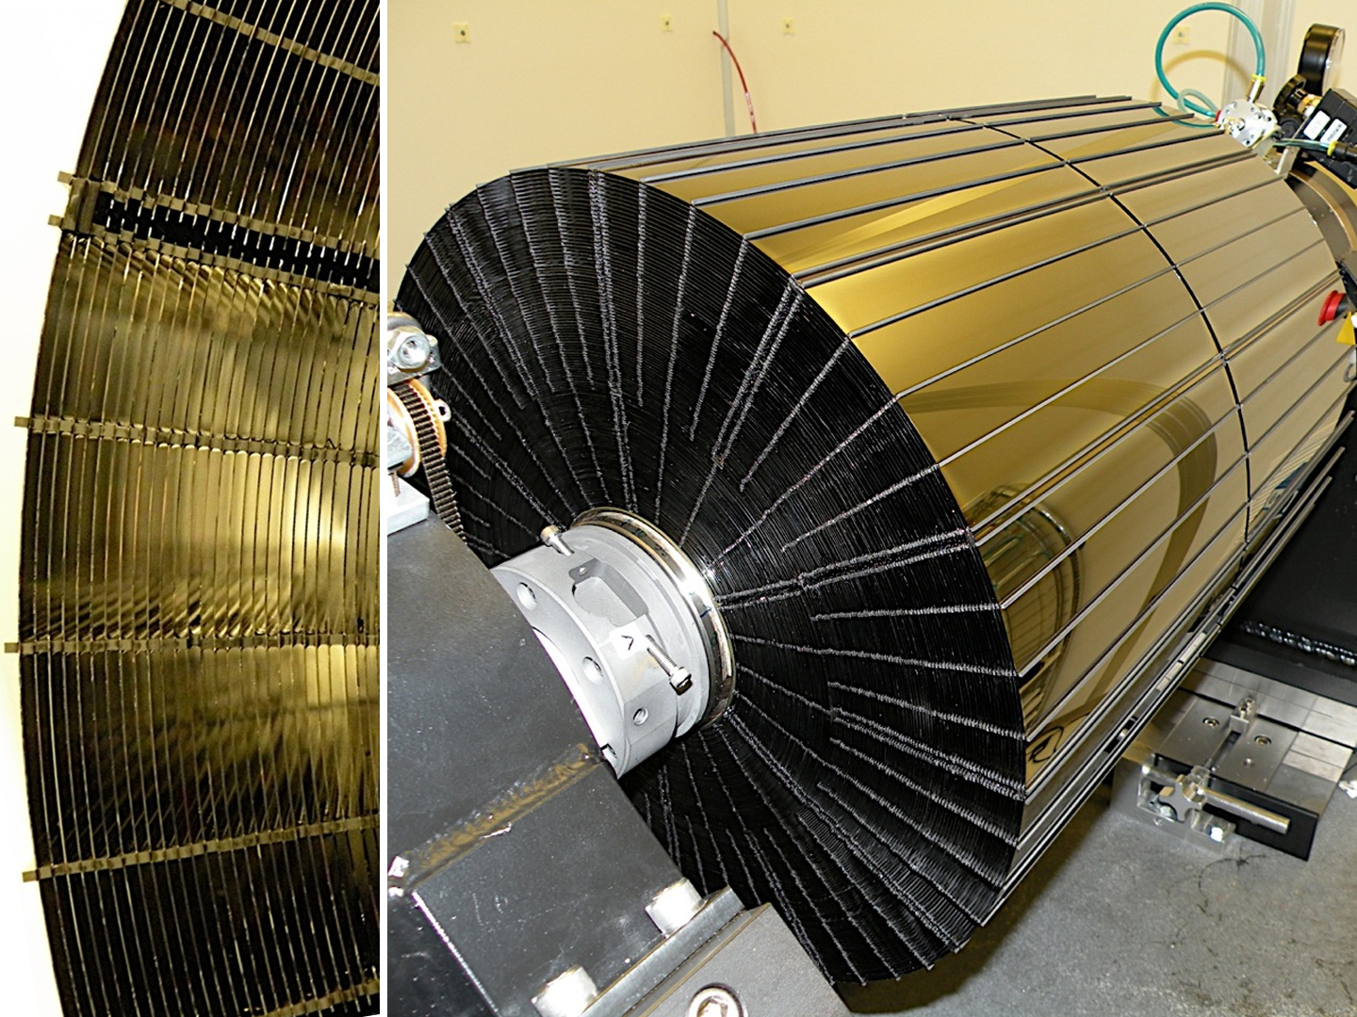
Xray Astronomy
NuSTAR

Slide 15
Xray Astronomy
CCDs + Coded Mask Aperture

Slide 16
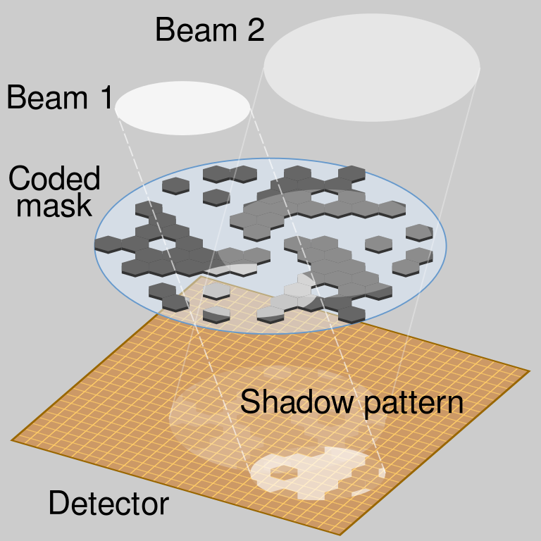
Xray Astronomy
CCDs + Coded Mask Aperture

Slide 17
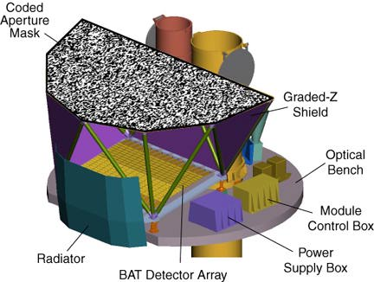
Xray Astronomy

Slide 18
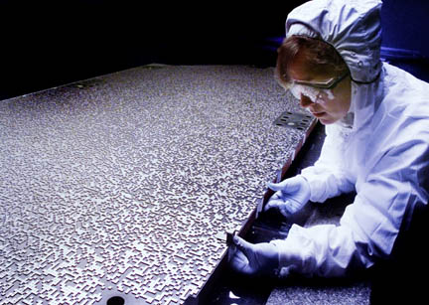
Xray Astronomy

Slide 19
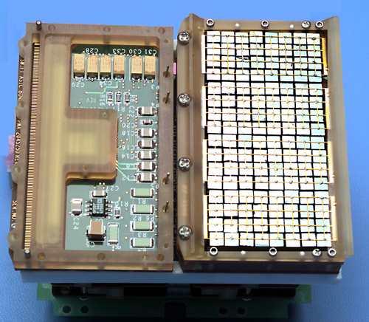
Xray Astronomy
Array of Detectors (1 of many)

Slide 20
Xray Astronomy
Array of Detectors (1 of many)
2^15 = 32,768 Detectors

Slide 21
We now know
Photons pass through a mask aperture and fall on an array of at most 32768 working detectors.
Software does raytracing to find the source.

Slide 22
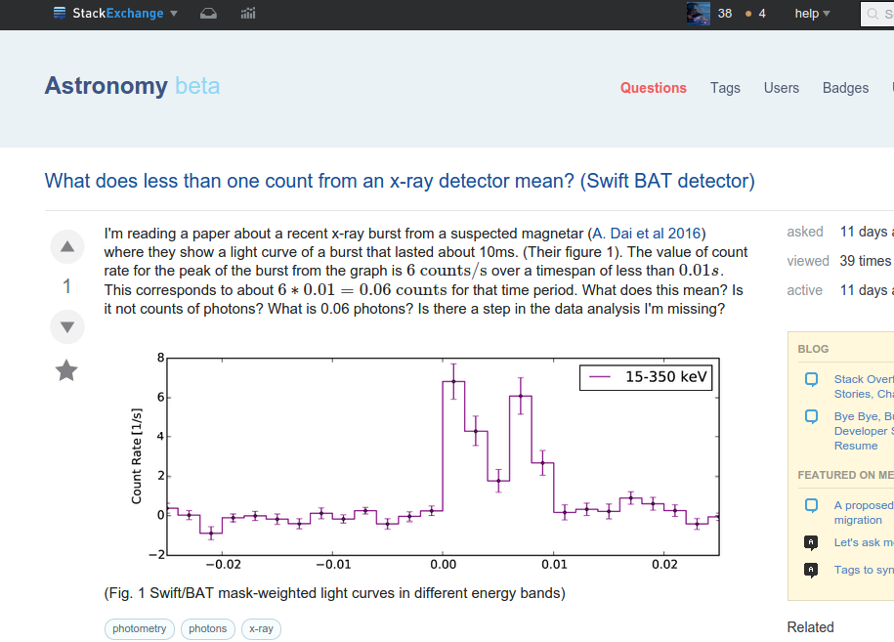

Slide 23
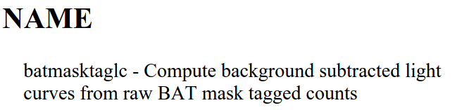

Slide 24
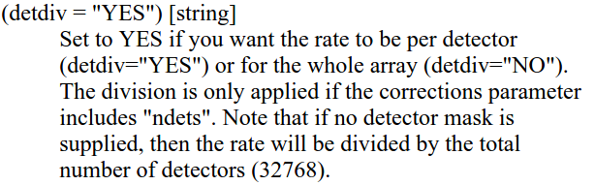

Slide 26
Fine, the data seems real.
What are the rest of the observations?

Slide 27
Fine, the data seems real.
What are the rest of the observations?

Slide 28

Fine, the data seems real.
What are the rest of the observations?
=

Slide 29
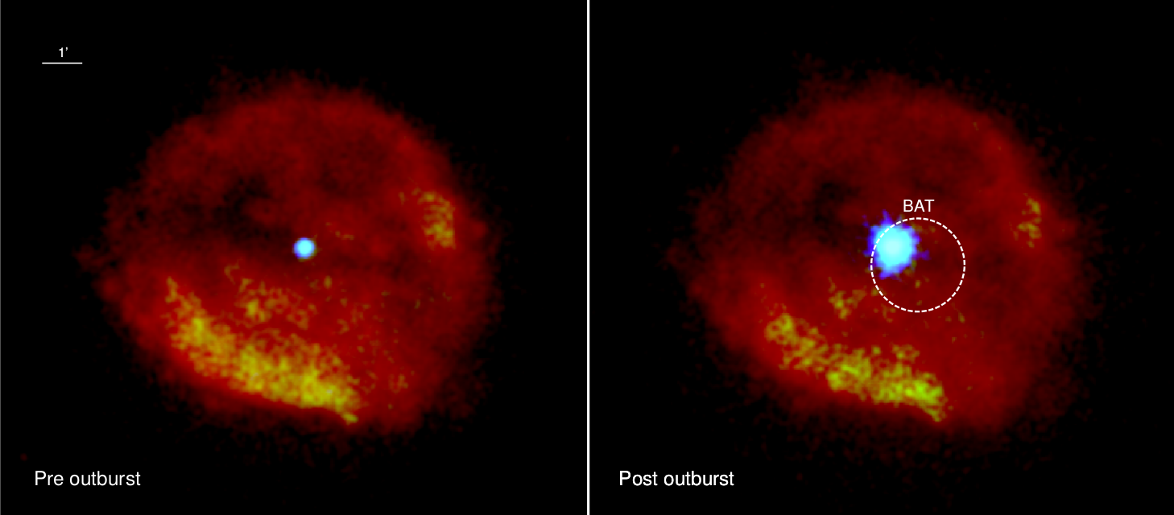

Slide 30
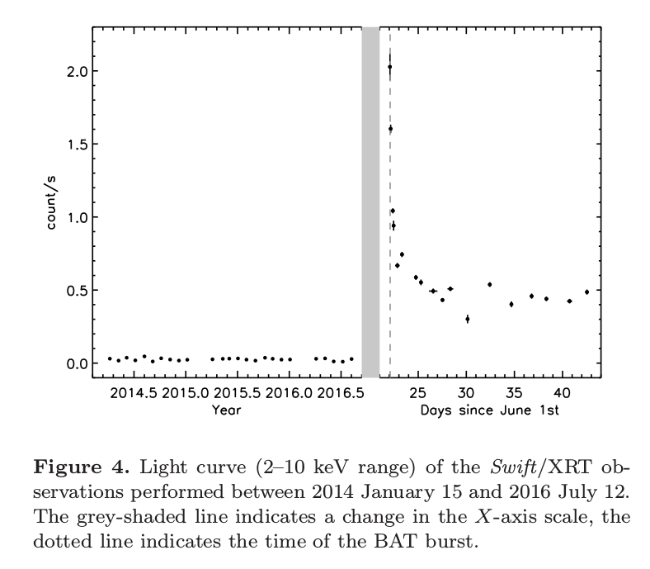

Slide 31
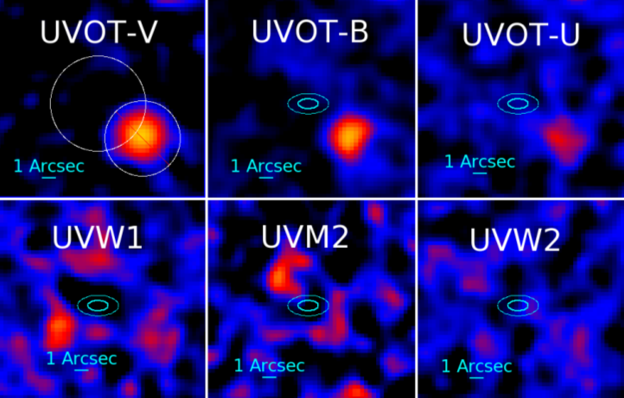

Slide 32
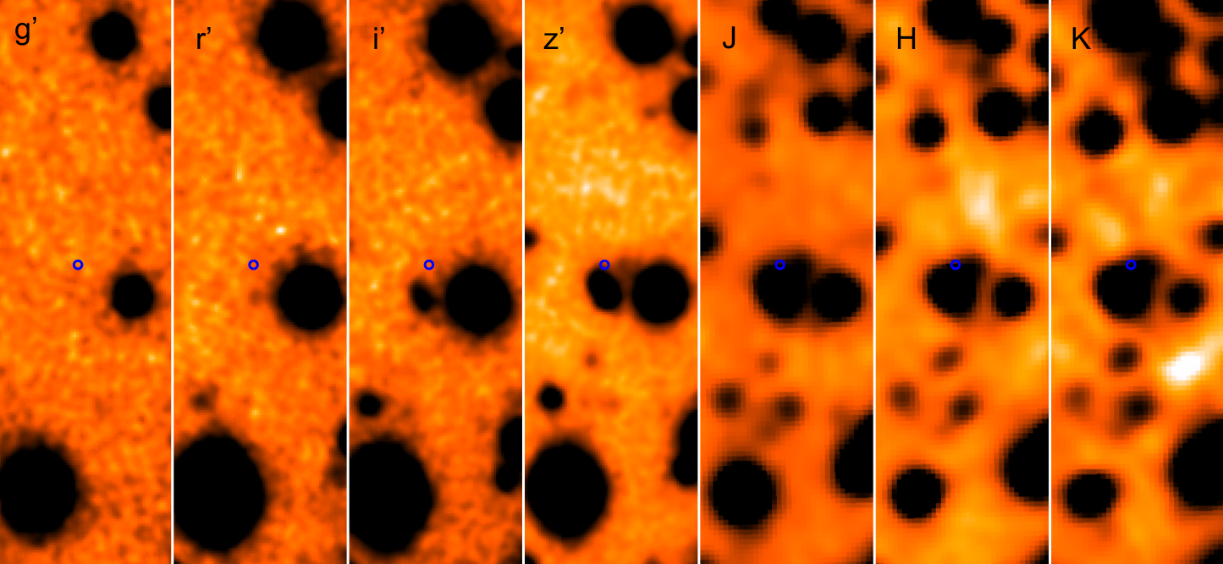
GROND Data (from Earth)

Slide 33
What do we know about Supernovae and their remnants? What kinds of objects can we expect 1E to be?

Slide 38


Slide 41

Almost want to rule this out too because of the slow period. Need to look more closely at pulsars.

Slide 42
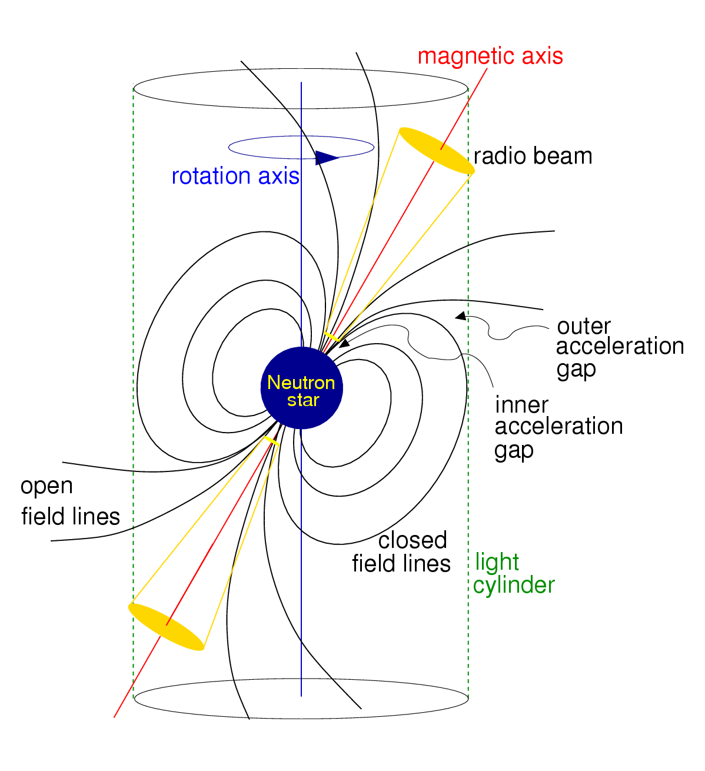
Pulsars

Slide 43
Pulsars
Known pulsars fall in spin periods between ~ms and 11minutes

Slide 44
Pulsars
Known pulsars fall in spin periods between ~ms and 11minutes
Our object (1E 1613) would definitely be an outlier

Slide 45
Magnetars = Pulsars + Strong B Field

Slide 46
Magnetars = Pulsars + Strong B Field
10¹⁴-10¹⁵ G

Slide 47
Magnetars = Pulsars + Strong B Field
10¹⁴-10¹⁵ G > 10¹² G

Slide 48
Magnetars = Pulsars + Strong B Field
10¹⁴-10¹⁵ G > 10¹² G

Slide 49
What about a binary?

Slide 50
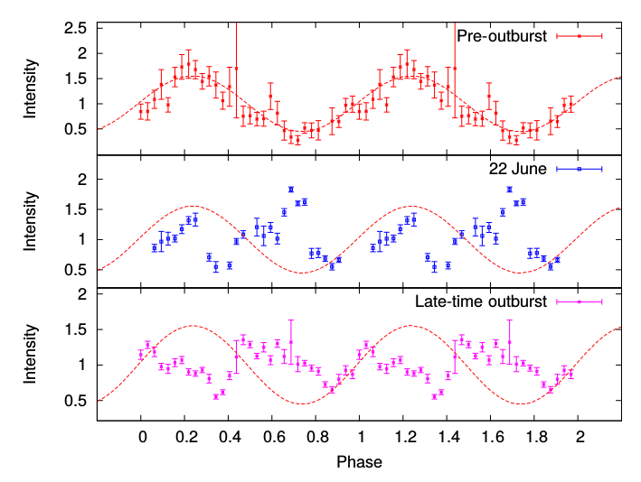
What about a binary?
Nope

Slide 51
If we for a moment totally accept 1E1613 is a magnetar,
what physics explains the dramatic spin-down given that the supernova is 2000 years old?

Slide 52
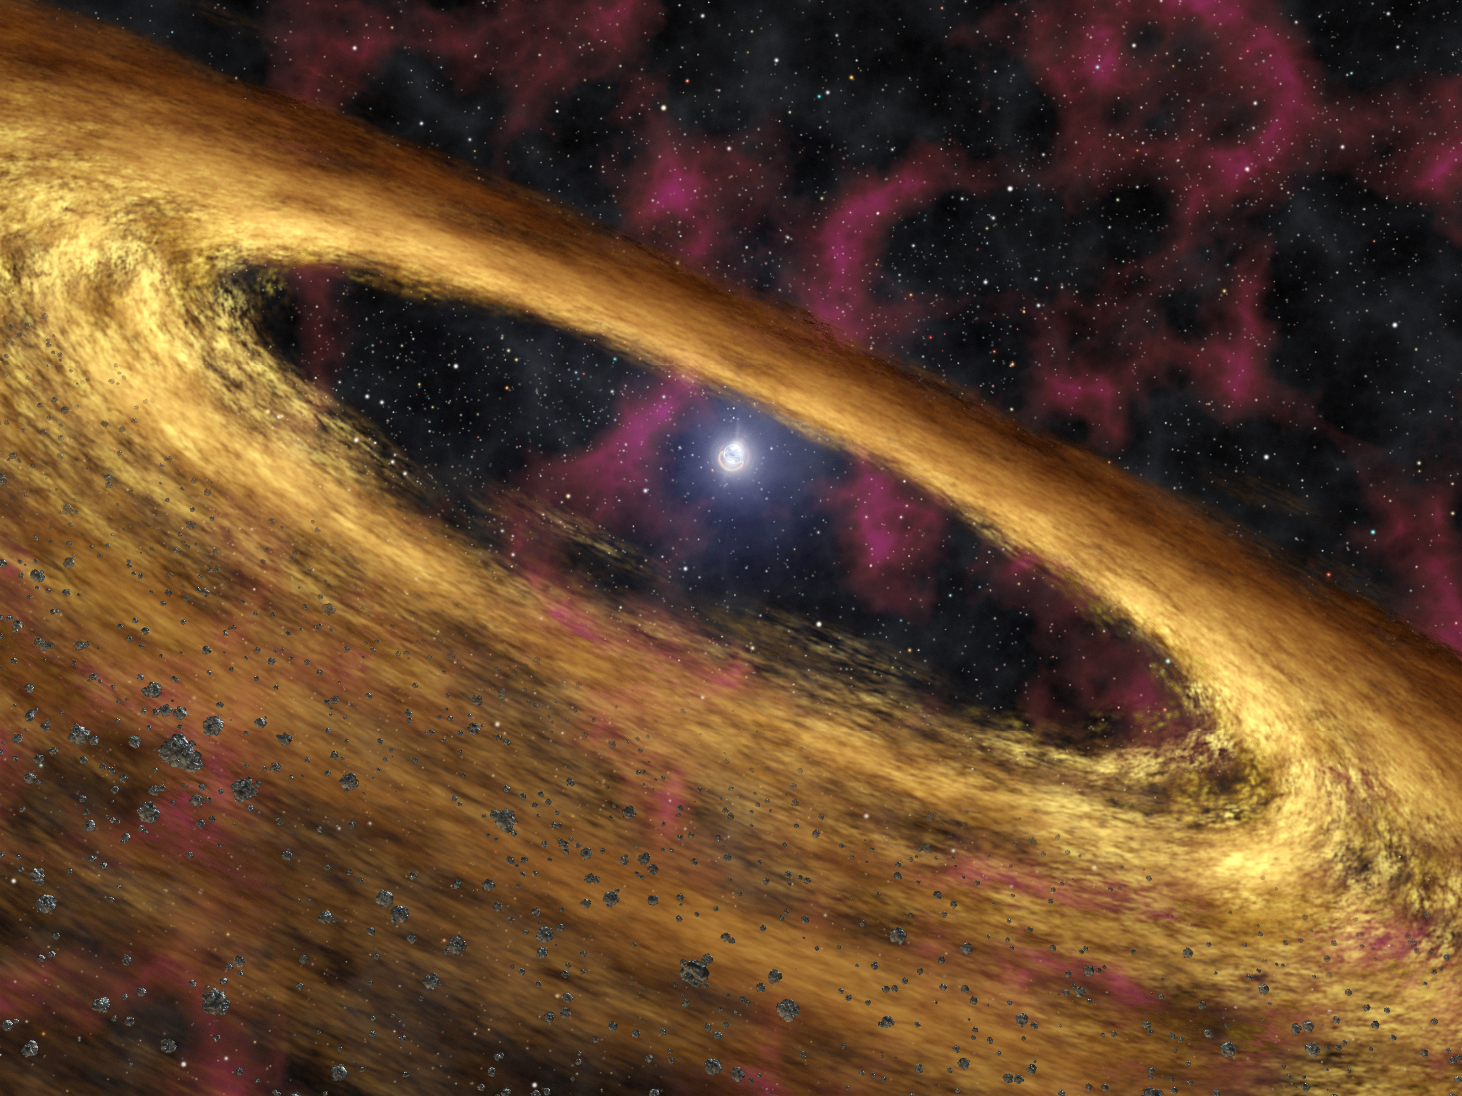

Slide 53


Slide 54


Slide 58
Therefore magnetars with fallback disks will slow down quickly.

Slide 59
Therefore magnetars with fallback disks will slow down quickly.
QED

Slide 60
The End

Slide 61
The End
The object at the center is weird because of 6.67hr variability in soft xrays

Slide 62
The End
The object at the center is weird because of 6.67hr variability in soft xrays
Probably not a binary system since the phase of the variability changed after the burst

Slide 63
The End
The object at the center is weird because of 6.67hr variability in soft xrays
Probably not a binary system since the phase of the variability changed after the burst
Spectrum and Post-burst behaviour fits with magnetar theory

Slide 64
The End
The object at the center is weird because of 6.67hr variability in soft xrays
Probably not a binary system since the phase of the variability changed after the burst
Spectrum and Post-burst behaviour fits with magnetar theory
Slowed down because of presence of a fallback disk.

Slide 65
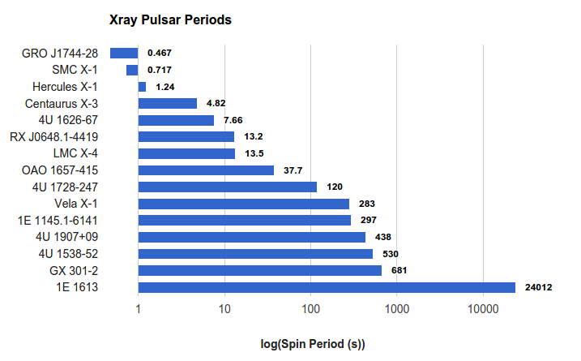
Probably the Slowest Pulsar Ever

Slide 66
Probably the Slowest Pulsar Ever
Thanks!

Slide 67
The End
The object at the center is weird because of 6.67hr variability in soft xrays
Probably not a binary system since the phase of the variability changed after the burst
Seems to fit with magnetar theory
Slowed down because of presence of a fallback disk.

