Slide 1
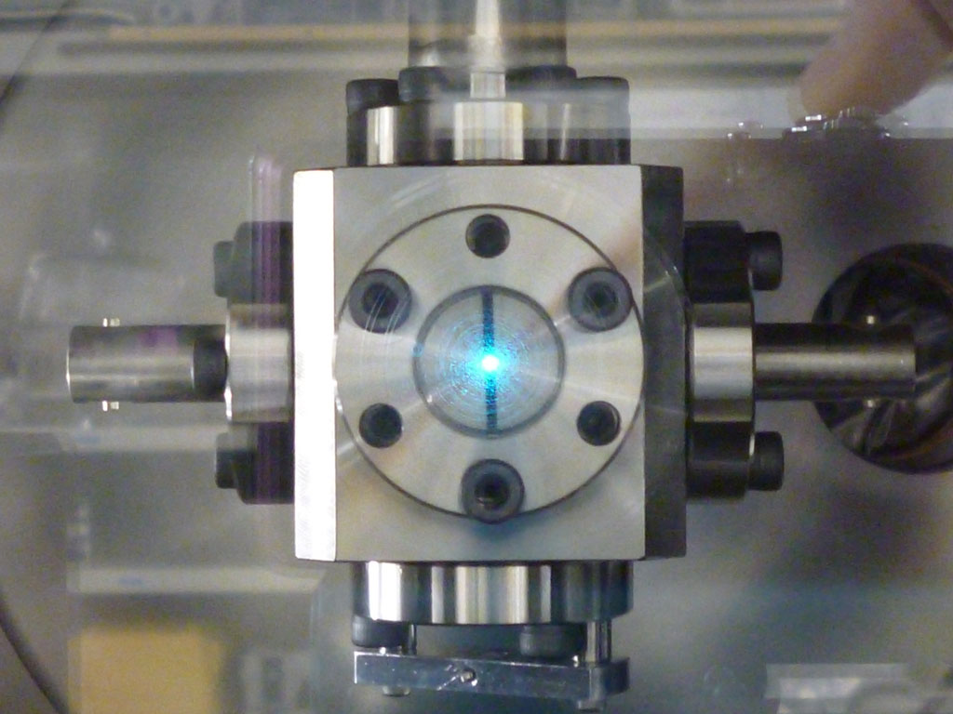
Free Electron Lasers
PHY4311
Mohammed Chamma
April 29 2015

Slide 2
All About Free Electron Lasers
Basic Properties
  What characteristics do these types of lasers have?
Operating Principles and Theory
  Basic FEL Cavity
  Emitted Wavelength Formula
SASE Free Electron Lasers
  Xray Free Electron Lasers
  Temporal Coherence Limit
An Application
  Molecular Imaging

Slide 3
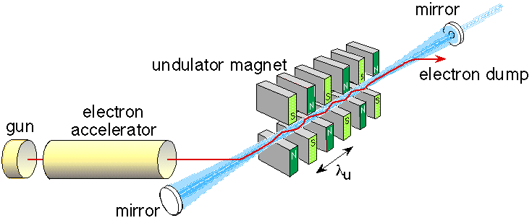
Basic Properties
No Medium. What instead?
Relativistic, free electrons are the source of the radiation.
The output wavelength is tunable.

Slide 4
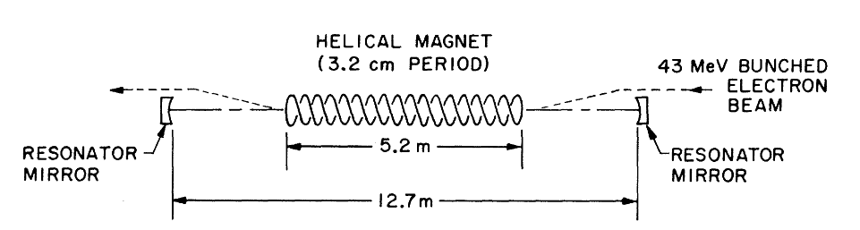
Operating Principles
A Basic Cavity
  Electron Beam
  Helical Magnet (Wiggler)
  Light Travelling parallel to the electrons.
“First Operation of a Free Electron Laser”, Deacon et al. Phys. Rev. Lett. 38, 892 (1977)

Slide 5
Operating Principles
Radiation arises from the interaction of three components
  Electron Beam
  Magnetic Field of the Wiggler
  EM Field of the light traveling parallel to the electrons
Decelerating charges emit radiation.
  Bremsstrahlung, The magnetic field of the wiggler changes the direction of the electron
“First Operation of a Free Electron Laser”, Deacon et al. Phys. Rev. Lett. 38, 892 (1977)

Slide 6
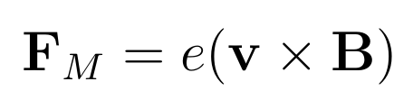
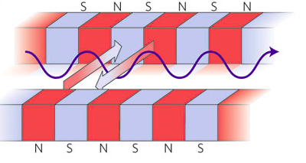
Operating Principles
The Wiggler (aka The Undulator)
  Creates a transverse, spatially periodic, constant, magnetic field
  Magnetic Force tells us the direction the electron will go. The electron starts to wiggle.

Slide 7
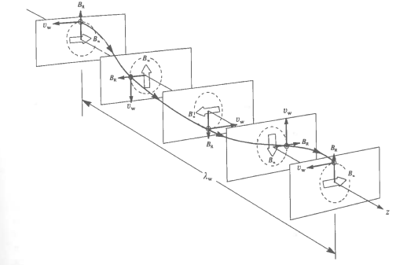
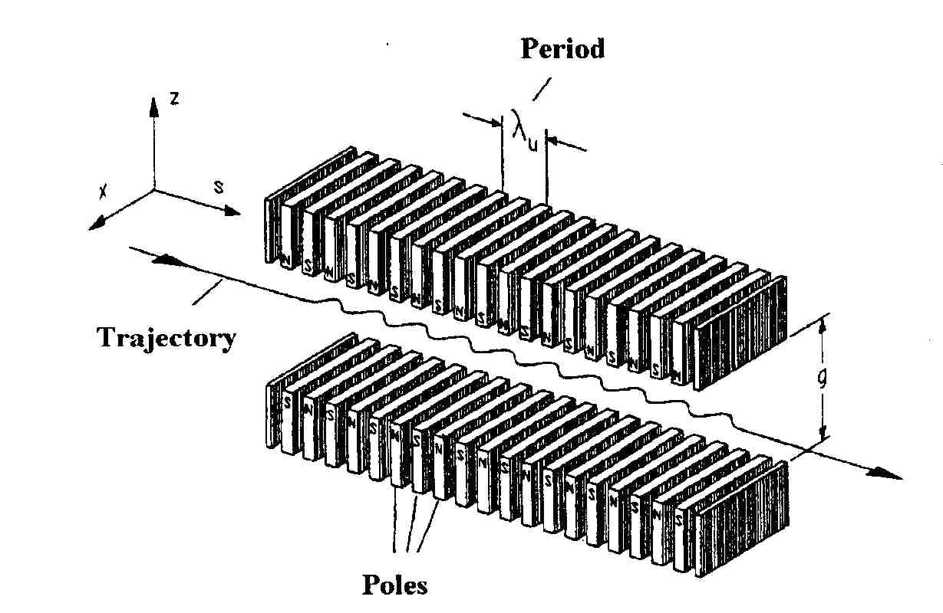
Operating Principles
Trajectory in a Helical Wiggler
Trajectory in a Linear Wiggler

Slide 8
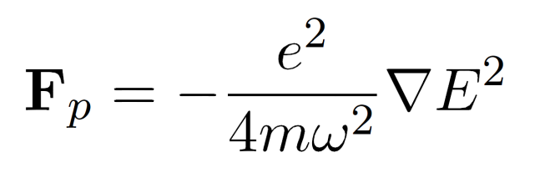
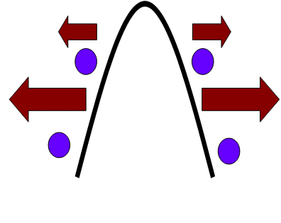
Operating Principles
Ponderomotive Force:
  This is the force an electron feels due to an oscillating field (like an EM wave)
  The magnetic field of wiggler + radiation field = ponderomotive wave. This wave is slower than c, so electrons can travel with it.

Slide 9
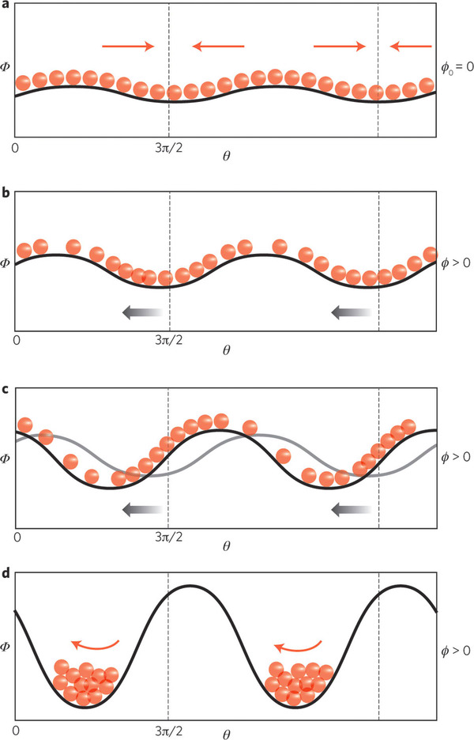
Operating Principles
Light Amplification and Electron Bunching
The electrons travel near the speed of the ponderomotive wave
The electrons can gain energy from the wave or lose energy to it
The electron's speed changes from being close to the speed of the wave to being in resonance with it.
The electrons form bunches

Slide 10


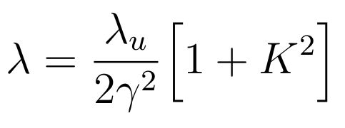
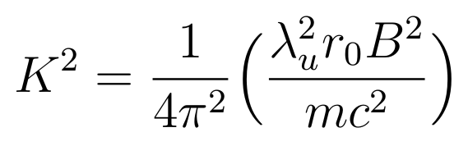
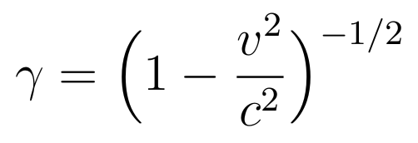
Operating Principles
Emitted Wavelength:
  Electrons travelling through the wiggler are relativistic and experience a length contraction. The wiggler wavelength they experience is
  The emitted radiation is then measured in the lab frame. Because the source of the radiation is moving close to c, we measure a Doppler shifted wavelength. So we have a second factor of
  Tuning: Pick wiggler period and B strength, vary electron energy

Slide 11
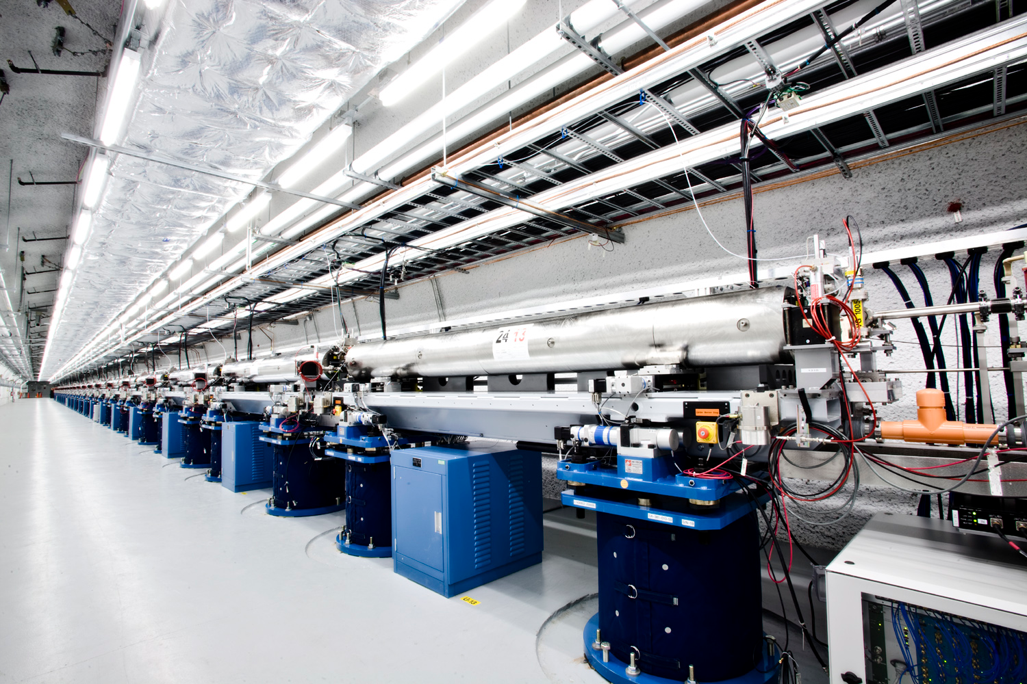
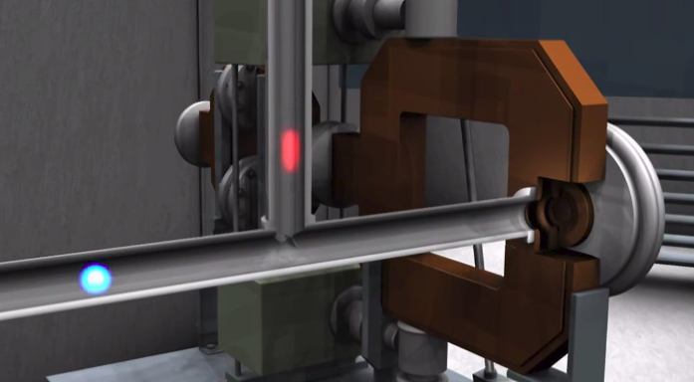
Xray Free Electron Lasers
SASE Free Electron Lasers
  No cavity, just one long wiggler (like at LCLS)
  Xray pulses are made by injecting electrons in bunches
  SASE: Electrons emit xray radiation, travel with the radiation, and amplify it.
  As the electrons travel they bunch together more and more. At saturation they form regularly spaced 'microbunches'. So the radiation is coherent and very intense.

Slide 12
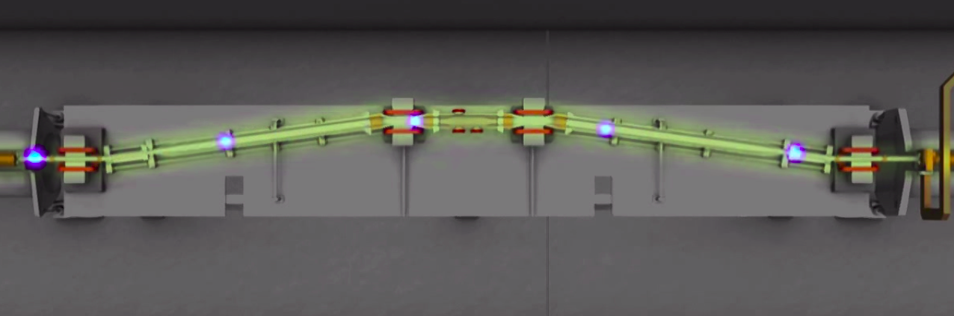

Xray Free Electron Lasers
Bunch Compressors (Chicanes)
  LCLS compresses the spacing between the electrons before entering the wiggler. This gives control over the duration between pulses.

Slide 13
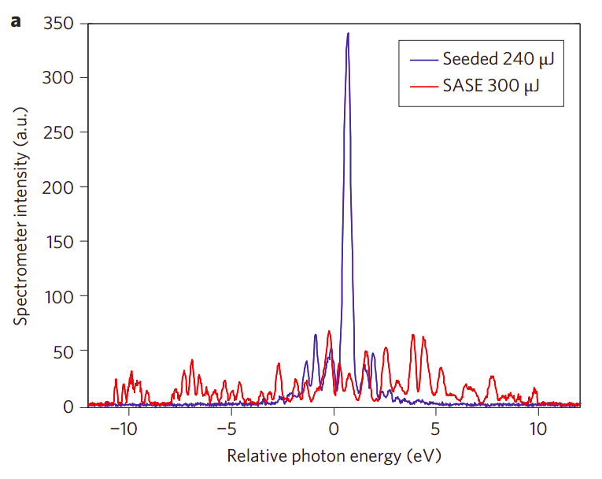
Xray Free Electron Lasers
Temporal Coherence Limitation
  SASE leads to noise. The electrons start off incoherent and emit incoherent radiation. This limits the temporal coherence of the beam.
  Possible Solution: Filter out noisy frequencies to get a smaller bandwidth. This hampers intensity.
  Possible Solution: Inject a temporally coherent pulse tuned to the speed of the electrons and the wiggler. The electrons then amplify this signal. This is called seeding. No easy access to Xray seeds.

Slide 14
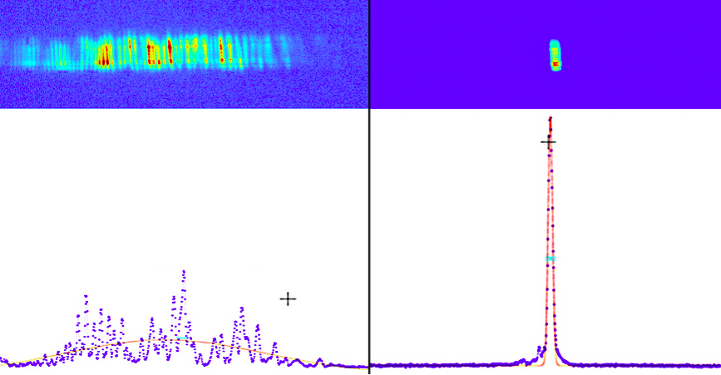
Xray Free Electron Lasers
LCLS 2012: Self-Seeding as a Solution
  Take Xrays from the first half of the undulator, pass it through a diamond monochromator. This selects a very sharp bandwidth of xrays.
  Use the pulse that comes out of the monochromator to seed the second half of the undulator. The result is a huge increase in intensity and a much sharper bandwith.

Slide 15
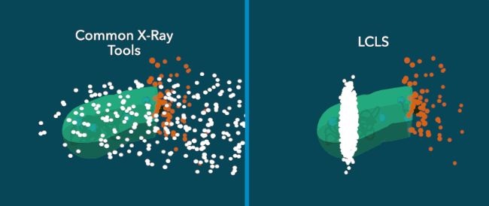
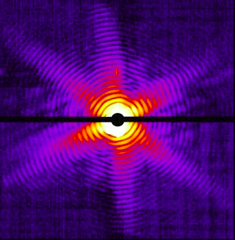
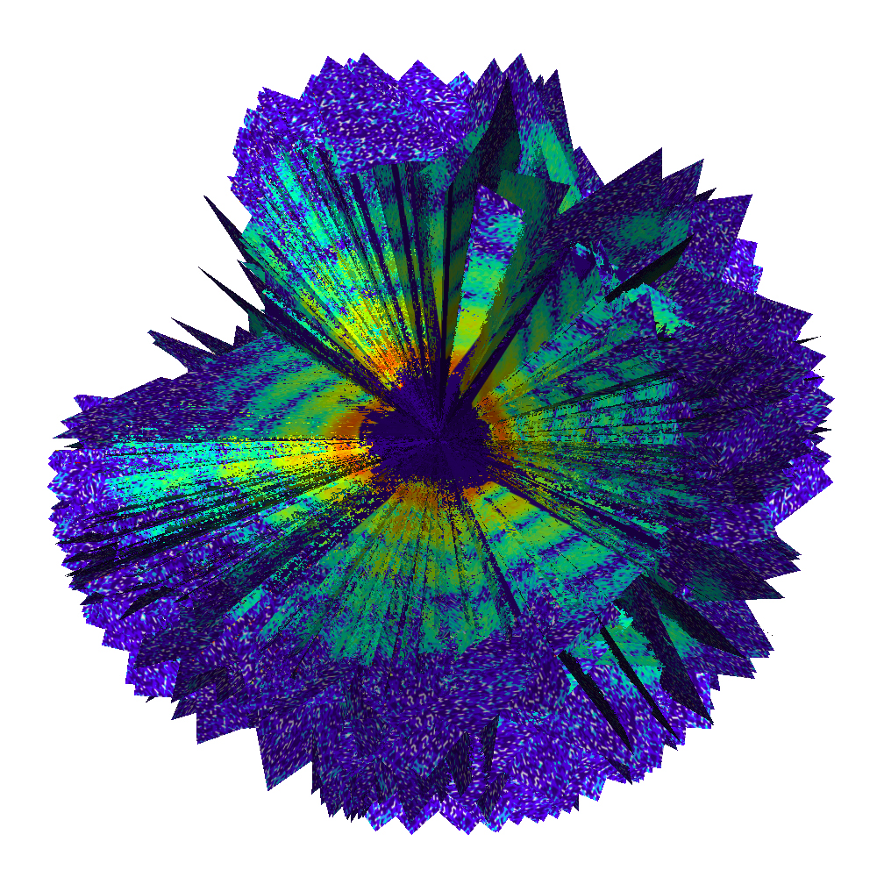
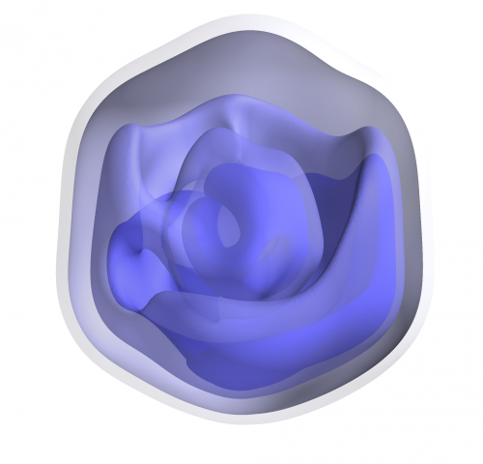
An Application: Molecule Imaging
Molecule Imaging
  Made possible by High Intensity + Short Pulses
  “Diffract before Destroying”

Slide 16
Thanks!
References and Further Reading
Cool Video
  “X-ray Laser Animated Fly-through” https://www.youtube.com/watch?v=pgaG7f96SKM
Cool Papers
  “First Operation of a Free Electron Laser”. Deacon et al., PRL Vol. 38, 1977.
  “Stimulated Emission of Bremsstrahlung in a Periodic Magnetic Field”. John Madey. Journal of Applied Physics Vol 42, 1971.
  “X-ray free electron lasers”. Mcneil et al., Nature Photonics 2010.
  “Demonstration of self-seeding in a hard-X-ray free-electron laser”. Amann et al., Nature Photonics 2012.
Cool Books
  “Principles of Free-electron Lasers”. H.P. Freund and T. M. Antonsen Jr. Chapman & Hall 1996.

