Slide 1
Free Electron Lasers
PHY4311
Mohammed Chamma
April 29 2015

Slide 2
All About Free Electron Lasers
Some Basic Properties. What characteristics do these types of lasers have?
Operating Principles and Theory
A Classical Explanation
SASE Free Electron Lasers
Xray Free Electron Lasers
Seed Limit
Uses and Applications

Slide 3
Properties and Characteristics
No Medium. What instead?
Relativistic, free electrons.
The output wavelength is tunable. How do we tune the wavelength?

Slide 4
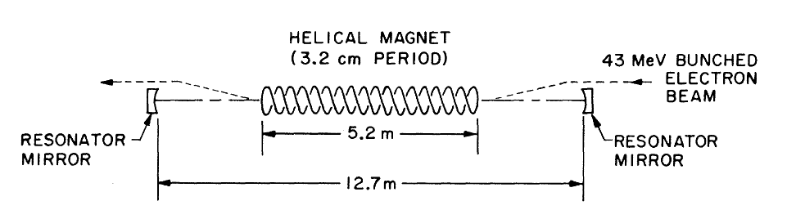
Operating Principles
A Basic Cavity
Electron Beam
Helical Magnet (Wiggler)
Light Travelling parallel to the electrons.

Slide 5
Operating Principles
Radiation arises from the interaction of three components
Electron Beam
Magnetic Field of the Wiggler
EM Field of the light travelling parallel to the electrons
The wig

Slide 6
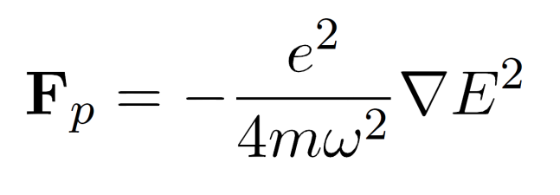
Operating Principles
Ponderomotive Force:
This is the force an electron feels due to an oscillating field (like an EM wave)
The magnetic field of wiggler + radiation field = ponderomotive wave. This wave is slower than c, so electrons can travel with it.
If the electrons are just slightly faster than the ponderomotive wave, they slow down to be in resonance. The energy they shed by slowing down amplifies the ponderomotive wave. (Classical Explanation)

Slide 7
SASE Free Electrons
NO MORE MIRRORS
Self-Amplified Stimulated Emission
Shot Noise
Seed Limit
Linear Accelerators

