Slide 1
Testing and Selecting Employees
Ch 4

Slide 2
When you finish studying this chapter, you should be able to:
Define basic testing concepts, including validity and reliability.
Discuss at four basic types of personnel tests.
Explain the pros and cons of background investigations, reference checks, and pre-employment information services.
Explain the factors and problems that can undermine an interview’s usefulness, and techniques for eliminating them.

Slide 3

Why is selection important?
First - your own performance depends in part on your subordinates. Employees with the right skills and attributes will do a better job for you and the company

Slide 4
Why is selection important?
Second - it’s costly to recruit and hire employees
Third - the legal implications of incompetent selection – negligent hiring

Slide 5
Validity
Tests must be valid, or measure what they are supposed to measure
A test should be job related - performance on a test should be a valid predictor of subsequent performance on the job

Slide 6
Demonstrating a test’s validity
Criterion validity
Demonstrating criterion validity -those who do well on the test also do well on the job, and those who do poorly on the test do poorly on the job

Slide 7

Demonstrating a test’s validity
Content validity
showing that the test constitutes a fair sample of the content of a job

Slide 8
Reliability
Consistency of scores obtained by the same person when retested with the identical tests or with an equivalent form of a test.

Slide 9
Ethical and Legal Questions in Testing
You must be able to prove that your tests were related to success or failure on the job
(2) You must prove that your tests don’t unfairly discriminate against either minority or non-minority subgroups

Slide 10

Employers use tests to measure a wide range of candidate attributes, including cognitive (mental) abilities, motor and physical abilities, personality and interests, and achievement

Slide 11

Intelligence tests, such as IQ tests, are tests of general intellectual abilities including memory, vocabulary, verbal fluency, and numeric ability
www.wonderlic.com

Slide 12
Tests of Motor and Physical Abilities - measure finger dexterity, strength, manual dexterity, and reaction time

Slide 13
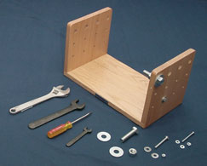
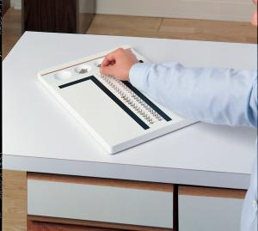
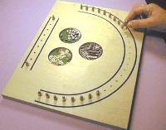
Hand Tool Dexterity Test
Purdue Pegboard Test

Slide 14
Personality and interests inventories are used as predictors of motivation and interpersonal skills
Personality tests measure basic aspects of an applicant’s personality, such as introversion, stability, and motivation

Slide 15
Personality tests—particularly the projective type—are the most difficult to evaluate and use
studies confirm that personality tests can help companies hire more effective workers

Slide 16

Personality tests
Emphasize the “big five” personality dimensions as they apply to personnel testing: extroversion, emotional stability, agreeableness, conscientiousness, and openness to experience

Slide 17
Conscientiousness shows a consistent relationship with all job performance criteria for all the occupations.
Extroversion is a valid predictor of performance for managers and sales employees
Openness to experience and extroversion predicted training proficiency for all occupations

Slide 18
Interest inventories compare one’s interests with those of people in various occupations
Achievement Tests are a measure of what a person has learned

Slide 19
Management Assessment Centers
Management candidates take tests and make decisions in simulated situations.
Lasts two or three days and involves 10 to 12 management candidates performing realistic management tasks
Can be expensive to operate

Slide 20

Management Assessment Centers
The in-basket - The candidate is faced with an accumulation of reports, memos, notes of incoming phone calls, letters, and other materials

Slide 21
Management Assessment Centers
The leaderless group discussion. A leaderless group is given a discussion question and told to arrive at a group decision.
The raters then evaluate each group member’s interpersonal skills, acceptance by the group, leadership ability, and individual influence

Slide 22

Management Assessment Centers
Individual presentations. A participant’s communication skills and persuasiveness are evaluated by having the person make an oral presentation on an assigned topic

Slide 23
Selection Interview
Selection procedure designed to predict future job performance on the basis of applicants’ oral responses to oral inquiries

Slide 24
Selection Interview
Non-structured - Interviewer asks questions as they come to mind,
no set format to follow
Structured - questions are specified in advance and the responses may be rated for appropriateness of content

Slide 25
Structured interviews
Structured interviews are generally more valid
can also help inexperienced interviewers to ask questions and conduct useful interviews.
structured interviews don’t always leave the flexibility to pursue points of interest as they develop

Slide 26

A deadline for a
project is near and it looks like you won’t meet the deadline. How would you handle this?
A customer comes in
angry and upset. How
would you handle this
situation?
Situational interviews - questions focus on the candidate’s ability to project what his or her behavior would be in a given situation

Slide 27
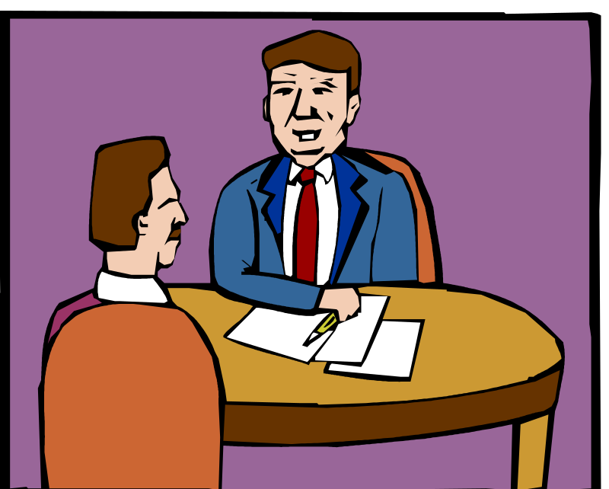
Describe a time when you were faced with a stressful situation that demonstrated your coping skills.
Give me a specific example of a time when you had to conform to a policy with which you did not agree
Behavioral interview
Applicants asked how they behaved in the past in some situation

Slide 28
Sequential interview - several persons interview the applicant in sequence before a selection decision is made
Panel interview - candidate is interviewed simultaneously by a group (or panel) of interviewers

Slide 29
Common Interviewing Mistakes
Snap Judgments
Negative Emphasis
Pressure to Hire
Candidate Order (Contrast) Error
Influence of Nonverbal Behavior

Slide 30

Common Interviewing Mistakes
An interviewer should remember to keep an open mind and consciously work against being preoccupied with negative feedback.

Slide 31
Common Interviewing Mistakes
Not Knowing the Job
Interviewers who don’t know precisely what the job entails and what sort of candidate is best suited for it usually make decisions based on incorrect stereotypes about what makes a good applicant

Slide 32
Guidelines for Conducting an Interview
Plan the Interview - start the interview with a clear picture of the traits of an ideal candidate.
Structure the interview - assures greater consistency, but helps to make sure that you are asking questions that provide real insight into how the person will perform on the job

Slide 33
Increase the standardization of the interview
Base questions on actual job duties
Use job knowledge, situational, or behaviorally oriented questions and objective criteria to evaluate the interviewee’s responses
Train interviewers
Use the same questions with all candidates
Use rating scales to rate answers
Use multiple interviewers or panel interviews
Take brief notes during the interview

Slide 34
Guidelines for Conducting an Interview
Establish Rapport
Be aware of the applicant’s status
Make it clear you’re going to conduct reference checks
Close the Interview
Try to end all interviews on a positive note
Review your interview notes

Slide 35
Don’t ask questions that can be answered “yes” or “no
Don’t put words in the applicant’s mouth or telegraph the desired answer
Don’t interrogate the applicant as if the person is a criminal, and don’t be patronizing, sarcastic, or inattentive.
Don’t monopolize the interview by rambling

Slide 36
Do ask open-ended questions
Do listen to the candidate to encourage him or her to express thoughts fully
Do draw out the applicant’s opinions and feelings by repeating the person’s last comment as a question
Do ask for examples

Slide 37
Background Investigations and Reference Checks
Why?
verify the accuracy of factual information provided by the applicant
uncover damaging background information such as criminal records and suspended drivers’ licenses.
Always get at least two forms of identification and always require applicants to fill at a job application

Slide 38
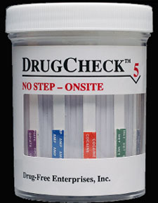
Polygraph Tests
the law prohibits most employers from conducting polygraph examinations of all applicants and most employees
Graphology
Drug Screening
www.kahntactmet.com/

