Slide 1

GEORG-AUGUST UNIVERSITÄT GÖTTINGEN
The Status Report
Philip, Marszal
12/05/2015
12/05/2015
Weekly Grid Meeting

Slide 2
GEORG-AUGUST UNIVERSITÄT GÖTTINGEN
Mixture Model
Distribution:
Bayes' Theorem:
EM-Algorithm:
Convergence:
M-Step
E-Step
12/05/2015
Weekly Grid Meeting
2

Slide 3
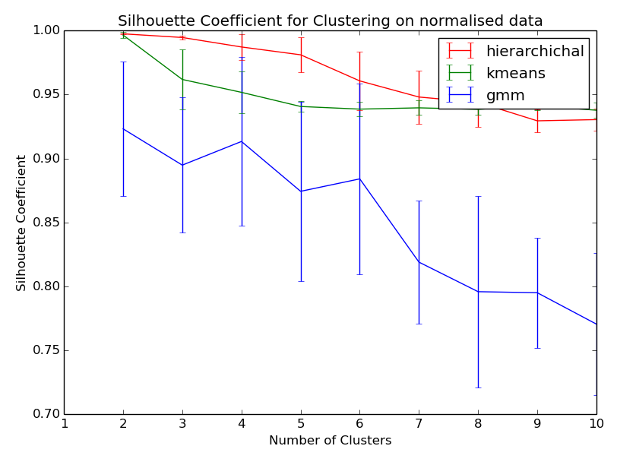
GEORG-AUGUST UNIVERSITÄT GÖTTINGEN
Plots
12/05/2015
Weekly Grid Meeting
3

Slide 4
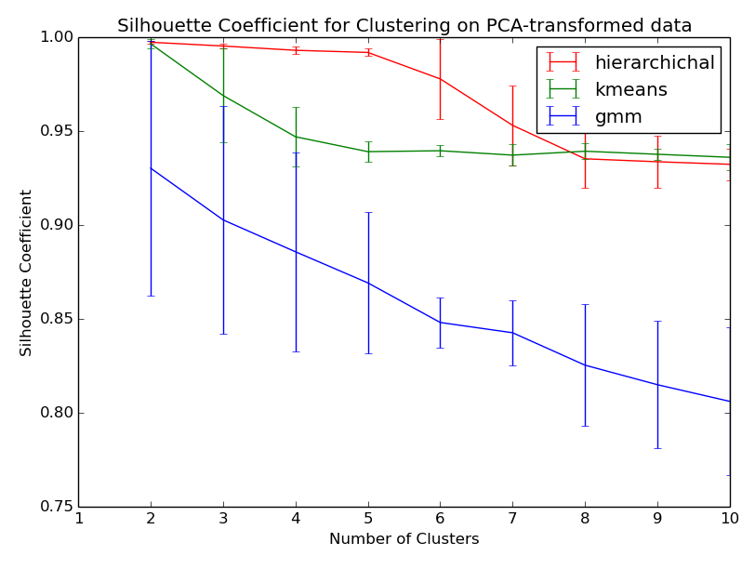
GEORG-AUGUST UNIVERSITÄT GÖTTINGEN
Plots
12/05/2015
Weekly Grid Meeting
4

