Slide 1
Composite Service Status Identification on SOA based Infrastructures

Slide 2
Composite Service
Communication between applications is achieved with services.
Composite services consist of sub-services and allow more complex operations.
Status of a composite service is not easily identified.

Slide 3
Clustering Problem
A Composite Service relies on the Status of all of its sub-services.
The Status of a single basic sub-service is determined by its response time.
The response-times of the sub-services at a given time can be interpreted as a point in the phase-space.
Multiple measurements show patterns in the phase-space.

Slide 4
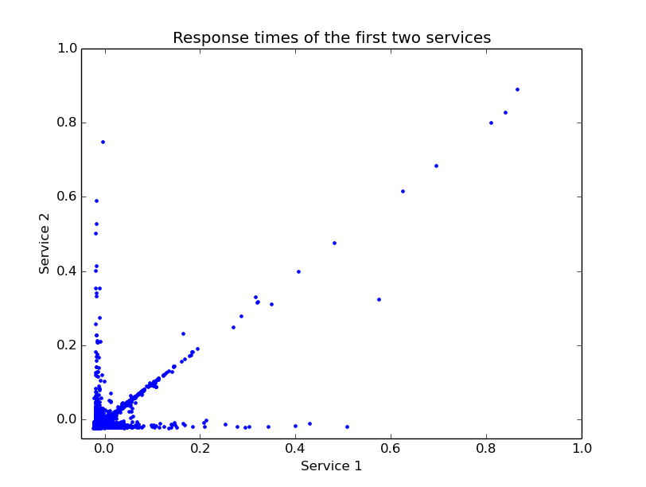

Slide 5
Clustering Problem
It is possible to attribute each point in the phase-space to a cluster corresponding to a status of the composite service.
Necessary steps:
  Determining the optimal number of clusters
  Determining the actual clusters

Slide 6
Methods
K-Means-clustering
  Starts with randomly distributed cluster centres.
  Attributes data-points to the cluster centre they are closest to.
  Calculates new cluster centres as the mean of the points in the cluster.
Hierarchical Clustering (Agglomerative)
  At the beginning each data point is a separate cluster.
  Clusters are merged based on distance.
  Provides different levels of clustering.

Slide 7
Determining the optimal number of clusters
Using the K-Means-Algorithm for different numbers of clusters
  The sum of squared distance (SSE) from cluster centre drops significantly at right cluster number (Elbow Method).
Hierarchical Clustering
Principle Component Analysis
  Number of principle components that cover most of the variance of the data (>95%) is a good estimate for the number of clusters.

Slide 8
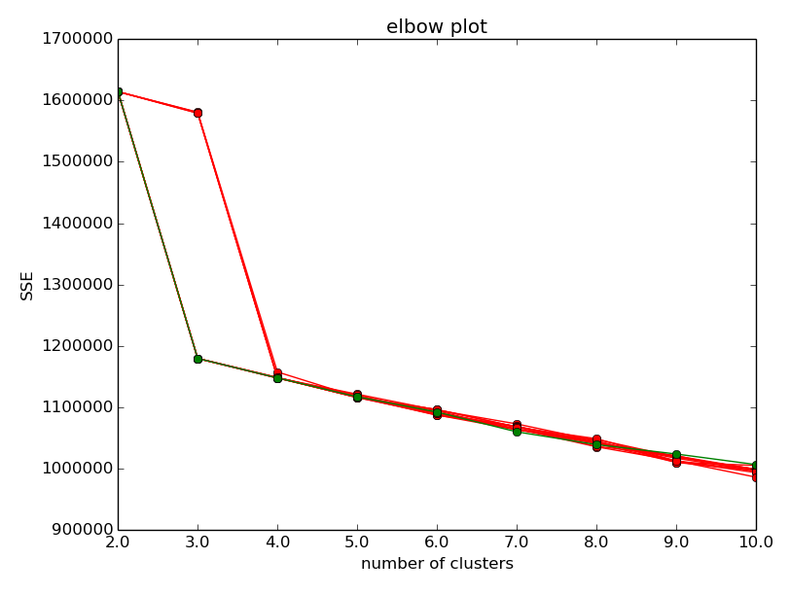
Elbow Method Plots

Slide 9
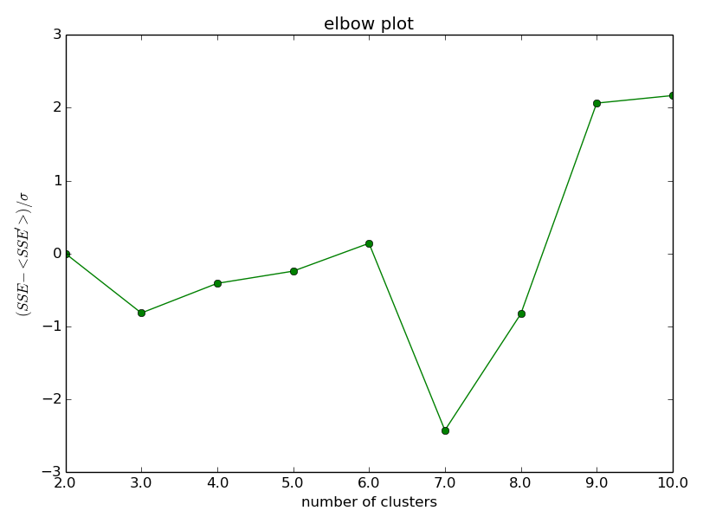
Elbow Method Plots

