Slide 1

GEORG-AUGUST UNIVERSITÄT GÖTTINGEN
The Status Report
Philip, Marszal
02/06/2015
02/06/2015
Weekly Grid Meeting

Slide 2
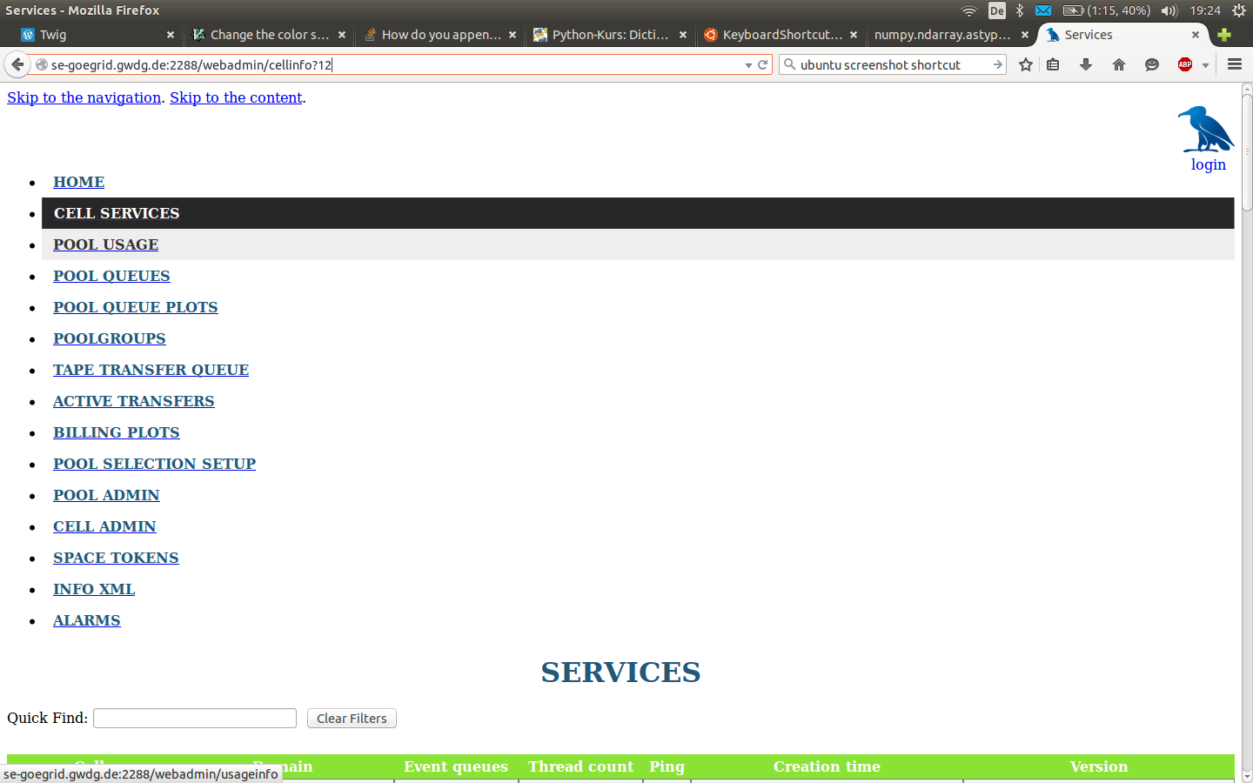
GEORG-AUGUST UNIVERSITÄT GÖTTINGEN
Services
02/06/2015
Weekly Grid Meeting
2

Slide 3
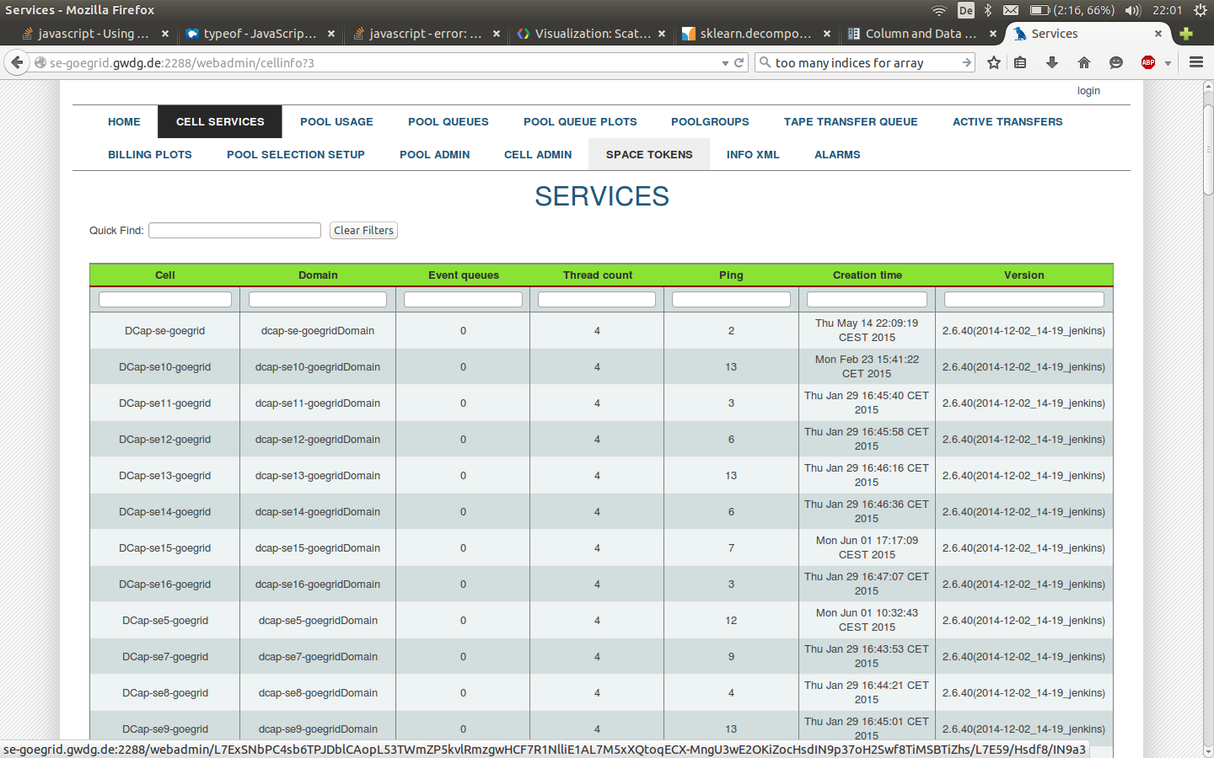
GEORG-AUGUST UNIVERSITÄT GÖTTINGEN
Services
02/06/2015
Weekly Grid Meeting
3

Slide 4
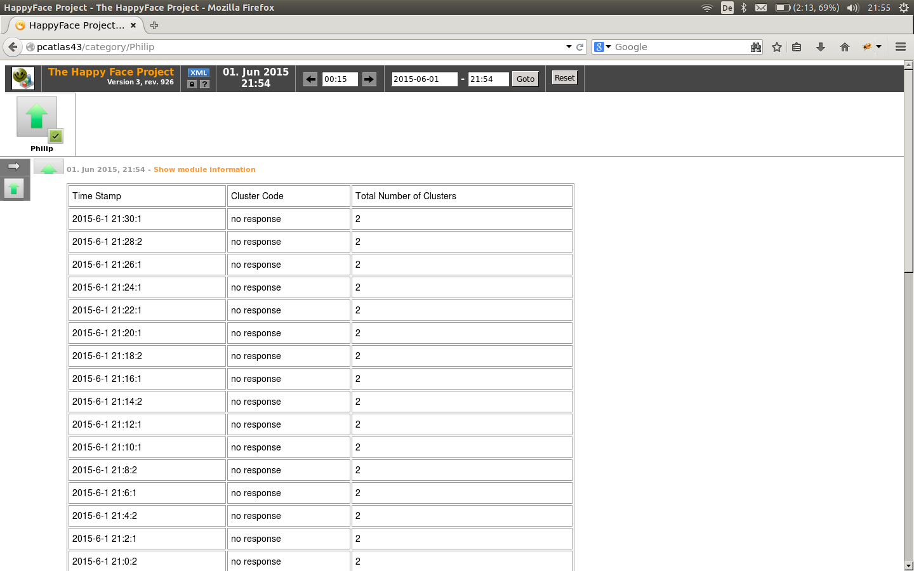
GEORG-AUGUST UNIVERSITÄT GÖTTINGEN
HappyFace
02/06/2015
Weekly Grid Meeting
4

Slide 5
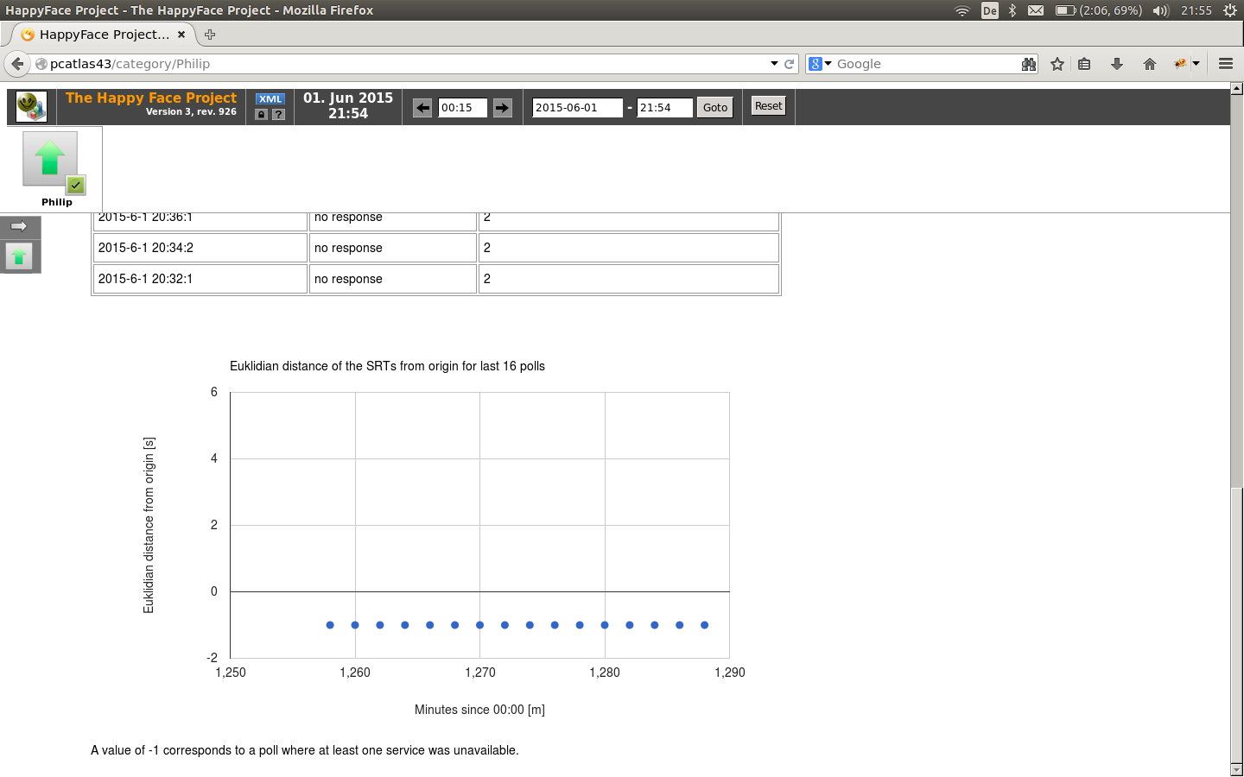
GEORG-AUGUST UNIVERSITÄT GÖTTINGEN
HappyFace
02/06/2015
Weekly Grid Meeting
5

