Slide 1

GEORG-AUGUST UNIVERSITÄT GÖTTINGEN
The Status Report
Philip, Marszal
05/05/2015
05/05/2015
Weekly Grid Meeting

Slide 2
GEORG-AUGUST UNIVERSITÄT GÖTTINGEN
Outline
Data-Structure
Clustering
Clustering on PCA transformed Data
05/05/2015
Weekly Grid Meeting
2

Slide 3
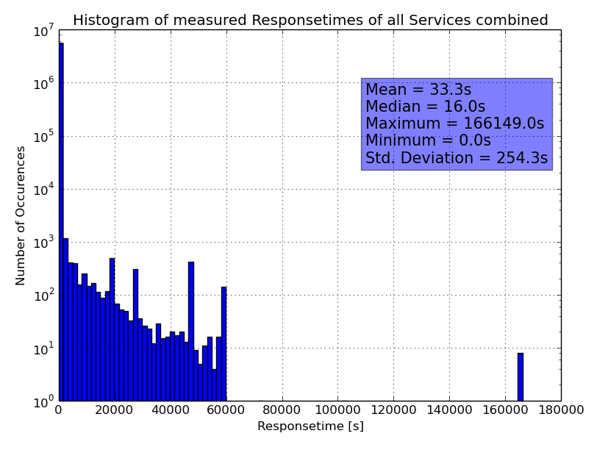
GEORG-AUGUST UNIVERSITÄT GÖTTINGEN
Plots
05/05/2015
Weekly Grid Meeting
3

Slide 4
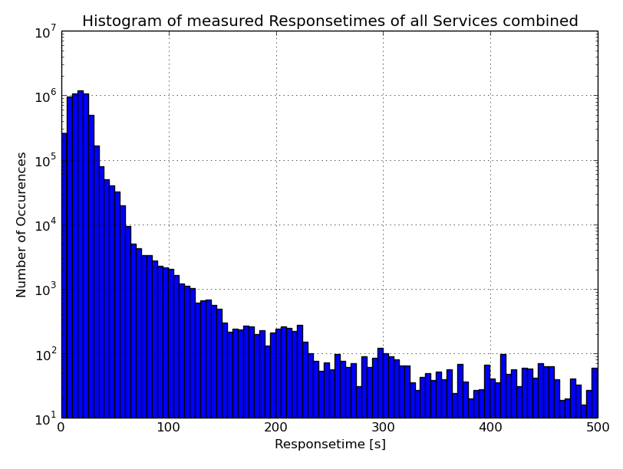
GEORG-AUGUST UNIVERSITÄT GÖTTINGEN
Plots
05/05/2015
Weekly Grid Meeting
4

Slide 5
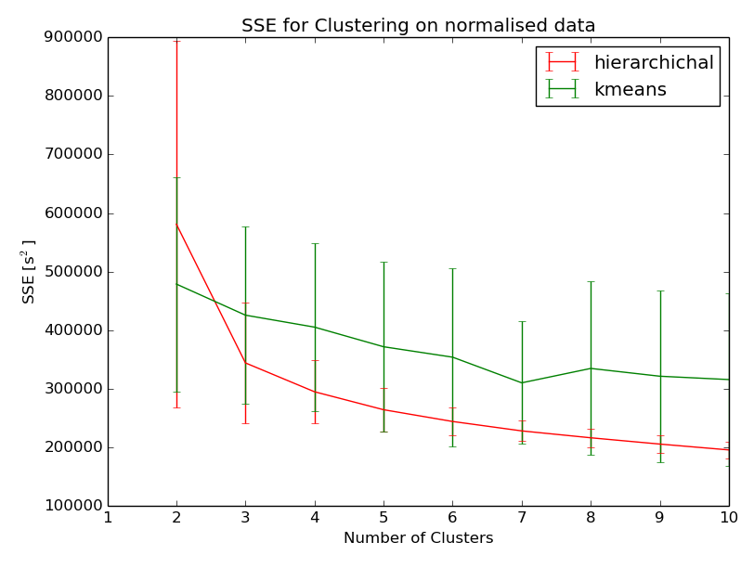
GEORG-AUGUST UNIVERSITÄT GÖTTINGEN
Plots
05/05/2015
Weekly Grid Meeting
5

Slide 6
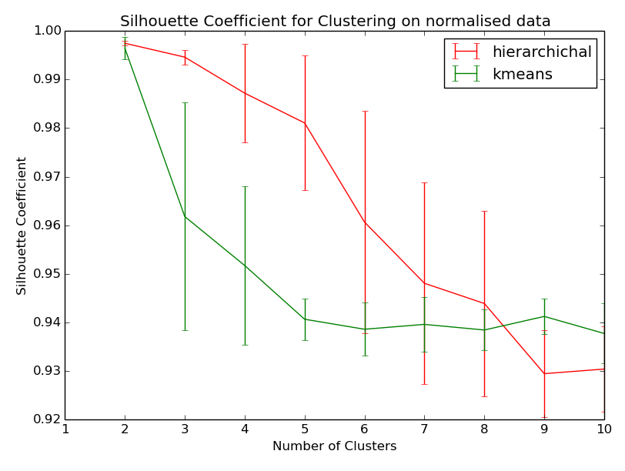
GEORG-AUGUST UNIVERSITÄT GÖTTINGEN
Plots
05/05/2015
Weekly Grid Meeting
6

Slide 7
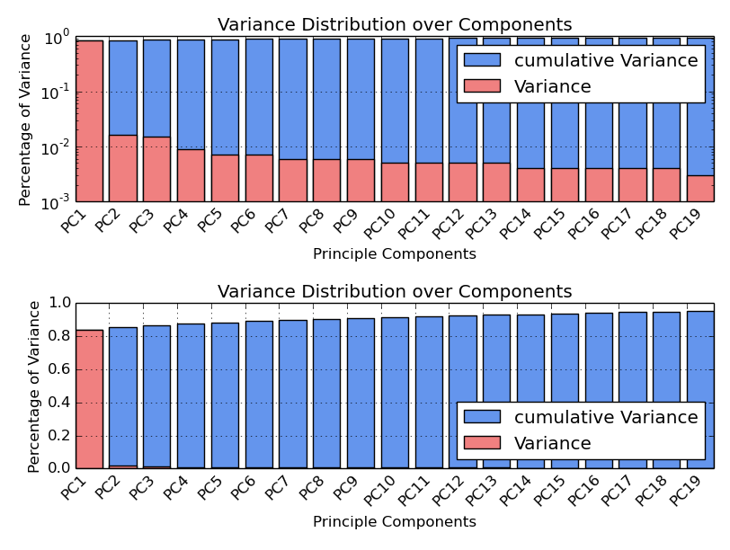
GEORG-AUGUST UNIVERSITÄT GÖTTINGEN
Plots
05/05/2015
Weekly Grid Meeting
7

Slide 8
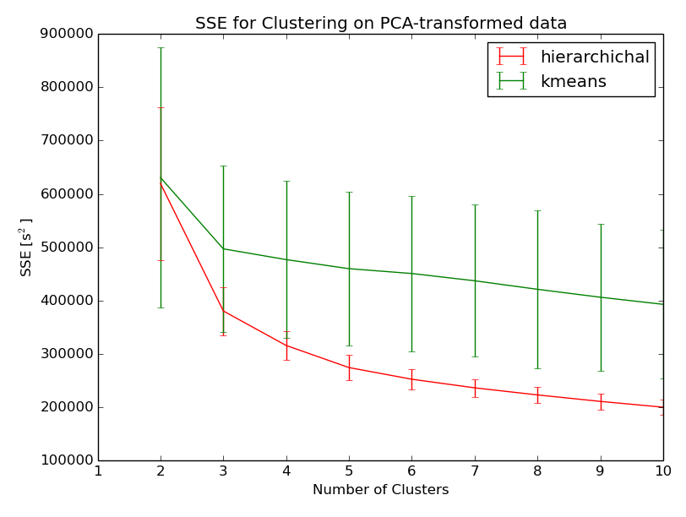
GEORG-AUGUST UNIVERSITÄT GÖTTINGEN
Plots
05/05/2015
Weekly Grid Meeting
8

Slide 9
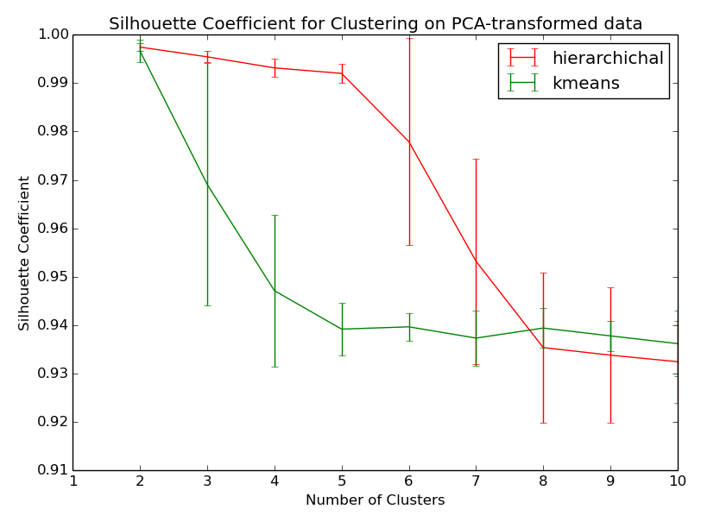
GEORG-AUGUST UNIVERSITÄT GÖTTINGEN
Plots
05/05/2015
Weekly Grid Meeting
9

