Slide 1

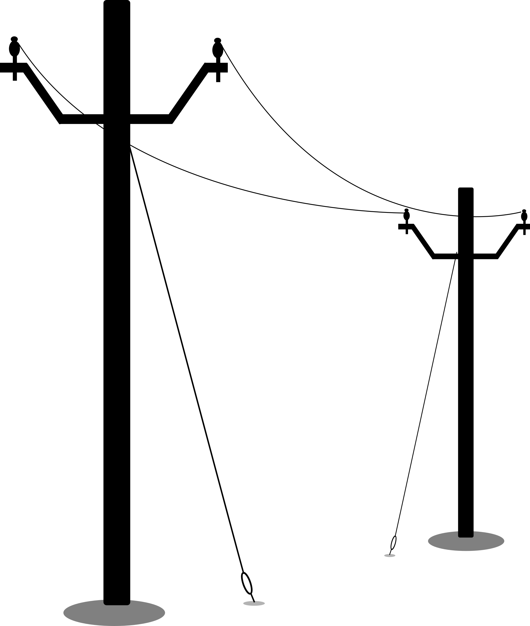
Inherent Susceptibility
Bird Susceptibility to cause Power Outages
Conditional
Susceptibility
Species Traits
Landscape
Exposure
Behavioral:
Preferred habitat
Nesting type
Flight type
Foraging type
Social behavior (flocking)
Circadian activity
Migratory activity
Habitat
Land use
Infrastructure configurations
Infrastructure placement
Vulnerability
Distribution
Abundance
Activity
Power outage
Stochastic
Susceptibility
Morphological:
Body size
Wing loading
Visual perception
Weather events
Exposure
Notes:
Social behavior-gregarious species increase in risk as multiple individuals gather near lines(Frazier)
Body size-connecting
Wingloading- high ratio of body mass/wing wingspan have less manuvarability in flight. More suseptable to collision (Damico)
Visual perception-bonicular vision is better at detecting obsticals than peripheral vision (Martin 2010)
Behvioral- Damico et al 2019, Bernardino et al 2018, Frazier, APLIC

Slide 2
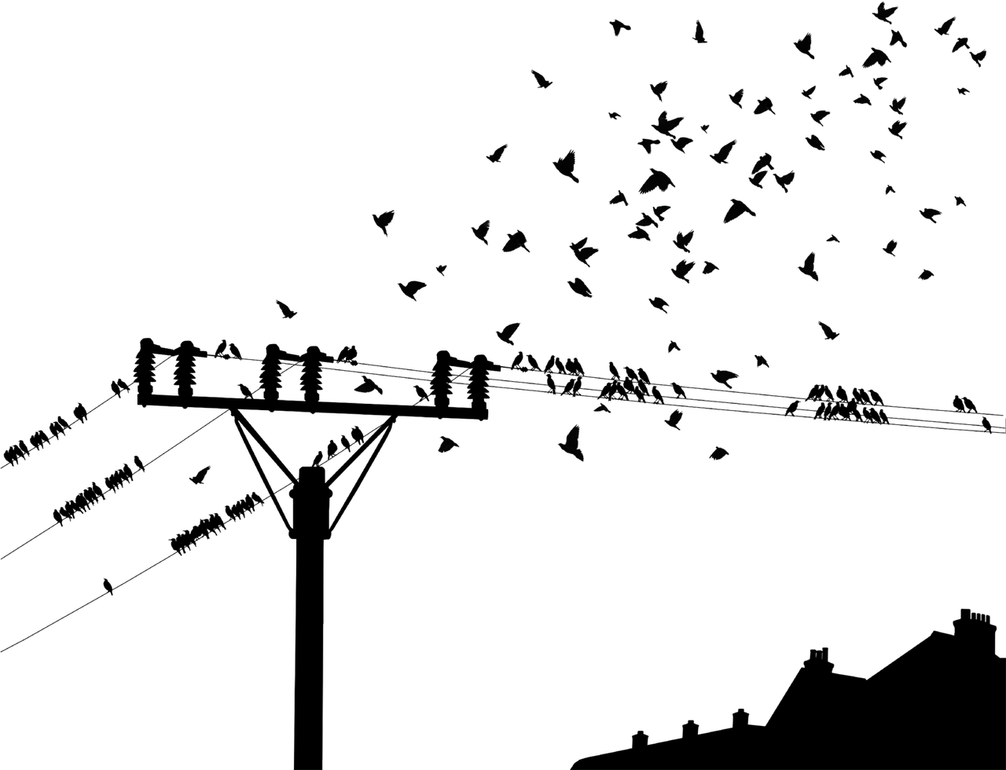

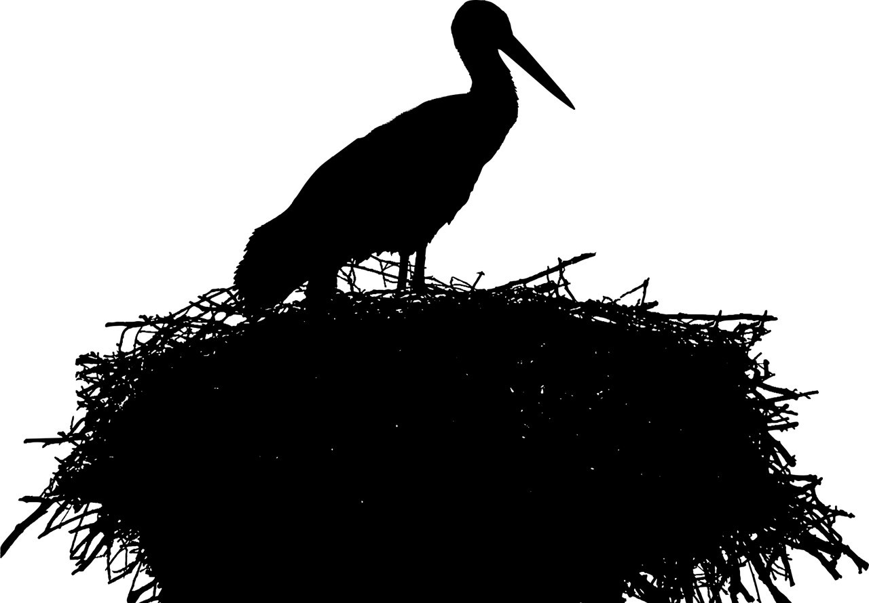


Biological Factors
Factors Contributing to ARO Risk
Vulnerability
Exposure
Biological Factors
Species Traits
Behavioral:
Preferred habitat
Nesting type
Flight type
Foraging type
Social behavior
Circadian activity
Migratory activity
Species distributions, abundance, and activity
Outage
Morphological:
Body size
Wing loading
Visual perception
Environmental Factors
Definite
Land use/Land cover
Infrastructure placement
Engineering Factors
Infrastructure configurations and mitigation strategies
Stochastic
Weather Events
Notes:
Social behavior-gregarious species increase in risk as multiple individuals gather near lines(Frazier)
Body size-connecting
Wingloading- high ratio of body mass/wing wingspan have less manuvarability in flight. More suseptable to collision (Damico)
Visual perception-bonicular vision is better at detecting obsticals than peripheral vision (Martin 2010)
Behvioral- Damico et al 2019, Bernardino et al 2018, Frazier, APLIC

Slide 3
Vulnerability
Exposure
Biological Factors
Deterministic Environmental Factors
Species Traits
Landscape Composition
(Land use/Land Cover)
Behavioral:
Preferred habitat
Nesting type
Flight type
Foraging type
Social behavior
Circadian activity
Migratory activity
Species distributions, abundance, and activity
Infrastructure placement and density
Outage Event
Morphological:
Body size
Wing loading
Visual perception
Species-Infrastructure Interactions
Engineering Factors
Stochastic Environmental Factors
Infrastructure configurations and mitigation strategies
Weather Events
Notes:
Social behavior-gregarious species increase in risk as multiple individuals gather near lines(Frazier)
Body size-connecting
Wingloading- high ratio of body mass/wing wingspan have less manuvarability in flight. More suseptable to collision (Damico)
Visual perception-bonicular vision is better at detecting obsticals than peripheral vision (Martin 2010)
Behvioral- Damico et al 2019, Bernardino et al 2018, Frazier, APLIC

Slide 4
Exposure
Vulnerability
Deterministic Environmental Factors
Biological Factors
Landscape Composition
(Land use/Land Cover)
Species Traits
Behavioral:
Preferred habitat
Nesting type
Flight type
Foraging type
Social behavior
Circadian activity
Migratory activity
Species distributions, abundance, and activity
Infrastructure placement and density
Species-Infrastructure Interactions
Outage Event
Morphological:
Body size
Wing loading
Visual perception
Engineering Factors
Stochastic Environmental Factors
Infrastructure configurations and mitigation strategies
Weather Events
Notes:
Social behavior-gregarious species increase in risk as multiple individuals gather near lines(Frazier)
Body size-connecting
Wingloading- high ratio of body mass/wing wingspan have less manuvarability in flight. More suseptable to collision (Damico)
Visual perception-bonicular vision is better at detecting obsticals than peripheral vision (Martin 2010)
Behvioral- Damico et al 2019, Bernardino et al 2018, Frazier, APLIC

Slide 5
Vulnerability
Exposure
Biological Factors
Deterministic Environmental Factors
Species Traits
Landscape Composition
(Land use/Land Cover)
Behavioral:
Preferred habitat
Nesting type
Flight type
Foraging type
Social behavior
Circadian activity
Migratory activity
Species distributions, abundance, and activity
Infrastructure placement and density
Outage Event
Morphological:
Body size
Wing loading
Visual perception
Species-Infrastructure Interactions
Engineering Factors
Infrastructure configuration and mitigation strategies
Stochastic Environmental Factors
Weather Events
Notes:
Social behavior-gregarious species increase in risk as multiple individuals gather near lines(Frazier)
Body size-connecting
Wingloading- high ratio of body mass/wing wingspan have less manuvarability in flight. More suseptable to collision (Damico)
Visual perception-bonicular vision is better at detecting obsticals than peripheral vision (Martin 2010)
Behvioral- Damico et al 2019, Bernardino et al 2018, Frazier, APLIC

