Slide 1

Menu Management and Cost Per Meal Dashboard
Michael Ferral
Nashville Software School DA5 Capstone

Slide 2
Agenda
Mission
Light Definitions
Motivation & Data Question
Workflow
Tour of Dashboard
Technologies Used
Moving Forward

Slide 3
Mission
“To bridge understanding that allows operators to use data to formulate conclusions on business performance”
Notes:
“To provide actionable data as quickly as possible to the people that can make the biggest impact- wordsmith
Define Operators!

Slide 4
Light Definitions
NetMenu- Menu management software
Gold- Card service software
Cost Per Meal = Total cost of food on the menu divided by number of customers that come through the door
Forecasted Amount/Cost- An educated guess on amounts to produce
Prepared Amount/Cost- The amount that got recorded for production in a real setting
Served Amount/Cost- The food that was served from the prepared
Leftover Amount/Cost- The difference of the prepared and served cost/amount

Slide 5
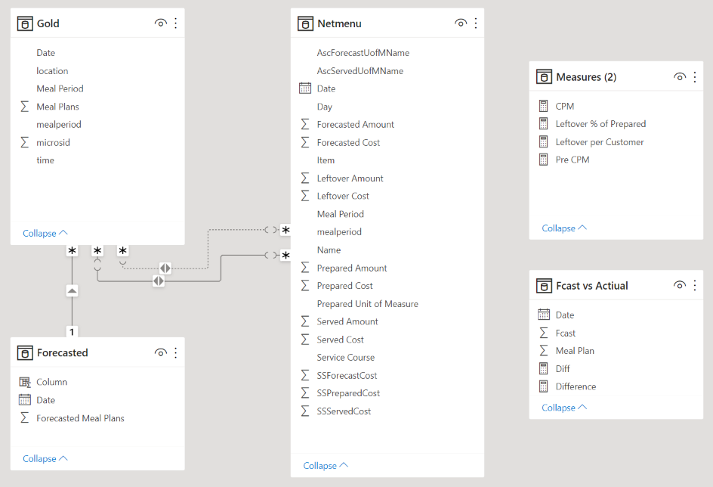
ERD

Slide 6
Data Question
How can we get NetMenu results to be displayed with visuals and have it updated with Meal Plan reports that are coming out of Gold daily?
Notes:
Pain Points- the foodservice business moves so fast, and in large scale dining operations the business is so nuanced, that there is often a lack of follow up with available information.
The real goal of this dashboard is to be a frequently visited page by the operators where they can adjust their production.
In my time at Vanderbilt I was on the team that led the implementation of this Menu Management software and the lack of meaningful feedback it was able to give to our operators was always in the back of my mind.
In NSS I often thought about how I could use all of the things I was learning to better the processes we already had and
saw this as low hanging fruit that could serve an immediate impact, especially as those operators navigate unknown forecasting, and unknown menu items as a result of the pandemic/product shortages etc.

Slide 7
Motivation
The motivation for creating this dashboard was to create a tool to have real time data
The opportunity to shorten the feedback loop and push information without operators having to run reports
Notes:
We have core LOB software that does not allow for automation, and this project identifies an opportunity to shorten the FB loop for enhanced operational effectiveness.
Shift managers that look at this information are the ones that have the ability to make the biggest difference.

Slide 8
Workflow
Business Date Happens and End of Day Processes are run. Email of CSV’s are sent
Power Automate moves those CSV’s to a local file based upon the subject line
The information from those files are ingested and parsed using python, and then moved to another folder where they get sourced by PowerBI
As the days’ data comes in PowerBI is refreshed via On-Premises Data Gateway and pushed to web environment
Dashboard is analyzed by front end user
Notes:
Specific libraries were used to read in entire folders of data and concatenate them into single dataframes. This was needed to put all the files together as Power Automate sent them in.
Transaction DataFrame- the data was cleaned to a specific point so that it only sent PowerBI the necessary information for that specific Dining Hall. There were many null values that had to be dropped and all the datetime formatting was done before PowerBI.
Menu DataFrame- there was a lot of erroneous information that needed to be sorted through. There were columns that would lead you to believe that at some point they were calculated fields, but they were not. I had to go back to the source system and decipher what was correct and recreate those calculated fields.
PowerBI- for measures that depended on relationships between the dataframes I made created a ‘measures’ table to drive the cards on the actual dashboard as well as a table that calculated the difference between forecasted and actual Meal Plan counts
"ingested, parsed, filtered by python"

Slide 9
Data Cleaning and Python
Specific libraries were used to read in entire folders of data and concatenate them into single dataframes. This was needed to put all the files together as Power Automate sent them in.
Transaction DataFrame- the data was cleaned to a specific point so that it only sent PowerBI the necessary information for that specific Dining Hall. There were many null values that had to be dropped and all the datetime formatting was done before PowerBI.
Menu DataFrame- there was a lot of erroneous information that needed to be sorted through. There were columns that would lead you to believe that at some point they were calculated fields, but they were not. I had to go back to the source system and decipher what was correct and recreate those calculated fields.
PowerBI- for measures that depended on relationships between the dataframes I made created a ‘measures’ table to drive the cards on the actual dashboard as well as a table that calculated the difference between forecasted and actual Meal Plan counts

Slide 10
Dashboard Tour

Slide 11
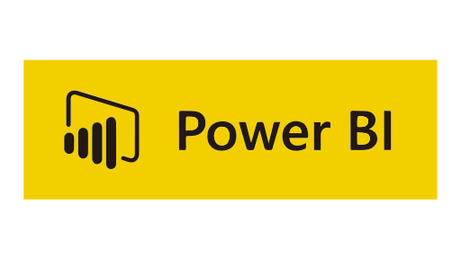


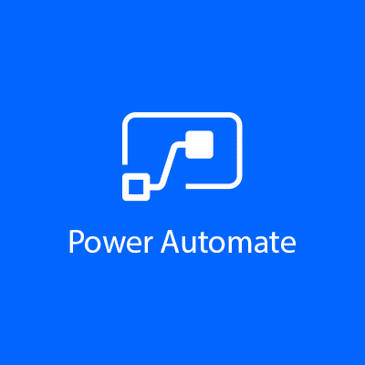
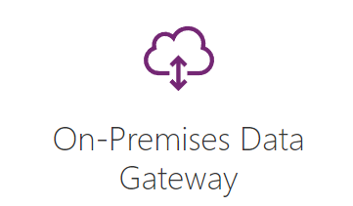

Technologies Used
Python os & glob libraries for reading in entire folders
Python schedule & time libraries for setting up automation loops
OKVIZ custom slicers for PowerBI

Slide 12
Moving Forward Recommendations and Closing
I would move the automation to occur in a cloud computing environment and have the python be run remotely
This process could run more than one time per day to give an even shorter feedback loop for operators to adjust narrowly if needed
Incorporate waste data as well as purchasing data for a detailed analysis of cost of goods
Thanks to all the Foodservice Staff who generated this information and to Vanderbilt Campus Dining for partnering with me for my NSS Capstone
Notes:
Give feedback to menu management software vendor to have their fields calculate automatically and for the ability for reports to be automated out of their system

