Slide 1
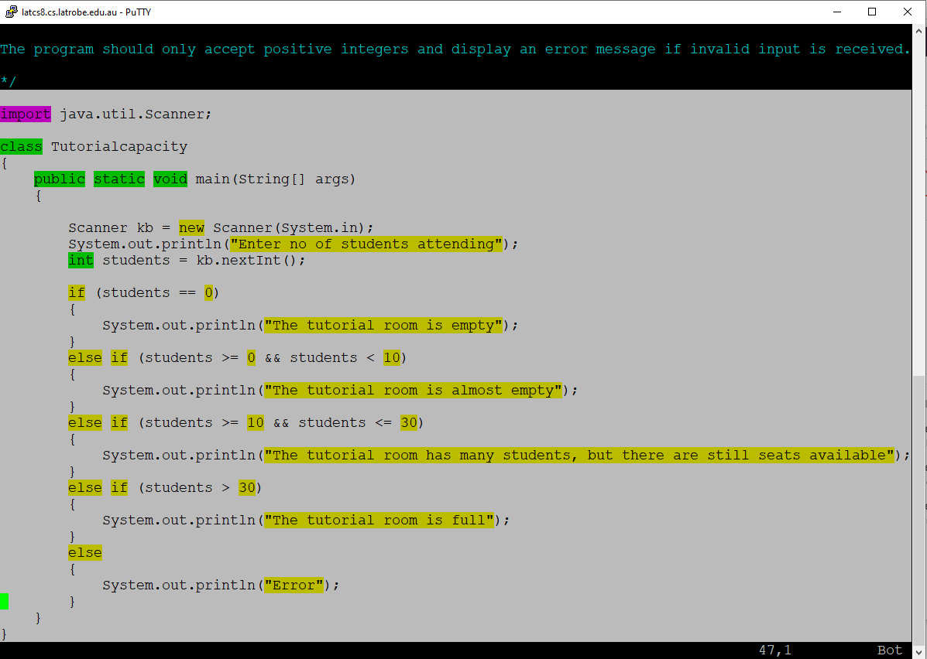
Windows: left-click and drag to copy text
MAC: select by dragging mouse, then cmd+C

Slide 2
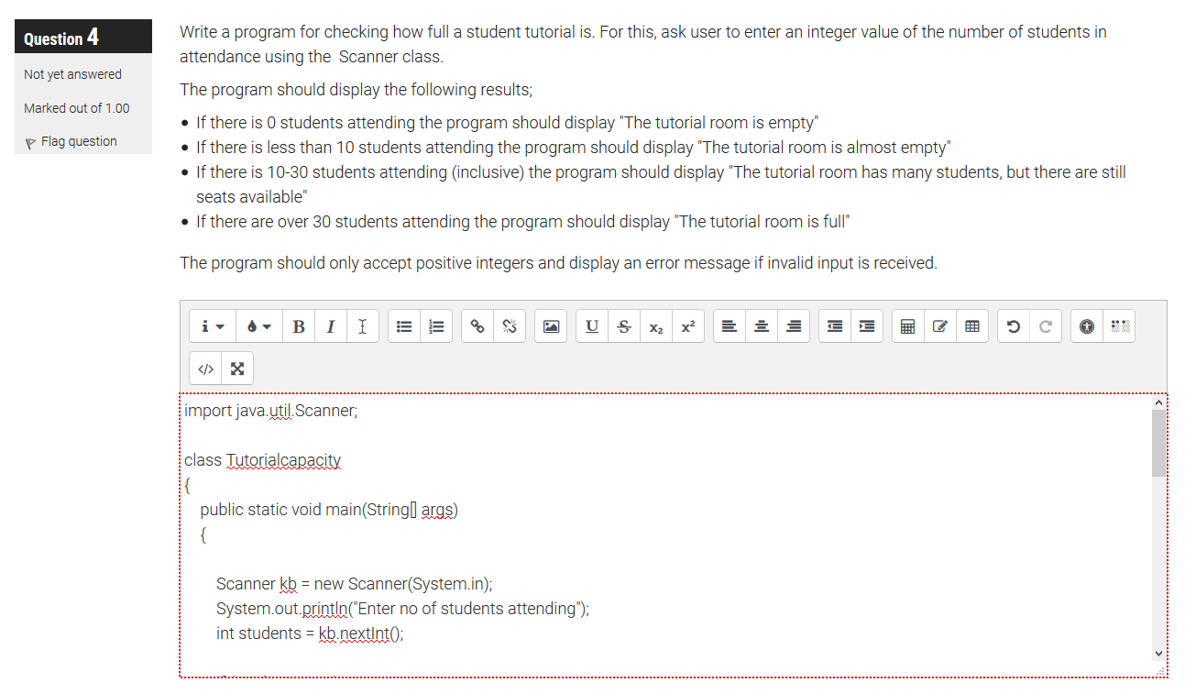
Windows: ctrl+V to paste into the LMS text field
MAC: cmd+V to paste into the LMS text field

Slide 3
Method | Description
isLetter() | Determines whether the specified char value is a letter.
isDigit() | Determines whether the specified char value is a digit.
isWhitespace() | Determines whether the specified char value is white space.
isLetterOrDigit() | Determines whether the specified char value is either a letter or digit.
isUpperCase() | Determines whether the specified char value is uppercase.
isLowerCase() | Determines whether the specified char value is lowercase.
toUpperCase() | Returns the uppercase form of the specified char value.
toLowerCase() | Returns the lowercase form of the specified char value.
toString() | Returns a String object representing the specified character value that is, a one-character string.

