Slide 1
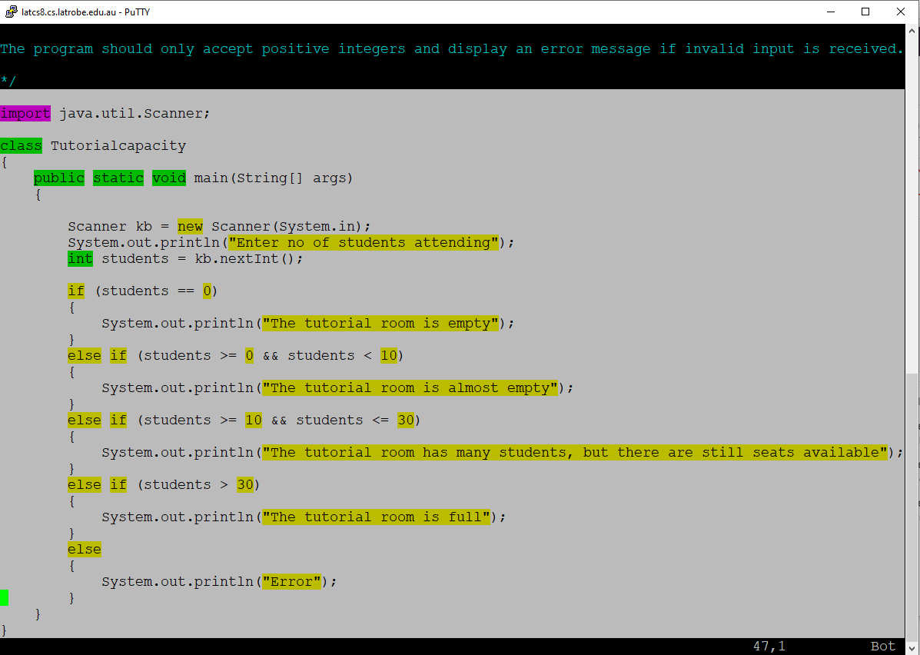
Windows: left-click and drag to copy text
MAC: select by dragging mouse, then cmd+C

Slide 2
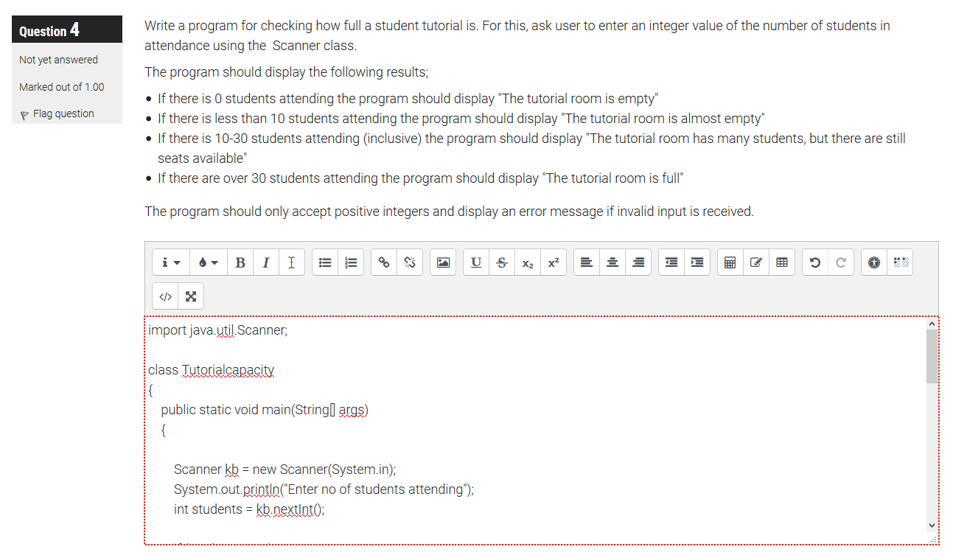
Windows: ctrl+V to paste into the LMS text field
MAC: cmd+V to paste into the LMS text field

