Slide 1

BEST Program
Problem Solving System (PORT™)
System introduction

Slide 2

BEST Excellence Academy_x000B_Driving talent and a culture of continuous improvement
Purpose: Build capabilities at every level of the organization through robust management systems, fostering efficient work and achieving objectives aligned with Hanseatic Global Terminals’ strategy.
Aligned
competencies
Strong values and principles
This is “how” we will achieve organizational objectives
Continuous learning culture

Slide 3













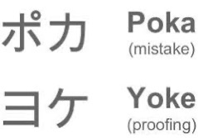

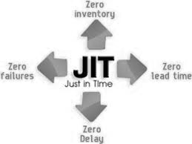
The Excellence Academy
Coach
Experto
Practicante
Fundamentos
Training facilitation, coaching, and strategic initiatives
Management
Roles
Advanced tools: Value Stream Mapping (VSM), SMED, Leadership Academy, and Yellow Belt training
Supervisory Roles
Basic Lean tools: 6S, Problem Solving and Visual Management, initiative generation (Kaizen), and change management practitioner skills
100%
of the workforce
Establish a common language and provide onboarding
Jidoka
*Integration with Cornerstone pending

Slide 4
Skills Matrix_x000B_Developing the right capabilities for the right people
 | Categoría de Habilidad | 100% de la población | Roles de Supervisión | Roles gerenciales
 | Fundamentos Lean | Conocimiento de los principios y bases del programa | Aplicación de los principios y bases del programa | Promoción y aseguramiento de la cultura Lean
 | Gestión visual y 6S | Conocimiento y aplicación | Seguimiento de la implementación, facilita entrenamientos | Seguimiento de resultados y facilita los recursos
 | Resolución de Problemas (PORT™) | Participación en las sesiones de resolución de problemas | Lideran las sesiones, facilita entrenamientos | Valida las acciones que corrigen la causa raíz
 | Yellow Belt (Problem Solving 2.0) | N/A | Aplicación de DMAIC en proyectos estratégicos | Da seguimiento a los proyectos y facilita recursos
 | Mapeo de la Cadena de Valor (VSM) | M/A | Ejecución en procesos | Diseño y optimización estratégica
 | Gestión del Cambio | Conocimiento general | Aplicación en proyectos, ADKAR | Liderazgo en transformación, espónsor
 | Hoshin Kanri (despliegue estratégico) | Comprender objetivos | Alineación de iniciativas con el equipo | Definir y comunicar objetivos estratégicos
 | Liderazgo y Coaching | N/A | Liderar equipos y dar retroalimentación | Coaching, mentoría y desarrollo de líderes
 | Gestión de indicadores (KPIs) | Interpretación básica | Seguimiento y análisis | Definición, análisis avanzado y toma de decisiones
 | Comunicación y colaboración | Comunicación efectiva | Coordinación interfuncional, pensamiento sistémico | Comunicación estratégica y gestión de stakeholders
6σ
Continuous learning culture

Slide 5
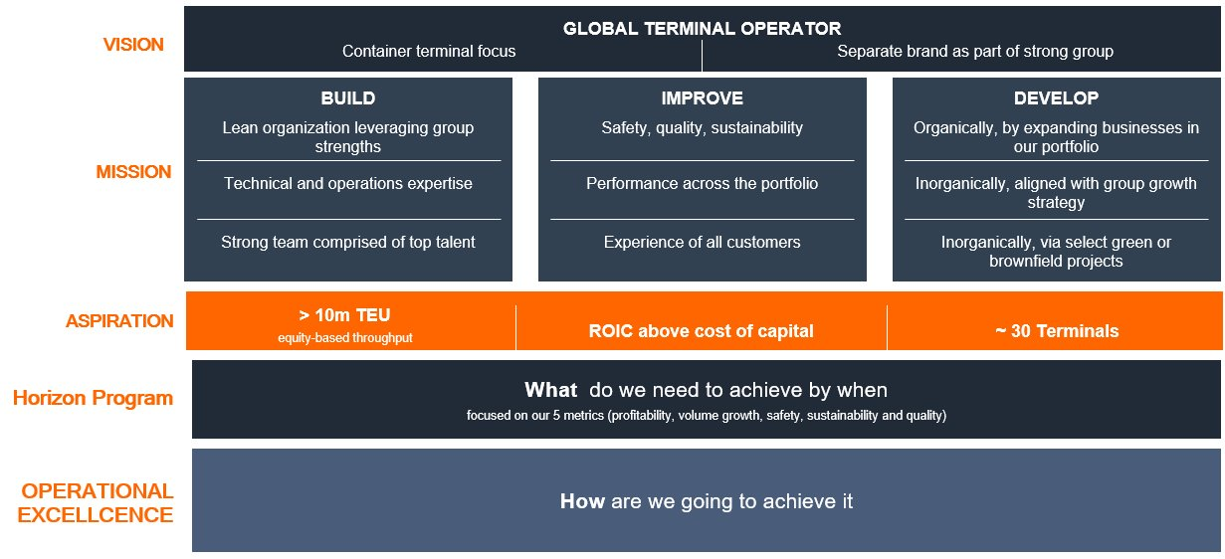
PORT™
PORT™ is Hanseatic Global Terminals’ official, registered tool for defining, analyzing, and solving problems in a structured way.
It was developed to strengthen frontline capabilities and ensure data-driven decisions across our business units. The tool is directly connected to HGT’s strategy and forms part of the foundation for achieving our organizational objectives.

Slide 6
Excellence Infrastructure: The Tools Behind the Transformation
Operational System
Tools & Methods
BEST Academy Training
Support Systems
Strategy Deployment
(“Hoshin Kanri”)
Quality & Customer Experience System
Problem Solving (PORT™)
Change Management Leadership
Standard Work &
Performance Management
Recognition System
6s & Visual Management
Genba as a leadership behavior
Learning & Development System
Process Management &
People Skills
Value Stream Mapping
Visualize and prioritize problems
Diagnostic Assessment
Improvement Management
Voice of the Customer
Coach & Mentor teams
6σ
Six Sigma (Problem Solving 2.0)
Excellence Agents Network
Project & Change Management
Improvement & Standardization cycles

Slide 7
Definitions
BEST: An excellence system that aims to improve safety, efficiency, and results through discipline, standardization, and continuous improvement.
Gemba Walk: Observe the process directly rather than from the office.
6S: A workplace organization, cleanliness, and safety methodology: Sort, Set in Order, Shine, Standardize, Sustain, and Safety.
Hoshin Kanri: A method for aligning strategic objectives with daily operational activities.
System: A set of processes, people, and tools working in an organized way to achieve a common goal.
KPI: A key indicator that measures the performance of a process or activity.
GMPH: A productivity indicator that measures the total moves completed per hour.
Sponsor: A leader who supports an initiative, removes resource barriers, and follows up on progress.
Visual Management: The use of boards, colors, charts, and signals to make information clear and visible to everyone.
Shibumi: The corporate platform for tracking BEST initiatives, impacts, and project progress.
Microsoft Forms: A tool for collecting information digitally through forms.
Microsoft Lists: A tool for recording, organizing, and tracking actions, tasks, or initiatives.

Slide 8
PORT™ Training
Week 1:
System Introduction
Week 2:
Pinpoint the Problem
Week 3:
Observe and Analyze, Part 1
Week 4:
Observe and Analyze, Part 2
Week 5: Resolve with Actions
Week 6: Track and Sustain
Problem Solving as a System
Scope
Definition
Caused vs. Created Problems
PORT Phases
Importance of Defining a Problem Correctly
Tree Diagram
Articulate the Problem Statement
Ishikawa Diagram
Multivoting Matrix
Root Cause
5 Whys
Countermeasure Definition
Countermeasure Prioritization
Action Plan Validation
Pilot Test
Communication Plan
Tracking Method
Meeting System
Visual Management
Recognition System
Reflection / Closing

Slide 9
Training
Week 1: Definition and Scope
Problem Solving as a System
Scope
Activity 1: The Factory Without a System
Problem Solving Definition
Difference Between Caused and Created Problems
When Not to Use Problem Solving
PORT™ Phases
Roles
9. Problem Capture
10. Despliegue
11. Tracking and Sustainment
12. Alignment with Other Systems
13. Activity 2: Hunting for Problems

Slide 10

BEST
PORT™
A Problem Solving tool

Slide 11
Problem Solving as a System
Standard
Frequency
Skill Development
BEST
Environment
Indicator
PORT™
A Problem Solving tool
Improvement
Feedback

Slide 12
System Scope
Problem Capture
Definition
PORT™ Phases
Roles
Deployment
Sustainment
Alignment
Standardization of Problem Capture and Resolution

Slide 13
Activity 1
The Factory Without a System
45 min
Blank sheets of paper, pens, and a stopwatch
Group Activity
Teamwork
PORT Training (Facilitator’s Manual), p. xx.
Deliverable:
Participants’ reflections

Slide 14

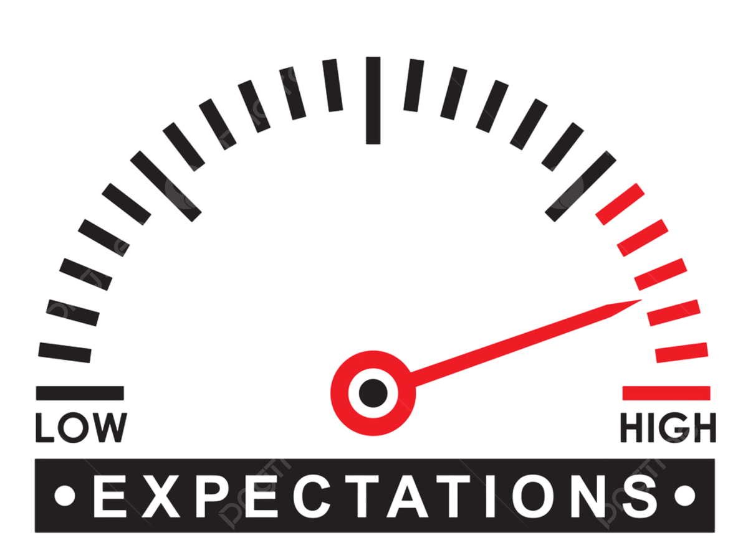
What Is Problem Solving?
Problem Solving is a structured approach to identifying, analyzing, and solving problems that prevent a desired outcome from being achieved. Its main objective is to eliminate the root causes of deviations—not just their symptoms—through analytical tools, collaboration, critical thinking, and data-driven decision-making.
BEST
PORT™
A Problem Solving tool
PDCA
Caused Problem
Created Problem
Failure to meet an existing standard.
➡ A deviation from what has already been defined; the root cause is unknown
Gap against a new expectation.
➡ An improvement challenge, not a failure to comply.

Slide 15

What Is Problem Solving?
Problem Solving is a structured approach to identifying, analyzing, and solving problems that prevent a desired outcome from being achieved. Its main objective is to eliminate the root causes of deviations—not just their symptoms—through analytical tools, collaboration, critical thinking, and data-driven decision-making.
BEST
SIX
PORT™
A Problem Solving tool
SIGMA
PDCA
Caused Problem
Complex Project
Created Problem
Failure to meet an existing standard.
➡ A deviation from what has already been defined; the root cause is unknown
Gap against a new expectation.
➡ An improvement challenge, not a failure to comply.
DMAIC

Slide 16

PORT™ or Six Sigma?
BEST
SIX
SIGMA
PORT™
A Problem Solving tool
The problem is operational and specific.
No statistical analysis is required.
Local impact (specific area).
The problem does not pose a high risk to safety, quality, or costs.
Short resolution time.
Small team, mainly frontline personnel.
The problem is complex.
It affects several processes or areas.
It requires statistical analysis and data handling.
It has a high impact on safety, quality, or costs.
Medium- to long-term resolution time.
Multidisciplinary team led by a Yellow Belt.

Slide 17
When Not to Use Problem Solving
The solution is obvious
The problem is an isolated, insignificant case (with no impact on safety or costs).
Problems already solved with a documented solution.

Slide 18
P
O
R
T
Phases
inpoint the Problem
bserve and Analyze
esolve with Actions
rack & Sustain

Slide 19
P
O
R
T
Definition
Proposed Scope
Creating Working Groups
Why Problem Solving?
What Is It Used For?
Caused or Created Problems
Problem Statement (gap / fluctuation)
Tree Diagram, Part 1
TAGS – SMART
Tree Diagram, Part 2
Ishikawa
Multivoting Matrix
5 Whys
Root Cause
Jefferson Memorial
Permanent / Temporary Countermeasures
Countermeasure Pilot
Implementation Plan
Countermeasure Validation
Ways to Ensure Sustainability
Examples of Each

Slide 20
Roles
Top management
Strategic Sponsor
Middle management
Facilitator and Supervisor
Front line
Doer and Detector

Slide 21
Roles
Top management
Strategic Sponsor
Tracks key indicators and results (Meeting System)
Promotes a culture of continuous improvement
Sets priorities
Allocates resources
Recognizes and celebrates achievements

Slide 22
Roles
Middle management
Facilitator and Supervisor
Ensures discipline
Removes barriers
Monitors countermeasure implementation
Develops capabilities
Translates objectives

Slide 23
Roles
Front line
Doer and Detector
Identifies problems
Documents and standardizes
Solves problems
Participates actively
Embraces continuous improvement

Slide 24


Problem Capture
Slide for Leaders
Problems are part of daily life at the terminal. Having a dedicated way to collect and prioritize them is a very important step in the Problem Solving system.
Standard Work & Performance Management
Gemba
Voice of the Customer (Customer Feedback)
Audits
Safety Incidents
Having No Problems Is a Big Problem
PROBLEM CAPTURE FORM

Slide 25
Problem-Solving Team
Effective Collaboration to Solve Problems
The process owner is the Problem Solving leader
4
Maximum of
4 members
Small Teams, Big Impact

Slide 26

Deployment (Visual Management System)
Slide for Leaders
w
Weekly meeting board
High
Problems identified
Avoid
Plan
Effort
P
O
Optional
Priority
Low
Low
Impact
High
T
R
Identified
In execution
Completed
Pinpoint the problem
Observe & analyze
Resolve with actions
Track, validate & sustain
Notes:
Cambiar DIVE por PORT

Slide 27
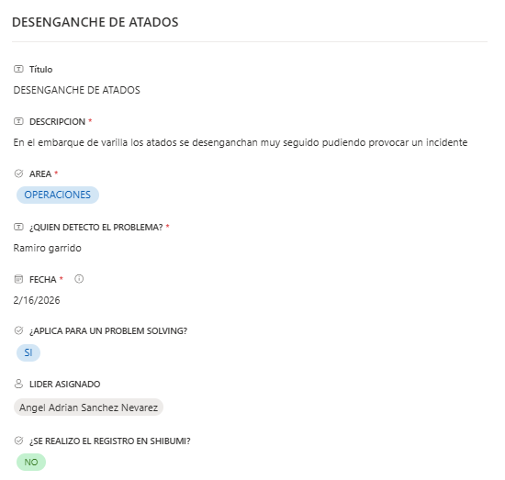
Meeting System_x000B_Daily and weekly control to ensure continuous improvement
Slide for Leaders
Problem Solving
Part of the weekly meeting agenda
Daily
Problem Capture
Weekly Meeting
Prioritization and Team Assignment
45 min
Trends
Actions
Problem Solving
Initiatives
Escalations
PROBLEM CAPTURE FORM
6S Plan
50% Past
50% Future

Slide 28
Alignment with Other Systems
Visual Management
6S
Meetings
Problem Solving
Hoshin
Kanri
Gemba Walk
Performance Management
Notes:
Cambiar DIVE por PORT

Slide 29


Slide 30
Activity 2
Hunting for Problems
Pair Activity
GEMBA
Guide Form
Entregable:
Present your observations in the next session using your preferred format (PowerPoint, Word, image, etc.). The problem collected will be the first step of the final project.
Formulario Genba.

Slide 31
BEST Program
Problem Solving System (PORT™)
Week 2: Pinpoint the Problem

Slide 32
Training
Week 2: Pinpoint the Problem.
Activity 2 Presentation: Hunting for Problems
Importance of Defining a Problem Correctly
What Is a Problem?
Symptoms, Problems, and Causes
Tree Diagram
Activity 3: Symptoms or Causes?
Articulate the Problem Statement
8. Activity 4: Before Solving, Learn to Define…
9. Form the Teams
10. Activity 5: Problem-Solving Team

Slide 33
Activity 2 Presentation
Hunting for Problems
What process did you observe?
What is the current condition?
What is the ideal situation?
What did you learn from the people performing the activity?
5 minutes per team

Slide 34

Pinpoint the Problem
Avoid Incorrect Solutions
It is said that Einstein remarked that if he had one hour to save the world, he would spend fifty-five minutes defining the problem and only five minutes finding the solution.
Save Time and Resources
Spending more time defining the problem = less time correcting mistakes later
Makes It Easier to Find the Cause

Slide 35
What Is a Problem?
A problem is a gap between what is and what should be.
Current Situation
Desired Situation

Slide 36

Symptoms, Problems, and Causes
Think of a problem as a seed:
Leaves = Symptoms (the result of the problem; visible)
Stem = Problem
Root = Cause (what creates the problem; not immediately visible)
Causes
Problem
Symptoms

Slide 37
Tree Diagram
A tool for defining a problem
Symptoms
An obvious result of the problem that indicates something is wrong
As a result…
Problem
Gap against the target or standard
Time
Causes
Causes the problem (not visible)
Because…

Slide 38

Tree Diagram
A tool for defining a problem
Example
Symptoms
Shipping line complaint
Additional gangs
Vessels waiting to berth
From June through August, GMPH has remained at 12 moves, while the established target is 15 moves.
Problem
Spreader failures
Inefficient yard planning
Poor visibility of container stacks
Causes

Slide 39

Actividad 3
Symptoms or Causes?
45 min
Cards, tape, and flip chart or whiteboard
Team reflection
3 teams
Symptom/cause cards.
Deliverable:
Cards sorted into the appropriate categories on the flip chart/whiteboard

Slide 40
Articulate the Problem Statement
A problem statement includes six essential elements
Trend
Behavior over time
Desired Situation
Where we want to be
Current Situation
Where we are now
Gap
Difference Between the Current and Desired Situations
Process
Where the Problem Occurs
Symptoms
Result of the Problem

Slide 41
Articulate the Problem Statement
Example
From June through August, container-loading GMPH has remained at 12 moves, while the established target is 15 moves. This gap of three moves per hour has resulted in shipping line complaints, additional gang costs, and vessels waiting to berth.
Trend
Process
Current Situation
Desired Situation
A
Gap
Symptoms

Slide 42
Activity 4
Before Solving, Learn to Define…
45 min
Pair Activity
Plantilla
Group Assessment
Problem Definition Template
Entregable:
Clear definition of the problem collected in Activity 1, including all essential elements

Slide 43
Reflection
Why is it important to understand the difference between symptoms and causes?
How does clearly defining the problem benefit us?
What are the consequences of not doing it correctly?

Slide 44
Pinpoint the Problem: Common Mistakes
Some common mistakes when defining the problem:
Addressing more than one problem
Mentioning causes
Blaming people
Mentioning solutions
Basarse en suposiciones
No considerar los 6 elementos esenciales

Slide 45

Tips for Leaders_x000B_Phase: Pinpoint the Problem
Slide for Leaders
Do…
Coach, train, and take advantage of teachable moments
Warn team members against rushing to prove that their proposed solution is “right” before properly defining the problem.
Allow team members to solve their own problems
Foster an opeeeeemind and openness to many possibilities
No…
Allowing team members to assume they understand the situation without going to Gemba to gain accurate, first-hand knowledge.

Slide 46
Form the Teams
Effective Collaboration to Solve Problems
4
Maximum of
4 members
Small Teams, Big Impact
The process owner is the Problem Solving leader
Frontline, Member 1
Frontline, Member 2
Frontline, Member 3

Slide 47
Activity 5
Problem-Solving Team
Pair Activity
Team Proposal
Proposal Presentation
Team Definition Template
Entregable:
Present the proposed team for the Problem Solving project at the next session, using your preferred format (PowerPoint, Word, image, etc.).

Slide 48
BEST Program
Problem Solving System (PORT™)
Week 3: Observe and Analyze, Part 1

Slide 49
Training
Week 3: Observe and Analyze, Part 1
Activity 5 Presentation: Problem-Solving Team
Identifying Causes
Diagrama de Ishikawa
Actividad 6: Ninguna idea es mala
Multivoting Matrix
Activity 7: Moving Forward in the Search for the Root Cause

Slide 50
Activity 5 Presentation
Problem-Solving Team
Who are the team members?
What roles do they have in the organization?
Why do you think these are the right people to participate in solving the problem?
5 minutes per team

Slide 51

Observe and Analyze
“Asking ‘why’ five times will bring you closer to the truth than accepting the first answer.”
— Taiichi Ohno
Identify patterns
Validate facts, not opinions
Use analysis tools
Before proposing solutions, observe and analyze the causes to understand reality and avoid assumptions.

Slide 52
Identifying the Causes
Symptoms
Who are the team members? What roles do they have in the organization?
Why do you think these are the right people to participate in solving the problem?
Problem
Causes

Slide 53
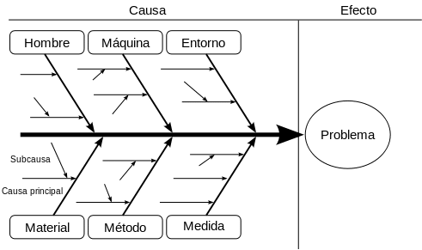
Ishikawa Diagram (Cause and Effect)
Relationship to the Tree Diagram
Symptoms
Who are the team members? What roles do they have in the organization?
Why do you think these are the right people to participate in solving the problem?
Problem
Causes

Slide 54

Ishikawa Diagram (Cause and Effect)
A brainstorming tool that helps identify potential causes grouped into categories.
It was developed by Kaoru Ishikawa in the 1960s and is widely used in quality management and continuous improvement.

Slide 55
Ishikawa Diagram (Cause and Effect)
Diagram Elements
Fish head: The problem to be analyzed (use the problem statement from the previous phase).
Who are the team members? What roles do they have in the organization?
Why do you think these are the right people to participate in solving the problem?
Bones: Categories of the main causes (usually those shown in the image).
Main spine: Connects the problem to the main causes.
Smaller bones: Specific factors that contribute to the problem.

Slide 56
Ishikawa Diagram (Cause and Effect)
How to Brainstorm Effectively
Divergent
(Individual)
Convergent
(Group)
Each person generates ideas independently
Ideas are shared, grouped, and prioritized together
Avoids bias
Increases participation
Improves idea quality

Slide 57
Ishikawa Diagram (Cause and Effect)
Tips and Common Mistakes
Consider
Avoid
Define the problem clearly
Involve the team
Think outside the box
Prioritize causes that directly affect the problem
Confusing symptoms with causes
Being too general
Failing to validate proposed causes with data
Limiting the team’s creativity

Slide 58
Slide for Leaders
Tips for Leaders_x000B_Phase: Observe and Analyze, Part 1
Do…
Guide the session without imposing ideas (encourage participation)
Encourage consideration of causes in all Ishikawa categories
Before voting, ask for evidence or examples to support the cause
Ask: “Why do we think this cause is likely?”
Ensure equitable participation
No…
Do not say “that is not possible” without checking the data
Prevent voting based on hierarchy or intuition
Do not rush the vote without consensus

Slide 59

Activity 6
No Idea Is a Bad Idea
Individual and Group Activity
Diagram Template
Team reflection
Cause-and-Effect Diagram Template.
Deliverable:
Participants’ reflections

Slide 60
Reflection
What did we learn by using this tool?
Do you think it is valuable for problem solving?

Slide 61
Ishikawa Diagram (Cause and Effect)
Next Steps
Remove duplicate causes
Group related causes
Remove causes the team considers impossible or unlikely
Transfer the remaining causes to the multivoting matrix
Filter Causes
Multivoting Matrix

Slide 62
Multivoting Matrix
A tool that reduces a long list of items to a more manageable number and focuses on the options with the greatest impact.
Objective Selection
Multivotación de causas
 | Causa | Votación
 |  | Impacto | Frecuencia | Control | Evidencia | Total
1
2
3
4
5
6
Focus on the Most Relevant Causes
Team Consensus and Participation

Slide 63
Multivoting Matrix
How is it used?
Manpower
Machine
Environment
Inexperienced foreman
Spreader failure
Poor visibility of container stacks
Insufficient operators
Insufficient terminal tractors
Moderate rain
Low Crane Productivity
Absent supervisor
Loading sequence
Shift start
Damaged twistlocks
Number of restows
Crane position
Terminal tractor waiting time
Material
Method
Measurement

Slide 64
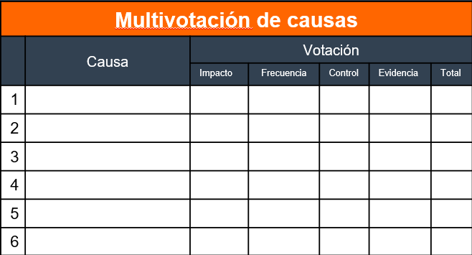
Multivoting Matrix
How is it used?
Manpower
Machine
Environment
Inexperienced foreman
Insufficient operators
Insufficient terminal tractors
Moderate rain
Low Crane Productivity
Loading sequence
Number of restows
Crane position
Material
Method
Measurement
Poor visibility of container stacks
1
3
3
3
2.8
Spreader failure
3
2
2
2
2.6
Each category has a different weight
Absent supervisor
1
2
1
1
3
5
Impact (0.4)
Frequency (0.3)
Control (0.2)
Evidence (0.1)
Shift start
2
3
2
3
2.4
Terminal tractor waiting time
3
3
3
3
3
Damaged twistlocks
2
2
1
2
1.5
Causes are scored within their respective categories on a scale of 1–3 according to the following criteria

Slide 65
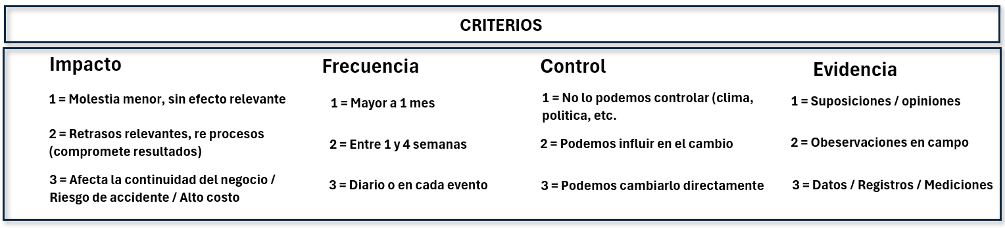
Multivoting Matrix
How is it used?

Slide 66
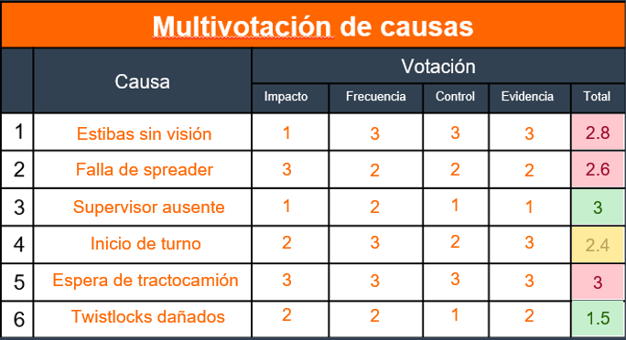
Multivoting Matrix
Results
Causes scoring 2.5 or higher will be considered for the next step in the Observe and Analyze phase of PORT™.
If no cause reaches the required score, the causes selected in the Ishikawa diagram may not be the most appropriate.
<2.0 (Low priority)
2.0–2.4 (Validate)
≥2.5 (5 Whys analysis)

Slide 67
Multivoting Matrix
How to Vote Without Bias (for Each Cause)
Individual and confidential voting
Collection and Recording
Group Discussion and Consensus
Each member (including the leader) votes independently on paper, assigning a score to the cause.
The leader collects the votes and records them in the matrix.
Discuss the final results.
Repeat the same process for the next cause.

Slide 68

Actividad 7
Moving Forward in the Search for the Root Cause
Pair activity (with the team defined in Activity 5)
Cause-and-Effect Diagram and Multivoting Matrix
Final Project Progress
Cause-and-Effect Diagram Template.
Deliverable:
Progress on the final project using the two tools covered in the session
Multivoting Matrix Template.

Slide 69
BEST Program
Problem Solving System (PORT™)
Week 4: Observe and Analyze, Part 2

Slide 70
Training
Week 4: Observe and Analyze, Part 2
Root Cause
Jefferson Memorial
5 Whys
Activity 8: Uncovering the Truth
Countermeasure Definition
Countermeasure Prioritization
Activity 9: From Cause to Solution

Slide 71
Root Cause
If it is not eliminated, the problem will recur.
The fundamental reason the problem occurs.
It is the origin of the problem.
It is not a symptom.

Slide 72
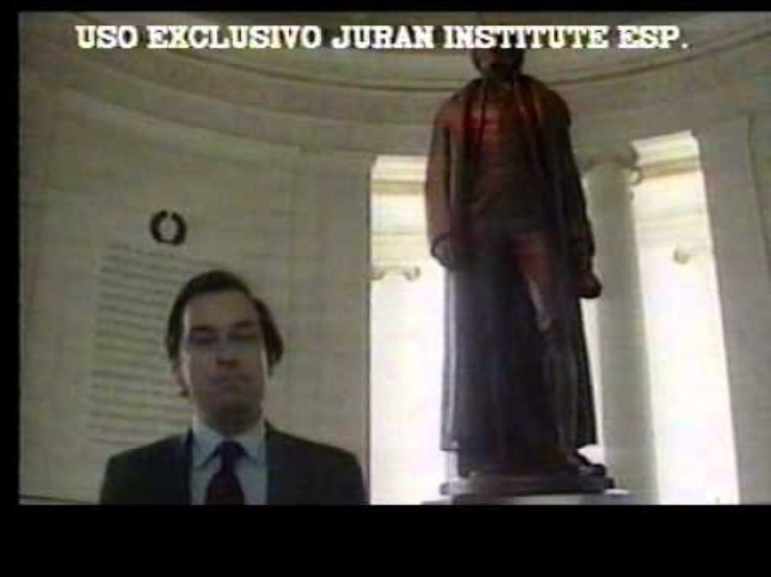

Slide 73
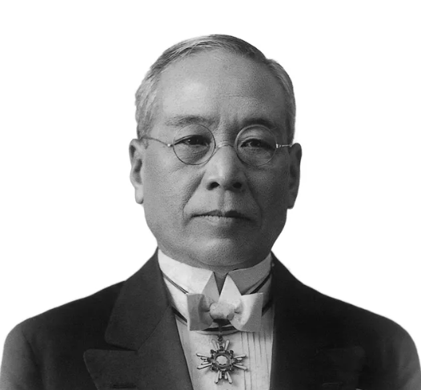
5 Whys
A simple technique for identifying the root cause of a problem by repeatedly asking “Why?” until the actual origin is reached.
Cause
Can Cause
Why?
1
Can Cause
Why?
2
Can Cause
Why?
3
Can Cause
Created by Sakichi Toyoda, founder of Toyota Industries, in the 1930s, it has become one of the key tools used for continuous improvement.
Why?
4
Can Cause
Why?
5
Identified Root Cause

Slide 74
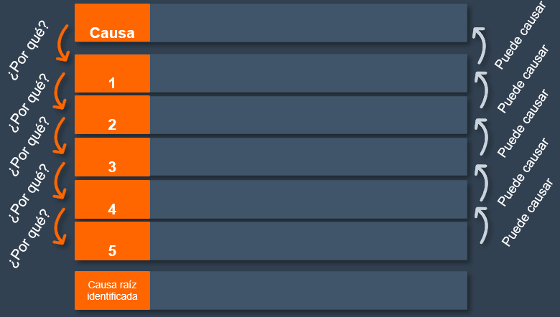

5 Whys
Next Step
Poor visibility of container stacks
1
3
3
3
2.8
Spreader failure
3
2
2
2
2.6
Absent supervisor
1
2
1
1
3
Shift start
2
3
2
3
2.4
Terminal tractor waiting time
3
3
3
3
3
Damaged twistlocks
2
2
1
2
1.5

Slide 75
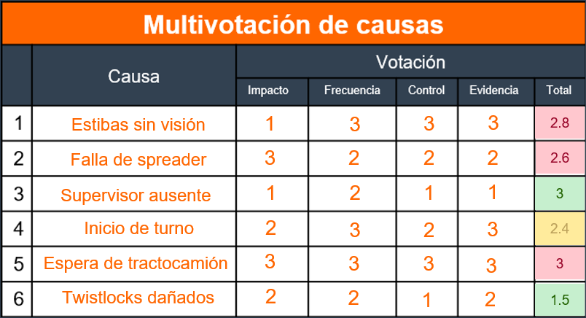
5 Whys
Next Step
Terminal tractor waiting time
The distance between the yard and the crane is too great
Berth 1 is assigned during vessel planning
Berth 5 is unavailable for container operations
The MHC crane cannot be positioned at Berth 5
The weight of the MHC crane affects the structure of Berth 5
The weight of the MHC crane affects the structure of Berth 5
The exercise must be performed for all causes with a score of 10 or higher

Slide 76
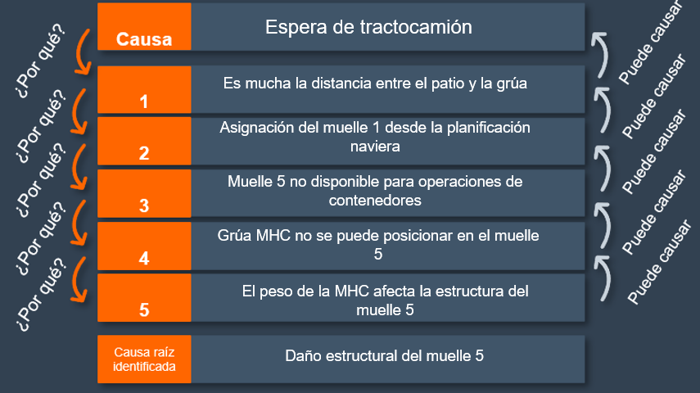
5 Whys
Validate using “Therefore”
Reinforces the logic of the analysis
Connects the answer to the previous “why”
Strengthens the reasoning
It is easy to lose track during a 5 Whys analysis. The “Can Cause” prompt helps validate that our answers are consistent and that we are moving in the right direction.

Slide 77
5 Whys
Alternative Paths
Cause
Terminal tractor waiting time
Can Cause
Why?
1
The distance between the yard and the crane is too great
Can Cause
Why?
2
Berth 1 is assigned during vessel planning
Can Cause
Why?
3
Berth 5 is unavailable for container operations
Can Cause
Why?
4
The MHC crane cannot be positioned at Berth 5
Can Cause
Why?
5
The weight of the MHC crane affects the structure of Berth 5
Identified Root Cause
Structural damage to Berth 5

Slide 78
5 Whys
Alternative Paths
Cause
Terminal tractor waiting time
Can Cause
Why?
A
B
1
The distance between the yard and the crane is too great
The terminal tractor takes too long in the yard
Can Cause
Why?
2
Berth 1 is assigned during vessel planning
A line of terminal tractors is waiting in the yard
Can Cause
Why?
3
Berth 5 is unavailable for container operations
The reach stacker is performing restow moves
Can Cause
Why?
4
The MHC crane cannot be positioned at Berth 5
The loading sequence was not planned early enough to keep the cargo readily accessible
Can Cause
Why?
5
The weight of the MHC crane affects the structure of Berth 5
The loading list was sent at short notice
Identified Root Cause
Structural damage to Berth 5
Loading information is received too late
Alternative paths may lead to the same root cause

Slide 79
5 Whys
Tips and Common Mistakes
Consider
Avoid
Ask the questions as a team
Use data, not assumptions
Apply “therefore”
Stop when you reach the root cause
Stopping at surface symptoms
Vague or generic answers
Forcing the analysis to reach five questions
Failing to validate the root cause

Slide 80
Activity 8
Uncovering the Truth
5 Whys Template
Team reflection
Pair Activity
Deliverable:
Final project progress through the 5 Whys analysis
5 Whys Template.

Slide 81
Reflection
Do you think finding the root cause is difficult?
What were the main challenges during the analysis?
What advice would you give a newcomer to help them conduct a good analysis?

Slide 82


Countermeasures
Actions to reduce or eliminate the root cause of a problem
Mitigation Countermeasures
Countermeasures that eliminate the root cause
They reduce the impact of the problem but do not eliminate the root cause.
They directly address the root cause and prevent recurrence.
Example:
Install a fan to reduce excessive heat
Example:
Repair the faulty cooling system

Slide 83
Countermeasures
8 Criteria
1
Focus on the root cause
5
Compliance with regulatory and safety requirements
2
Feasible with available resources
6
Easy to implement
3
Favorable cost-benefit ratio
7
Measurable and verifiable
4
Sustainable over time
8
Team acceptance

Slide 84
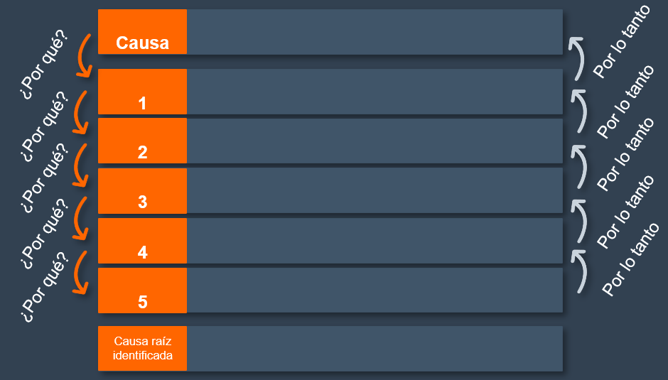
Countermeasures
First Steps
Terminal tractor waiting time
Contramedidas
Causa raíz | Acción | Quien | Fecha
The distance between the yard and the crane is too great
Berth 1 is assigned during vessel planning
Berth 5 is unavailable for container operations
The MHC crane cannot be positioned at Berth 5
The weight of the MHC crane affects the structure of Berth 5
Structural damage to Berth 5

Slide 85
Countermeasures
First Steps
Terminal tractor waiting time
Contramedidas
Causa raíz | Acción | Quien | Fecha
The distance between the yard and the crane is too great
Structural damage to Berth 5
Repair of Berth 5
Berth 1 is assigned during vessel planning
Insufficient terminal tractors
Terminal tractor standard based on yard distances
Berth 5 is unavailable for container operations
Root Cause 3
Action 3
The MHC crane cannot be positioned at Berth 5
The weight of the MHC crane affects the structure of Berth 5
Each root cause identified in the 5 Whys analysis must have a corresponding countermeasure

Slide 86
Slide for Leaders
Countermeasure Prioritization
The proposed countermeasures must be evaluated by the area coordinator/supervisor, who will assign owners.
Feedback is provided to the Problem Solving leader on the solutions discussed.
The leader formally notifies the action-plan owner, who must develop the plan and set a committed due date.

Slide 87
Countermeasure Prioritization
Complete the countermeasure table by adding owners and committed due dates.
Contramedidas
Causa raíz | Acción | Quien | Fecha
Structural damage to Berth 5
Repair of Berth 5
José L.
01/01
Insufficient terminal tractors
Terminal tractor standard based on yard distances
Miguel C.
15/01
Root Cause 3
Action 3
Roberto G.
15/01

Slide 88
Slide for Leaders
Tips for Leaders_x000B_Phase: Observe and Analyze, Part 2
Do…
Ask questions that guide the team toward discovering the root cause
Validate each “why” with evidence
Stay focused on the original cause and use the “Can Cause” prompt to avoid going off track
Involve the team in proposing practical, sustainable solutions
Prioritize solutions that address the root cause
No…
Accepting vague answers such as “because it has always been this way” or “because there is a lack of commitment”
Imposing countermeasures without consensus
Confusing an immediate action with a permanent solution

Slide 89
Activity 9
From Cause to Solution
Propose Countermeasures
Presentation of Proposals
Pair Activity
Countermeasure Definition Template.
Deliverable:
Proposed countermeasures entered in the template table (without owners or due dates), to be presented in the next session

Slide 90
BEST Program
Problem Solving System (PORT™)
Week 5: Resolve with Actions

Slide 91
Training
Week 5: Resolve with Actions
Activity 9 Presentation: From Cause to Solution
Action Plan Validation
Countermeasure Pilot Test
Communication Plan
Activity 10: Plan, Test, Succeed

Slide 92
Activity 9 Presentation
From Cause to Solution
What countermeasures are being proposed?
Why do you think these countermeasures will eliminate the root cause of the problem?
5 minutes per team

Slide 93
Resolve with Actions
“Do not look for someone to blame; look for causes. Countermeasures must eliminate the problem, not hide it.”
— Taiichi Ohno
Recurrence Prevention
C
Closing the Gap
Reliability and Safety
Decision-Making
Effective countermeasures eliminate the root cause of problems and prevent them from recurring.

Slide 94
Action Plan Validation
If We Don’t Measure, We Don’t Improve
Validating the action plan is critical to ensure the solution truly solves the problem without creating side effects.
8
Criteria
KPIs

Slide 95
Action Plan Validation
8
Criteria
If We Don’t Measure, We Don’t Improve
1
Focus on the root cause
5
Compliance with regulatory and safety requirements
2
Feasible with Available Resources
6
Easy to implement
3
Favorable cost-benefit ratio
7
Measurable and verifiable
4
Sustainable over time
8
Team acceptance

Slide 96
Action Plan Validation
If We Don’t Measure, We Don’t Improve
Validating the action plan is critical to ensure the solution truly solves the problem without creating side effects.
8
Criteria
KPIs

Slide 97
Action Plan Validation
If We Don’t Measure, We Don’t Improve
KPIs allow us to objectively measure the success and sustainability of actions.
KPIs
GMPH
Waiting Time
Number of Errors
Etc…

Slide 98
Countermeasure Pilot Test
Validation in a Controlled Environment
A pilot test is a temporary, controlled implementation of a solution or countermeasure within a limited scope, designed to validate its effectiveness before large-scale deployment.
Reduces the risk of failures during full-scale implementation
Saves time and money by detecting issues early
Provides evidence for data-driven decisions

Slide 99
Countermeasure Pilot Test
Slide for Leaders
Validation in a Controlled Environment
Objective: Confirm effectiveness before formal rollout
Scope: One gang, shift, or specific team
Metrics: Key KPIs (e.g., GMPH, waiting time, number of errors)
Duration: 1–4 weeks, depending on the case

Slide 100
Countermeasure Pilot Test
Slide for Leaders
Steps to Carry It Out
1
Plan the pilot test
Select the specific gang, tool, or team
Define the KPIs that will measure effectiveness
Set the duration of the test
Communication Plan

Slide 101
Slide for Leaders
Communication Plan
Communicate = Coordinate
A structured strategy to inform, coordinate, and align everyone involved in implementing countermeasures. Its purpose is to ensure that everyone understands what will be done, why, how, and when, avoiding confusion and resistance to change.
Takes place before, during, and after implementation
Build awareness of the upcoming change
Ensures sustainability
Share results
Recognize achievements

Slide 102
Slide for Leaders
Communication Plan
Example
Etapa | Objetivo | Canal | Frecuencia | Responsable | Contenido Clave
Antes | Informar propósito, beneficios y preparar a las personas para el cambio | Reunión inicial / correo electrónico | Una vez | Líder de contramedida | Objetivo, alcance, roles, cronograma
Durante | Monitorear avances y resolver dudas | Reunión semanal / pizarra | Semanal | Supervisor | Alertas
Después | Compartir resultados | Reunión mensual / reporte | Mensual | Gerente | KPIs logrados, lecciones, próximo pasos
A structured strategy to inform, coordinate, and align everyone involved in implementing countermeasures. Its purpose is to ensure that everyone understands what will be done, why, how, and when, avoiding confusion and resistance to change.

Slide 103
Countermeasure Pilot Test
Slide for Leaders
Steps to Carry It Out
2
Monitor implementation
Conduct Gemba walks to stay informed about implementation
Record and identify any obstacles encountered
Adjust the pilot test to mitigate those obstacles

Slide 104
Countermeasure Pilot Test
Slide for Leaders
Steps to Carry It Out
3
Analyze the results and implement at scale
Review the results obtained during the test
Document the effectiveness of the countermeasure
Officially implement at scale

Slide 105
Pilot Test & Communication Plan
Tips and Common Mistakes
Consider
Avoid
Define clear objectives
Select a limited scope
Document everything
Involve the team
Define roles and frequency
Proceeding without informing stakeholders
Ignoring team feedback
Failing to define success criteria
Lack of follow-up during execution
Not sharing results

Slide 106
Slide for Leaders
Tips for Leaders_x000B_Phase: Resolve with Actions
Do…
Ask powerful questions such as “What evidence supports this decision?” or “How will we measure success?”
Validate ideas and encourage equitable participation
Use the pilot test as an opportunity to develop skills
Recognize small wins to maintain motivation
No…
Resolver por el quipo
Dismissing team feedback
Hiding negative results
Gestionar el cambio

Slide 107
Activity 10
Plan, Test, Succeed
Pair Activity
Plantilla
Team reflection
Pilot Plan + Communication Plan.
Deliverable:
Pilot test plan and communication plan proposals using the corresponding template

Slide 108
Reflection
Why is planning important?
What are the consequences of failing to communicate the plan effectively?
How does conducting a pilot test benefit us before formal rollout?

Slide 109
BEST Program
Problem Solving System (PORT™)
Week 6: Track and Sustain

Slide 110
Training
Week 6: Track and Sustain
Gemba as a Sustainment Practice
Tracking Method
Meeting System
Visual Management
Recognition System
Activity 11: What Is Visible Is Sustained
Reflection and Closing

Slide 111
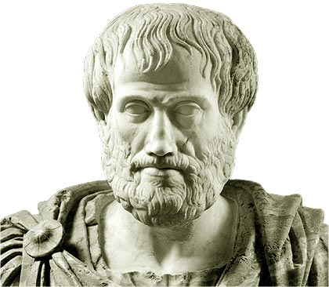
Tracking and Sustainability
“La excelencia no es un acto, es un hábito.”
- Aristóteles
Ensuring Discipline
Establishes Clear Standards
Creates Transparency
Promotes Continuous Improvement
Tracking keeps us on course; sustainability ensures we do not go backward.

Slide 112
Gemba Walk_x000B_Consistency Makes the Difference
Without Gemba
Occasional Gemba
Systematic Gemba
Implemented
Reviewed occasionally
Verified
Forgotten
Unstable results
Corrected
The problem returns
The problem returns
Standardized
Without Gemba: Temporary Improvement
With Gemba: Lasting Improvement

Slide 113
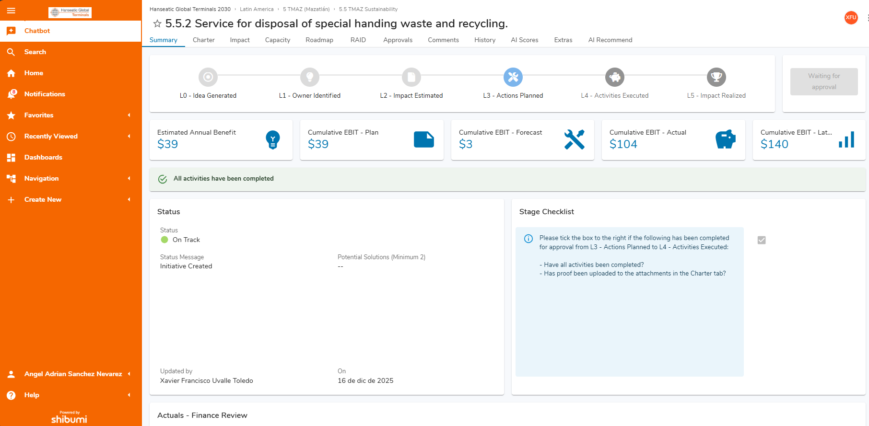
Tracking Method
Shibumi
Shibumi is the official platform for registering Problem Solving projects. As with Horizon initiatives, the L0–L5 development framework will be used, with each level directly linked to the PORT™ phases.

Slide 114
Tracking Method
Slide for Leaders
PORT Phases & L0–L5
Pinpoint the problem
Observe and Analyze
Resolve with actions
Track and Sustain
L0
L1
L2
L3
L4
L5

Slide 115
Tracking Method
Slide for Leaders
Pinpoint the Problem (L0–L1)
Pinpoint the problem
L0
L1

Slide 116
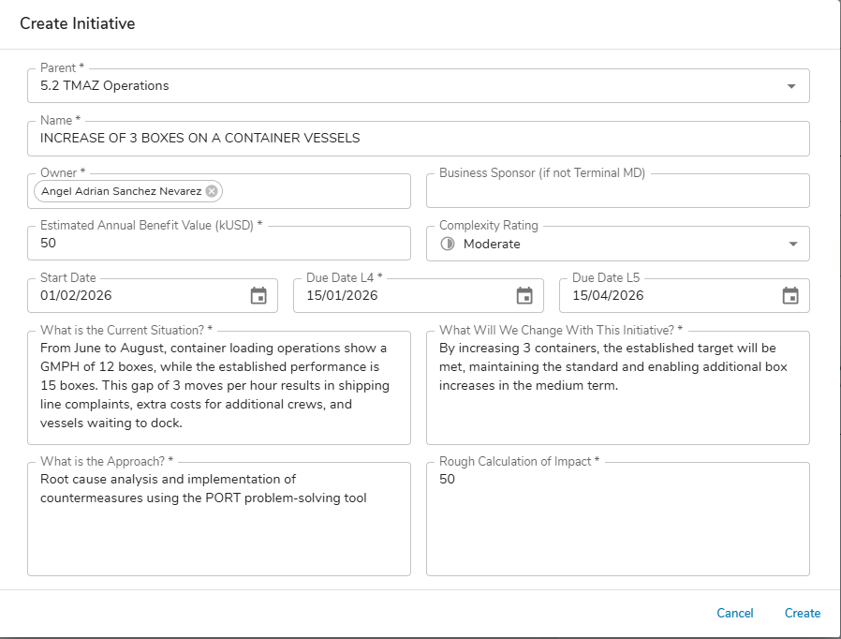
Tracking Method
Slide for Leaders
Pinpoint the Problem (L0–L1)
L0: The defined problem is registered at this stage.
Pinpoint the problem
01/01/2026
L1: The Problem Solving leader or owner is defined.

Slide 117
Tracking Method
Slide for Leaders
Pinpoint the Problem (L0–L1)
Problem Solving leader or owner
A clear, precise title focused on the intended outcome
This is the date of the first Problem Solving session (problem definition).
Estimated date for implementing the countermeasures
Estimated date for validating effectiveness and closing the project
Add the problem statement (the same one used in the tree diagram).
01/01/2026
Describe what this Problem Solving project aims to achieve. It aligns with the main title but provides more detail.
This allows us to identify initiatives that originate from PORT™.

Slide 118
Tracking Method
Slide for Leaders
PORT Phases & L0–L5
Pinpoint the problem
Observe and Analyze
Resolve with actions
Track and Sustain
L0
L1
L2
L3
L4
L5

Slide 119
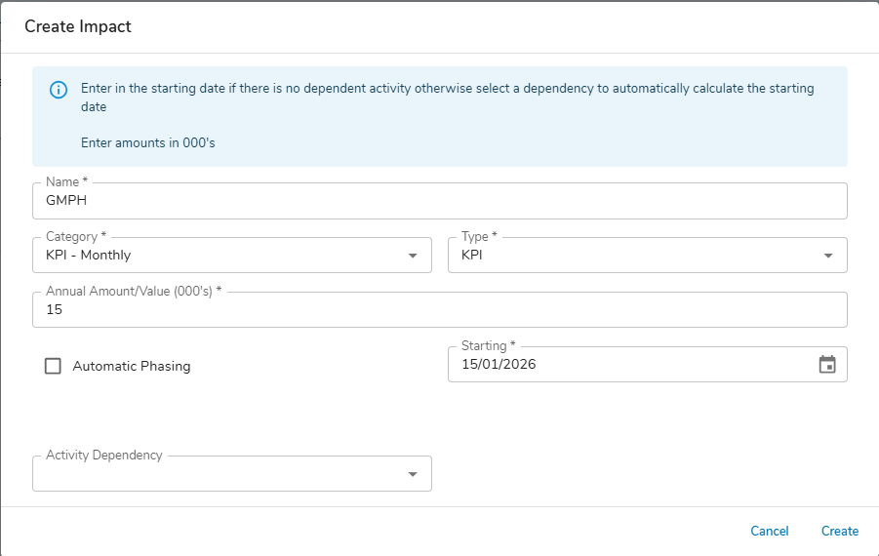
Tracking Method
Slide for Leaders
Observe and Analyze (L2–L3)
L2: Add the impact, whether financial or KPI-related, at this stage.
Observe and Analyze
L3

Slide 120
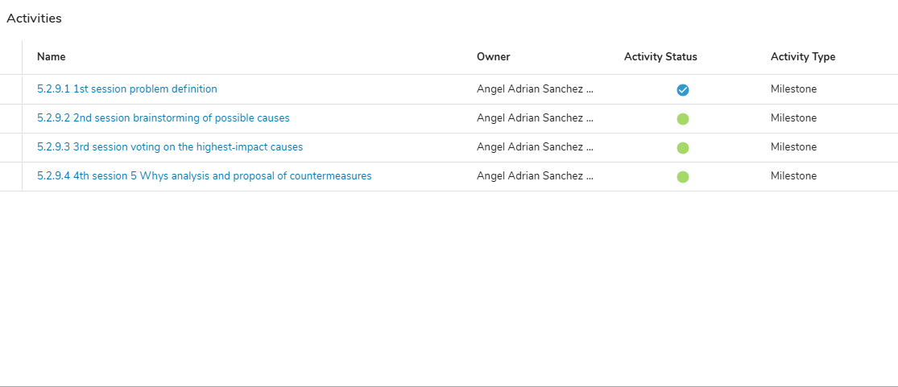
Tracking Method
Slide for Leaders
Observe and Analyze (L2–L3)
L3: Record the planned root-cause analysis sessions in the roadmap.
Observe and Analyze
L2

Slide 121
Tracking Method
Slide for Leaders
PORT Phases & L0–L5
Pinpoint the problem
Observe and Analyze
Resolve with actions
Track and Sustain
L0
L1
L2
L3
L4
L5

Slide 122
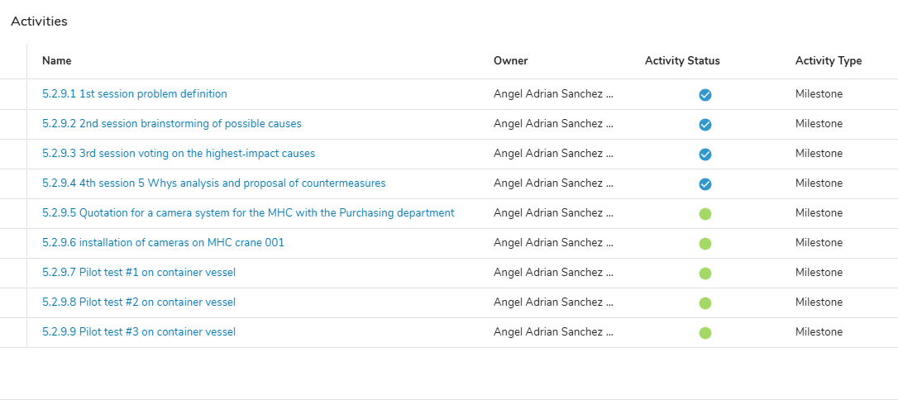
Tracking Method
Slide for Leaders
Resolve with Actions (L3–L4)
L3: Record the countermeasure implementation plan in the roadmap once the countermeasures have been defined.
Resolve with actions
L4

Slide 123
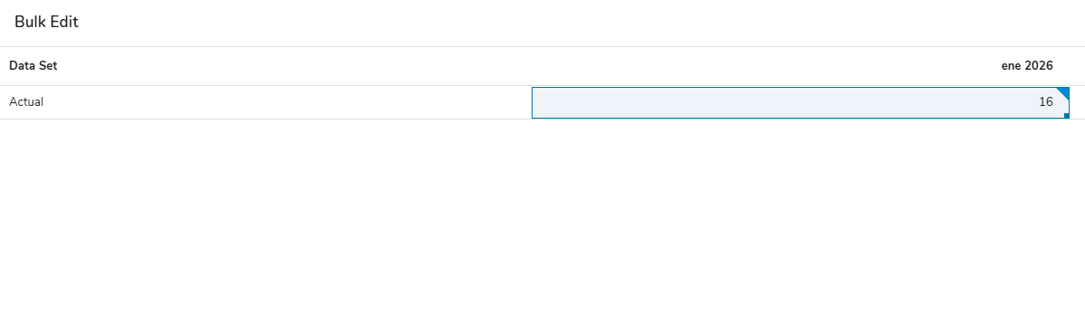
Tracking Method
Slide for Leaders
Resolve with Actions (L3–L4)
L4: Once the pilot test is complete, implement the countermeasures at scale and measure their effectiveness monthly.
Resolve with actions
L3

Slide 124
Tracking Method
Slide for Leaders
PORT Phases & L0–L5
Pinpoint the problem
Observe and Analyze
Resolve with actions
Track and Sustain
L0
L1
L2
L3
L4
L5

Slide 125
Tracking Method
Slide for Leaders
Tracking and Sustainability (L4–L5)
L4: At the beginning of each month, record the current impact of the countermeasure(s).
Track and Sustain
L5: Achieve more than 90% of the KPI target or three consecutive months in line with the current plan.

Slide 126
Meeting System_x000B_Daily and weekly control to ensure continuous improvement
Problem Solving
Part of the weekly meeting agenda
Daily
Problem Capture
Weekly Meeting
Prioritization and Team Assignment
45 min
Trends
Actions
Problem Solving
Initiatives
Escalations
PROBLEM CAPTURE FORM
6S Plan
50% Past
50% Future

Slide 127
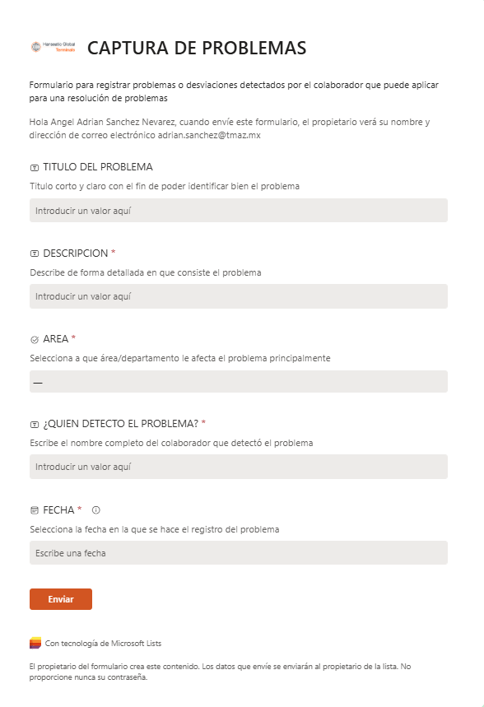
Meeting System_x000B_Problem Capture
During daily operations, terminal employees capture identified problems using a simple five-question form.
Daily
Problem Capture
PROBLEM CAPTURE FORM

Slide 128
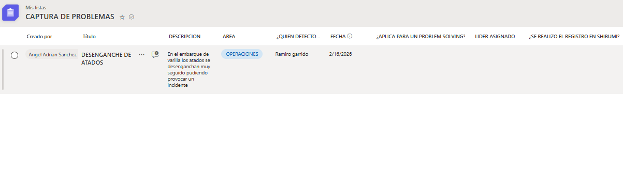
Meeting System_x000B_Problem Capture
The form automatically creates a record in Microsoft Lists, making issues visible and allowing them to be prioritized during the weekly functional meeting.
Daily
Problem Capture

Slide 129
Meeting System_x000B_Problem Capture

Slide 130
Meeting System_x000B_Prioritization and Leader Selection
During the weekly functional meeting, collected problems are reviewed, those suitable for Problem Solving are categorized, and leaders are assigned.

Slide 131
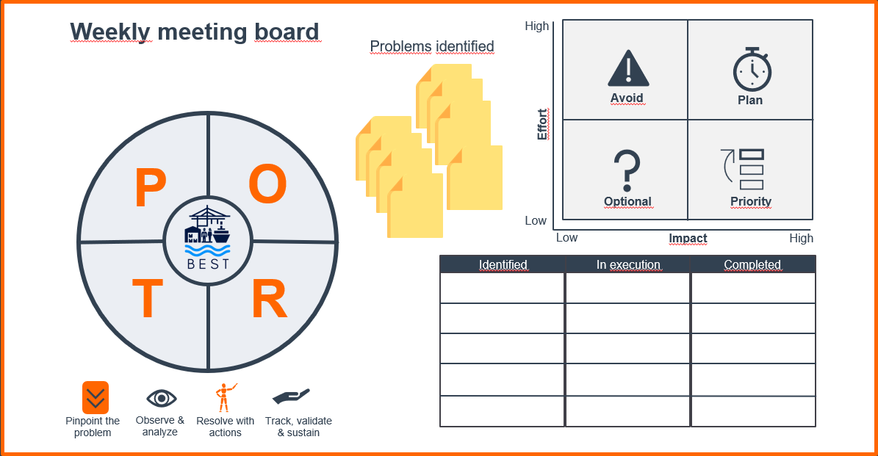
Visual Management_x000B_Prioritization and Leader Selection
=
The visual board used in the weekly meeting is replaced by Microsoft Lists.

Slide 132
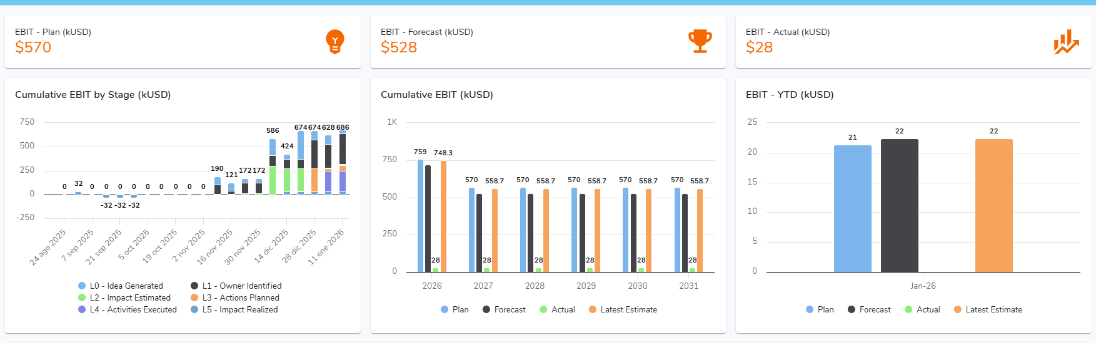
Visual Management_x000B_Tracking Problem Solving Status
Shibumi dashboard to be developed

Slide 133

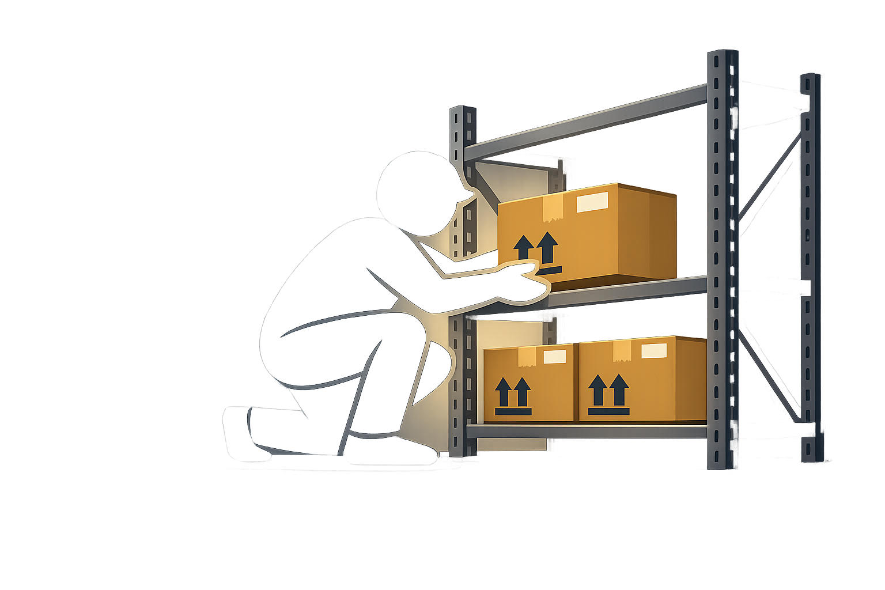

Visual Management_x000B_Make Important Things Visible to Ensure They Happen
Visual Management is a way of managing work by using clear, simple, visible information where activities take place.
Standard Board
Control Board
Alert Board
Pick up the package
1
Place on the shelf
95
2
Scan the item
WARNING!
BIOLOGICAL HAZARD
3
Remember the countermeasure
Prevents errors
Standardizes the process
Prevents recurrence

Slide 134
Recognition System_x000B_Celebrating Those Who Make It All Work
PENDING TOPIC

Slide 135
Actividad 11
What Is Visible Is Sustained
Pair Activity
Poster board, pencil, markers
Team reflection
Deliverable:
Visual Management proposals to ensure countermeasures are sustained

Slide 136
Reflection and Closing
BEST
PORT™
A Problem Solving tool

Slide 137
In a process, problems often appear as loud signals: a machine stops, an error repeats, or an unexpected result occurs. The first reaction is usually to rush to “fix” what is obvious. But real improvement begins when we stop, observe, and ask: why did it really happen?
The root cause is rarely on the surface. Sometimes it is a small habit, an overlooked condition, or a detail that has always been there. Finding it requires curiosity, humility, and discipline. It is not about finding someone to blame; it is about understanding.
And when the root cause is finally discovered, the right countermeasures do more than eliminate the problem: they change the way we think. They teach us that improvement is not about repairing, but preventing; not about acting quickly, but acting well.
Continuous improvement is a journey in which every problem stops being an obstacle and becomes an opportunity—an opportunity to grow, do things better, and demonstrate that every process has room to improve, if we are willing to look a little deeper.

Slide 138
THANK YOU!

