Slide 1

Laboratory chamber checks
Data acquisiton systems
Anna Toschi

Slide 2
Checks necessary before starting an experiment
Security of the room
Temperature
Work table stability

Slide 3
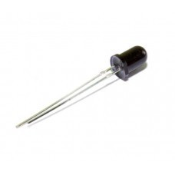
Security of the room
Using a flame sensor it is possible to detect if in the lab there is something burning, which can be very dangerous. The flame sensor used is an analogic sensor, so the ADC of Arduino will be used.
If the flame sensor detects any source of fire an alarm will be sent.
Flame sensor

Slide 4
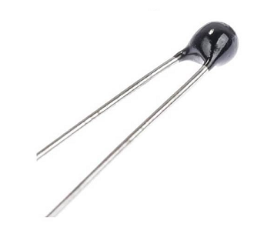
Temperature
Using a temperature sensor it is possible to measure the temperature of the room. This is useful in the case in which the sample requires a precise temperature.
The sensor that will be used is a NTC thermistor: it is variable resistor that changes its resistance with temperature. Also in this case it is an analogic sensor and the ADC of Arduino will be used.
NTC thermistor

Slide 5
Battery status
Some devices used in the lab can work using batteries. It is important to check the status of the batteries before using them. It is possible to measure the voltage of the battery using Arduino and to convert this analog signal into a digital one: if the signal is under a certain value a red LED will turn on, if it is between a certain range of values a yellow LED will turn on and in another range of values a green LED will turn on. According to which LED is turned on a certain message will be shown on the display.

Slide 6
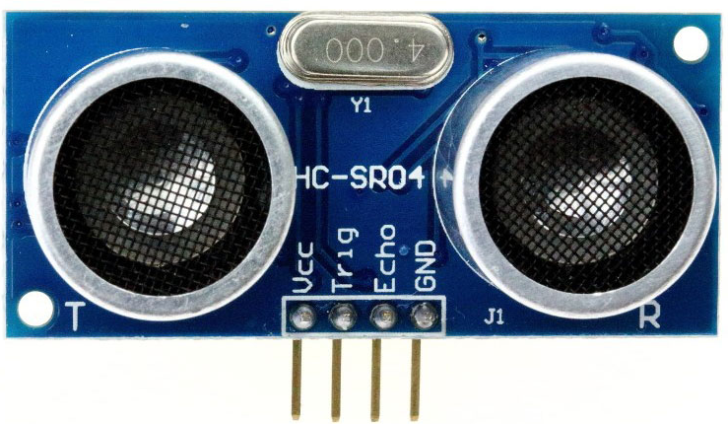
Stability of the work table
Sometimes it can also be important that there is nothing/nobody close to the work table during the experiment since it can be dangerous or it can touch the table and introduce some errors in the measurement. To check this it is possible to use an ultrasonic distance sensor that measure the distance.
Ultrasonic sensor HC-SR04

Slide 7
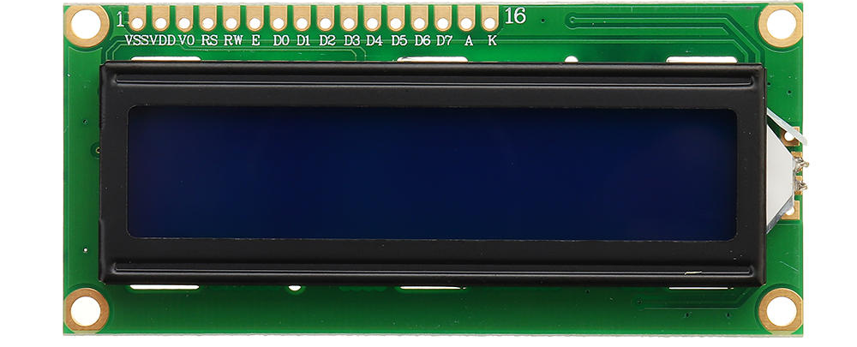
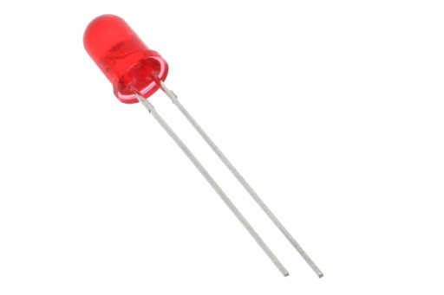
Output devices
The outputs will be shown on a LCD screen.
In case of something going wrong in the lab a red LED will turn on.

Slide 8
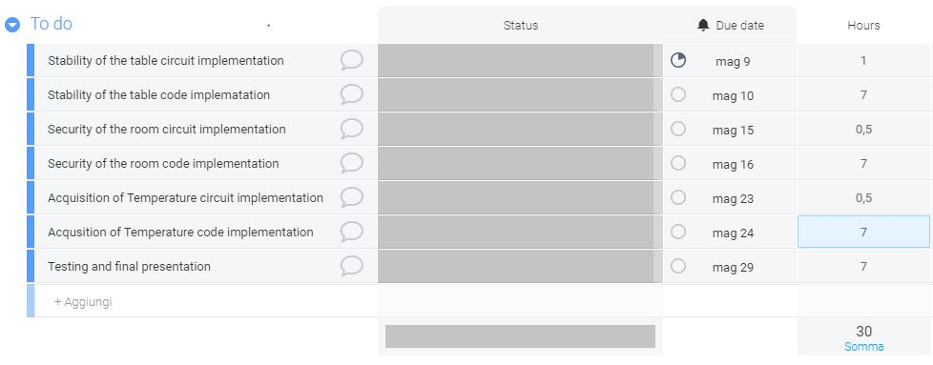
Time schedule

