Slide 1
Exploring the Interrelationship Between Quality Education and Sustainable Energy Access
A Sentiment Analysis of Global Perspectives Using Twitter Data
By OLAJIDE IJAOLA

Slide 2
PRESENTATION GUIDLINE
INTRODUCTION AND BACKGROUND REVIEW.
METHODOLOGY: Data Collection; Data Preprocessing & Sentiment Analysis.
MODEL DEVELOPMENT: Sentiment Classification & reasons for Classifier choice.
RESULTS and DISCUSSIONS.
SENTIMENT TRENDS OVERTIME.
GEOGRAPHICAL ANALYSIS.
LIMITATIONS OF STUDY.
CONCLUSION and FUTURE RESEARCH CONSIDERATIONS.

Slide 3






INTRODUCTION AND BACKGROUND REVIEW
The Launch
2016
2023/2024
2030
2019/2020
2022
SDG-4
------------------------------------------------
Mid Goal
The Goal
UN
SDG-7
------------------------------------------------
ML
ML
ML
Data Analysts
---------
---------
Me
Research Focus:
Analyse the relationship between Quality Education and Energy access through sentiment analysis of Twitter data
The world is falling behind in achieving Quality Education.
Increase in Out of School Children and Students lacking basic skills.
Several negative world events have slowed down the pace.
Energy crisis in several underdeveloped Countries will make achieving the goals almost impossible.
Sub-Saharan Africa still struggling with Energy crisis.
Public financing for clean energy in developed countries keeps reducing.
Better Data Science and Machine learning techniques in analyzing available SDG data.
Comapring direct data with Sentiment data using Machine learning etc.

Slide 4
METHODOLOGY
1. Data Collection:
Data(Twitter)
Source Features
Statistics
Attributes(Columns)
Keywords: SDG4, SDG7,
Quality Education, Energy
Date Range: 2016-2023
Post Limit: 35,000
Language: English
Contributors: 26,103
Language: English(35,000)
French(2), Estonian(1)
Posts: 35,003
Replies: 13,354
Links&Pictures: 18,357*
Likes: 380069*
Users
Usernames
Date
Posts
Reposts
Likes count
Impressions
Replies
Bookmarks
Post value*
Location*
Age
Followers
User value*

Slide 5
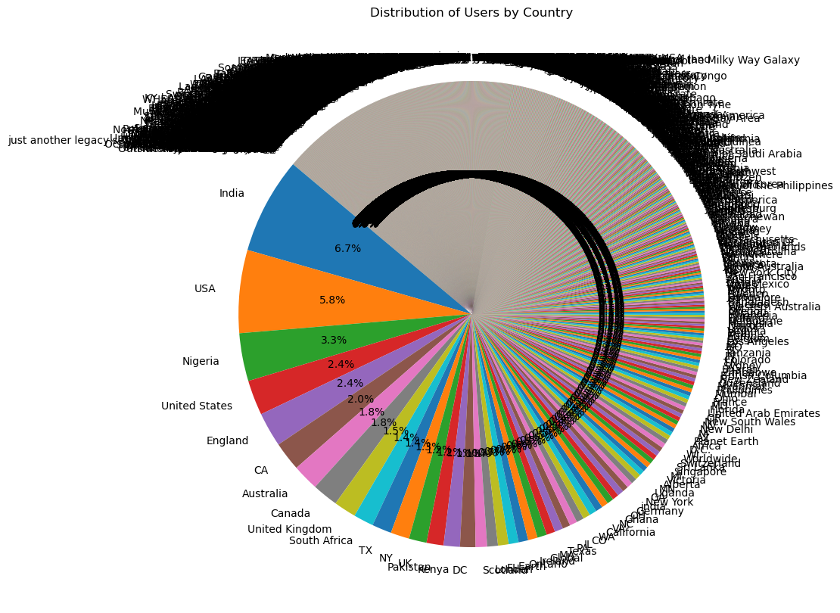

Slide 6
2. Data Preprocessing
Import Data
Excel files are loaded into Jupyter Notebook.
Merge Data
All dataframes are combined into a single merged dataframe.
Exploratory Data Analysis
We analyze the “post” column to understand our sentiment data.
Data Cleaning
HTML tags, URLs, pictures, special characters, duplicates etc, are removed.
Lemmatization
Words in the “post” column are converted to their base forms.
Tokenization
We split text into individual tokens or words.
Lowercasing
All text are converted to lowercase for uniformity.
Output
Cleaned and Standardized data are produced and ready for Sentiment Analysis.

Slide 7
3. Sentiment Analysis:
After proper EDA, the dataset is ready for Sentiment Analysis.
TextBlob is an essential NLP library for sentiment analysis at both the sentence and text levels (Badriya Murdhi Alenzi et al., 2022).
TextBlob uses a predefined lexicon where each word has a polarity and subjectivity score.
The TextBlob function computes the average polarity and subjectivity scores for all words in the text to give an overall sentiment score.
Sentiment polarity or category (positive, negative, neutral) is generated for each post based on these scores.
Two additional columns, “sentiment” and “sentiment_category,” are created and added to the dataframe.
Plotting the “sentiment_category” count shows data distribution and helps determine the need for Random Oversampling or SMOTE for balancing the dataset.

Slide 8
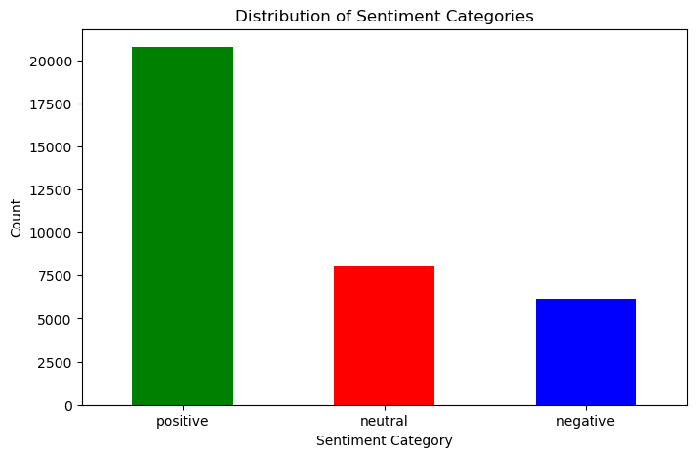
*Let’s provide context for the imbalanced data distribution above, with positive sentiments outweighing negative and neutral sentiments by 50-60%.

Slide 9
Is Data balancing necessary in this case?
Imbalanced datasets can skew research outcomes and lead to biased outputs (Asmaa Mountassir et al., 2012).
Balancing techniques like Random Oversampling (increase minority samples) or Random Undersampling (reduce majority samples) can address imbalance.
Data balancing may not be necessary if the imbalance reflects the true distribution of sentiments in the data source.
Artificially balancing the data might distort the reality if positive sentiments genuinely dominate.
In this context, it's better to work with the dataset as it is, to accurately reflect the progress of development goals.

Slide 10
MODEL DEVELOPMENT
Naïve Bayes
Traditional Classifiers
Support Vector Machine
Sentiment Classifiers
Long Short-Term Memory
Neural Network Classifiers
Simple Neural Network
Why these four model classifiers?
Traditional Classifiers: Simplicity and speed. Effective performance with Text classification problems.
There are several literatures supporting their use for NLP tasks.
Neural Network Classifiers: LSTM, for its ability to retain information over long periods which is crucial for
context, and its effectiveness in modelling complex sequential patterns where
understanding sequences of text is important.
SNN, ease of implementation and speed of training, versatility(it can be applied
to a wide range of problems including NLP), efficiency with small datasets.

Slide 11
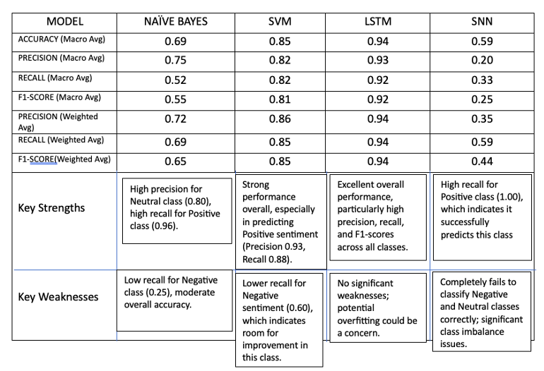
Comparing the four model classifiers (Results and Discussions)

Slide 12
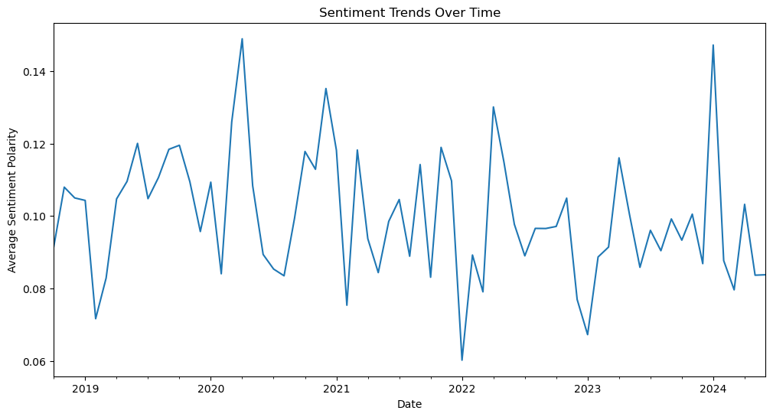
SENTIMENT TRENDS OVERTIME
COVID-19
Bounce
back
SDG
Half-term
Report
bounce
COVID-19
EFFECT
Russia-Ukraine
War

Slide 13
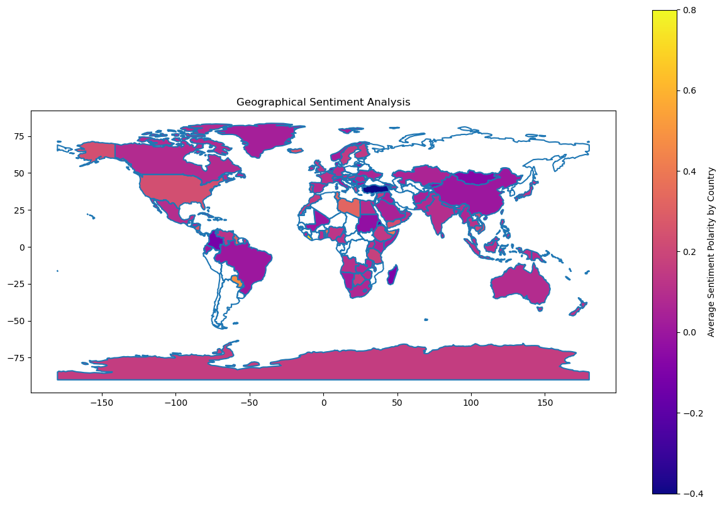
GEOGRAPHICAL ANALYSIS
North America, Europe & Asia
(Blend of Purple & Pink)
Moderate to Low Sentiment
Africa & South America
(Stronger Yellow Hue)
Higher positive
sentiments
Australia & Southern
Africa. (Mix of Purple
& slight Pink)
Neutral to slighlty
positive
*NOTE: Approximately 9,000 location data were available for this analysis out of 35,003

Slide 14
LIMITATIONS OF STUDY
Data limited to English Twitter posts; excludes other platforms (e.g., Facebook, Instagram).
Deleted tweets and users not included due to privacy.
Twitter API limits restrict data to recent tweets.
Lack of geolocation data affects clustering by location.
Limited hashtags for SDG 4 and SDG 7 required custom hashtag lists.

Slide 15
CONCLUSIONS AND FUTURE RESEARCH CONSIDERATIONS
NLP and sentiment analysis used to study the relationship between education quality and energy access through 35,000 tweets (2016-2023).
Focus on public sentiment toward SDG 4 (Quality Education) and SDG 7 (Affordable and Clean Energy) in Nigeria and Ethiopia.
Machine learning models, including Naïve Bayes, SVM, and LSTM, were applied; LSTM achieved the highest accuracy at 94%.
Findings suggest improved energy access may positively impact education, offering insights for policymakers.
Future research should integrate various fields to further explore the energy-education link in achieving the SDGs.

