Slide 1
Anavid Test
Safa Mefteh

Slide 2
Data Preprocessing
- Handling Null Values
- Feature Scaling
- Handling Categorical Variables

Slide 3
Results
By using Non-Tree based models
Model | F1 Score (%)
Logistic Regression | 88.88
Naive Bayers | 81.18
SVM (using linear kernel) | 90.74
SVM (using sigmoid kernel) | 48.14
SVM (using RBF Kernel) | 88.88
SVM (using poly RBF kernel) | 92.59
K-nearest Neighbors | 81.18

Slide 4
Results
By using Tree based models
Model | Accuracy (%)
Decision Tree Classifier | 98
Random Forest Classifier | 94.44
XGBoost Classifier | 100

Slide 5
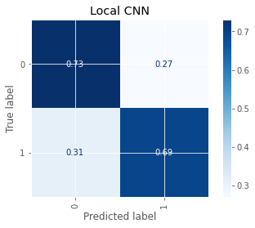
Results
By using Convolutional Neural Network
Model | Accuracy (%)
Custom CNN | 71.15
Confusion Matrix

