Slide 1

BUILDING
USEFUL IDEAS.
OPENING DOORS TO STEM.
OMRAMANATHAN.COM

Slide 2

OM RAMANATHAN
STUDENT BUILDER · FOUNDER · COMMUNITY LEADER
Engineering ideas, building products, and expanding access to hands-on STEM learning.

Slide 3
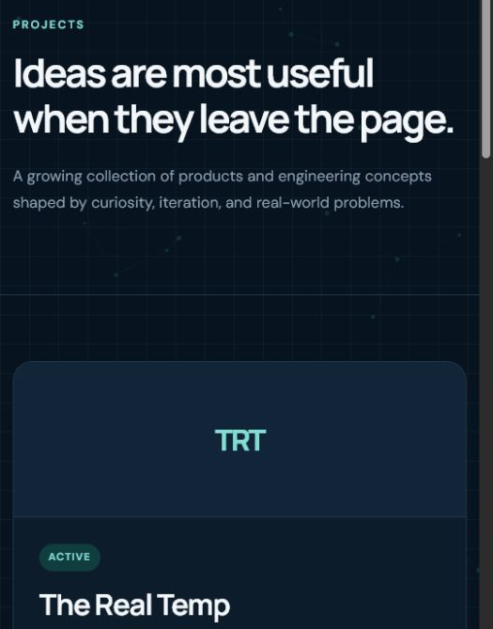
01 / PRODUCT + SOFTWARE
THE REAL TEMP
FOUNDER · DESIGNER · DEVELOPER
ACTIVE

Slide 4
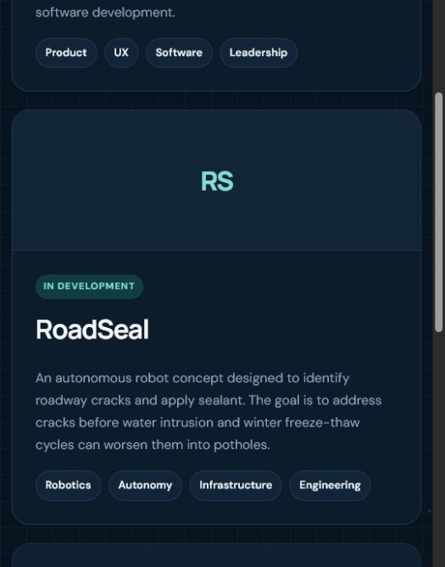
02 / ROBOTICS + INFRASTRUCTURE
ROADSEAL
AUTONOMOUS ROAD-CRACK SEALING ROBOT CONCEPT
IN DEVELOPMENT

Slide 5
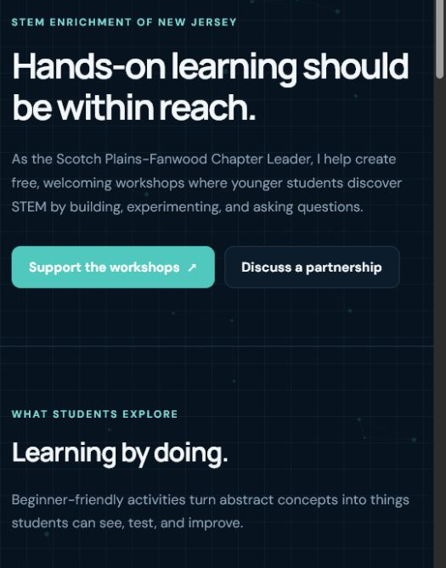
03 / COMMUNITY IMPACT
FREE, HANDS-ON
STEM WORKSHOPS
CODING · ROBOTICS · ELECTRONICS
Learning by doing.

Slide 6
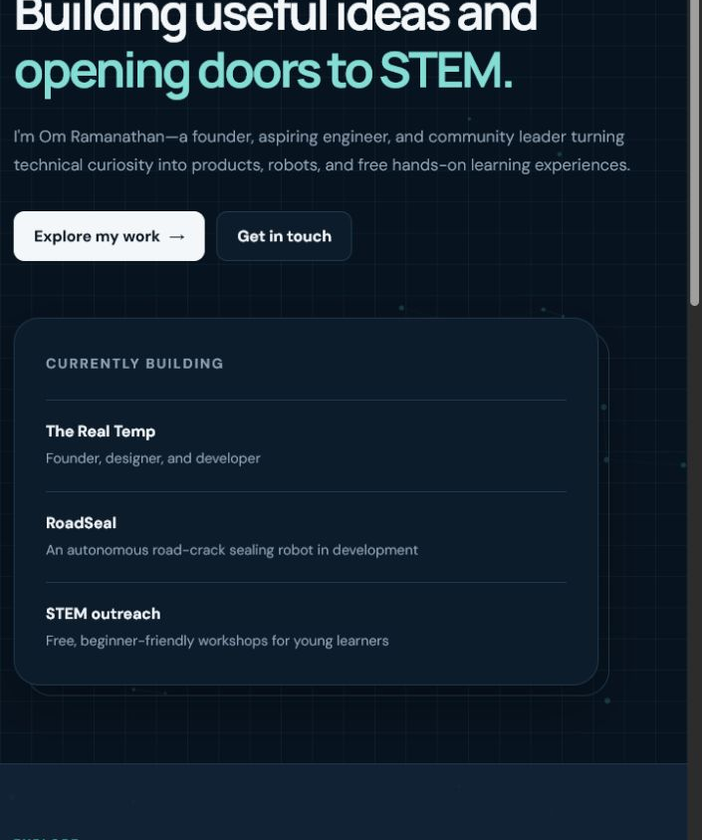
PROJECTS · PROFILE · OUTREACH
EXPLORE
MY WORK.
OMRAMANATHAN.COM
BUILDING USEFUL IDEAS. OPENING DOORS TO STEM.

