Slide 1
How Well Does a Single Mitochondrial Gene (CYTB) Reconstruct Leopardus Phylogeny?
Elizaveta Barabanova
Victor Florin

Slide 2
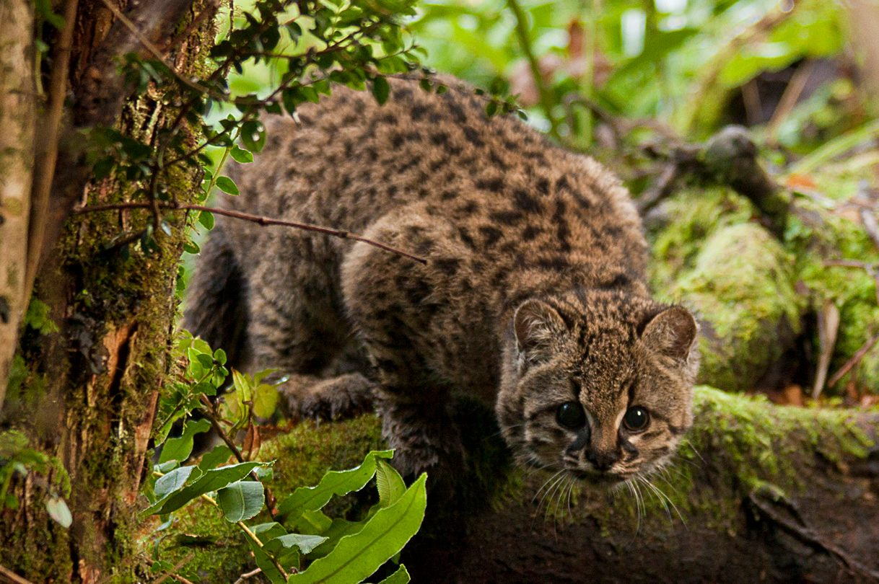
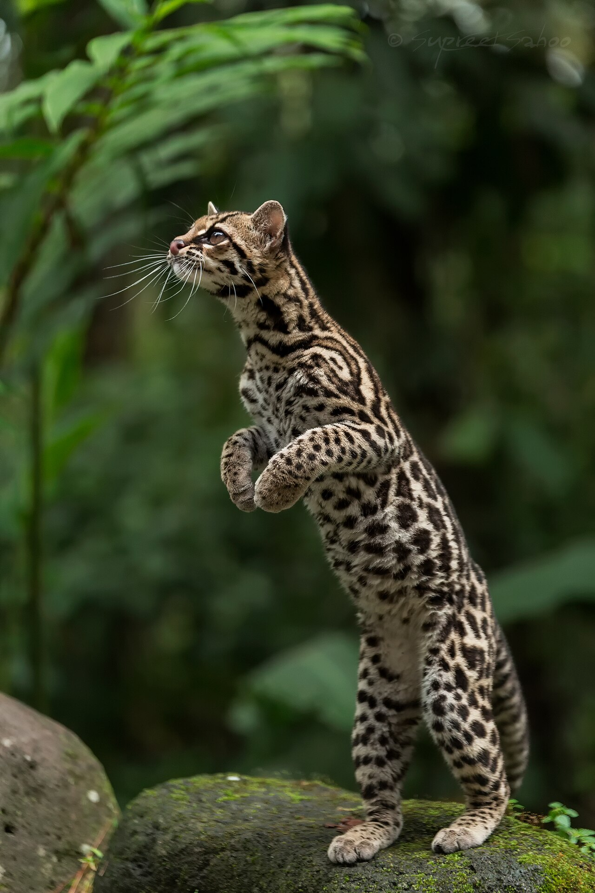
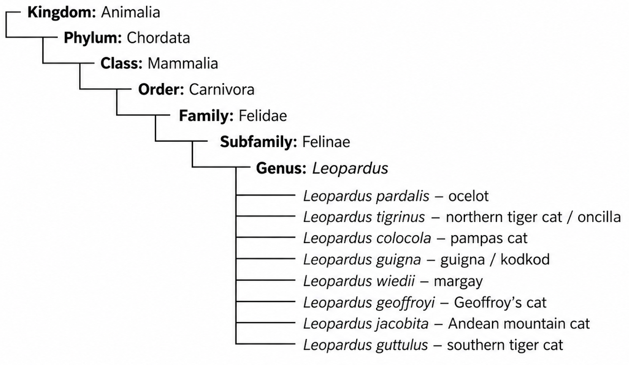
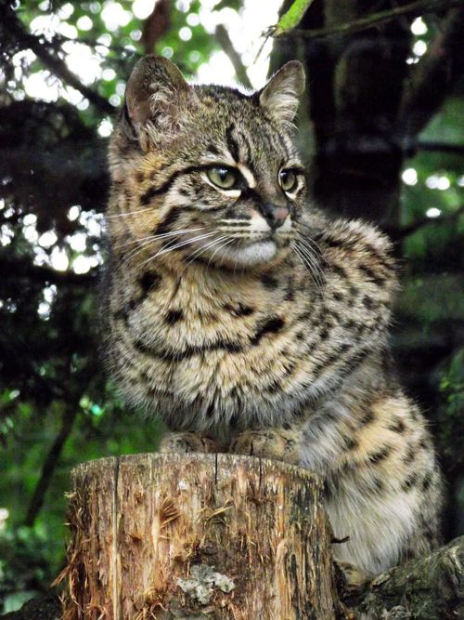
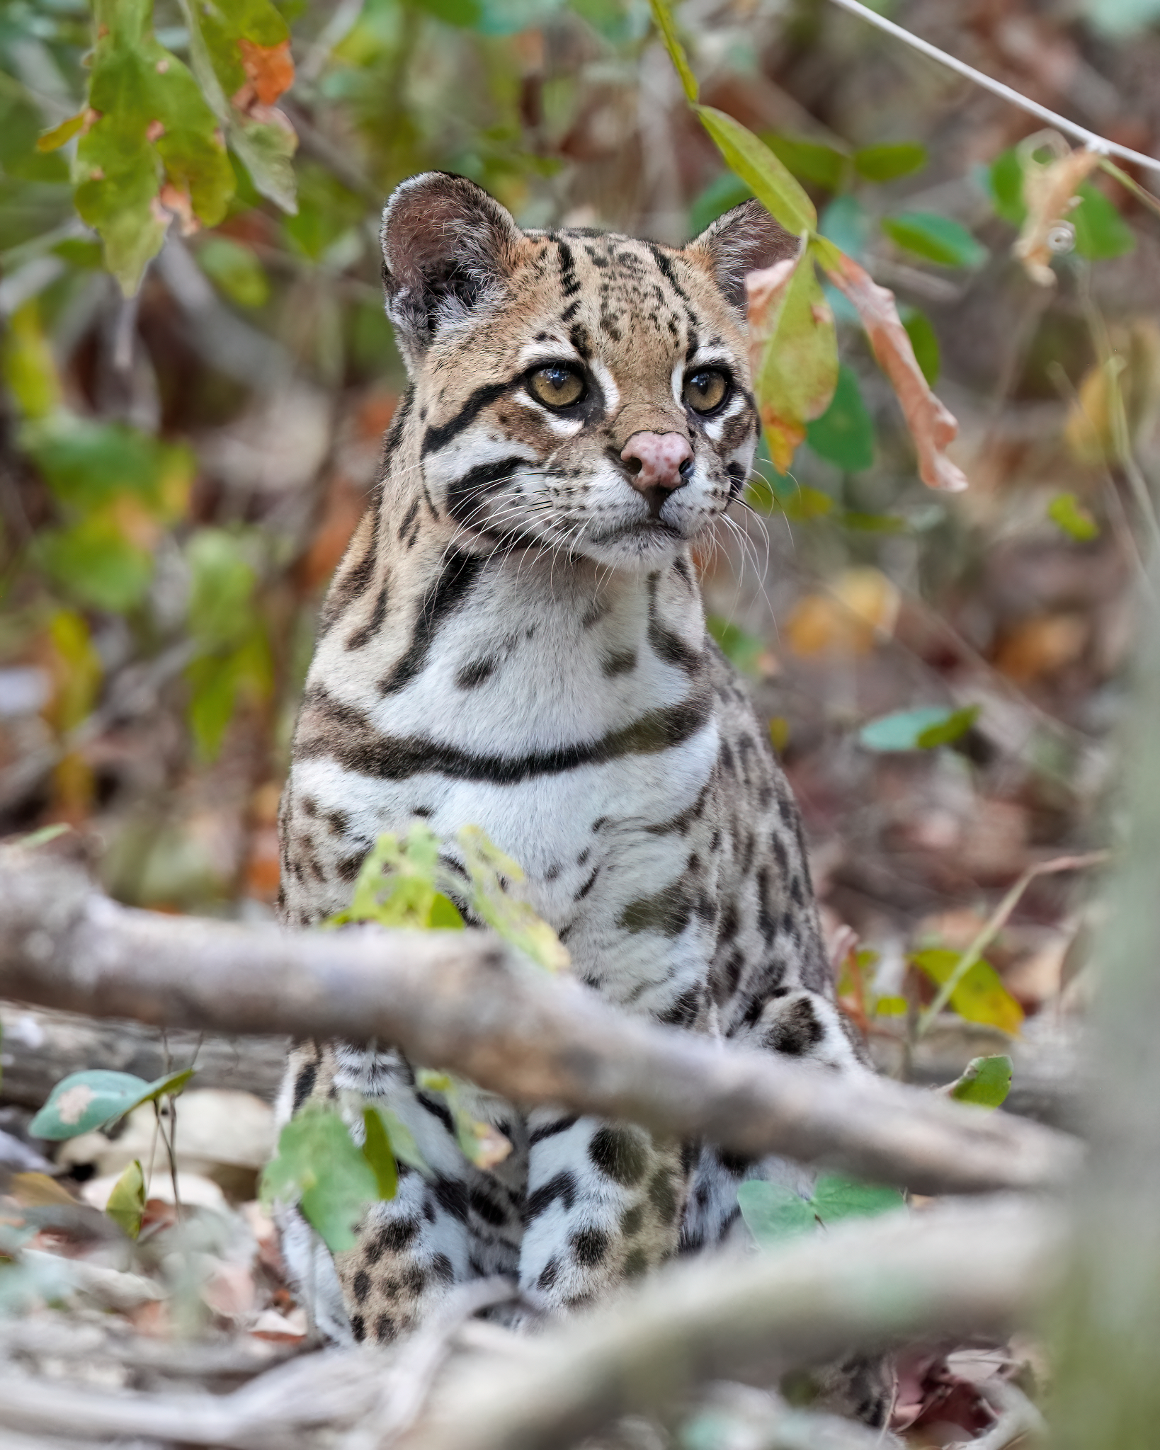
Classification of the genus Leopardus
Kodkod / guigna
Margay
Geoffroy’s Cat
Kitchener, A. C., Breitenmoser-Würsten, C., Eizirik, E., et al. (2017). A revised taxonomy of the Felidae: The final report of the Cat Classification Task Force of the IUCN/SSC Cat Specialist Group. Cat News, Special Issue 11
Ocelot

Slide 3
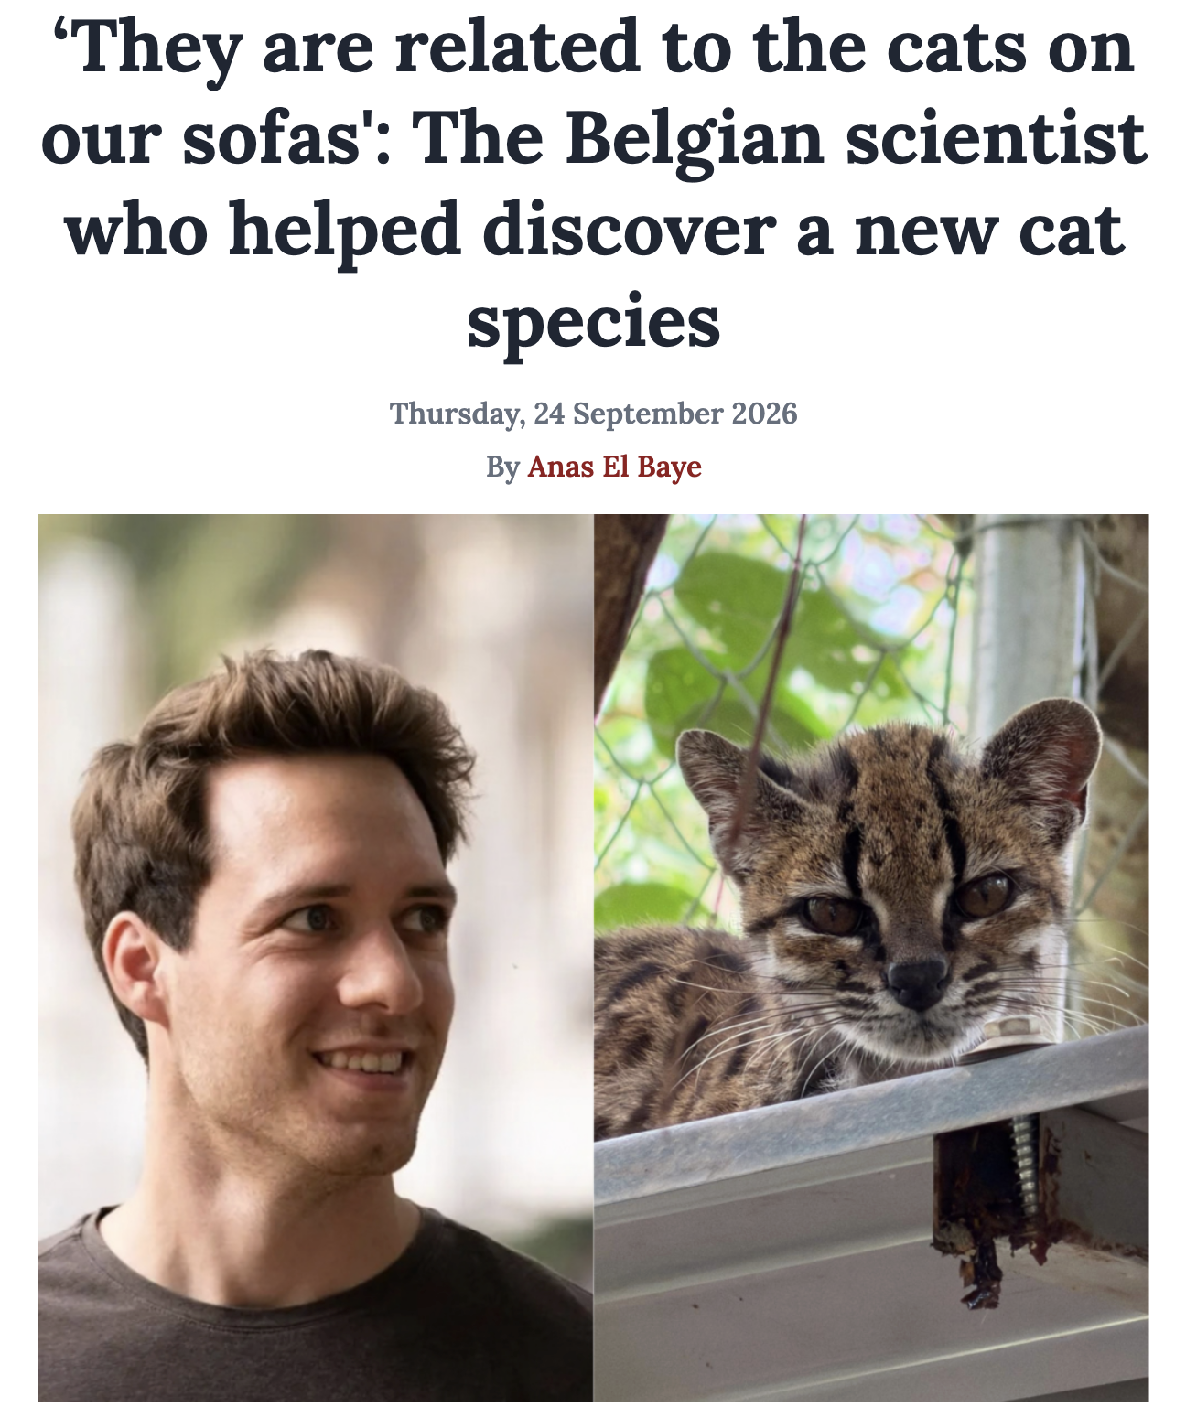
Jonas Lescroart, Alejandra Bonilla-Sánchez, Constanza Napolitano, Diana L Buitrago-Torres, Héctor E Ramírez-Chaves, Paola Pulido-Santacruz, William J Murphy, Hannes Svardal, Eduardo Eizirik, Extensive Phylogenomic Discordance and the Complex Evolutionary History of the Neotropical Cat Genus Leopardus, Molecular Biology and Evolution, Volume 40, Issue 12, December 2023, msad255, https://doi.org/10.1093/molbev/msad255
Tree based on complete mitochondrial genome
Consensus tree based on nuclear DNA
Jonas Lescroart

Slide 4
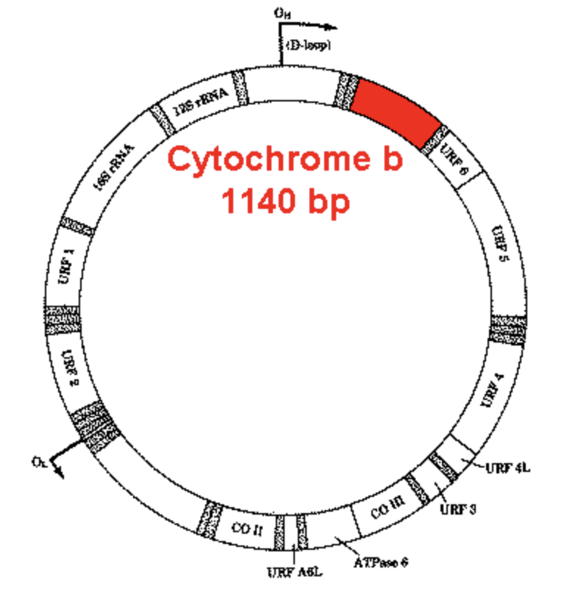
CYTB: traditional marker in phylogentic studies
Relatively fast evolutionary rate → useful for distinguishing closely related species
Clean maternal lineage signal → little recombination, simple genealogy
Extensive reference data available

Slide 5
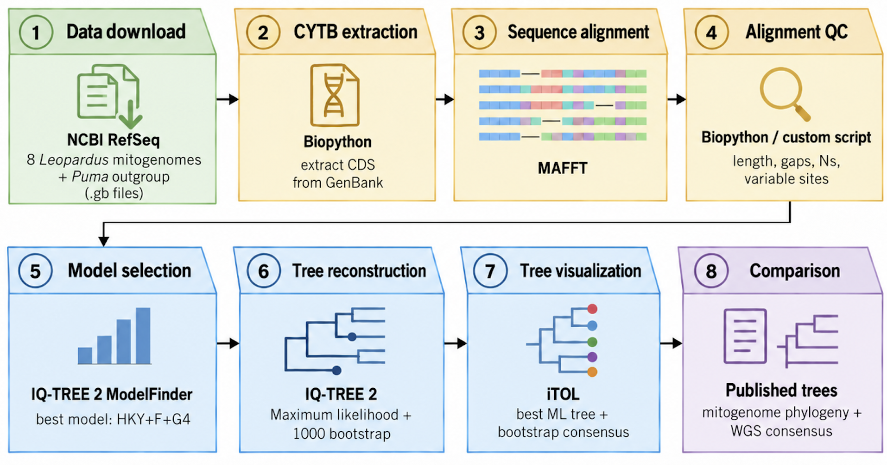
Our pipeline

Slide 6
ModelFinder assumptions
Assumption | Meaning
HKY | The model estimates transitions and transversions in the sequences and allows them to occur at different rates
+F | A, C, G and T occur at different frequencies, the model uses the observed frequencies
+G4 | Some positions in CYTB change quicker than others. The model divides sites into 4 categories, from slower to faster
More assumptions?
✅ Partitioning: using a different model for the third codon positions

Slide 7
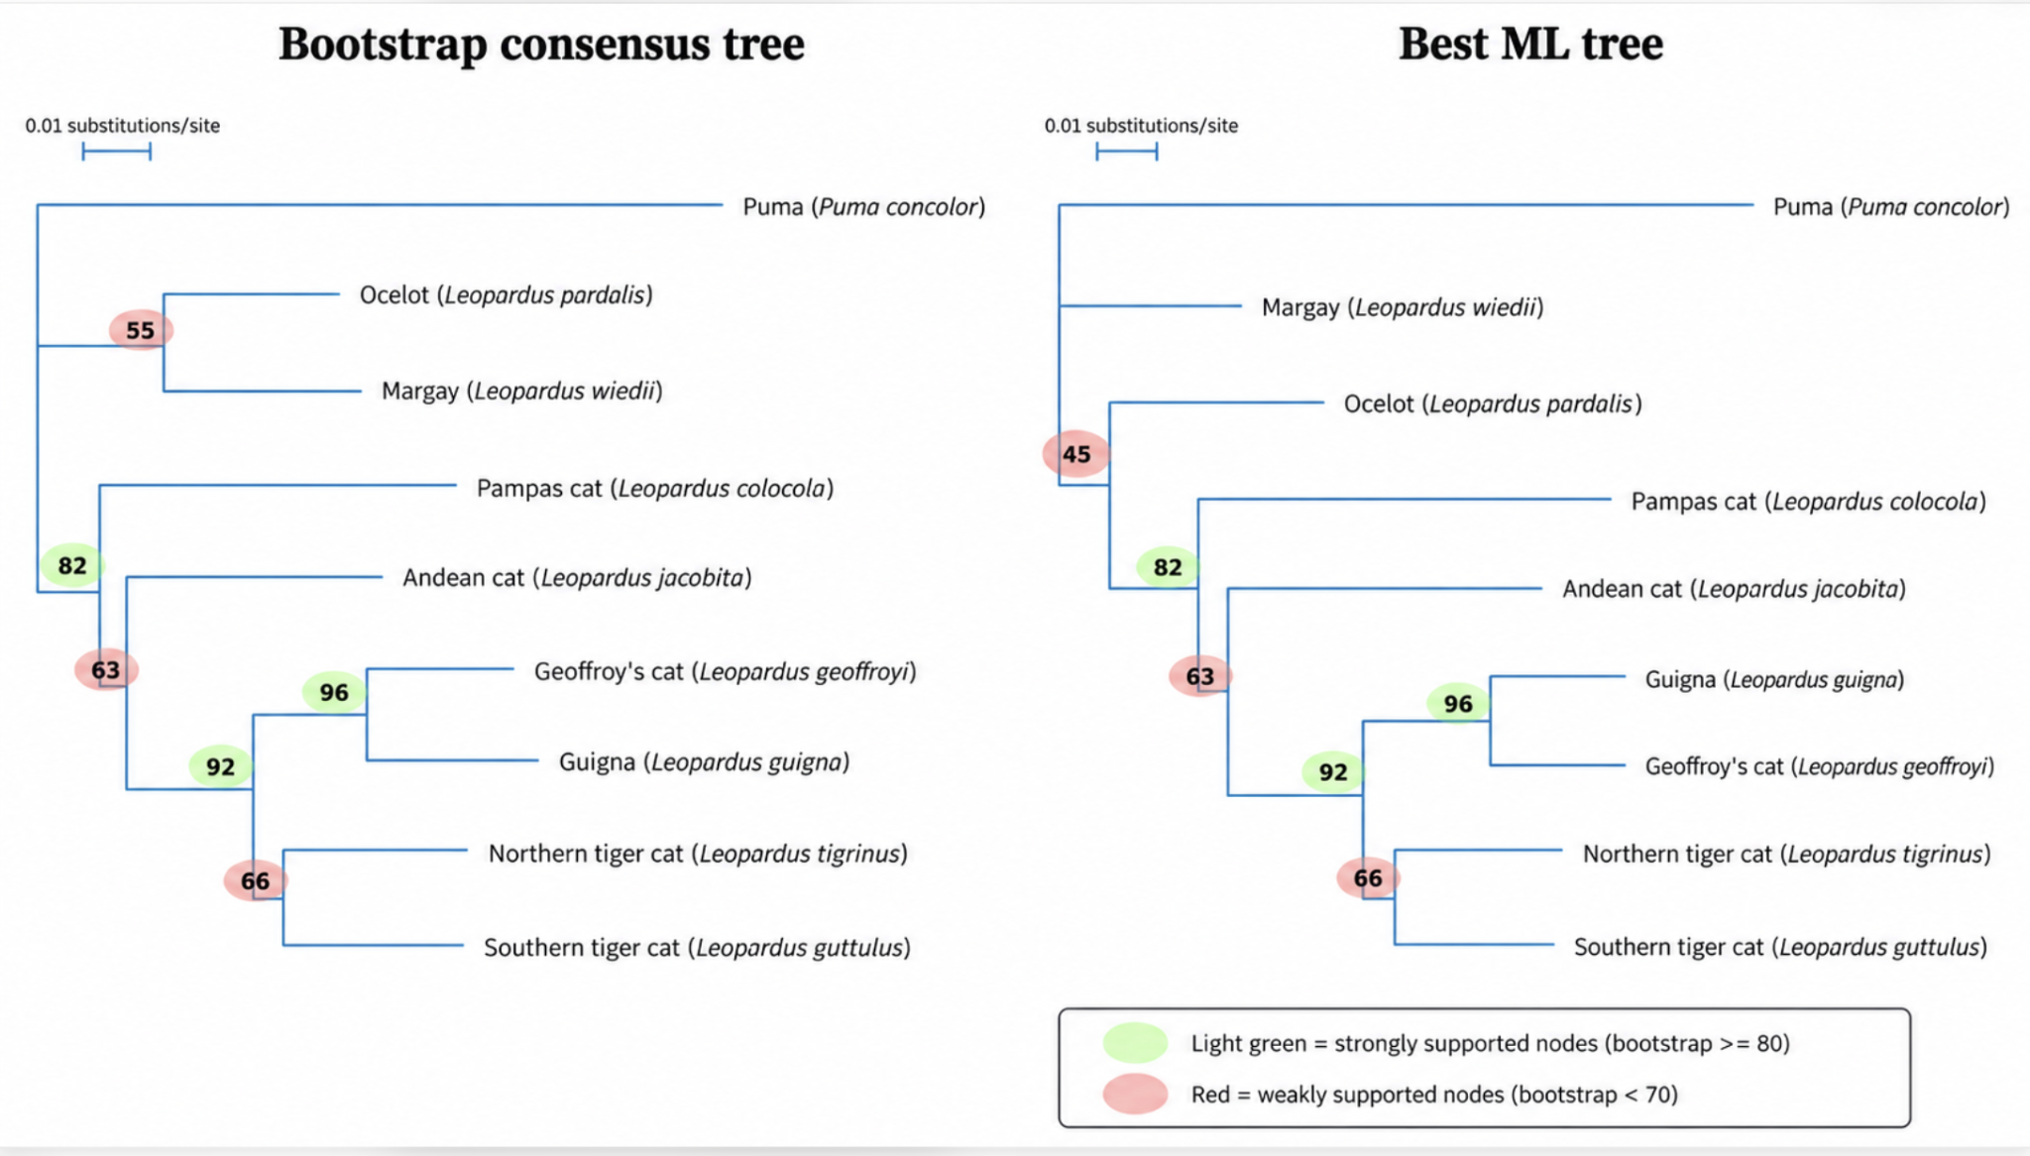

Slide 8
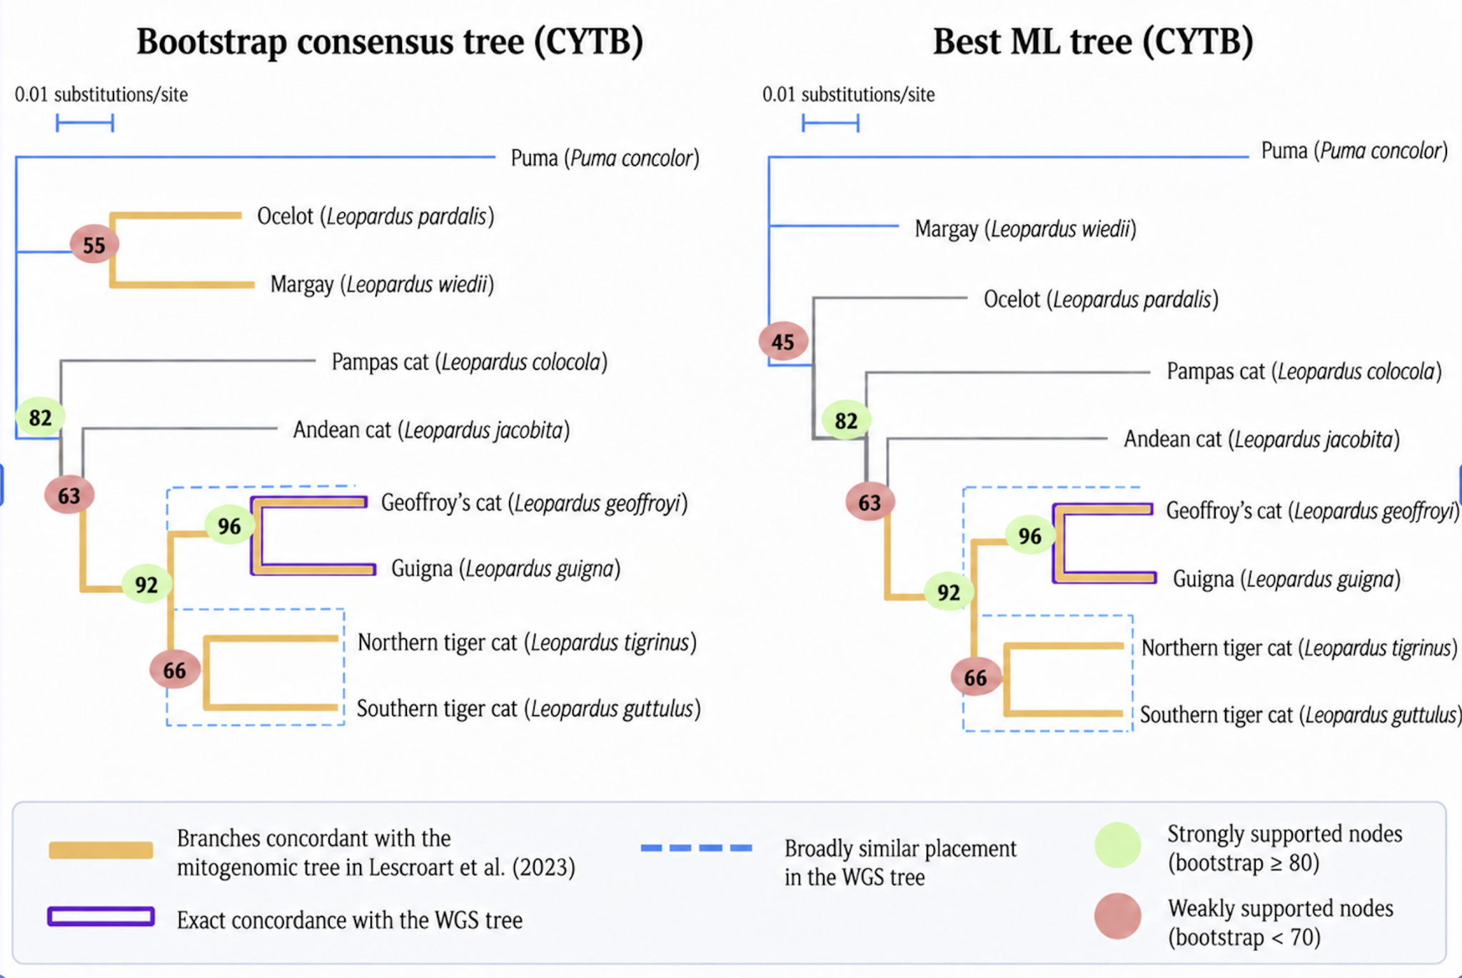

Slide 9
Conclusions
CYTB recovered some evolutionary relationships
Insufficient to resolve all parts of the genus phylogeny
BUT
Leopardus is a genus with a complex history
incomplete lineage sorting (ILS)
introgression
WGS-based tree: conflicting signals across different genes, no “true tree” so far

Slide 10
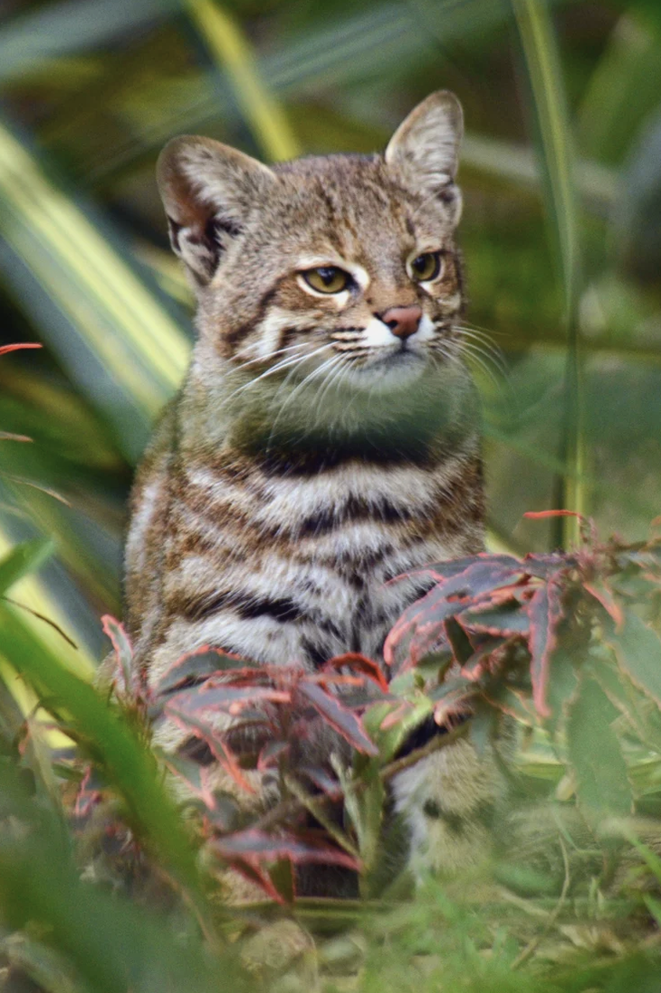
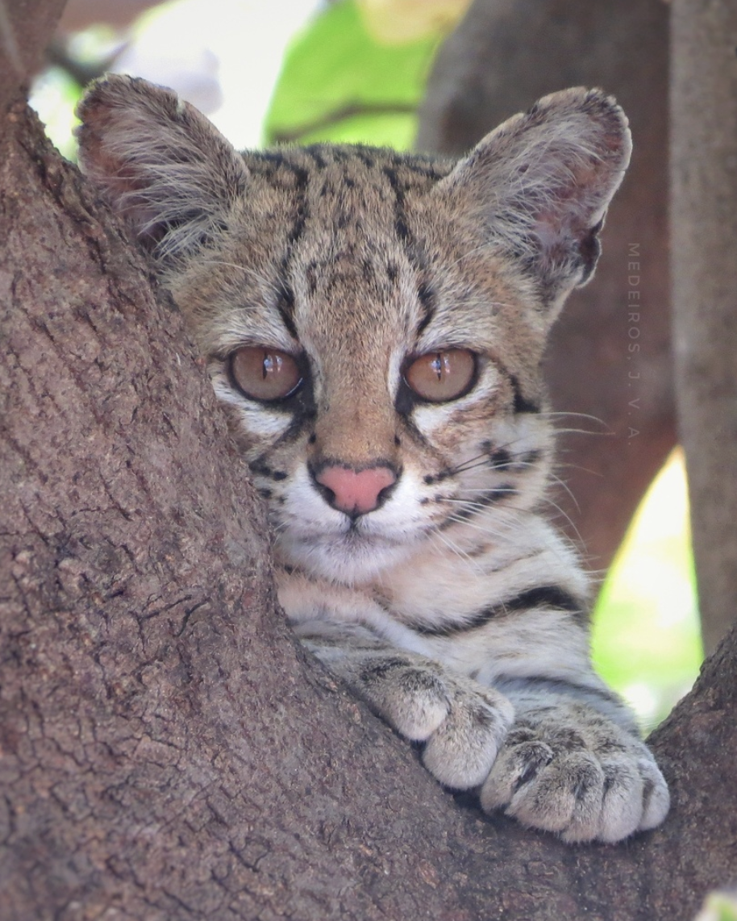
Mitochondrial capture
Gen | Mating | Nuclear genome of offspring | Mitochondrial DNA
1 | Pampas-cat ♀ × tiger-cat ♂ | 50% pampas cat + 50% tiger cat | 100% pampas-cat
2 | Hybrid ♀ × tiger-cat ♂ | 25% pampas cat + 75% tiger cat | 100% pampas-cat
3 | Hybrid ♀ × tiger-cat ♂ | 12.5% pampas cat 87.5% tiger cat | 100% pampas-cat
Pampas cat female (Leopardus colocola)
Tiger cat male (Leopardus tigrinus ssp. emiliae)

Slide 11
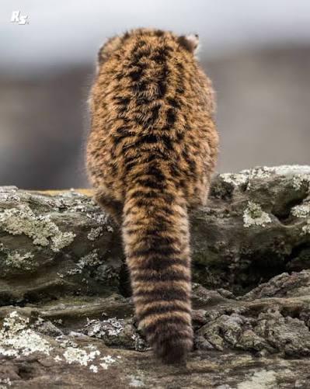
Thanks!

