Slide 1
Security Games with Protection Externalities: Planar variant
Brian Gauch

Slide 2
Our Contribution in a Nutshell
We modified an existing formulation of security games to model security games that take place on a plane
We were able to leverage this planar assumption to find good locations for defense resources
We show that the defender gets significantly higher utility when they are aware of the planar property, if it exists

Slide 3
Security Games with Protection Externalities (SPE)
When a defense resource is assigned to protect a target, it may also protect other targets as a side effect, or externality
General SPE model:
Take as input an arbitrary adjacency matrix among targets
Each defender’s pure strategy is a set of primary targets to defend; other targets may also be defended
NP-Hard to find the Strong Stackelberg Equilibrium (SSE)
Due to reduction from set cover decision problem
Polynomial approximate solutions exist

Slide 4
Planar SPE Variant Motivation
If a resource defends additional targets as an externality, it is likely because they are nearby in some sense
Can we benefit from taking as input the underlying metric space, instead of just the adjacency matrix?
Many real-world defense scenarios happen on the surface of the Earth, which is planar locally
Ignoring occlusion/obstacles, a camera/radar system or mobile response unit defends a disk on this plane

Slide 5
Planar SPE Variant
General SPE model:
Take as input an arbitrary adjacency matrix among targets
Each defender’s pure strategy is a set of primary targets to defend; other targets may also be defended
Our planar model:
Take as input target locations on a plane and range of each (identical) defense resource
Each resource defends all targets within a disc with this radius
Each defender pure strategy is a set of arbitrary locations on the plane for defense resources

Slide 6
Finding Good Locations
A good location corresponds to the center of a disk of radius r that contains many targets
Convert problem so that targets have disks associated with them, not the resource
A disk with radius r centered at p1 contains p2 ⬄ p1 is within distance r of p2 ⬄ a disk with radius r centered at p2 contains p1
Now a good location is a point that lies at the intersection of many disks
This is reminiscent of the well-studied problems of finding the maximum clique / maximal cliques in a unit disk graph

Slide 7
Non-dominated Locations
Formalized notion of a good location
We say a resource location l₁ is dominated by resource location l₂ if the set of targets defended by a resource at location l₁ is a subset of the set of targets defended by a resource at l₂.
We say a location is non-dominated (and therefore good) if it is not dominated by any other location

Slide 8
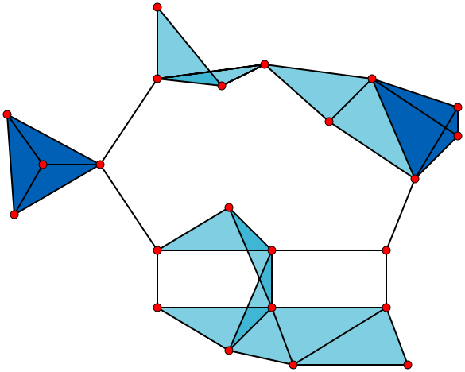
Graph Theory: Cliques
A clique in a graph is defined as a set of vertices such that every vertex in the set is adjacent to every other member of the set
A maximum clique is the largest (allowing ties) such set in the graph
A maximal clique is a clique such that no other vertex in the graph could be added to the set in the clique while maintaining the clique property

Slide 9
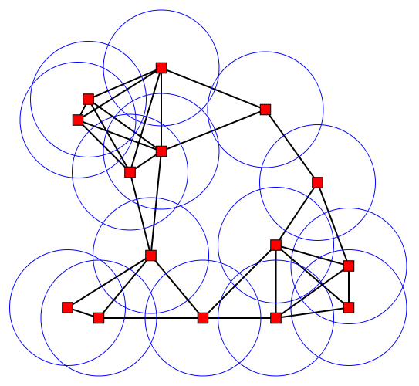
Graph Theory: Unit disk graphs
Consider drawing disks of unit radius on a plane
Consider creating a graph G from such a drawing, as follows:
For each disk, create a vertex in G
Vertices v and w have an edge between them in G if and only if the corresponding disks intersect in the drawing
A graph that can be created from such a drawing is called a unit disk graph

Slide 10
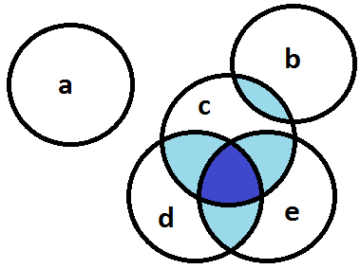
Graph Theory: Unit disk graph cliques
If we allow defender locations to be real, there are an infinite number of feasible locations
What if we instead consider regions in a unit disk graph?
Below, maximal cliques are {a}, {b,c}, and {c,d,e}
These correspond to non-dominated locations!

Slide 11
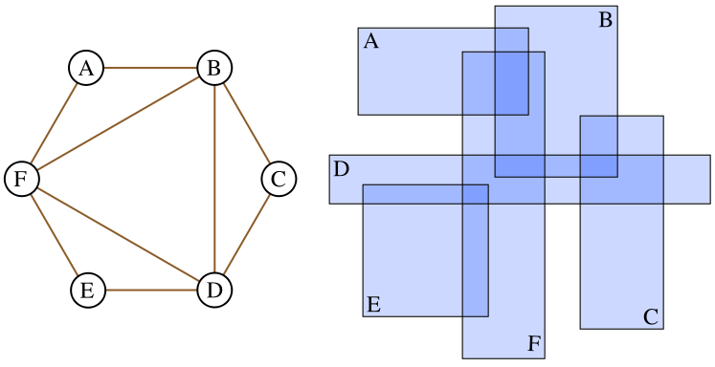
Graph Theory: Boxicity 2 graphs
A vertex in graph G corresponds to an axis-aligned rectangle on the plane
Vertices v and w have an edge between them in G if and only if the corresponding rectangles intersect on the plane

Slide 12
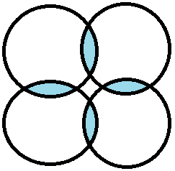
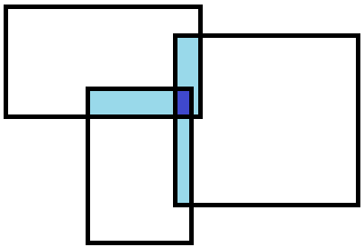
Graph Theory: Helly Property
A graph class defined by a geometric intersection model is said to have the Helly property if for every clique C, there is some single point p such that every vertex of C includes the point p
What we really care about is finding a point on the plane that intersects these shapes, so we need this property to be able to convert our problem into the problem of finding maximal cliques
The fact that the intersection of two rectangles is itself a rectangle gives rise to the Helly property for boxicity 2 graphs
Unit disk graphs do not have the Helly property

Slide 13
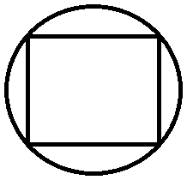
Graph Theory: Unit Disk vs. Boxicity 2 graphs
Unit disk:
Exponential number of maximal cliques
Would have to use some form of polynomial approximation
Do not have the Helly property
Closer to reality
Boxicity 2:
O(n^2) maximal cliques
Have the Helly property
Can approximate unit disk graph
s = r/sqrt(2)
We will use boxicity 2 graphs as an approximation

Slide 14
Implementation: Non-planar
For each trial, we generate points on the plane uniformly at random and place targets at these locations
With no metric space, we are constrained to placing resources right on top of targets
Each point is a possible resource location, but a defender action is a set of locations equal in size to the number of resources, so we have a combinatorial number of defender actions/pure strategies
We pass this combinatorial-sized game into the zero-sum game solving LP from hw3 and record the expected utility

Slide 15
Implementation: Planar
For each trial, we generate points on the plane uniformly at random and place targets at these locations
We pass this set of points into a solver that interprets the points as the centers of axis-aligned rectangles and finds all maximal cliques in the boxicity 2 graph
Each clique is returned as a point
Each point is a good location, but a defender action is a set of good locations equal in size to the number of resources, so we have a combinatorial number of defender actions/pure strategies
We pass this combinatorial-sized game into the zero-sum game solving LP from hw3 and record the expected utility

Slide 16
Implementation: Modules
All code written in C++ on Linux
World Builder
Place targets
Resource Location Selector
Planar: find maximal cliques
Non-planar: simply return set of target locations
Game Initializer
Generate combinatorial game
Game Solver
Solve zero-sum game and return utility

Slide 17
Implementation: maximal clique finding algorithms
Current implementation
Iteratively grow each maximal clique by trying to intersect it with each original rectangle
O(knlog(n)) where k is number of maximal cliques
O(n³log(n)) for boxicity 2 graphs which have O(n^2) maximal cliques
Line-sweep based implementation
Not yet implemented
Scan from left to right, adding and removing rectangles from the active list
If it works, could be O(n²log(n)

Slide 18
Evaluation
Defender utility is –p where p is the probability of a target being destroyed
That is, each target had equal value
In each trial there were 5 targets, placed between [0.0, 0.0] and [1.0, 1.0] uniformly at random

Slide 19
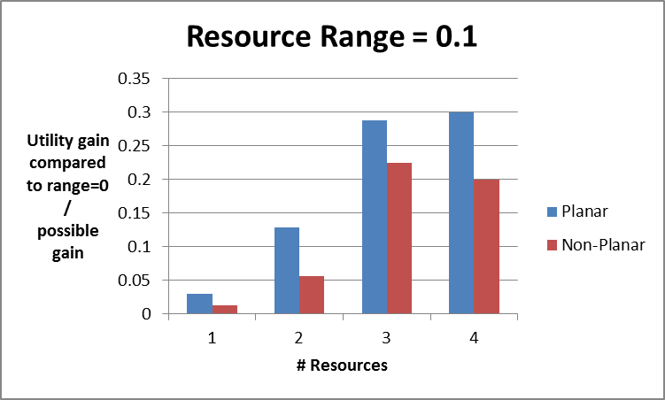
Results
Each data point below is based on NE defender utility averaged across 4 to 10 trials

Slide 20
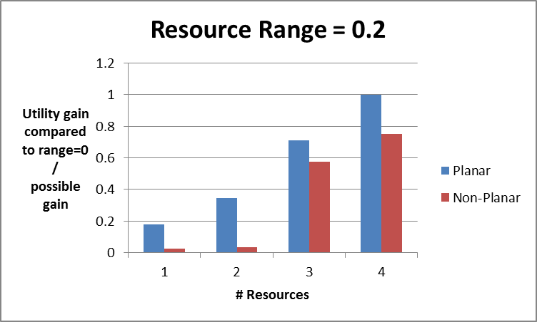
Results
Each data point below is based on NE defender utility averaged across 4 to 10 trials

Slide 21
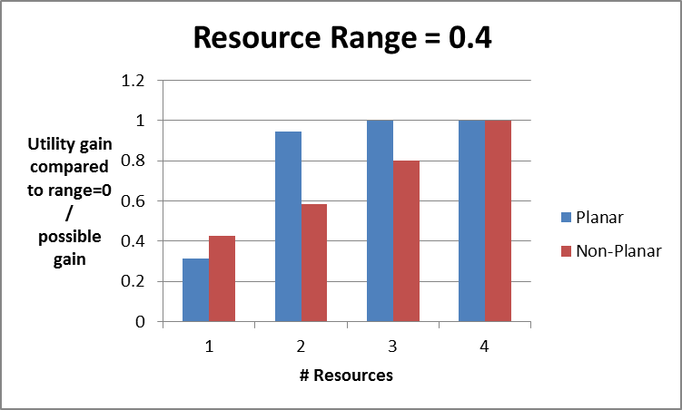
Results
Each data point below is based on NE defender utility averaged across 4 to 10 trials

Slide 22
Conclusions
Our results so far are indicate that planar properties are worth considering when they exist
Difficulty of finding maximal cliques to exploit planar property is dwarfed by difficulty of solving combinatorial-sized game anyway
Currently we consider all O(n^2) maximal cliques but we could consider only O(n) of them and provably perform no worse than non-planar model

Slide 23
Future Work
Implement faster sweep line algorithm to find maximal cliques in boxicity 2 graph
Verify significance
Further explore parameter space
Outside scope of project:
Polynomial game solution approximations to deal with combinatorial-sized games
Stackelberg game solver implementation

Slide 24
References
Jiarui Gan, Bo An, and Yevgeniy Vorobeychik. Security games with protection externalities. (AAAI, 2015, to appear).
Gupta, Rajarshi, Jean Walrand, and Olivier Goldschmidt. "Maximal cliques in unit disk graphs: Polynomial approximation." Proceedings INOC. Vol. 2005. 2005.
Fang, F.; Jiang, A. X.; and Tambe, M. 2013. Optimal patrol strategy for protecting moving targets with multiple mobile resources. In Proceedings of the 12th International Conference on Autonomous Agents and Multi-agent Systems (AAMAS’13), 957–964.
Brown, Gerald, et al. "Defending critical infrastructure." Interfaces 36.6 (2006): 530-544.
Xu, H.; Fang, F.; Jiang, A. X.; Conitzer, V.; Dughmi, S.; and Tambe, M. 2014. Solving zero-sum security games in discretized spatio-temporal domains. In Proceedings of the 28th AAAI Conference on Artificial Intelligence (AAAI’14).
Pita, James, et al. "Deployed ARMOR protection: the application of a game theoretic model for security at the Los Angeles International Airport." Proceedings of the 7th international joint conference on Autonomous agents and multiagent systems: industrial track. International Foundation for Autonomous Agents and Multiagent Systems, 2008.

Slide 25
References
Jain, Manish, et al. "Security Games with Arbitrary Schedules: A Branch and Price Approach." AAAI. 2010.
Korzhyk, Dmytro, Vincent Conitzer, and Ronald Parr. "Complexity of Computing Optimal Stackelberg Strategies in Security Resource Allocation Games." AAAI. 2010.
Spinrad, Jeremy P. Efficient graph representations. American mathematical society, 2003.
Wikipedia contributors. "Game theory." Wikipedia, The Free Encyclopedia. Wikipedia, The Free Encyclopedia, 1 Mar. 2015. Web. 4 Mar. 2015.
Wikipedia contributors. "Clique (graph theory)." Wikipedia, The Free Encyclopedia. Wikipedia, The Free Encyclopedia, 6 Apr. 2015. Web. 6 Apr. 2015.
Wikipedia contributors. "Unit disk graph." Wikipedia, The Free Encyclopedia. Wikipedia, The Free Encyclopedia, 24 Aug. 2014. Web. 6 Apr. 2015.
Wikipedia contributors. "Boxicity." Wikipedia, The Free Encyclopedia. Wikipedia, The Free Encyclopedia, 22 Mar. 2015. Web. 6 Apr. 2015.

