Slide 1
USING MACHINE LEARNING TO PREDICT USED CAR PRICES
Name: Austine Igho Efenarua
Student ID: 23096669
Github Link:

Slide 2
Background
1. Market Overview:
- The second-hand vehicle market has grown rapidly due to economic, social, and environmental factors.
- Traditional pricing methods often rely on subjective factors(guess work) and are usually unreliable.
2. ML in Car Pricing:
- Machine learning algorithms (e.g., Random Forest, XGBoost) offer a more accurate, data-driven approach.
- Recent studies show that these models outperform traditional methods, providing better predictions (Gao, 2024; Guo & Zhang, 2024).

Slide 3
Research Questions & Objectives
1. Research Questions:
What insights can Exploratory Data Analysis (EDA) reveal about used car prices?
Which ML model gives the most accurate price predictions?
Which features most influence car prices?
2. Project Objectives:
Perform EDA to uncover trends and correlations in the dataset.
To evaluate and compare the performance of ML models.
To analyse and Identify key features affecting car prices.

Slide 4
Why this Project & Usefulness
1. Why This Project?
- The used car market faces challenges with pricing accuracy and reliability.
- ML models like Random Forest and XGBoost can bring consistent, accurate and reliable predictions.
2. Usefulness:
- Improved pricing predictions can lead to better market decisions.
- Helps buyers and sellers make informed, data- driven decisions.
- Enhances market efficiency and trust.

Slide 5
Methodology
1. Research Design:
- Data collected from Kaggle with 4,009 observations across12 variables.
2. Ethical Considerations:
- No personal data used; dataset is open and publicly available.
- GDPR compliance ensured for data processing.
3. Data Collection:
- Data preprocessing (cleaning, encoding, scaling, feature engineering)
4. Model training:
- For the Train-Test Split: Data was divided into 80/20 split ratio.

Slide 6
Suitability of the Models
Model | Key Strength | Limitation | Suitability
Linear Regression | Simple and interpretable | Poor with non-linear data | It’s a Baseline model (Benchmark)
Random Forest | Handles complexity and interactions | Less interpretable | Strong for tabular data
XGBoost | High accuracy with regularization | More complex, needs tuning | Best for this prediction task

Slide 7
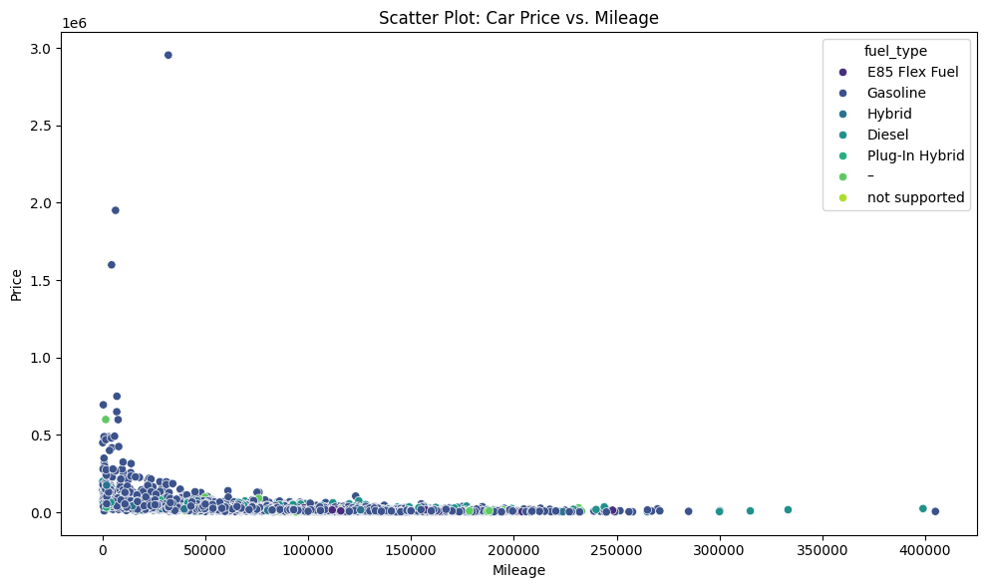
Scatter Plot for Price Vs. Mileage
Prices generally decrease as mileage increases.
Some high-mileage cars still have high prices, likely luxury models.
Gasoline is the most common fuel type in the dataset.

Slide 8
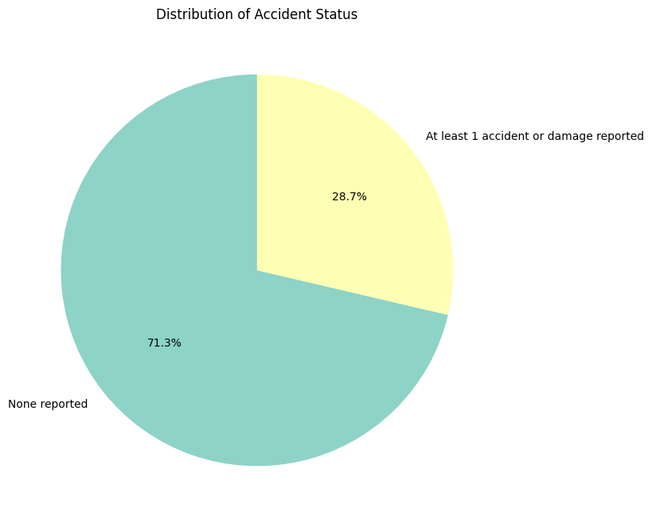
Pie plot showing distribution of Accident Status
71.3% of cars have no reported accidents or damage.
28.7% of cars have at least one accident or damage reported.
Most cars are accident-free.
Dealers and buyers often use accident history as a key factor in negotiating car price.

Slide 9
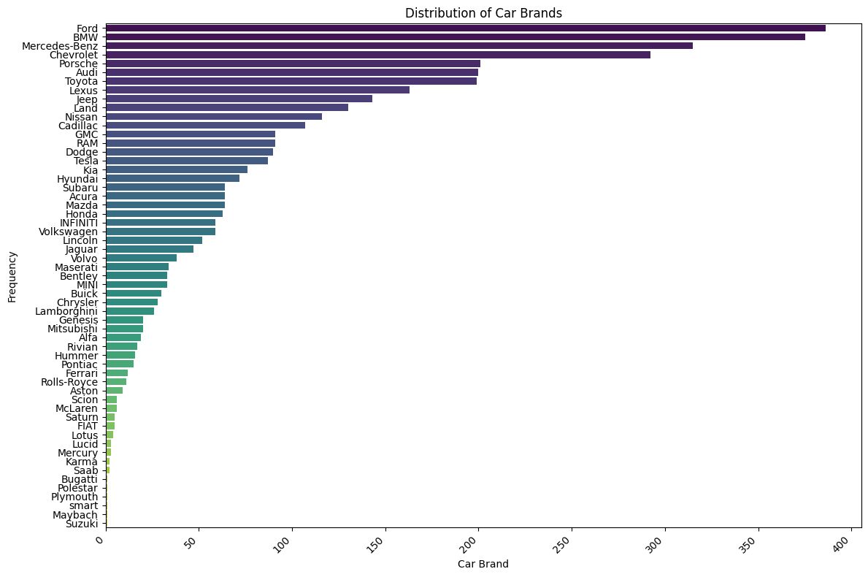
Count Plot for Car brand distribution
Ford, BMW, Mercedes-Benz, and Chevrolet are the most frequent brands (300+ listings each).
Brands like McLaren, Rolls-Royce, Bugatti, and Suzuki have fewer than 50 listings.
The data mostly focuses on popular car brands.
.
Notes:
Ford, BMW, Mercedes-Benz, and Chevrolet are the most frequent brands (300+ listings each).
Brands like McLaren, Rolls-Royce, Bugatti, and Suzuki have fewer than 50 listings The data mostly focuses on popular car brands.
Less common brands appear only a few times.

Slide 10
Results
1. Model Performance (Before Optimization):
- High MAE, RMSE, and low R² values indicating underfitting.
- XGBoost, Random Forest, and Linear Regression all showed poor initial results.
Model Performance (After Optimization):
After hyperparameter tuning, models improved significantly.
- XGBoost had the best performance:
- MAE: 0.3148
- RMSE: 0.4014
- R²: 0.7505
Model | MAE | RMSE | R²
Linear Regression | 0.3223 | 0.4251 | 0.7202
Best Random Forest | 0.3319 | 0.4175 | 0.7301
Best XGBoost | 0.3148 | 0.4014 | 0.7505

Slide 11
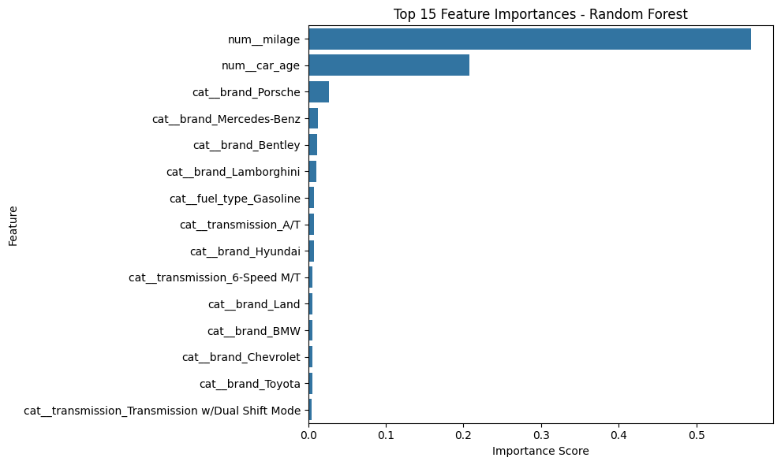
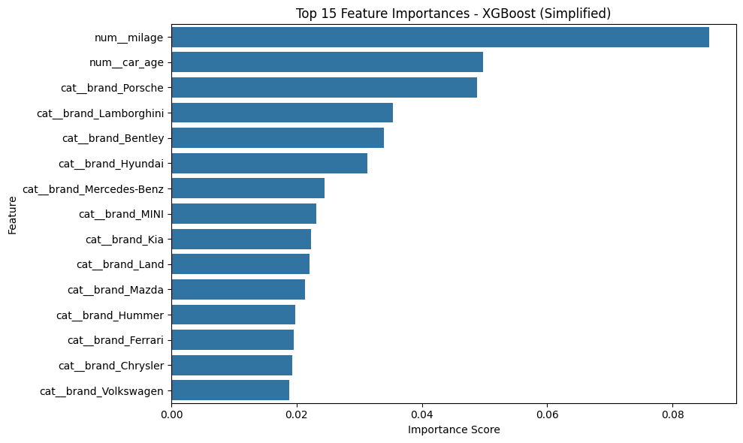
Result cont.
Feature Importance:
- From the above plots, both models confirm Key predictors as: Mileage, car age, and brand.
- XGBoost places higher importance on brand than Random Forest.

Slide 12
Comparison with Literature
1. Literature Review Findings:
- Previous studies (e.g., Gao, 2024; Guo & Zhang, 2024) indicate that ensemble methods like Random Forest and XGBoost outperform traditional models in car price predictions.
2. Results:
- Consistent with literature, XGBoost achieved the best predictive performance.
- Feature importance aligns with studies highlighting the significance of variables like car age, mileage, and brand.

Slide 13
Conclusion & Future Work
1. Conclusion:
- XGBoost outperformed other models, with significant improvements after optimization.
- Key factors influencing car prices: Mileage, age, and brand.
- The project confirms the superiority of ML models in providing more accurate car price predictions.
2. Future Work:
- Expand the dataset to include more diverse geographic regions.
- Further optimization and integration into real-time systems for practical applications.
- Explore user-friendly tools for dynamic price prediction in the automotive sector.

Slide 14
References
Gao, J. (2024). Second-hand car price prediction based on multiple linear regression and random forest. Theoretical and Natural Science, 52(1), pp.31–40. doi:https://doi.org/10.54254/2753-8818/52/2024ch0105.
Guo, S. and Zhang, B. (2024). Revolutionizing the used car market: Predicting prices with XGBoost. Applied and Computational Engineering, [online] 48(1), pp.173–180. doi:https://doi.org/10.54254/2755-2721/48/20241349.
Najib, T. (2023). Used Car Price Prediction Dataset. [online] Kaggle.com. Available at: https://www.kaggle.com/datasets/taeefnajib/used-car-price-prediction-dataset?resource=download [Accessed 5 May 2025].
Zhu, Y. (2023). Prediction of the price of used cars based on machine learning algorithms. Applied and computational engineering, 6(1), pp.671–677. doi:https://doi.org/10.54254/2755-2721/6/20230917.

