Slide 1
Build a ChatBot based on knowledge contained within documents
Challenge

Slide 2
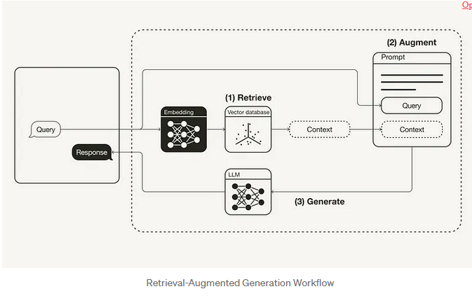
Work approach

Slide 3
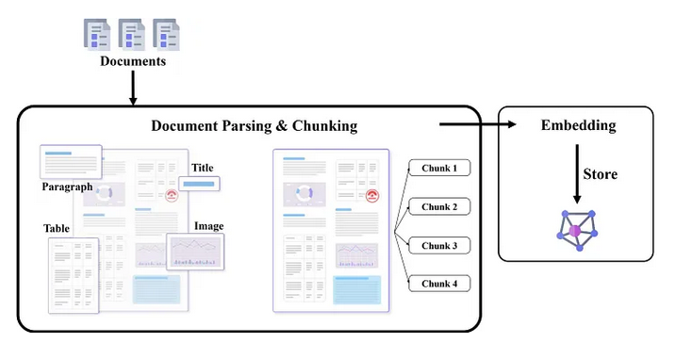
Step1
Split documents into chunks containing a maximum of 1200 characters, using a period as a delimiter (The choice of 1200 characters per chunk and using a period as a delimiter is based on my examination of the documents).
Embedding: Transform Text chunks to numerical sementic vectors
Store indexed numerical sementic vectors by using Faiss library for Efficient similarity research and retrieval of context

Slide 4
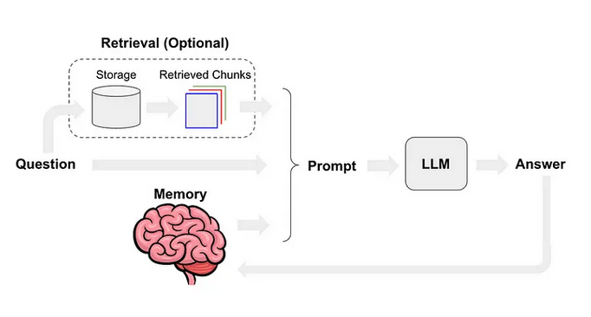
Step2
Construct Chains (Prompt_Template, ConversationalRetrievalChain) using the langChain framework to ensure that the LLM model follows system instructions (predefined prompts) and integrates chat history and retrieved context that closely match the user query within the main prompt (user query + context + chat history combined by predefined prompt)

Slide 5
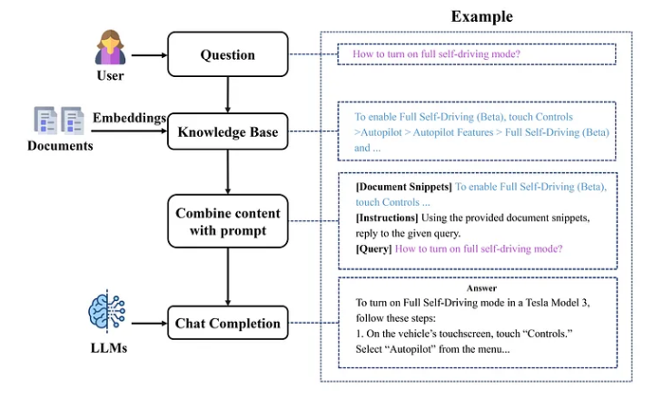
Step3
Integrate all built models from document splitting and embedding to create chat chains. To build a sample chatbot interface using Streamlit.
Note: To mitigate memory issues associated with using LLM models, I utilize an embedding model and the Mixtral8*7B model hosted on Hugging Face.

Slide 6
Step 4
Manually test the chatbot by asking it a set of questions related to the topic of risk factors in financial trade. Validate the accuracy of the responses based on the documents.

Slide 7
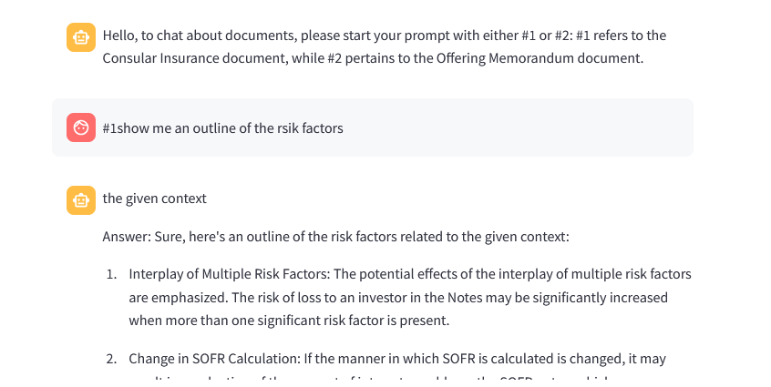
Demonstration

Slide 8
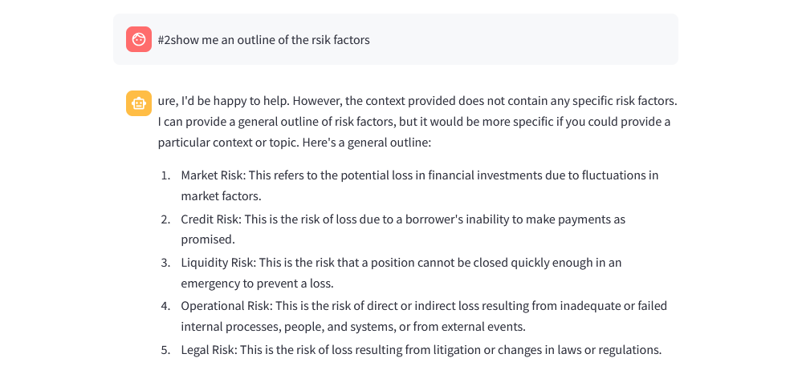
Demonstration

Slide 9


