Slide 1
High
Generic
subdomains
Core
subdomains
Business logic
complexity
Generic and Supporting
subdomains
Supporting
subdomains
Low
Low
Business
differentiation
High

Slide 2
Customer service
Help desk system
Case routing
(Core)
Help desk System
(Generic)
Ticket life cycle
(Generic)
Search
(Generic)
Telephony
(Generic)
Shift management
(Supporting)
Knowledge base
(Generic)
Alert system
(Generic)

Slide 3
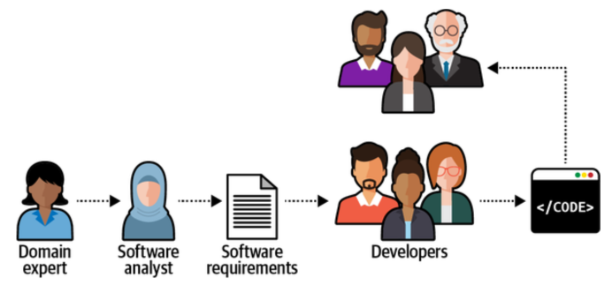

Slide 4
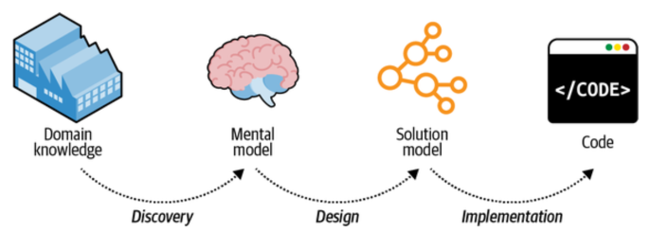

Slide 5



Domain experts
The ubiquitous language
Developers

Slide 6
Subdomain 1
Bounded context 1
Subdomain 2
Bounded context 2
Bounded context 3
Subdomain 3
Subdomain 4
Bounded context 4

Slide 7
Partnership
Shared kernel
Conformist
Open-host service
Anticorruption layer
Separate ways
More cooperation
Less cooperation

Slide 8
Bounded
context 1
Bounded
context 2
Shared
kernel

Slide 9
Open-host
service
Bounded context 2
OHS
PL V1
Bounded context 1
PL V2
Bounded context 3
Published
languages

Slide 10
Billing
Marketing
Identity and access
Conforms
Conforms
U
D
D
U
Partners
Conforms
Ads publisher
CRM
Legacy system
ACL
ACL
Billing
OHS
SQS

Slide 11
Domain
Partnership
Ubiquitous language
Sub
domain
Core sub
domain
Shared kernel
Bounded context
Separate ways
Domain expert
Generic sub
domain
Conformist
Developer
Supporting sub domain
Contract
Open-host service
Anti corruption layer

Slide 12
Generic sub
domain
Supporting sub domain
Partnership
Core sub
domain
Domain expert
Shared kernel
Composed
of many
Domain
Are types of
Are types of
Conformist
Sub
domain
Contract
Developer
Discover
Anti corruption layer
Is a
model of
Develop
& use
Related to and
informed by
but not tied to
Ubiquitous language
Open-host service
Bounded context
Develop
& use
Separate ways
Design

Slide 13
Cart service
Database
AddItem(int productId, int quantity) : void
ListItems() : CartItem[]
SetShippingAddress(Address address) : void
Validate() : ValidationResult

Slide 14

Database
1. Execute
IncrementQuoteItemQuantity
2. Update
3. Result

Slide 15
The aggregate root
Application layer
Quote
1
*
QuoteItem
1
Shipping Address
1
Billing Address
The aggregate

Slide 16
Rehydrate
Events
Aggregate
Event Store
Events
Commit

Slide 17
Procedure to handle
business transactions
Data access and business
logic in the same object
Transaction
script
Active record
Immutable
objects
Use as
properties of
Use for
Use for
Value object
Mutable
objects
Simpler domains
Entity
A hierarchy
of related
Aggregate
Supports fetching
and appending
More complex domains
Building
blocks of
Exposes
functionality via
Command
Event store
Stores domain
events in
Contains logic that
involves many
Use for
Use for
Publishes
significant
Domain service
Event sourced domain model
Domain model
Domain event
Projection
Full object oriented
model of the domain
Represents
state using
Source of truth of
Used to construct

Slide 18
Presentation layer
Web UI
Web API
CLI
Business logic layer
Entities
Rules
Processes
Data access layer
Database
Message bus
Object storage

Slide 19
Presentation layer
Service layer
Action
Action
Action
Business logic layer
Data access layer

Slide 20
Infrastructure
Application
Business logic
Adapter
Adapter
Adapter
Adapter
Ports

Slide 21
Command
execution
model
Execute
commands
Publish
changes
Projection engine
Consumers
Query
Project
Read models

Slide 22
Checkpoint storage
1. GetLastCheckpoint
4. UpdateLastCheckpoint
Projection engine
2. GetChangesAfter
3. UpdateProjections
Command execution model storage
Projections storage
Read models storage

Slide 23
E-commerce bounded context
Catalog
CQRS
architecture
Shopping cart
Layered
architecture
Checkout
Ports and adapters architecture

Slide 24
Transformed
request
Request
Bounded context A
Proxy
Bounded context B
Transformed
response
Response

Slide 25
Downstream
API Gateway
Published language v1
Downstream
Upstream
Published language v2
Downstream
Published language v3
Downstream

Slide 26
Producer
Model A
Message proxy
Model B
Consumer

Slide 27
Bounded context A
Many messages
Proxy
(aggregator/combinator)
Batch/combined message
Bounded context B
Storage

Slide 28
Database
Transaction
Aggregate state
Commit
state & events
Application
Query
Message relay
Publish
Message bus
Outbox table

Slide 29
Online store
Payment processor
Inventory
Shipping
Order captured
Payment
accepted
Inventory cleared
Shipment dispatched
Update order status
Process payment
Prepare package
Order processing saga
Schedule
shipment

Slide 30
Online store
Start new
order processing
workflow
Payment processor
Application
Order processing process manager
Inventory
Shipping
State

