Slide 1
PRESENTED BY FLEETEL
Digi-Switchride
Electric vehicle rental operations for web and mobile
Customer presentation · Live product walkthrough with screenshots from the operations portal and rider app

Slide 2
AGENDA
What we will cover
Platform overview — one product for operators and riders
Web operations portal — dashboard, fleet, riders, KYC, finance
Live tracking and IoT — GPS, Track360, active rides
Ops desk — bookings, breakdowns, service, support
Multi-company control — organisations, hubs, branding
Rider mobile app — book, pay, vehicle, KYC, support
Delivery model and next steps with Fleetel
Confidential · Presented by Fleetel · Digi-Switchride
2

Slide 3
PLATFORM
Digi-Switchride at a glance
Web operations portal
Rider mobile app
Command centre for SuperAdmin and company staff: riders, vehicles, hubs, charging, KYC, bookings, rides, IoT, finance, branding.
Android app for login by organisation, wallet, rentals, nearby hubs, UPI/wallet payments, KYC, breakdowns and support.
Telematics & IoT
Multi-tenant by design
Track360 pull plus HTTP/TCP/MQTT ingest. Vehicles refresh on the map every 10 seconds. 2/3/4-wheeler icons. Road-aligned live tracking.
Each customer (company) sees only their hubs, vehicles, riders and devices. SuperAdmin assigns records and company logos.
Confidential · Presented by Fleetel · Digi-Switchride
3

Slide 4
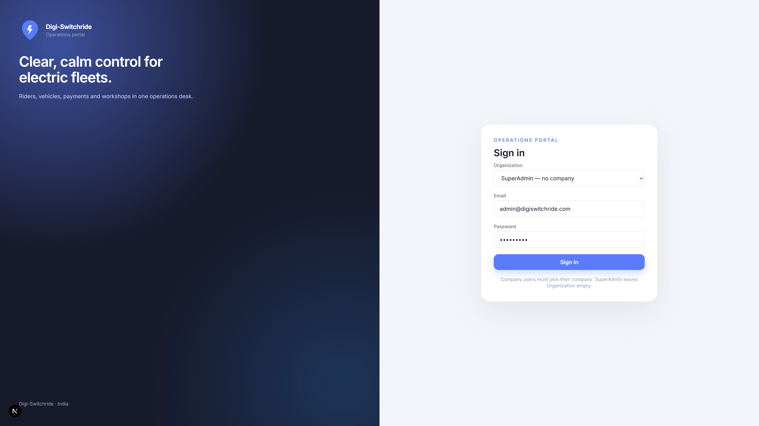
FLEETEL · DIGI-SWITCHRIDE
Secure operations login
SuperAdmin leaves Organisation empty. Company users pick their company so they never mix fleet data.
Role-based sign-in
Company picker for operators
SuperAdmin is not branded with a customer logo
JWT session into the operations desk
Confidential · Presented by Fleetel · Digi-Switchride
4

Slide 5
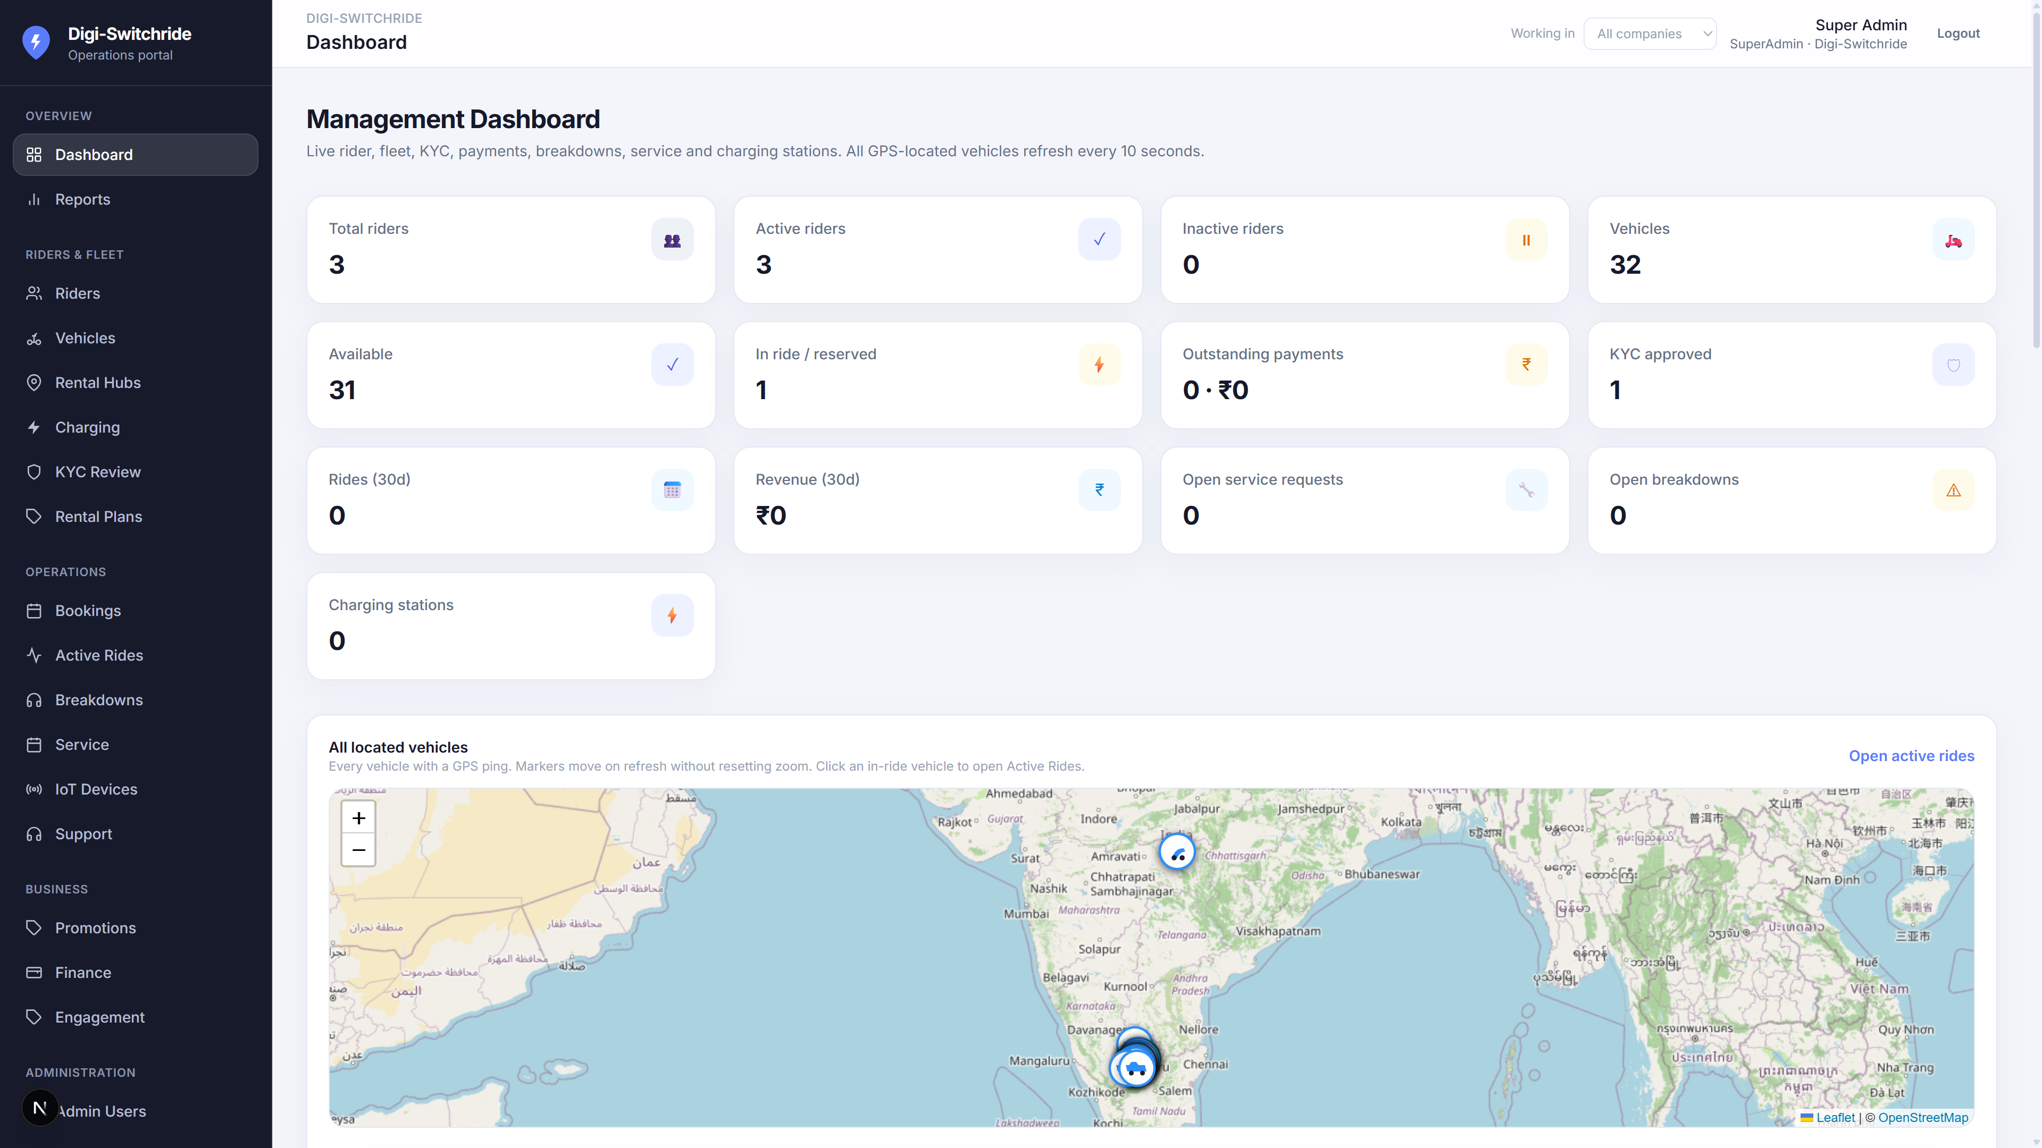
FLEETEL · DIGI-SWITCHRIDE
Management dashboard
Live KPIs plus every GPS-located vehicle on one map. Locations refresh without resetting zoom.
Riders, fleet, KYC, payments
In-ride / reserved at a glance
Map of all located vehicles
Click through to Active Rides
10-second location refresh
Confidential · Presented by Fleetel · Digi-Switchride
5

Slide 6
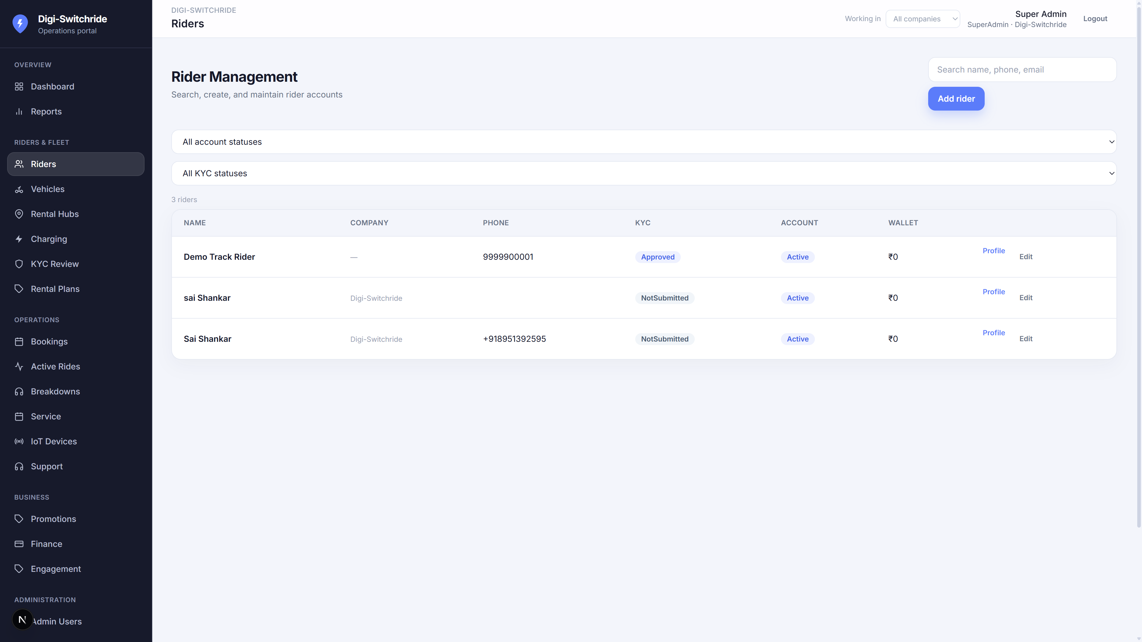
FLEETEL · DIGI-SWITCHRIDE
Rider management
Create, search and maintain rider accounts with KYC and wallet status.
Name, phone, company
KYC status filters
Account Active / Suspended
Wallet balance
Assign riders to a company
Confidential · Presented by Fleetel · Digi-Switchride
6

Slide 7
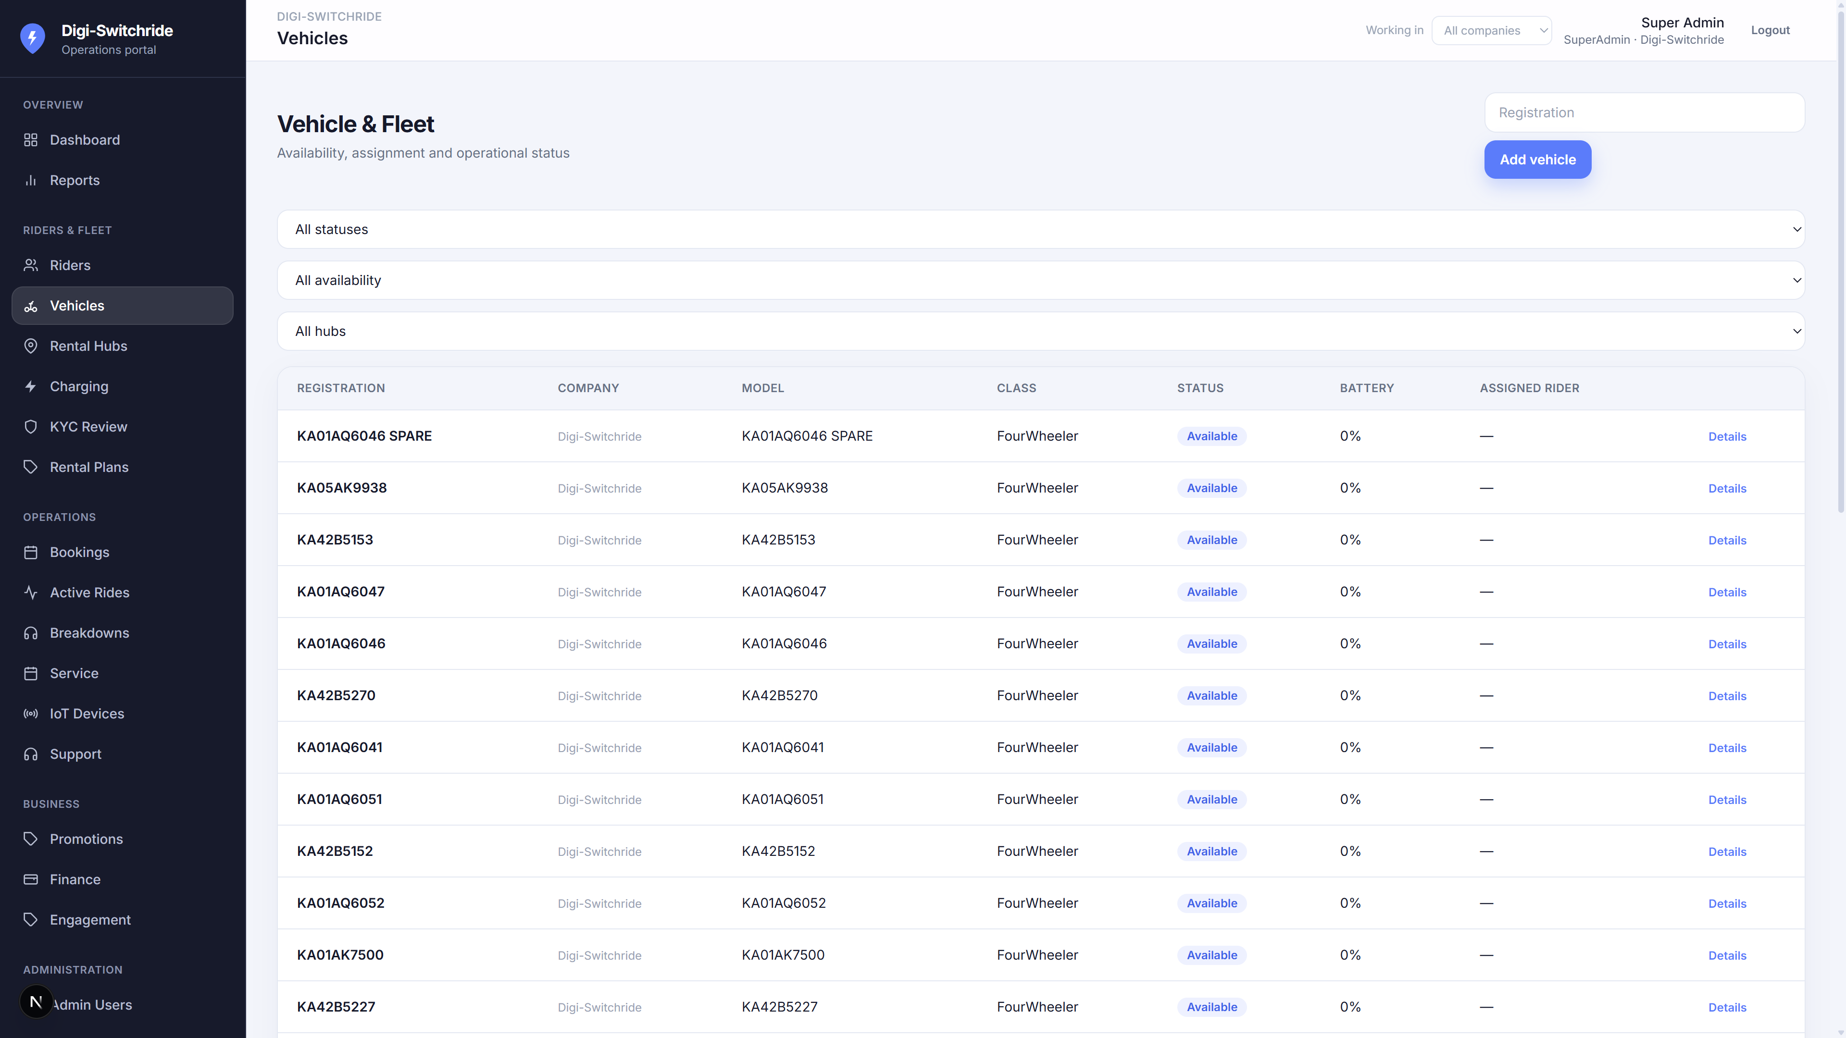
FLEETEL · DIGI-SWITCHRIDE
Vehicle & fleet
Registration, class, hub, status, battery and assigned rider.
2 / 3 / 4 wheeler classes
E-scooter, e-bike, e-rickshaw, e-car
India registration numbers
Availability and assignment
Linked IoT device
Confidential · Presented by Fleetel · Digi-Switchride
7

Slide 8
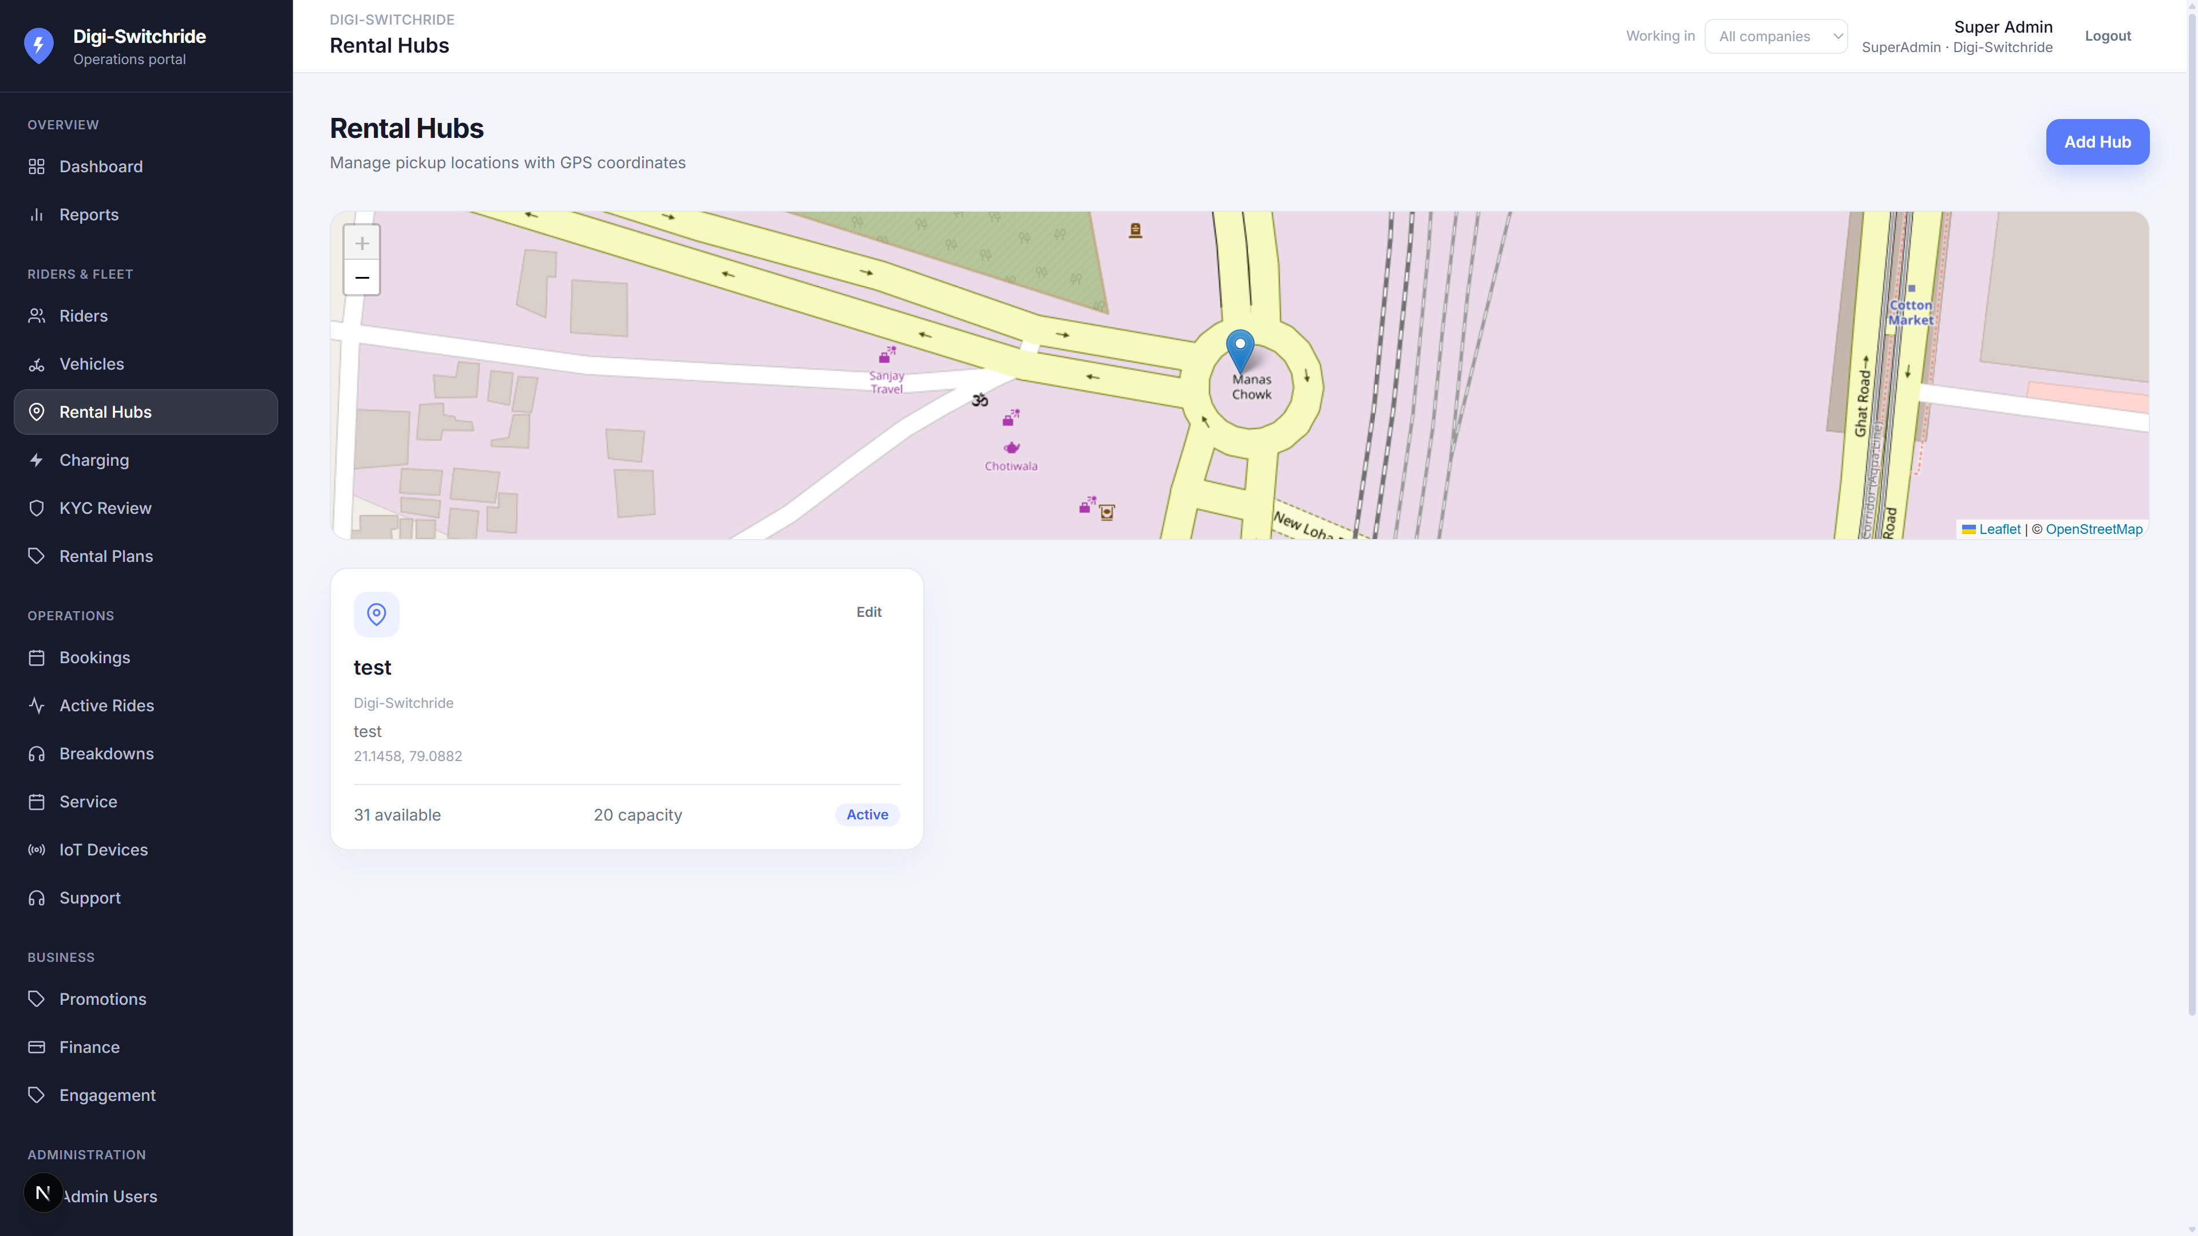
FLEETEL · DIGI-SWITCHRIDE
Rental hubs
Hubs are the operating locations. Staff can be limited to assigned hubs.
Create and locate hubs
Hub-scoped operators
Vehicles sit at a hub
Charging stations attach to hubs
Confidential · Presented by Fleetel · Digi-Switchride
8

Slide 9
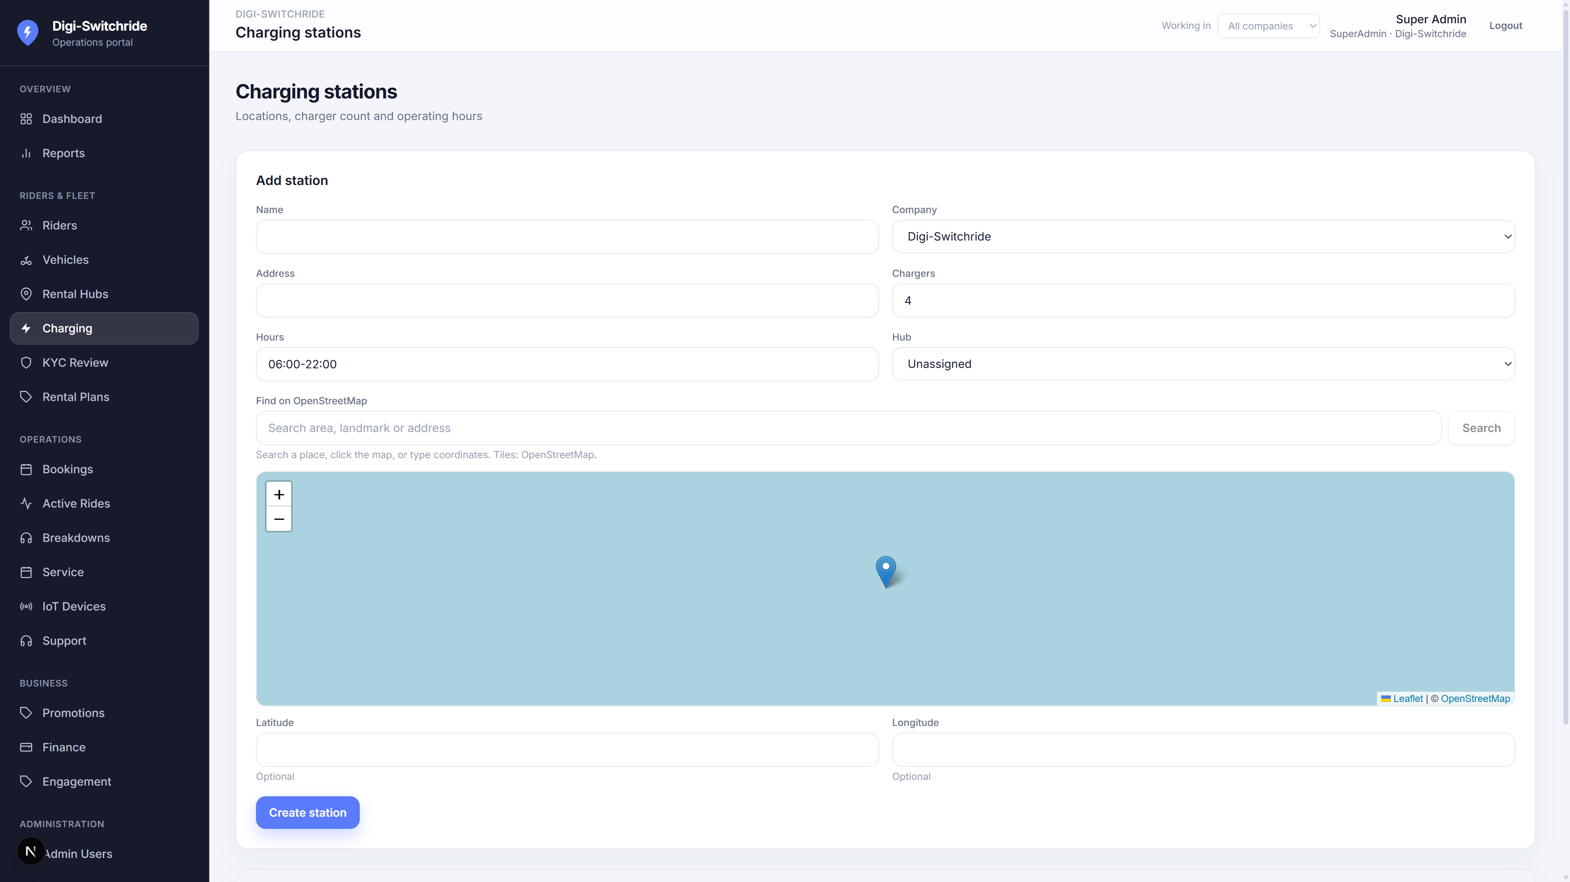
FLEETEL · DIGI-SWITCHRIDE
Charging stations
Network of charging points linked to rental hubs.
Station inventory
Operating hours
Company assignment
Visible to riders nearby
Confidential · Presented by Fleetel · Digi-Switchride
9

Slide 10
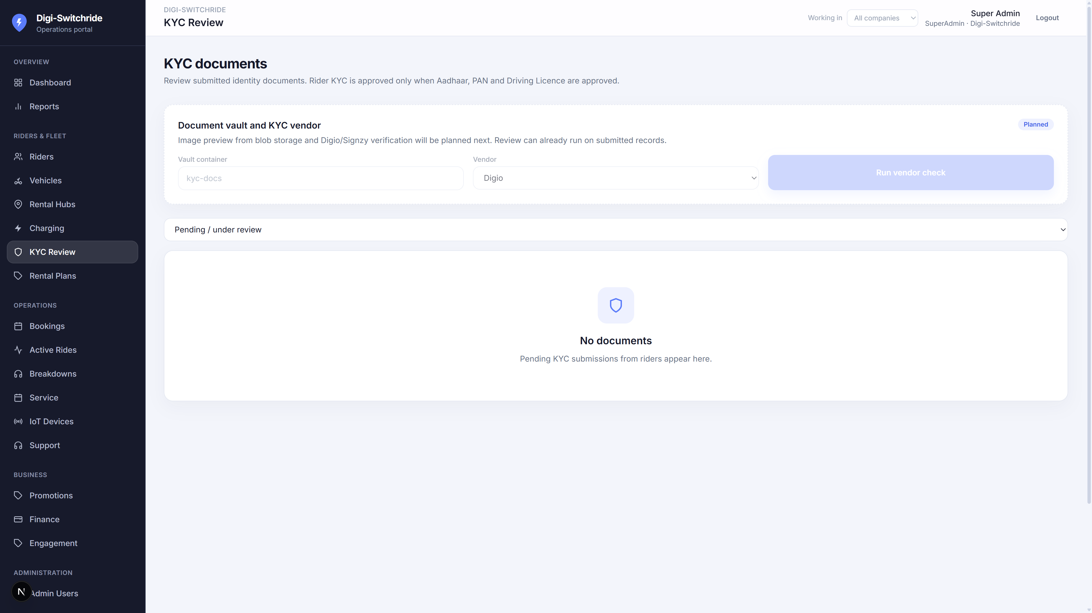
FLEETEL · DIGI-SWITCHRIDE
KYC review
Approve or reject rider documents before they ride.
Pending queue
Under review / approved / rejected
Operator workflow
Confidential · Presented by Fleetel · Digi-Switchride
10

Slide 11
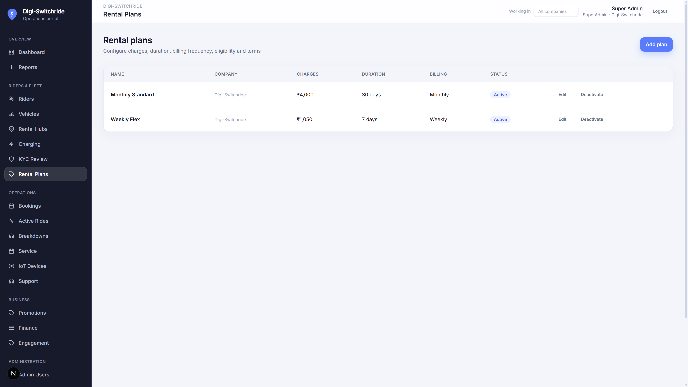
FLEETEL · DIGI-SWITCHRIDE
Rental plans
Price books for daily, weekly and monthly EV rentals.
Plan catalogue per company
Shown in the rider app
Linked to bookings
Confidential · Presented by Fleetel · Digi-Switchride
11

Slide 12
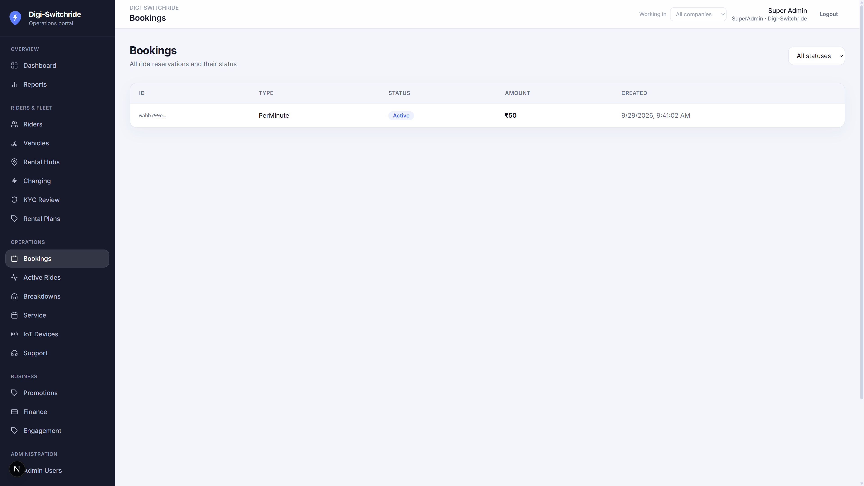
FLEETEL · DIGI-SWITCHRIDE
Bookings
Reserve a vehicle at a hub against a plan.
Create and track bookings
Hub and vehicle assignment
Feeds Active Rides
Confidential · Presented by Fleetel · Digi-Switchride
12

Slide 13
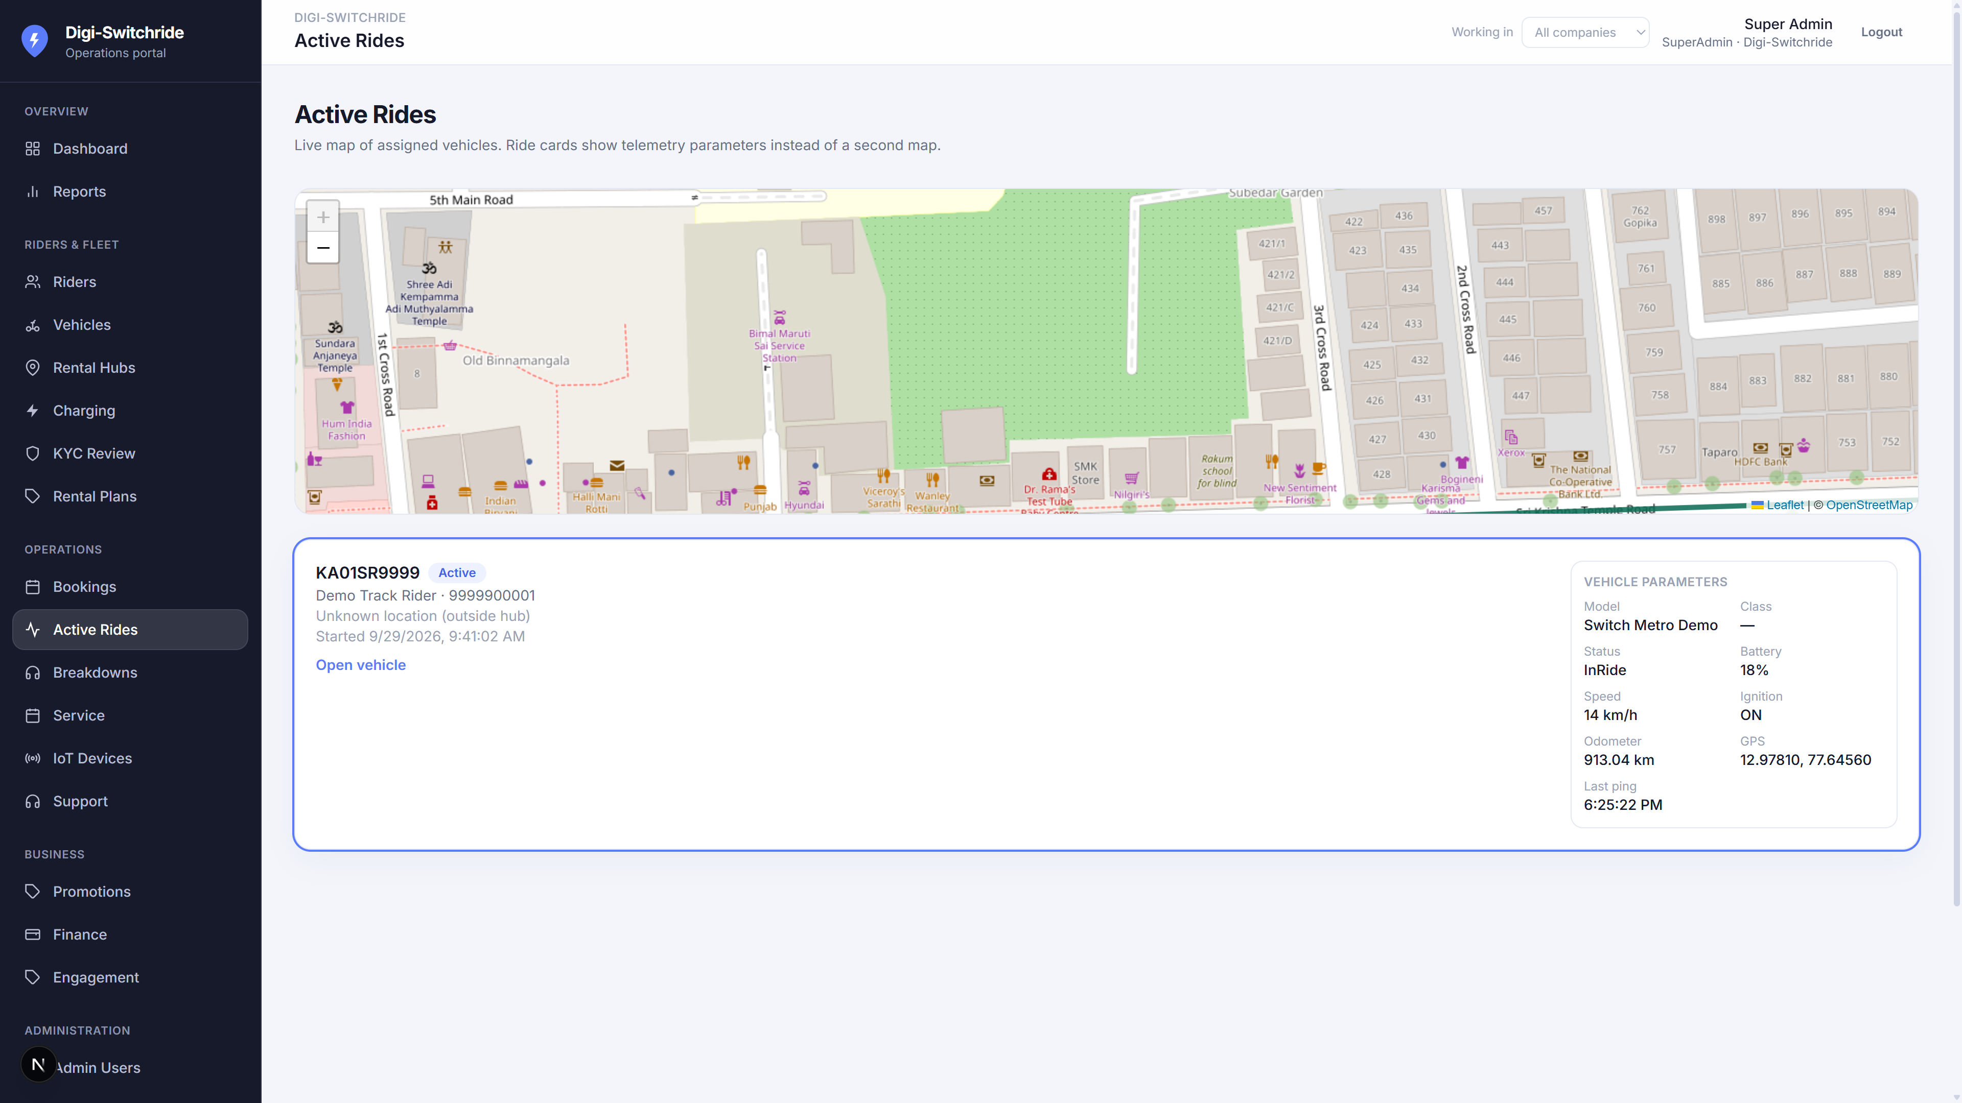
FLEETEL · DIGI-SWITCHRIDE
Active rides
One main map. Vehicle parameters instead of many small maps.
Live ride list
Road-aligned tracking
Battery, speed, status
Sample trail for demos
Confidential · Presented by Fleetel · Digi-Switchride
13

Slide 14
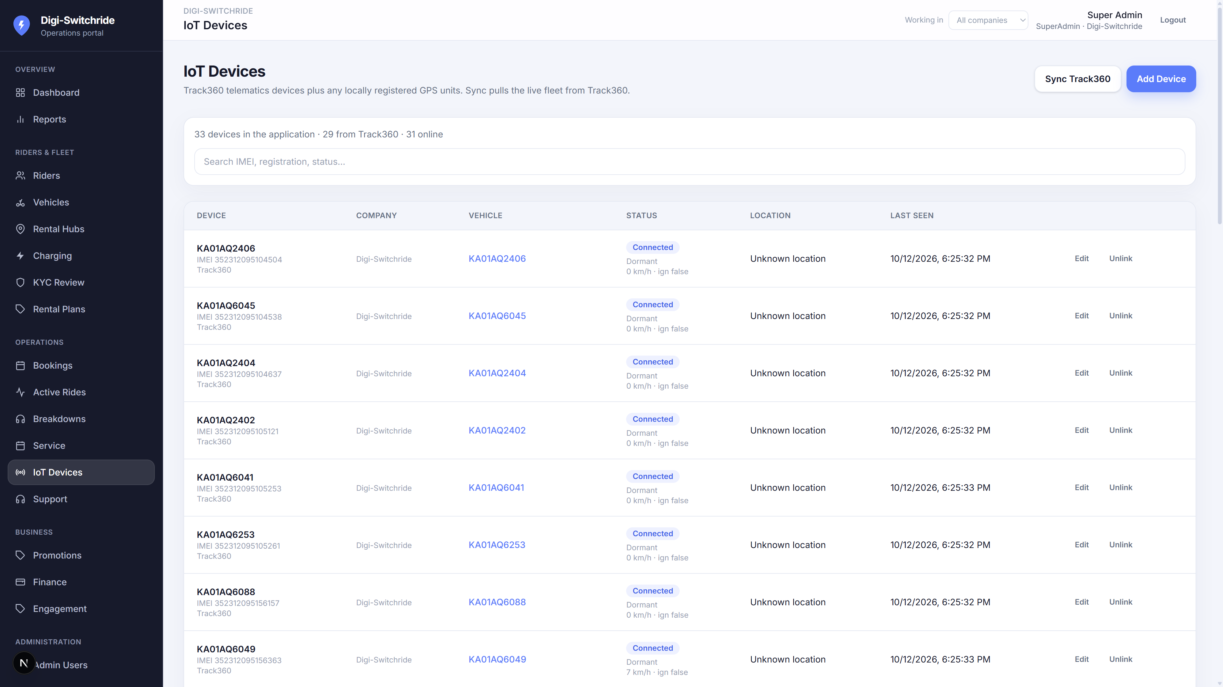
FLEETEL · DIGI-SWITCHRIDE
IoT devices
Track360 devices listed and linked as vehicles automatically.
Device inventory
Pull API sync
Same name as vehicle
Telematics every 10 seconds
Confidential · Presented by Fleetel · Digi-Switchride
14

Slide 15
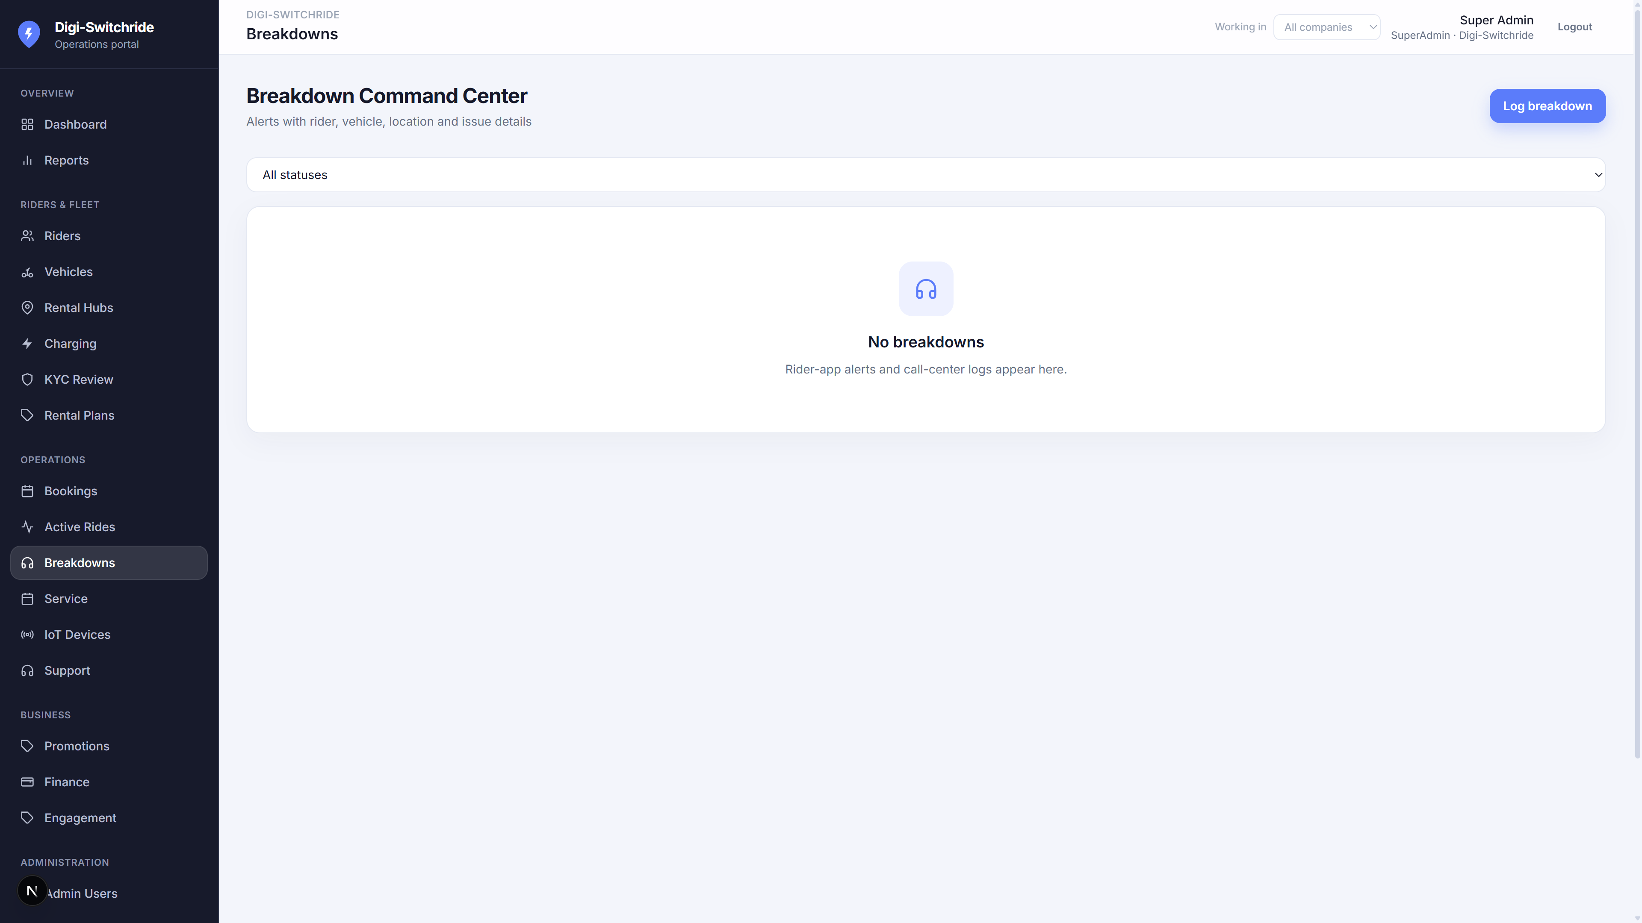
FLEETEL · DIGI-SWITCHRIDE
Breakdowns & command centre
Riders report issues from the app; operators action them here.
Open tickets
Vehicle and rider context
Company scoped
Confidential · Presented by Fleetel · Digi-Switchride
15

Slide 16
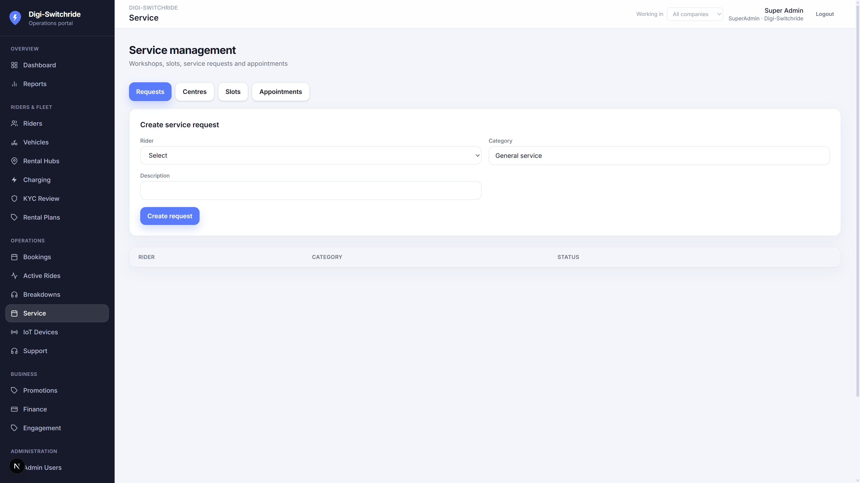
FLEETEL · DIGI-SWITCHRIDE
Service requests
Workshop jobs from riders or staff.
Open / in progress
Vehicle history
Confidential · Presented by Fleetel · Digi-Switchride
16

Slide 17
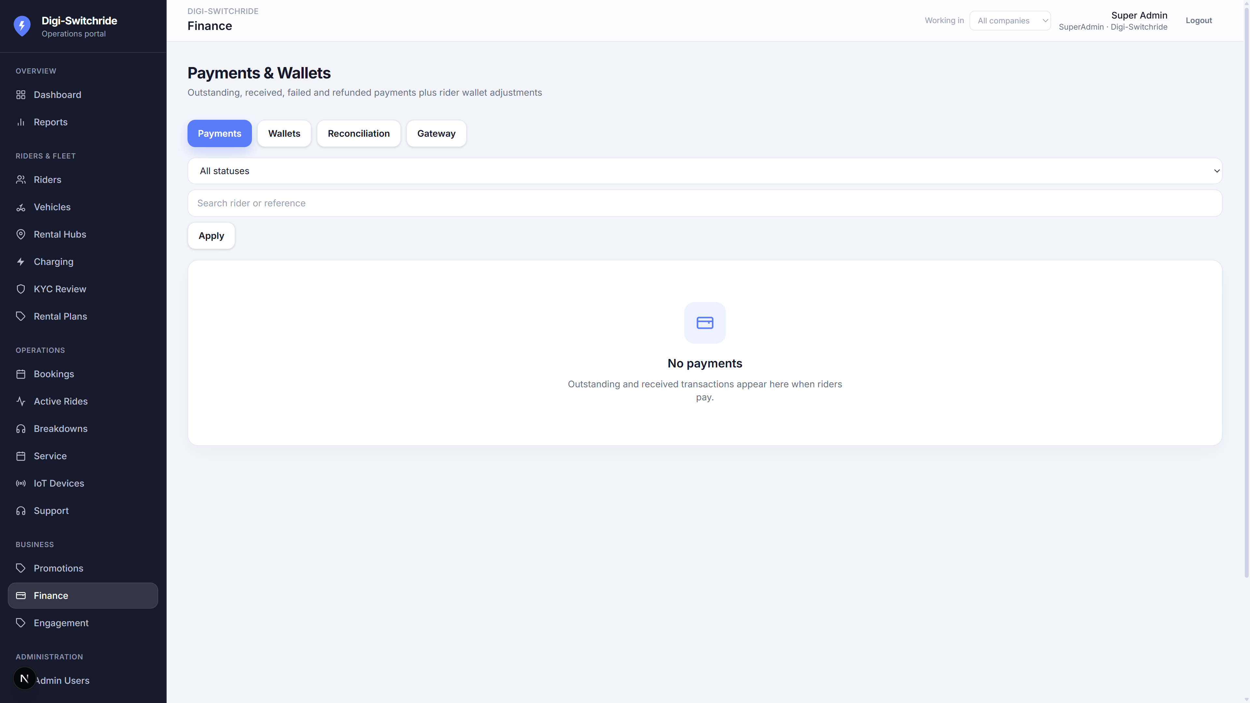
FLEETEL · DIGI-SWITCHRIDE
Finance
Outstanding dues, collections and 30-day revenue.
Dues and wallets
UPI / wallet / cards (provisioned)
Confidential · Presented by Fleetel · Digi-Switchride
17

Slide 18
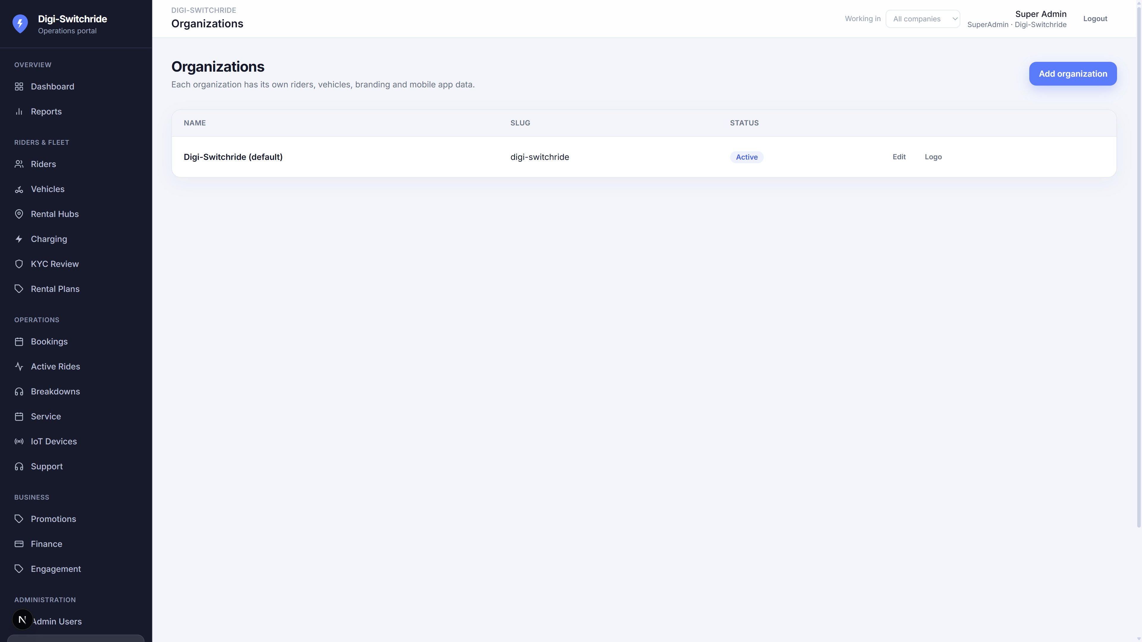
FLEETEL · DIGI-SWITCHRIDE
Organisations (multi-company)
Fleetel SuperAdmin creates customer companies and assigns data.
One product, many customers
Isolated riders, fleet, IoT
Company-wise logo
Confidential · Presented by Fleetel · Digi-Switchride
18

Slide 19
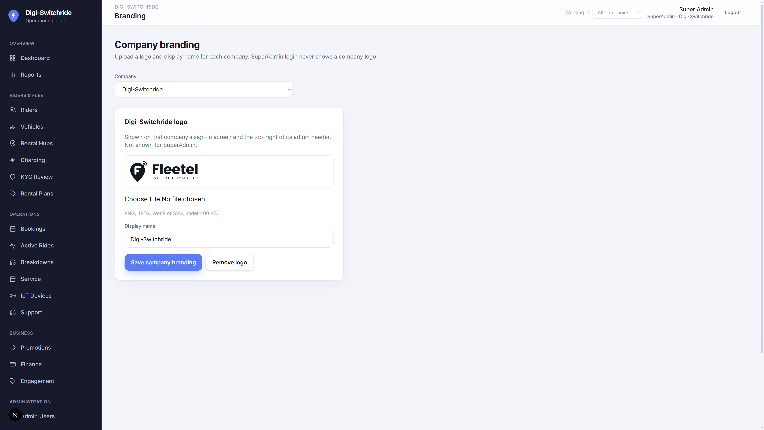
FLEETEL · DIGI-SWITCHRIDE
Company branding
Each company uploads its own logo. Product mark stays Digi-Switchride.
SuperAdmin picks company
Logo on company login and header
Never shown on SuperAdmin login
Confidential · Presented by Fleetel · Digi-Switchride
19

Slide 20
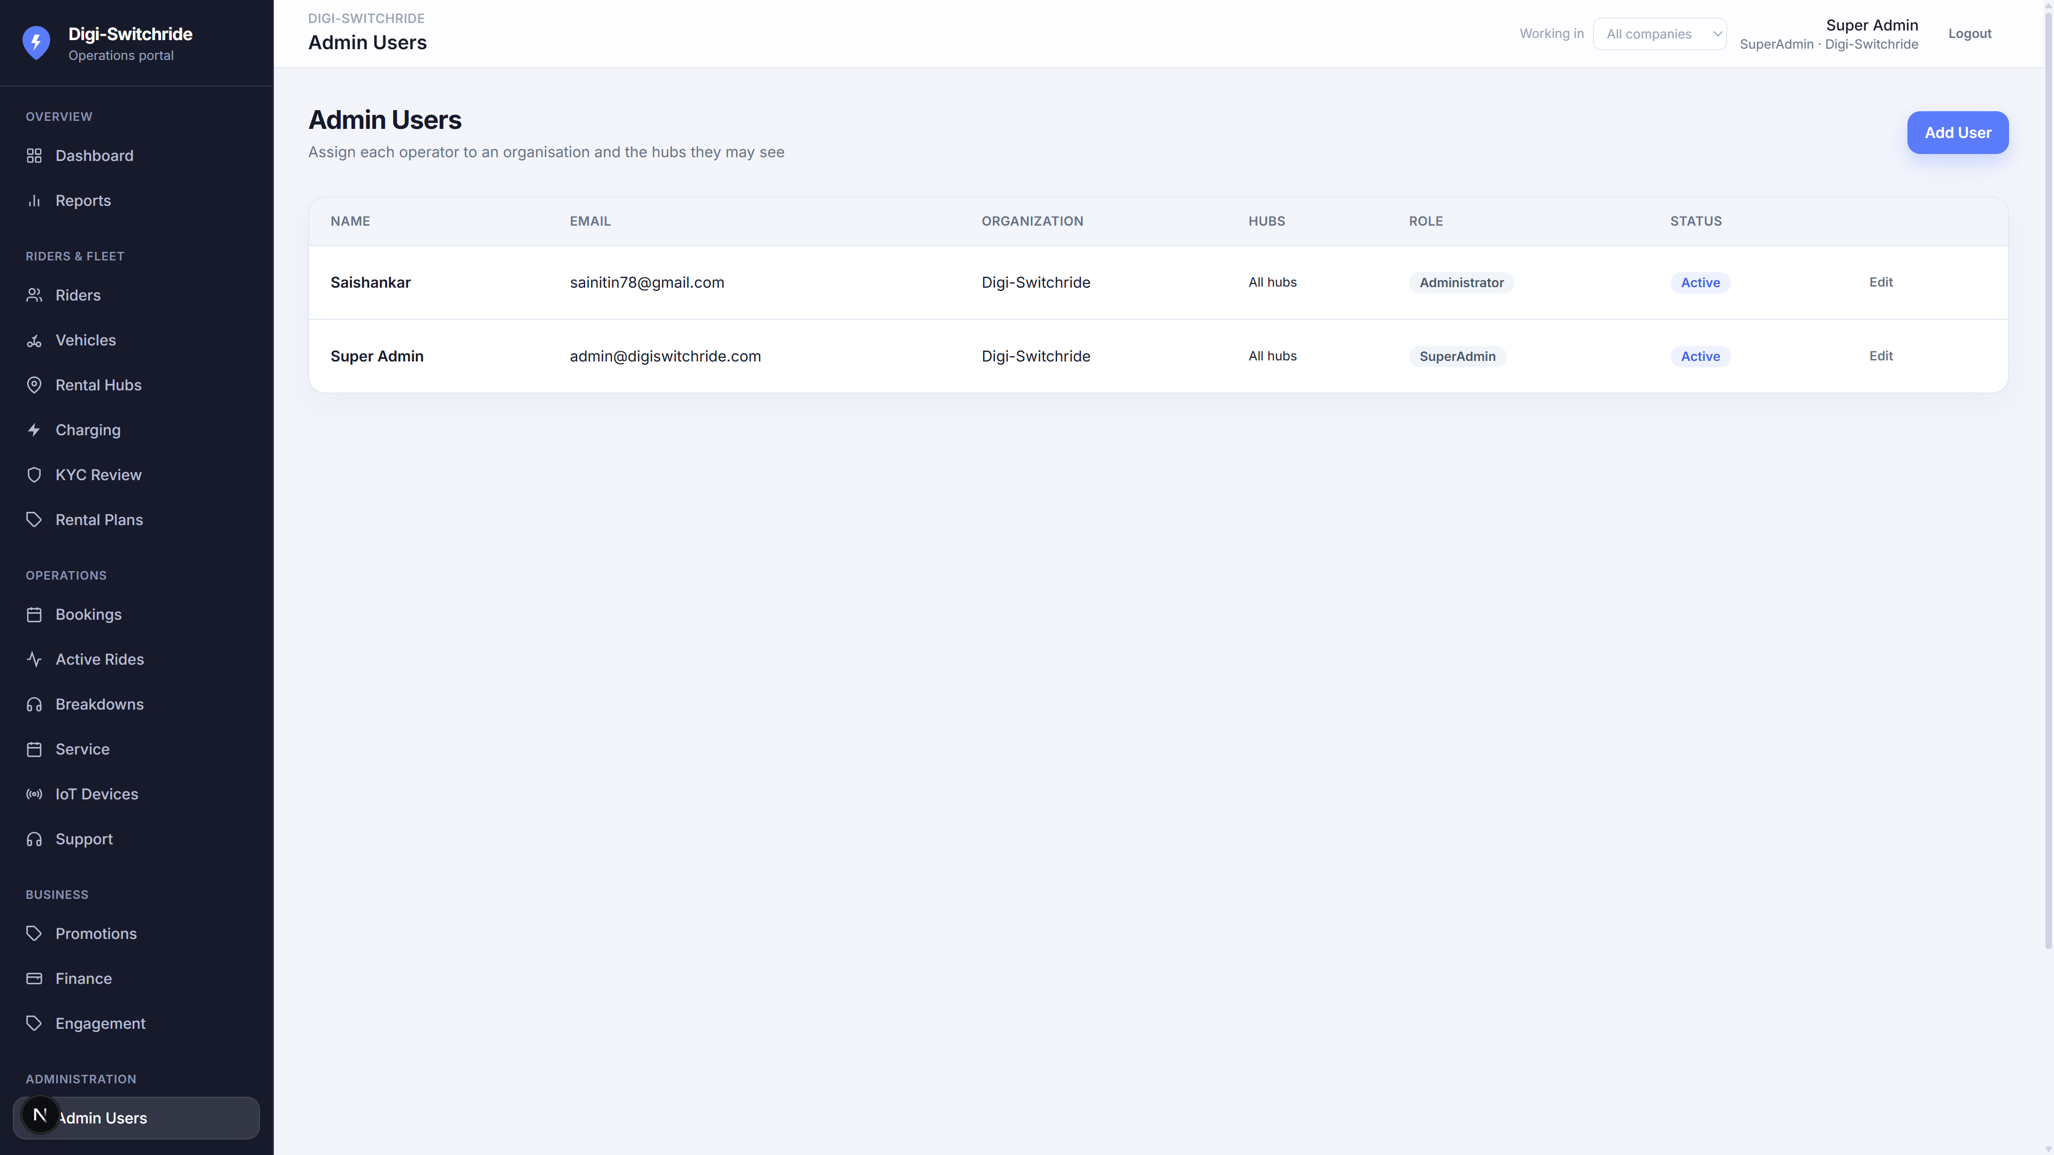
FLEETEL · DIGI-SWITCHRIDE
Admin users & hub access
Invite operators, set role, company and hubs they may see.
SuperAdmin / Administrator / staff
Hub-restricted lists
Company login shows company name
Confidential · Presented by Fleetel · Digi-Switchride
20

Slide 21
RIDER MOBILE APPLICATION
Book, pay, ride and get help
Android app aligned to the same companies, hubs, vehicles and payments as the web portal.

Slide 22
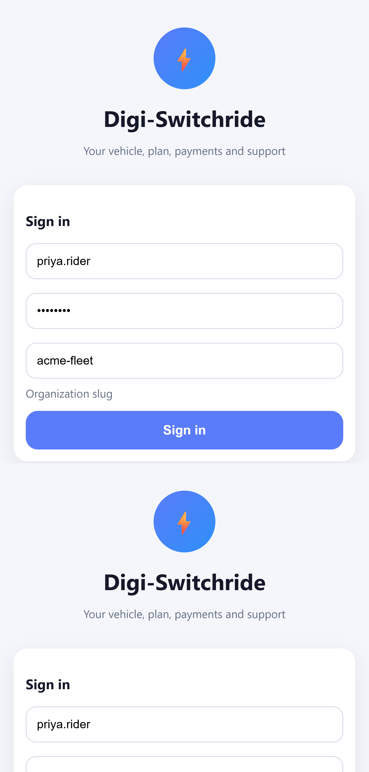
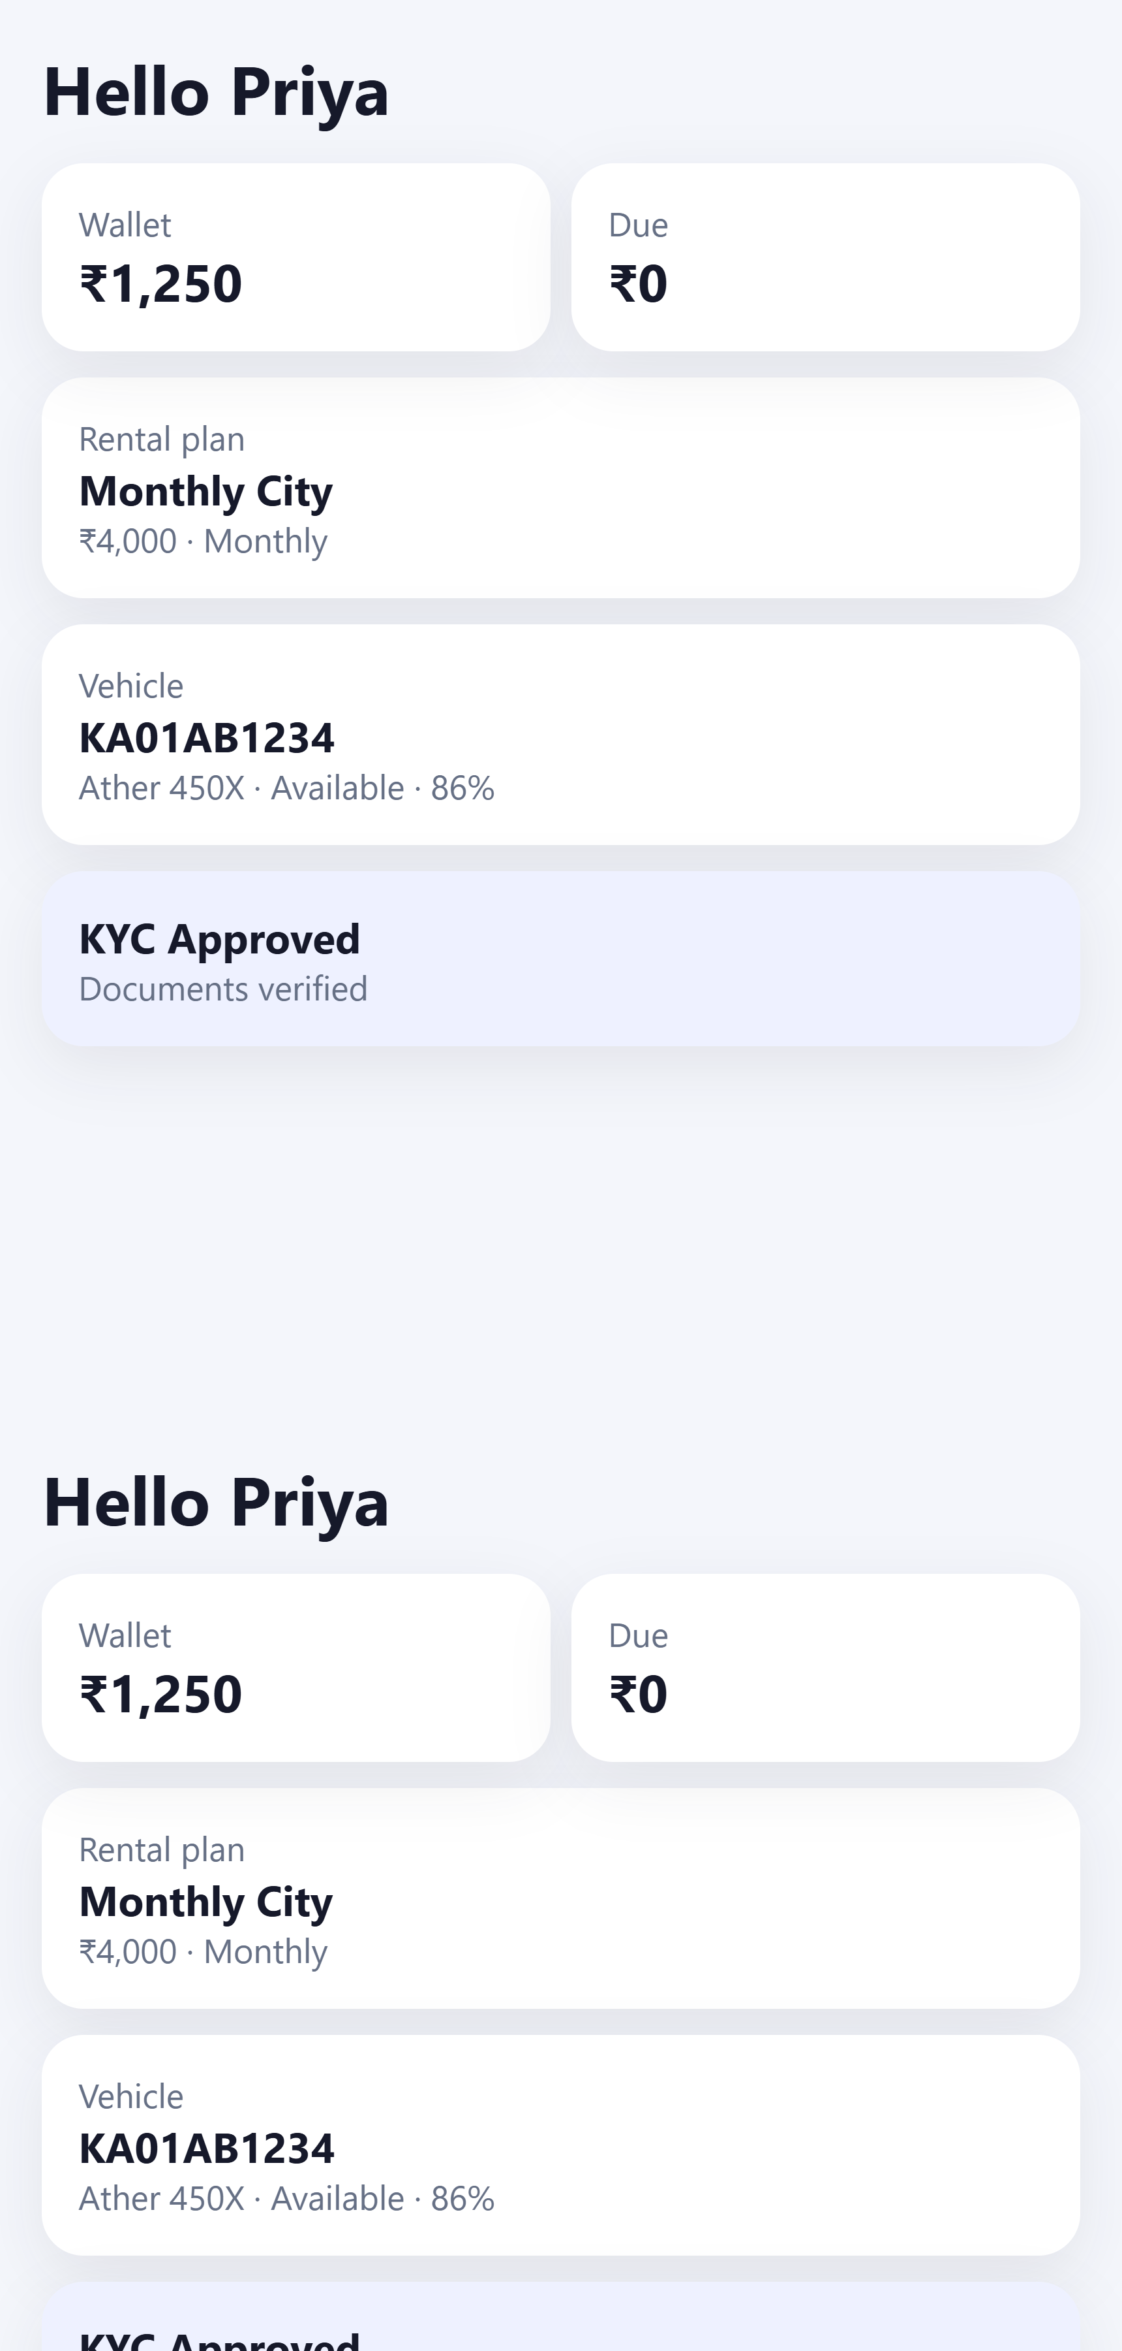
RIDER APP
Sign in and home
Riders enter their company slug
Home shows wallet, dues, plan
Assigned vehicle and battery
KYC status on the first screen
Organisation login
Home — wallet, plan, vehicle
Confidential · Presented by Fleetel · Digi-Switchride
22

Slide 23
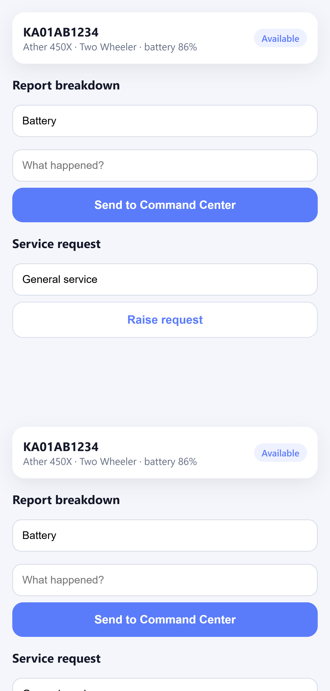
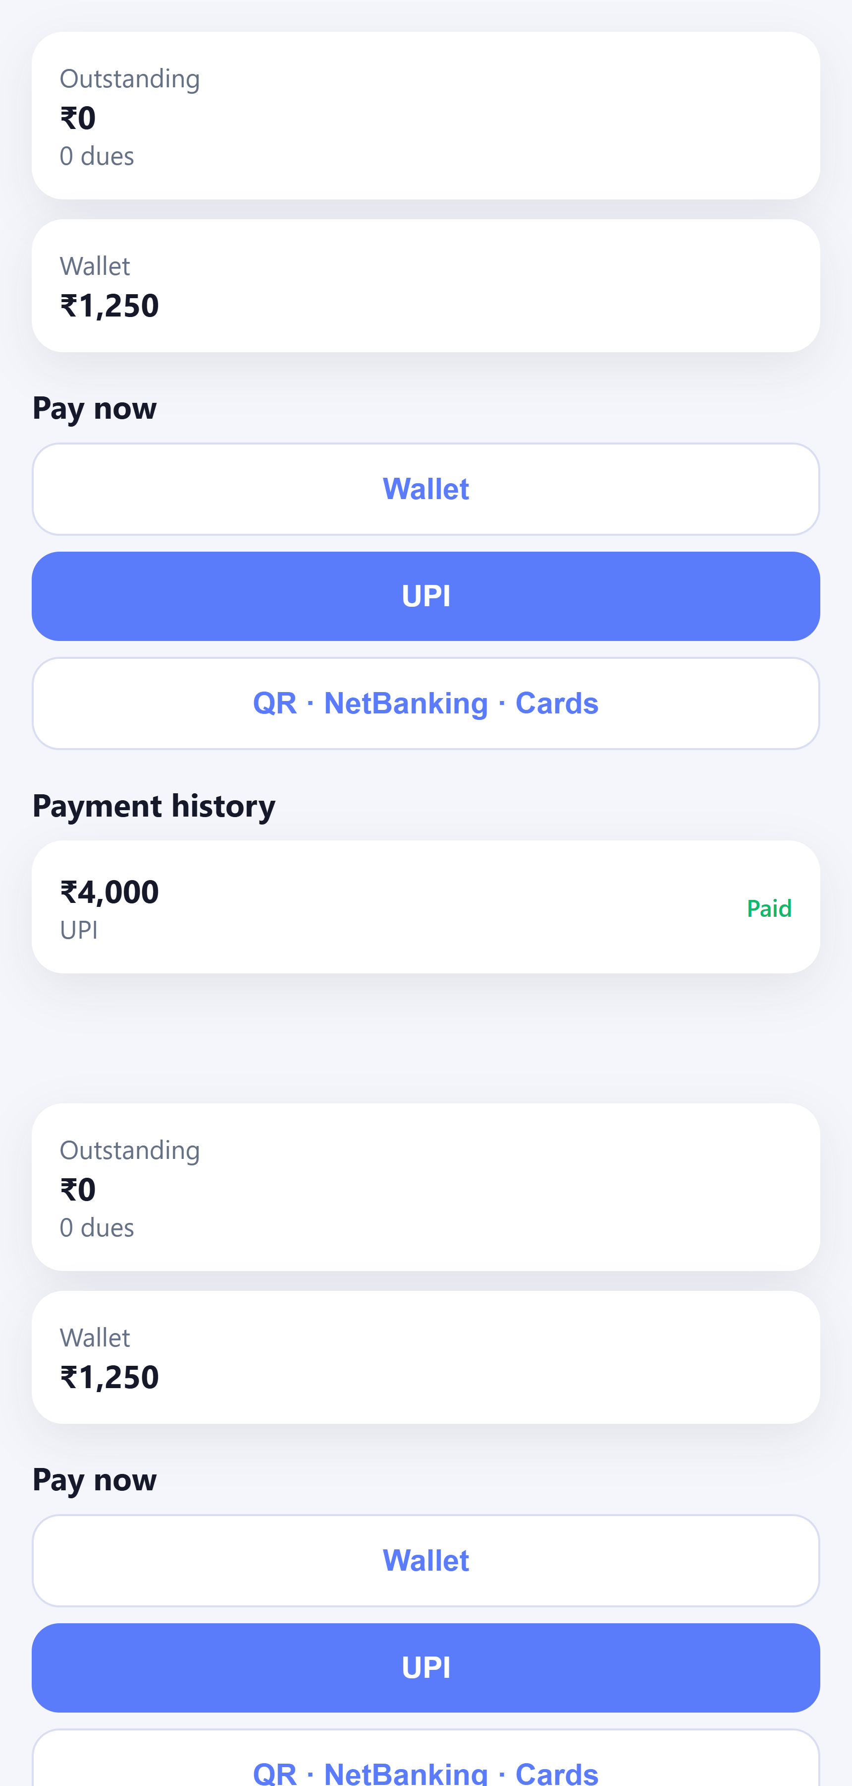
RIDER APP
Vehicle, service and payments
Report breakdown to Command Centre
Raise a service request
Wallet, UPI, QR, net banking, cards
Payment history
Vehicle & breakdown
Pay now
Confidential · Presented by Fleetel · Digi-Switchride
23

Slide 24
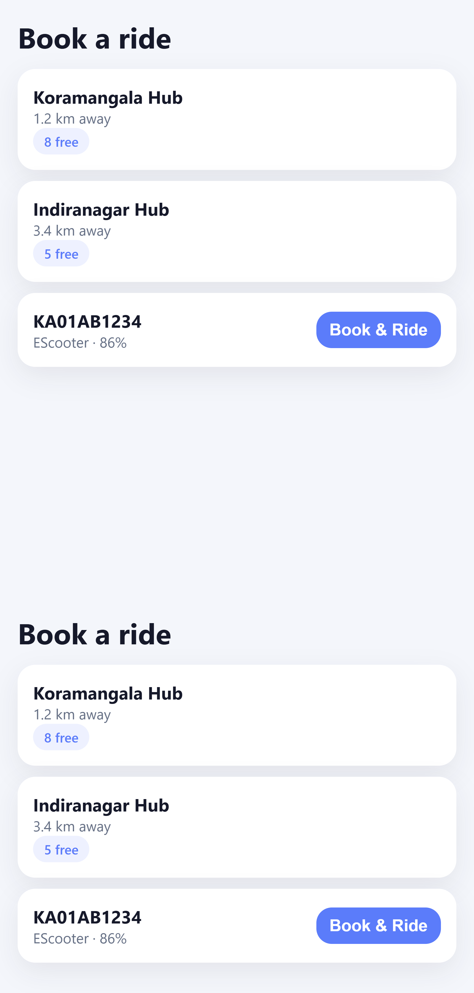
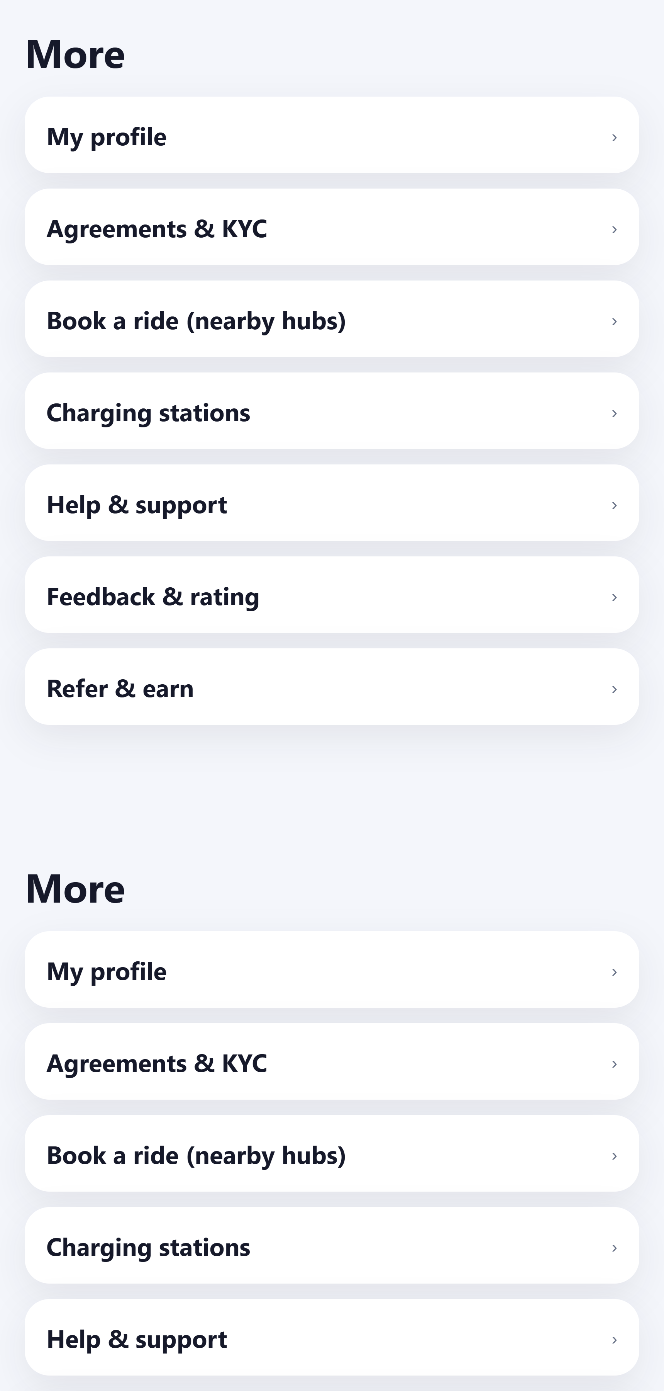
RIDER APP
Book a ride and more
Nearby hubs with free vehicles
Book & Ride
Profile, agreements & KYC
Charging stations, help, refer & earn
Nearby hubs
More menu
Confidential · Presented by Fleetel · Digi-Switchride
24

Slide 25
CAPABILITY MAP
Web + mobile, one operational spine
Riders & KYC
Onboard, approve documents, wallets
Fleet
Vehicles, hubs, charging, 2/3/4-wheeler icons
Rentals
Plans, bookings, active rides
Tracking
All vehicles on one map, 10s refresh, IoT / Track360
Service
Breakdowns, workshop jobs, support tickets
Commercial
Dues, UPI/wallet, promotions, reports
Governance
Companies, hub-scoped users, audit, branding
Confidential · Presented by Fleetel · Digi-Switchride
25

Slide 26
NEXT STEPS
Fleetel can stand up your company on Digi-Switchride
Create your organisation and upload your logo
Import hubs, vehicles and IoT devices (including Track360)
Invite operators with hub-level access
Onboard riders on Android with your company slug
Go live with bookings, tracking, KYC and collections

Slide 27
Thank you
Digi-Switchride · Electric fleet rental, built for Indian operators
Presented by Fleetel

