Slide 1
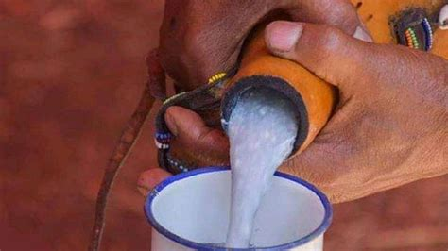
THE SIGNIFICANCE OF MURSIK IN KALENJIN CULTURE
PRESENTED BY :WILLIN BROAD KIPLIMO

Slide 2
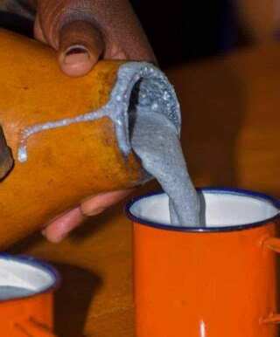
Mursik is a traditional drink of the Kalenjin people of Kenya, made from cow or goat milk fermented in a gourd lined with soot and charcoal.
WHAT IS MURSIK?

Slide 3

The Science of Preparation
The Sotet: A gourd prepared specifically for milk storage.
The Cleaning: The gourd is cleaned using a burning stick (Sosusiek).
Botany: The stick comes from specific trees like Cassia didymobotrya (Senetwet) or Lantana kituiensis.

Slide 4
The Chemistry of Fermentation
reservation: The charcoal acts as activated carbon, absorbing impurities.
Pasteurization: Traditional boiling of milk kills harmful bacteria.
Culturing: The milk ferments for 3–5 days, creating lactic acid which preserves the milk naturally.

Slide 5


Social Significance: Marriage (Koito)
The Negotiation: During dowry talks (Koito), Mursik is the centerpiece.
The Symbolism: Sharing Mursik symbolizes the agreement between two clans.
The Ritual: If the bride's father drinks the Mursik, the marriage is approved.

Slide 6
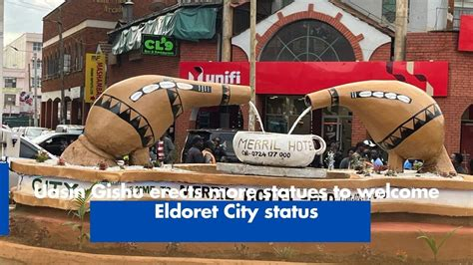
Social Significance: Athletes & Heroes
The Homecoming: Returning athletes are greeted with Mursik at the airport.
Identity: It reconnects global stars with their local roots.
Resilience: It symbolizes the strength and endurance of the community.

Slide 7
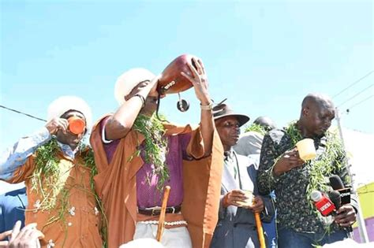
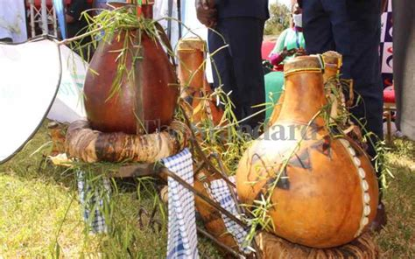
Rites of Passage
Initiation: Mursik is served during initiation ceremonies (Tumdo).
Recovery: It is considered a restorative food for initiates healing after the process.

Slide 8
Relevance to Modern Society
Cultural Identity: In a globalized world, Mursik remains a distinct marker of Kalenjin heritage.
Health: It is a probiotic, rich in healthy bacteria for digestion.

Slide 9

Challenges & Preservation
The Threat: Plastic bottles are replacing the Sotet gourd.
Deforestation: The specific trees needed for the charcoal are becoming scarce.
The Solution: Promoting the planting of indigenous trees and teaching the traditional process to the youth.

Slide 10
Conclusion
Summary: Mursik is more than a drink; it is a social contract and a historical record.
Final Thought: Preserving the process is just as important as preserving the taste.

