Slide 1
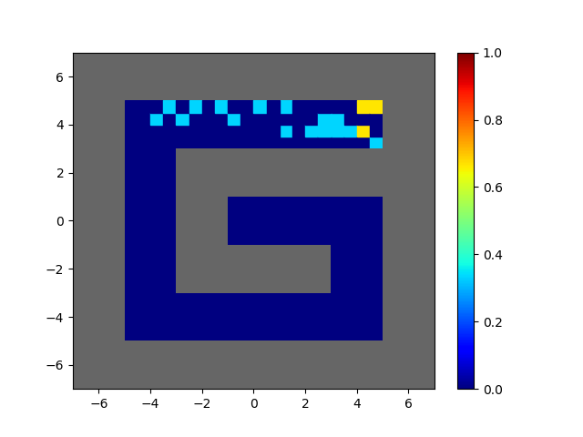
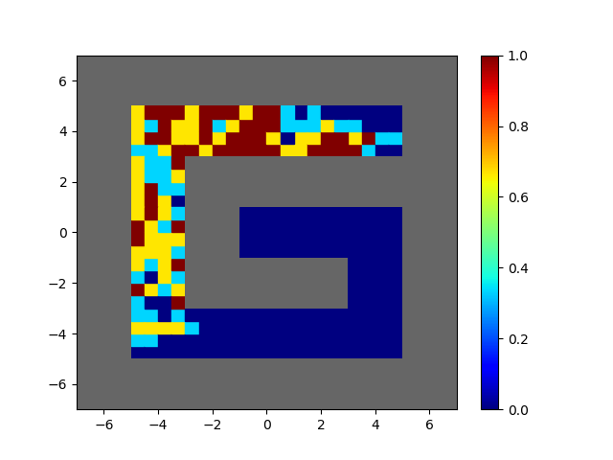
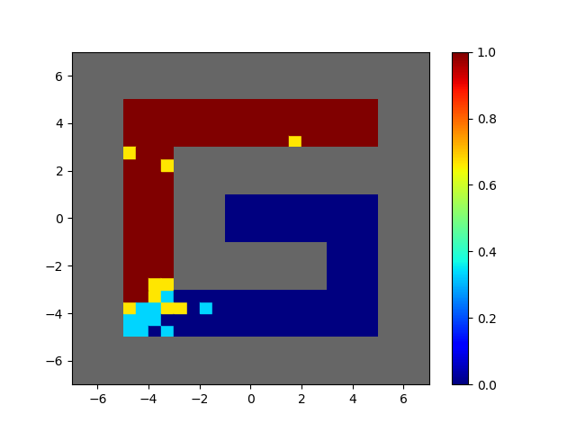
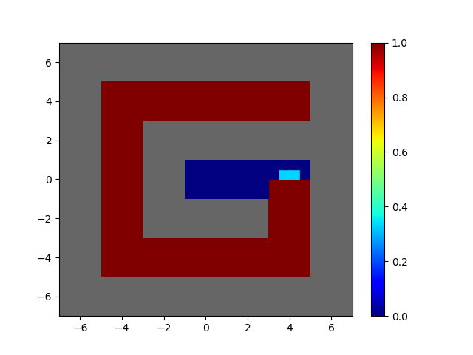
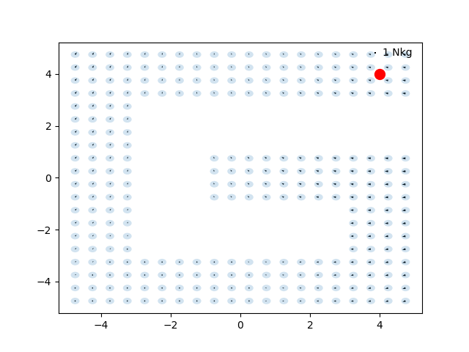
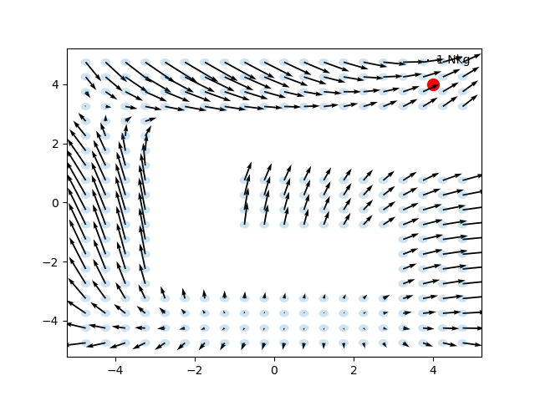
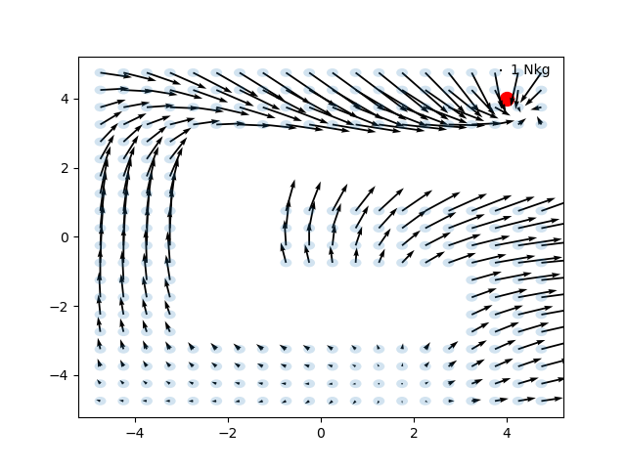
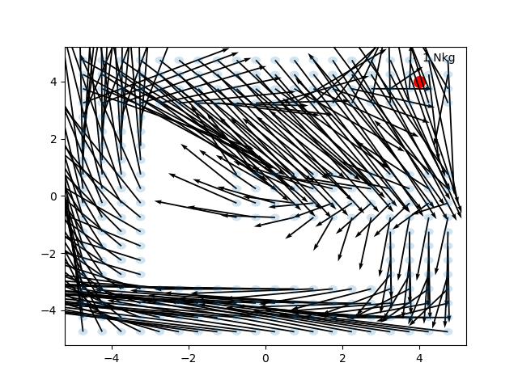
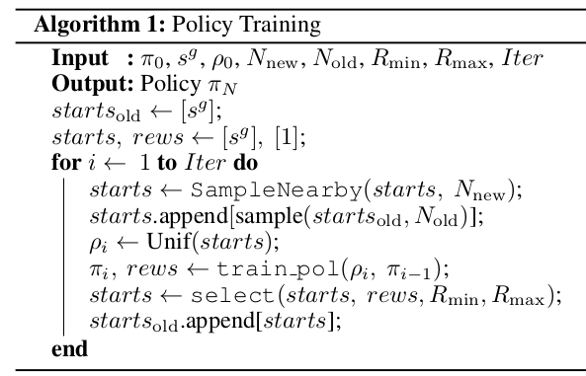
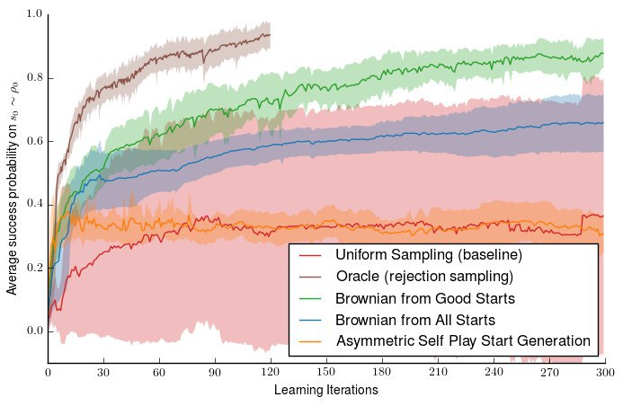
Reverse Curriculum Amadeus Hovekamp, Megan Klaiber, Hans Nübel, Rabea Turon
Project Idea
Reproduce the results of „Reverse Curriculum Generation for Reinforcement Learning“ […]
Using Code provided by the authors
Using a RL environment from the paper and OpenAI baselines RL algorithm
Reverse Curriculum idea: start training from states close to the goal and gradually move further away
Adaptive Curriculum Generation
Curriculum generation algorithm
Sampling using Brownian Motion
Sample from start states of current iteration
Use random actions (Brownian Motion)
Results
Original results, seen in [..]
Reproduced results with rllab code
Our code
Issues
Problems in original code (rllab)
Differences between Code and Papar
Incompatibility of OpenAI algorithms and rllab environments

