Slide 1
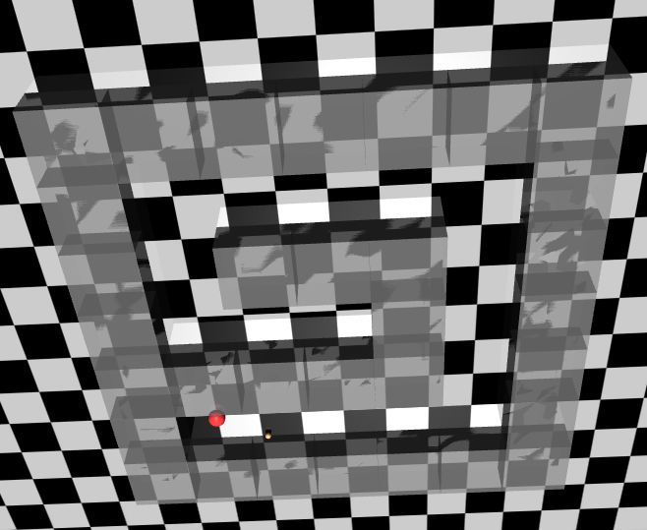
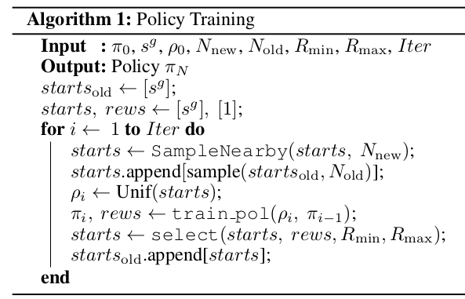
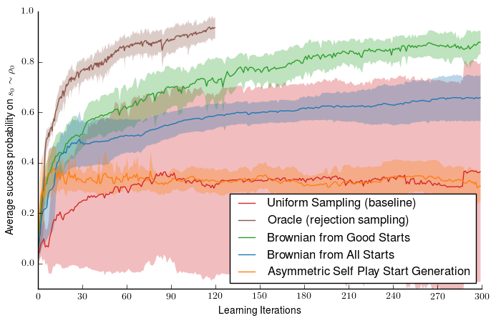
Reverse Curriculum
Amadeus Hovekamp, Megan Klaiber, Hans Nübel, Rabea Turon
Project Idea
Reproduce the results of „Reverse Curriculum Generation for Reinforcement Learning“ […]
Using Code provided by the authors
Using a RL environment from the paper and OpenAI baselines RL algorithms
Reverse Curriculum idea: start training from states close to the goal and gradually move further from the goal
Adaptive Curriculum Generation
Curriculum generation algorithm:
Sampling Using Brownian Motion
Sample from start states of current iteration
Use random actions (brownian motion) to create new start states
Results
Original results
Reproduced results with rllab code
Issues
Problems in original code (rllab)
Differences between Code and Paper
Incompatibility of OpenAI algorithms and rllab environments
Notes:
<Foliennummer>

