Slide 1
Intro to High-Performance Computing
Workshop Lead: Megan Ng
September 28, 2026
Notes:
- Self intro
- How HPC is necessary for my research
- Everyone introduction
- Name
- Department
- Why they are here
- One hobby

Slide 2

Scan for feedback!

Slide 3
Workshop Outline
Module I:
About the Digital Research Alliance of Canada (DRAC)
Module II:
Preparing Your Data and Code for DRAC
Module III:
Running a Job on DRAC
Module IV:
Handling Job Errors

Slide 4
Pre-requisites
You must have…
A terminal
A Digital Research Alliance of Canada account, login information, and access to one of their general-purpose clusters (Fir, Narval, Nibi, or Rorqual)
The Duo Mobile application downloaded on your phone
Globus Connect Personal installed and running in the background on your laptop
A code editor (I will be using VS code)
Workshop materials downloaded to your laptop

Slide 5
Module I:
About the Digital Research Alliance of Canada (DRAC)

Slide 6
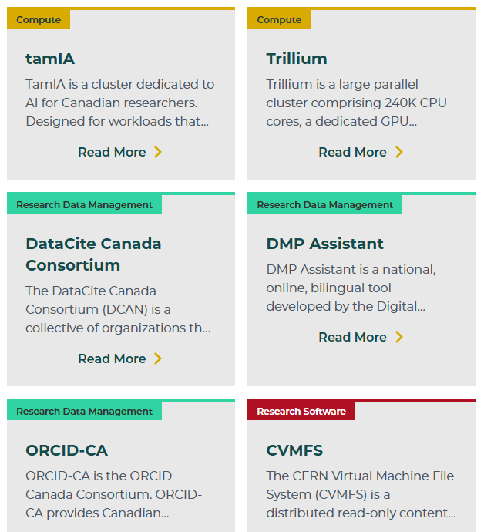


About DRAC
What is DRAC?
A national not-for-profit membership-based organization that provides digital research services for researchers in Canada

Slide 7
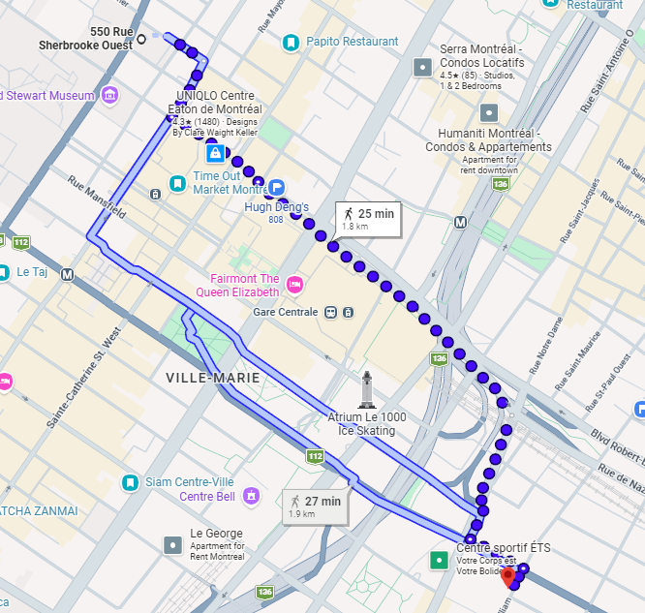



About DRAC
Why do we use DRAC?
CPU/GPU and memory constraints can make computationally intensive tasks slow or impossible on your everyday computer
Your computer :/
A DRAC Supercomputer
Notes:
Narval at ETS (30min walk from McGill campus)

Slide 8
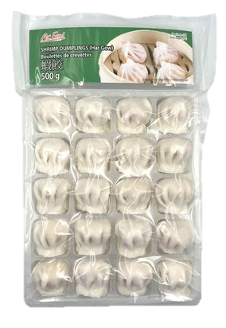
You and DRAC: An Analogy
Task: Make 2026 frozen dumplings by the end of 2026 (for good luck in 2027 duh)
Your Limitations:
SPEED
  You are one person → You would need to make 156 dumplings every single weekend
STORAGE
  You have a regular sized fridge/freezer → You do not have the space to store the ingredients nor completed frozen dumplings

Slide 9


You and DRAC: An Analogy
Distributed Recipe Acceleration Centre (DRAC):
Cooking service that addresses your limitations
  100,000+ chefs
  Large scale kitchen equipment/storage
Can complete your cooking task efficiently

Slide 10


DRAC Service Rules
You must prepare and deliver your ingredients and recipe yourself
To schedule a cooking job, you must submit a job request to the DRAC manager
When the job is finished, you must pick up the final product yourself
DRAC

Slide 11
You and DRAC Analogy Quiz
You and your regular kitchen
Ingredients
Recipe
Distributed Recipe Acceleration Centre
Digital Research Alliance of Canada
Code
Input data
You and your regular computer

Slide 12
Module II:
Preparing Your Data and Code for DRAC

Slide 13
DRAC Service Rule #1
You must prepare and deliver your ingredients and recipe yourself
DRAC
You must prepare and deliver your input data and code yourself

Slide 14
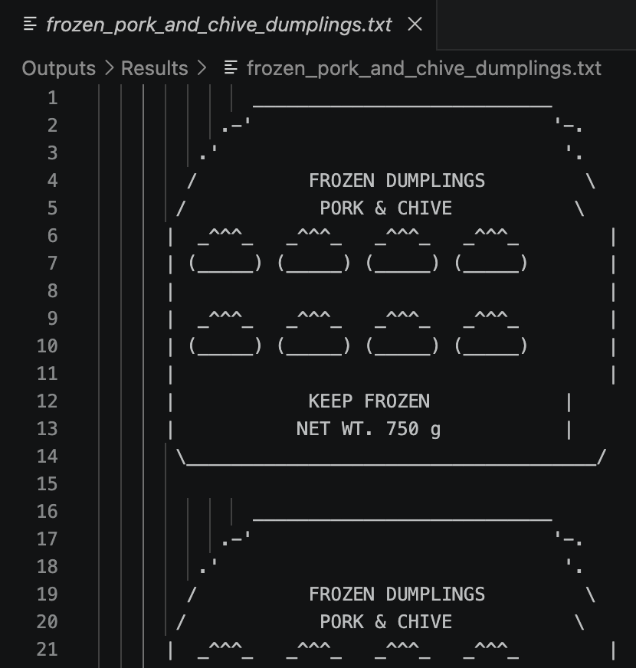

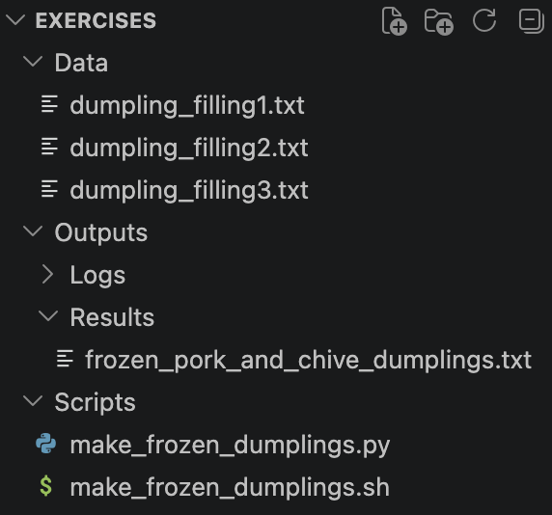
Step 1a: Preparing your data and code
Result
Input Data
Code
Notes:
Recipe refinement should happen in your own kitchen → Debugging your code should happen locally.
You can imagine that this is just a place holder for your own code

Slide 15
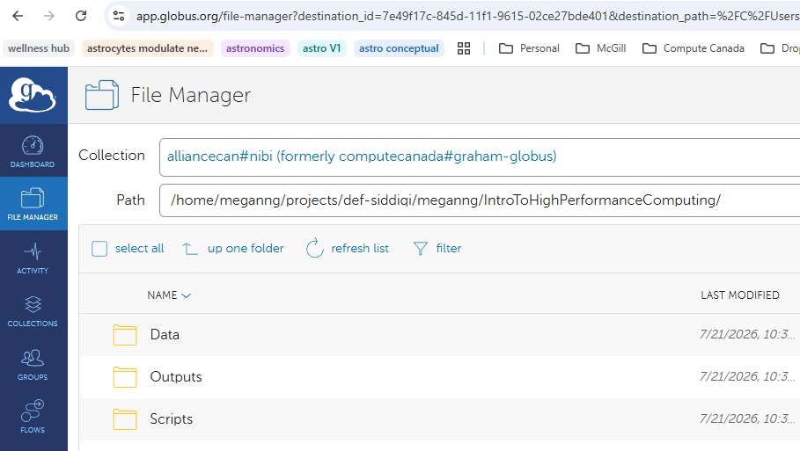

Step 1b: Delivering your data and code (with Globus)
About Globus:
Web app for file management
Use can use it to…
  Visualize your files and folders
  Transfer local files to and from DRAC

Slide 16
Demo:
Navigating folders with linux commands
Notes:
Give demo in local terminal

Slide 17
Activity: Get familiar with linux commands
What directory are you currently in?
Navigate to the “IntroToHighPerformanceComputing” folder
Navigate to the “Data” folder
Print the contents of the one of the files in the Data folder.
Execute the command “cd ..”. Where does that take you?
Command | Description | Usage
pwd | Print current directory path | pwd
cd | Change directory | cd some/folder/path
ls | List contents of a folder | ls some/folder/path
cat | Print contents of a file | cat someFile.txt
mkdir | Makes a new directory | mkdir DirectoryName
Notes:
Do in split window (local terminal + folder)
Go through each command

Slide 18
Demo:
Creating a destination folder on DRAC with Globus
Notes:
Creating a destination folder on globus:
Go to globus website
Click file manager
Search for nibi
Navigate to projects folder
Create new IntroToHighPerformanceComputing folder

Slide 19
Activity: Create a destination folder on DRAC with Globus
Go to Globus
Click file manager
Search for the DRAC cluster you are using
Navigate to your projects folder
Create a new folder called “IntroToHighPerformanceComputing”

Slide 20
Demo:
Logging into DRAC
Notes:
Log into DRAC to illustrate parallel between globus and folders on DRAC

Slide 21
Activity: Log into DRAC
In terminal, initiate login
  $ ssh <username>@nibi.alliancecan.ca
Enter your password
Enter “1” to receive Duo Push notification on phone
Accept Duo Push notification on phone
Using the terminal commands cd and ls, navigate to new folder to verify it has been created
Notes:
Goal: ls command shows your new folder

Slide 22
Demo:
Delivering files to DRAC with Globus

Slide 23
Activity: Delivering files to DRAC with Globus
On Globus, set your destination folder to be “IntroToHighPerformanceComputing”
Click “Transfer or Sync to…”
Set your source folder to be the “IntroToHighPerformanceComputing/Exercises” folder on your local computer
Select all folders inside the “Exercises” folder
Click “Start”

Slide 24
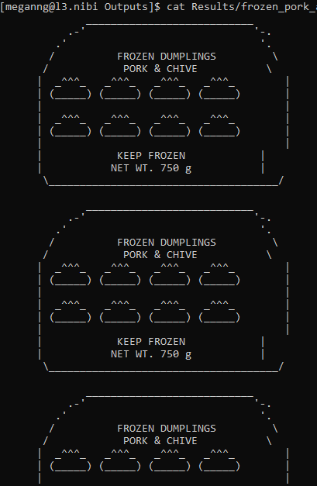
Activity: Confirm your file transfer to DRAC
Goal: Print the contents of the file in the “Results” folder to terminal
Hint: You will need to use the following terminal commands
cd → change directory
ls → list contents of directory
cat → print contents of file to terminal

Slide 25
Module III:
Running a Job on DRAC
Notes:
Recap: Our materials have been delivered

Slide 26
DRAC Service Rule #2
To schedule a cooking job, you must submit a job request to the DRAC manager
DRAC
To schedule your code to run, you must submit a job to slurm

Slide 27


What is slurm?
A job scheduler used by supercomputers
Manages allocating compute resources among all users

Slide 28
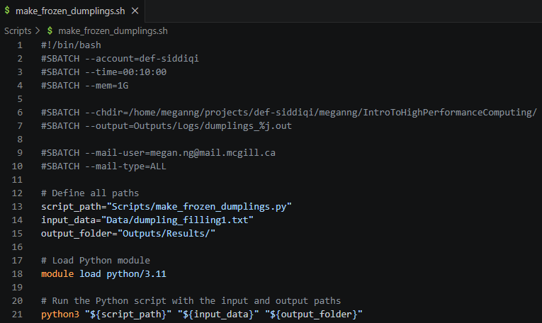
How do I submit a job to slurm?
1. Create a batch script (instructions for how to run your code)
MANDATORY
EXTRA
PATHS TO DATA AND CODE
LIBRARIES YOUR CODE NEEDS TO RUN
RUNS YOUR CODE

Slide 29
How do I submit a job to slurm?
2. Submit your batch script with sbatch
Usage → $ sbatch batchScript.sh

Slide 30
Common slurm Commands
squeue / sq: Prints out information about your job submission (where you are in the queue, how long your job has been running, etc.)
Usage → $ sq
scancel: Cancels a submitted job
Usage → $ scancel [jobID]

Slide 31
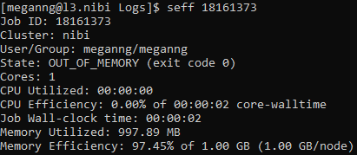
Common slurm Commands
seff: Prints out information about a completed job (ex. How much time/memory it took in total)
Usage → $ seff [jobID]

Slide 32
Activity: Submit your job to DRAC
On DRAC print out the contents of the current batch script in the “Scripts” folder
On your local computer, modify the batch script
  Personalize lines ending with “# CHANGE”
  Change the input data text file to filling2 or filling3
Save the edited file and upload it to DRAC with Globus
On DRAC, print out the contents of the updated batch script to confirm your changes have been uploaded
Submit your batch script with sbatch
Check on the job’s status with squeue
Notes:
Together
to 4. By themselves and go around the room to check
5. to 6. together

Slide 33
Module IV:
Handling Job Errors
Notes:
Break
Recap what they learned
Your job is complete, let’s talk about the output files:
1. What output file are you expecting? Where are you expecting it to be written?
2. Is it there?
3. Are there other files output? If so, where are they? (don’t print out)

Slide 34
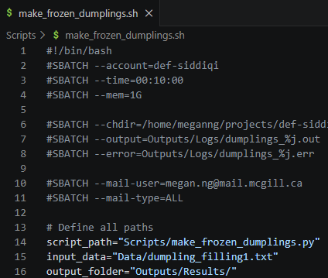
Output and Error Files
Output File: The output of any print statements within your batch script and code will be found here
Error File: Any error messages generated during your job will be found here

Slide 35
Common Errors and Their Solutions
Error Type | Error Signal | Solution
Insufficient time or memory requested | Error message written in output/error file and/or email | Adjust time or memory request in batch script
Incorrect path to file | Error message written in output/error file and/or email | Correct path in batch script
Missing libraries/modules/packages | Error message written in output/error file and/or email | Load in necessary libraries/modules/packages in batch script
How to Debug on DRAC:
Identify error by reading output/error file and/or email
Edit batch script accordingly

Slide 36
General Advice
Make sure your actual code is bug free before running it on DRAC
  Eases DRAC debugging process by limiting sources of possible errors
Request only the time and memory you NEED
  More demanding jobs usually == longer time before your job begins
If you are experiencing an unexplainable error, first check the status of the cluster you are using
  Google “DRAC [cluster name] status”

Slide 37
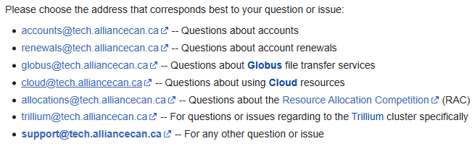
DRAC Technical Support
They are friendly and fast!
See https://docs.alliancecan.ca/wiki/Technical_support for more info

Slide 38
Activity: Debug your batch script
Print out the contents of the .out file. What type of error occurred?
Fix the error in your batch script, update the file locally on your laptop, sync the changes you made to DRAC with Globus, and resubmit the job with sbatch.
Oh no there is another error… repeat steps 1-2
Notes:
Can change input file for fun here

Slide 39
Demo:
Retrieving your results from DRAC with Globus

Slide 40
Activity: Retrieve your results from DRAC with Globus
Go to Globus
Click file manager
Search for the DRAC cluster you are using
Navigate to your “Results” folder
Select the resulting text file you want to retrieve
Click “Transfer or Sync to…”
Search for your local computer and navigate to your “Results” folder
Click “Start”
Open the retrieved text file on your laptop to verify the transfer

Slide 41
Summary
Module I:
Module II:
Module III:
Module IV:
What is DRAC and the services they provide
The conceptual workflow of interacting with DRAC
How to upload files from your local computer to DRAC
How to download files from DRAC to your local computer
How to run your code using DRAC’s high-performance computing system
How to monitor the status of your job
How to identify and address common errors
How to get external technical help when needed

Slide 42
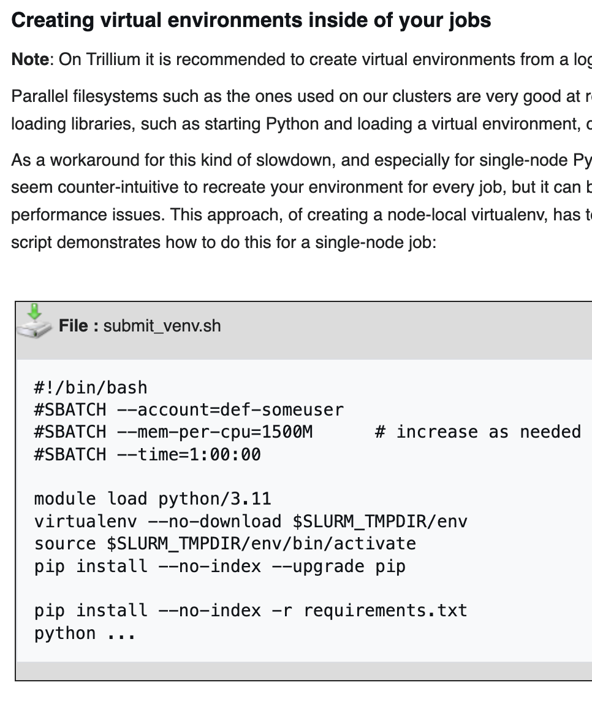
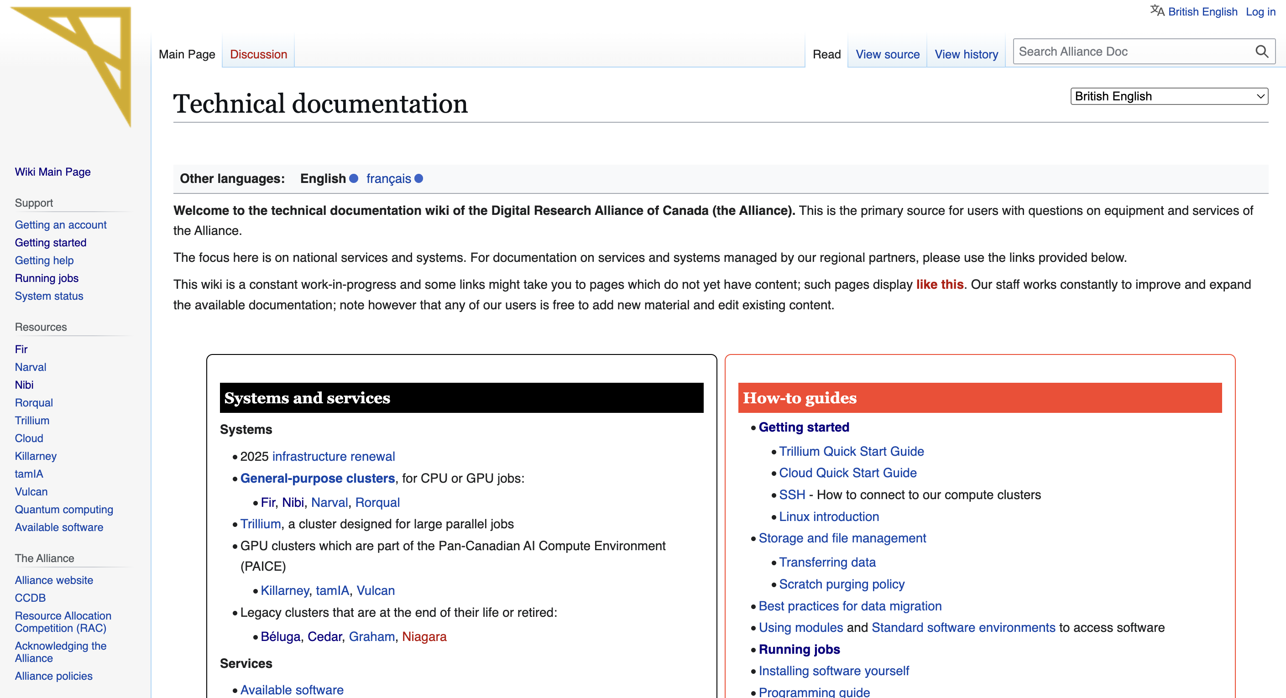
Additional Information
DRAC’s Wiki Page:
All information not covered in this workshop can be found here
When you encounter an issue, try searching for the solution here first
This website is informative but dense → Do not hesitate to reach out to technical support if you feel stuck
Installing packages/libraries:
Your own code likely has dependencies from various packages/libraries
The protocol for making these dependencies accessible to your code when a job is run varies slightly between programming languages
All information regarding these protocols can be found on DRAC’s wiki page

Slide 43
Scan for feedback!

