Slide 1
GOOGLE Apps Project
Findings Presentation
Jonny and Megan

Slide 2
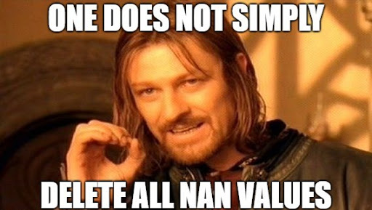
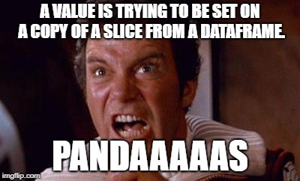
Memes that we can relate to

Slide 3
Q1 Which category, in your opinion, has the best ratings? How are you measuring best ratings?
Findings:
We concluded that Education was the highest rated app, on the weighted average basis.
Recommendation:
To consumers with children, or looking into further education, we would recommend they explore using an app rather than traditional book learning as our data indicates uses who download this apps, give them a high rating, implying they are useful in the education process

Slide 4
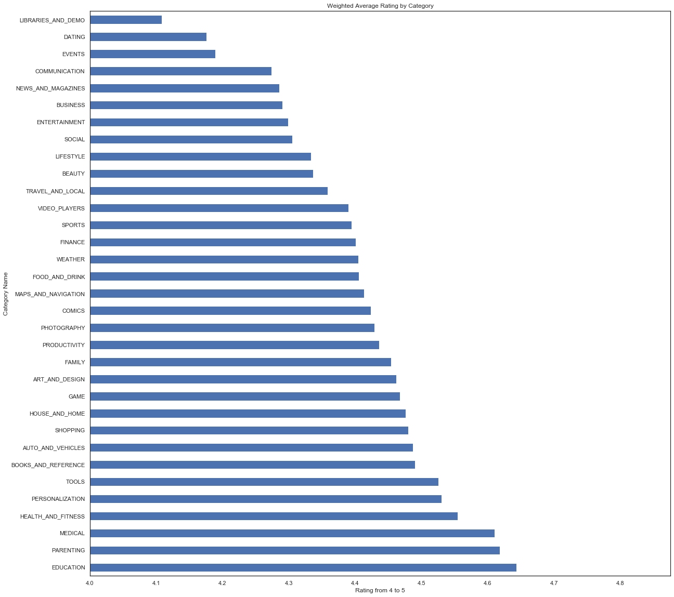

Slide 5
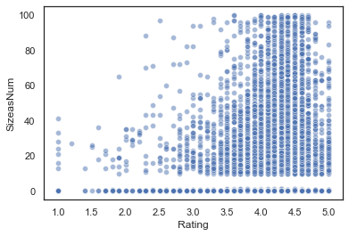
Q2 Is there a relationship between ratings and size? How did you measure the relationship? Why did you choose this measurement?
There is no relationship between ratings and size. This is clear from our scatterplot, and can also be confirmed from the correlation coefficient between ratings and size being 0.06

Slide 6
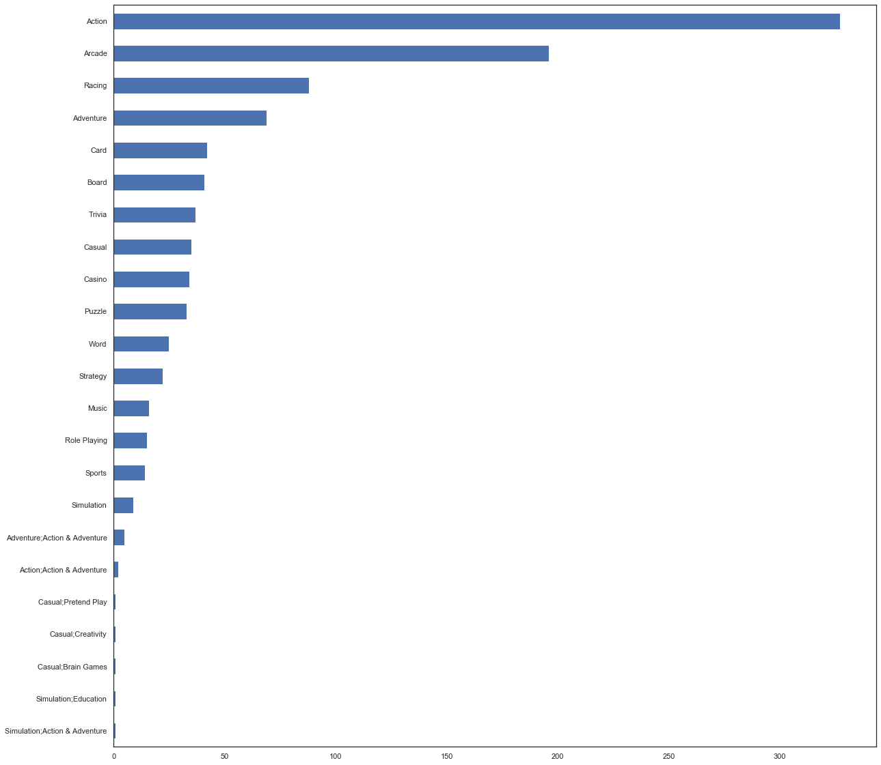
Q3 For your category, how many genres are represented? What are their counts? Please show this with a bar chart.
There are 23 Genres
Recommendation
To app developers developing games, Action appears to be the most saturated genre in he game category. We would recommend looking at other less saturated categories, such as simulation or Role Playing. Moreover, we would recommend ensuring that you choose the name of the genre you wish to be in to avoid being lost in app searches by genre. We found that genres such as Casual;Creativity were not coming up in searches for Casual.
.

Slide 7
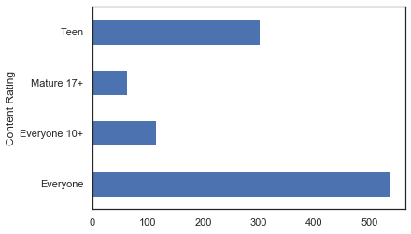
Q4 What is something interesting you found about your category?
Reccomendation: For app developers, we would recommend looking into the mature 17+ , or the everyone 10+ categories, as these are least made.

Slide 8
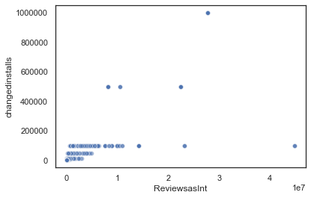
Q4 -
Correlation Coefficient = 0.72
Positive Correlation between the Number of Reviews and the Number of Installation

Slide 9
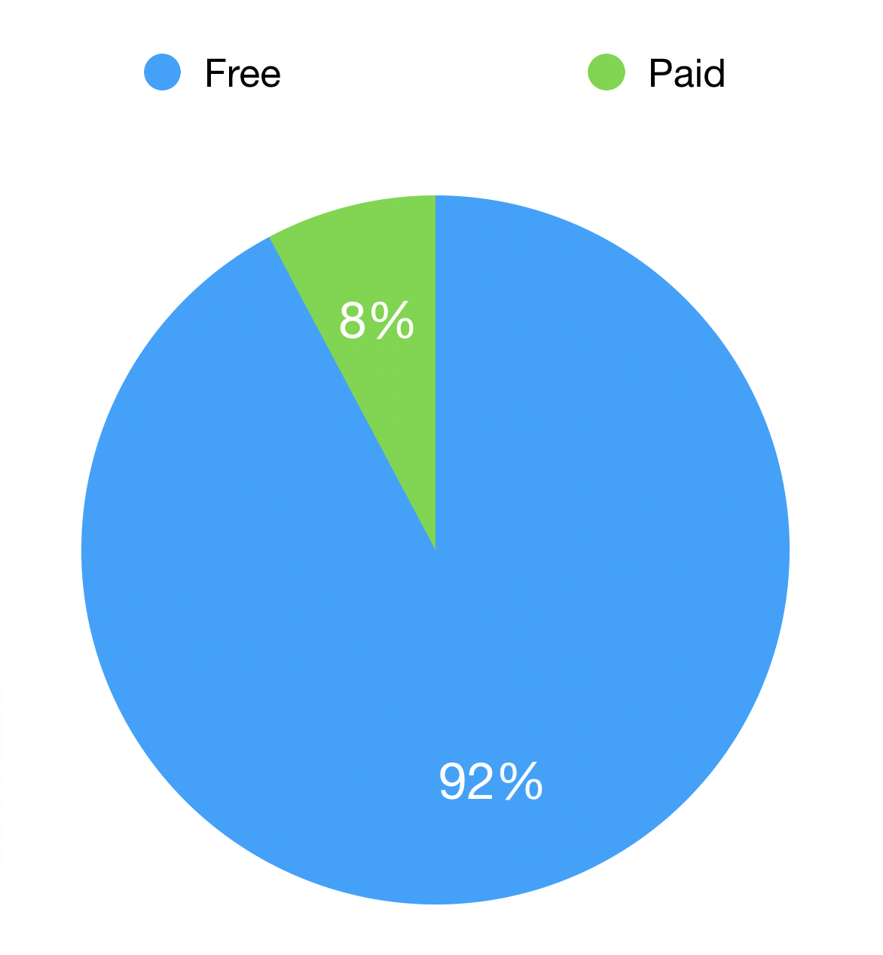
Q5: What is something interesting you found about your category in relationship to the rest of the data?
Finding:
The Game category was ranked 3rd highest in the free section, and 2nd highest in the paid section for number of apps. As a percentage within the Game Category, 92% of apps were free. Given that only 8% of Game apps were paid for , it is interesting that it is the 2nd highest category for paid apps. This could be down to the fact that the Game Category is the second largest in terms of app counts, or could imply that most categories do not offer paid apps.

Slide 10
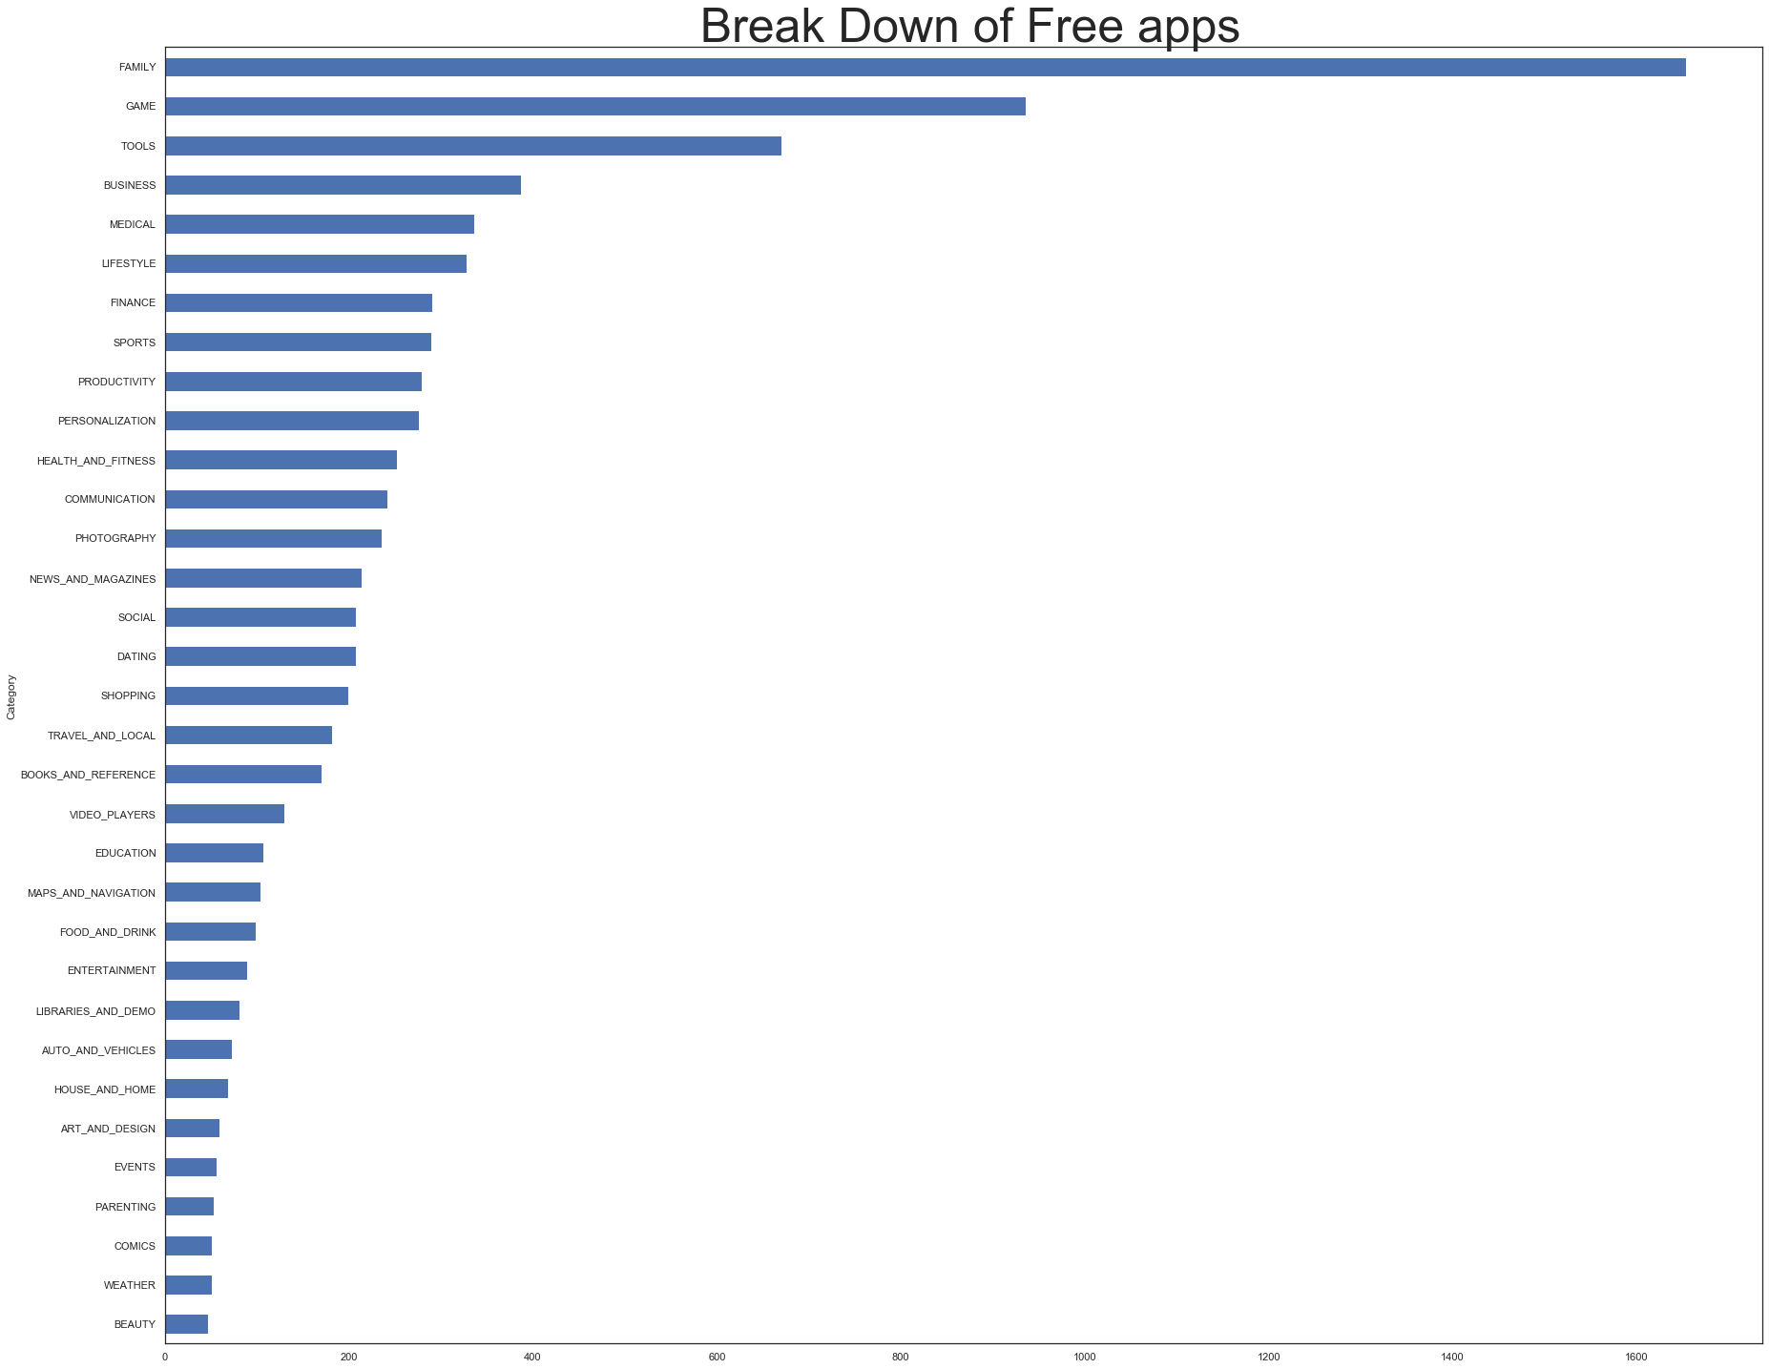
Recommendations:
Our Recommendation for app developers, we would recommend making apps for this genre free, and making money from ingame purchases or advertisements, rather than a fee for the app itself.

Slide 11
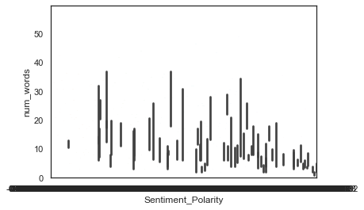
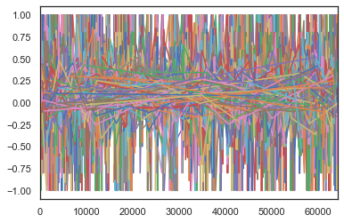
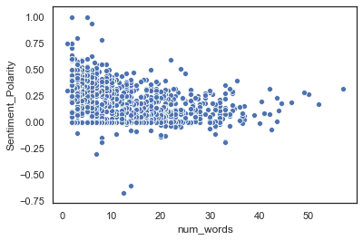
Q6 Anything else we should know about this dataset?
Findings: NaN
We worked with the user review data to find correlations between, number of words, sentiment and sentiment polarity ect..
Unfortunately, we ran out of time, here are some results. We did not manage to find any correlations in our time. However if any of you did it would be great to know!

Slide 12

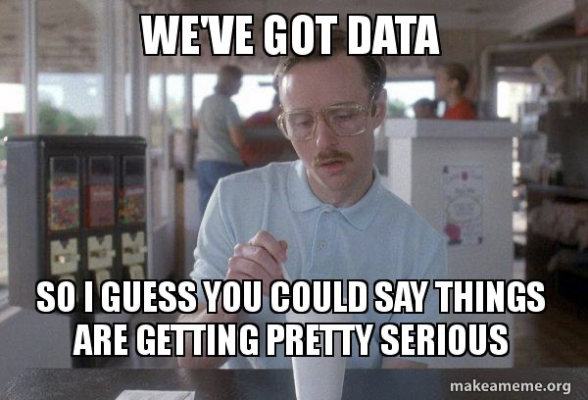
Take-aways

