Slide 1




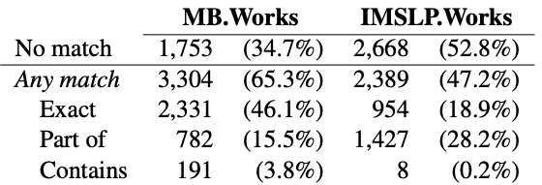
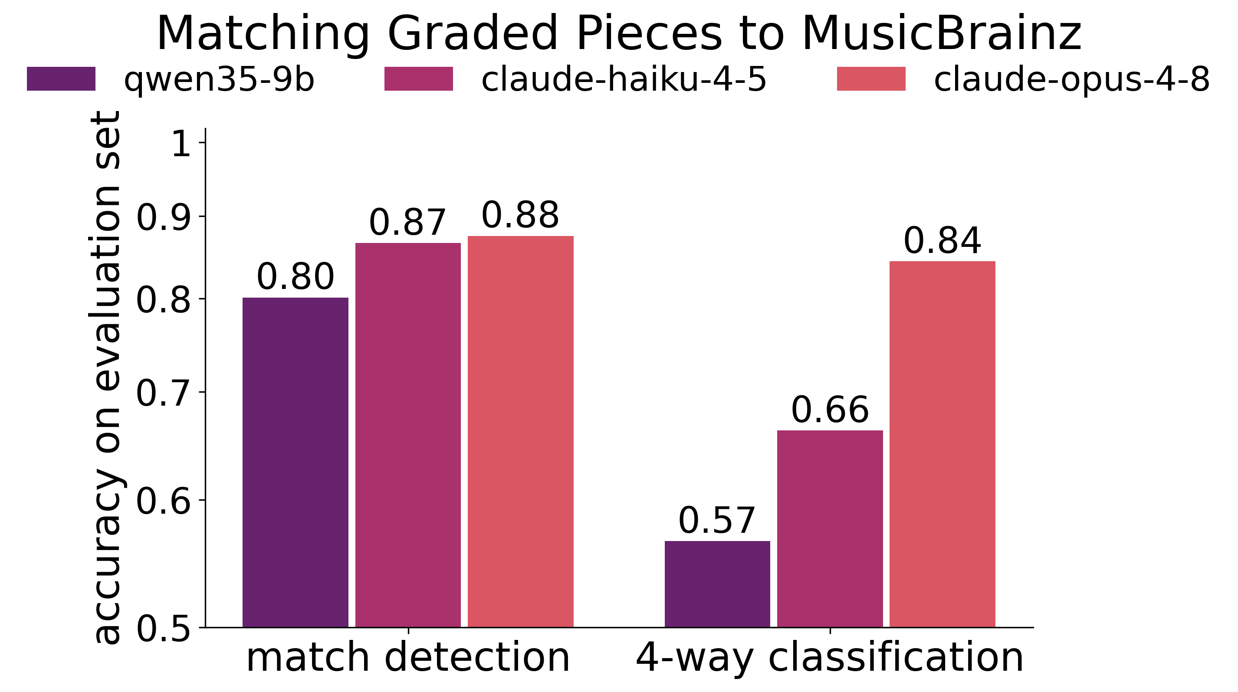
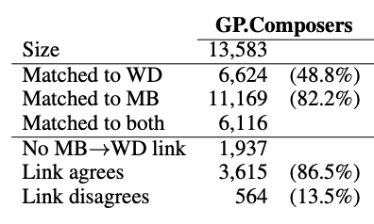
MetaMatch: Reconciling Metadata for Aggregating Music Difficulty Annotations
Megan E. Finch¹, Chris G. Willcocks¹, Mark R. H. Gotham²
¹ Durham University, UK ² King’s College London, UK
Motivation
Application: Aggregating Music Difficulty Annotations
Recent work in automated performance difficulty recognition focuses predominantly on piano music, due to data availability.
Music exam board repertoire lists provide a rich source of difficulty labels for dozens of instruments; and the sheet music for many of the listed works is in the public domain.
To make use of this data, we must first link musical works across multiple corpora with inconsistent metadata.
RCM
Trinity
Score
ABRSM
WikiData
Score
Exam Board
Syllabi
Graded Pieces
IMSLP
Other Difficulty Datasets
MusicBrainz
Other Sheet Music Corpora
Existing (partial) link
(e.g. CIPI, PianoStreet, etc)
(e.g. PDMX)
Links to infer
Dataset
(Some) Challenges
58,104 repertoire list entries collated from exam boards, covering 20+ instruments and 13k+ composers.
Includes 7,737 entries for piano.
Ambiguous composers
Alternative titles
Query: “Jean-Baptiste Loeillet” or “Loeillet”
Graded Pieces
IMSLP
Match?
WikiData
Title | Chaconne
Composer | Handel
Book | Classics to Moderns, Book 4
Difficulty | MTB, Grade 4, Piano
Suite in G minor, HWV 432 | ✓
Chaconne in F major, HWV 485 | ✗
Chaconne in G major, HWV 435 | ✗
Chaconne in G major, HWV 442 | ✗
ID | Label
Q1319135 | Jean-Baptiste Loeillet of London
Q1347001 | Jean Baptiste Loeillet of Ghent
Previous work
Composer names can be under-specified or ambiguous.
Pieces can have different titles, including translations and levels of detail. For example, Chaconne here refers to movement VI. Passacaglia of HWV 432.
The LinkedMusic project [1] uses OpenRefine’s reconciliation API to semi-automatically match as many values to WikiData entities as possible.
Different granularities
Missing entities
Graded Pieces
IMSLP
Query: “Tom Davoren”
MusicBrainz.Artists
Wiki
Data
Title | In Yugoslav Mode
Composer | Béla Bartók
Book | MTB Piano Grade 1
Difficulty | Grade 1
is part of
Mikrokosmos, Sz. 107
ID | Name
d8acb7b0… | Tom Davoren
527f3f97-7… | Tony Davoren
57c6f649… | Tom Jones
is the same piece as
MusicBrainz
WikiData
Peeters & Bizer [2] showed that LLMs with little or no fine-tuning perform competitively on entity matching tasks.
Mikrokosmos, Sz. 107, BB 105: Volume II, No. 40: In Yugoslavian Mode (Allegretto)
No entries
No consistent meaning of ‘musical work’ across database schemas.
Many musical works, and even artists, have no WikiData entry; no single ‘backbone’ dataset covers all entities one might wish to link.
Method
Matching Pipeline
Metadata backbone: attempt to find a more complete matching by routing through any of several ‘backbone’
QUERY
Graded Pieces
Reconcile other entities
Rank candidates
LLM
Title | Chaconne
Composer | Handel
Book | Classics to Moderns, Book 4
Difficulty | Grade 4
Graded Pieces
no match
WikiData
Title | Chaconne
Composer ID | Q7302
Candidate Works
Candidate Works
A is a
part of B
datasets,
Music
Brainz
Metadata
‘backbone’
TARGET
Handel - Chaconne in F major, HWV 485
Handel - Suite in G minor, HWV 432
Handel – Admeto, HWV 22
Handel - Chaconne in F major, HWV 485
Handel - Suite in G minor, HWV 432
Handel – Admeto, HWV 22
and by leveraging existing
no match
links between them as a weak supervision signal. Matching against two target datasets which have such a link (e.g. some MusicBrainz works link to an IMSLP URL) allows us to assess matching accuracy/consistency.
e.g. IMSLP
Only works with matching entity IDs (e.g. same composer)
Results
How many pieces can be matched?
How accurate is the LLM matching?
Match composers: for tractability, we first filter candidate works for each graded piece entry using other entities which are easier to reconcile (e.g. composers).
LLM-based entity recognition: ask the LLM to classify (query, candidate) pairs as ‘match’, ‘no match’, or ‘piece A is a part of piece B’ (or vice versa).
Evaluation dataset: to assess LLM accuracy, we manually label 447 graded pieces with their closest match in MusicBrainz, where available.
Of 5,057 piano pieces with known composers:.
LLMs can accurately detect when two pieces match (i.e. ‘match’ vs ‘no match’), but not the type of match (i.e. ‘match’ vs ‘A is part of B’).
47% have a matching IMSLP work.
How many composers can be matched?
11k composers matched to a MusicBrainz artist.
Matching to MusicBrainz vs WikiData is largely consistent.
Commercial models substantially outperform SOTA open weight models.
Conclusion
References
Present method for reconciling entities across heterogenous music datasets, combining existing reconciliation services with LLM-based entity matching.
Demonstrate that this method can be used to link entries from music exam board repertoire lists to IMSLP works, and hence produce new difficulty-labelled datasets for multiple instruments.
I. Fujinaga, “Sustainable archiving of music databases through RDF and NLQ2SPARQL,” in Proceedings of the 12th International Conference on Digital Libraries for Musicology, 2025, pp. 100–104.
R. Peeters and C. Bizer, “Using ChatGPT for entity matching,” in European Conference on Advances in Databases and Information Systems. Springer, 2023, pp. 221–230.
Notes:
✓

