Slide 1
EDES 301 PCB Project
Megan Enriquez
Due 12/17/2024 @ 11:59pm

Slide 2
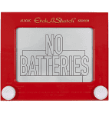
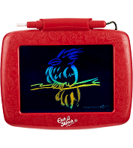
Background Information
Create a PCB for an “Etch-a-Sketch”
Hardware:
SPI Display Screen
Two Potentiometers
Two Buttons (Reset the Game, Change Color)
Three LEDs (Red, Green, and Blue for Color)
USB Port (Expansion)
Replace this slide with your own if you are doing a PCB around your Project #1

Slide 3
System Block Diagram – “Etch-a-Sketch”
5V
3.3V
PocketBeagle
USB Host
VCC
SPI Display
USB
SPI
SPI
VCC
USB
SPI
GPIO
GPIO
GPIO
GND
3.3V
GND
GND
1k
1.8V
Potentiometer
3.3V
GPIO
1k
AIN
GPIO
AGND
GPIO
1.8V
Potentiometer
GPIO
AIN
AGND
GPIO

Slide 4
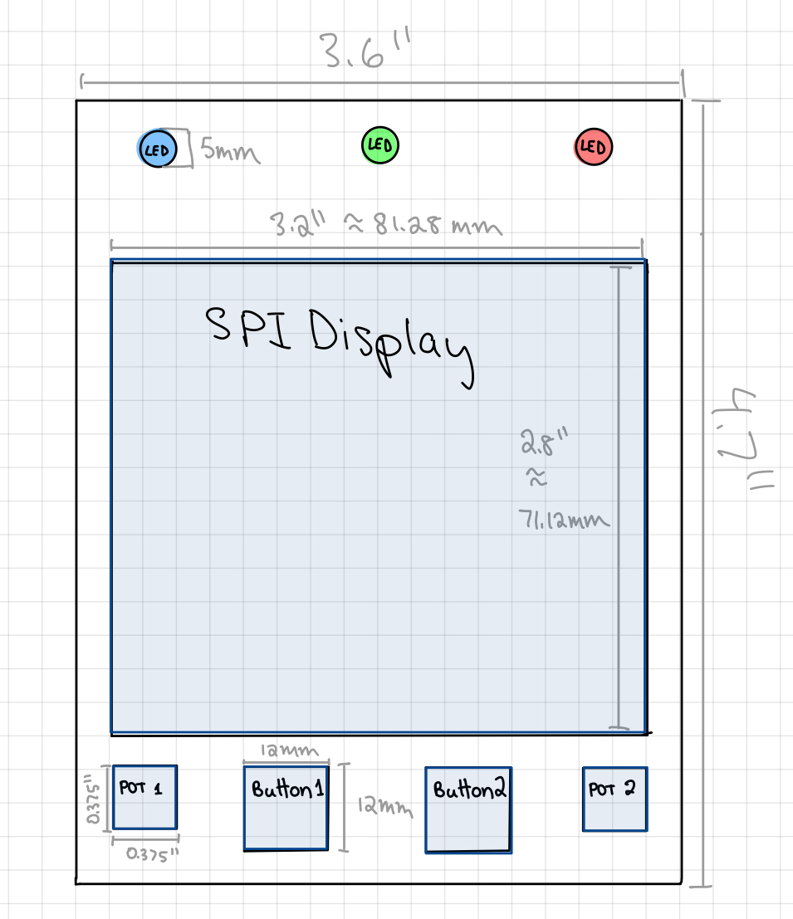
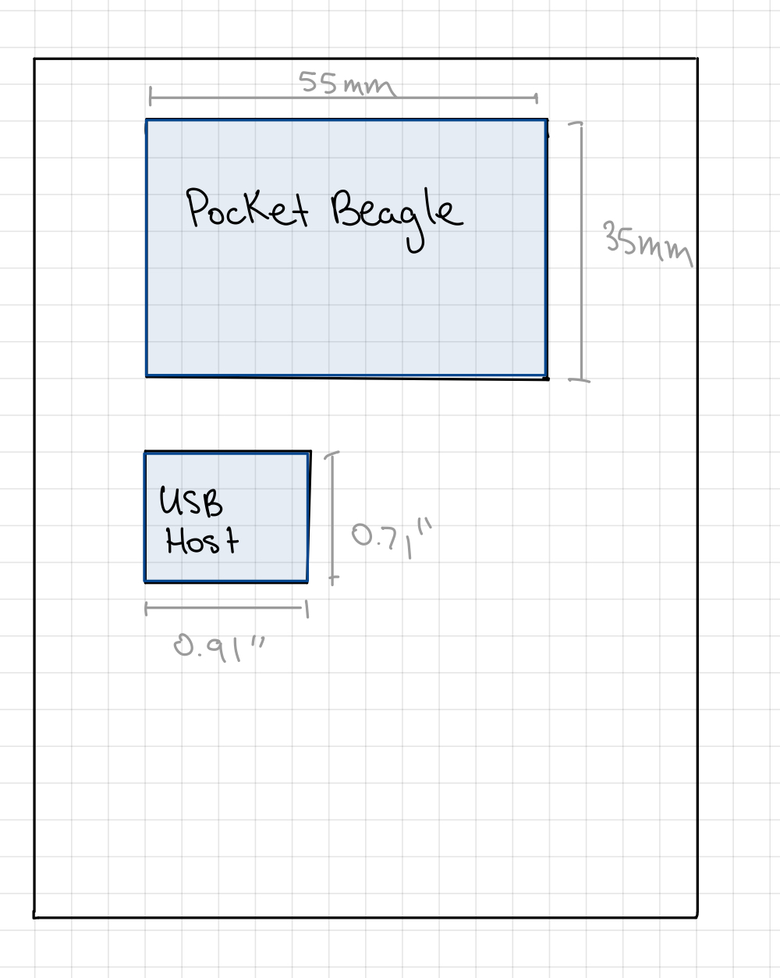
Mechanical Drawing
Each Grid Box is 0.2”
FRONT
BACK

