Slide 1
R Stats Bootcamp 08
Distributions Ed Harris / Megan Lewis

Slide 2


Slide 3

R Stats Bootcamp
R Stats Bootcamp 08
Distributions
Can you guess the weight of this bull? What about you and 99 friends?”.

Slide 4
Objectives
Use of the histogram
Gaussian: that ain’t normal!
Poisson distribution
Binomial distribution
Diagnosing the distribution

Slide 5
Use of the histogram
Plots a numeric variable on the x axis
Frequency of observations on the y axis

Slide 6
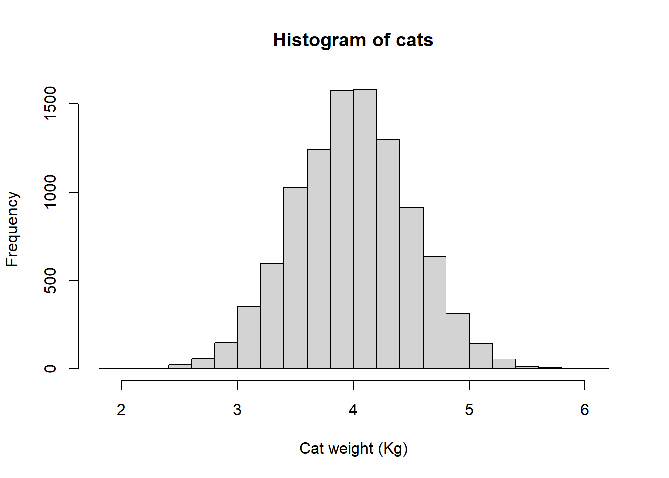
Typical histogram for continuous variable

Slide 7
Let’s go coding!

Slide 8
Sampling and Populations
Remember the concept of population versus sample?
Population of 10,000 cats versus a sample of 100 cats
Expected variation in random sample means?
Coding examples!

Slide 9
Gaussian: That ain’t necessarily normal!
Classic “Bell curve” shaped distribution
Continuous numeric variables that “measure” things (e.g., human height)

Slide 10
The Gaussian assumption (important topic)
Regression and ANOVA
Gaussian is described by 2 quantities: the mean and the variance

Slide 11
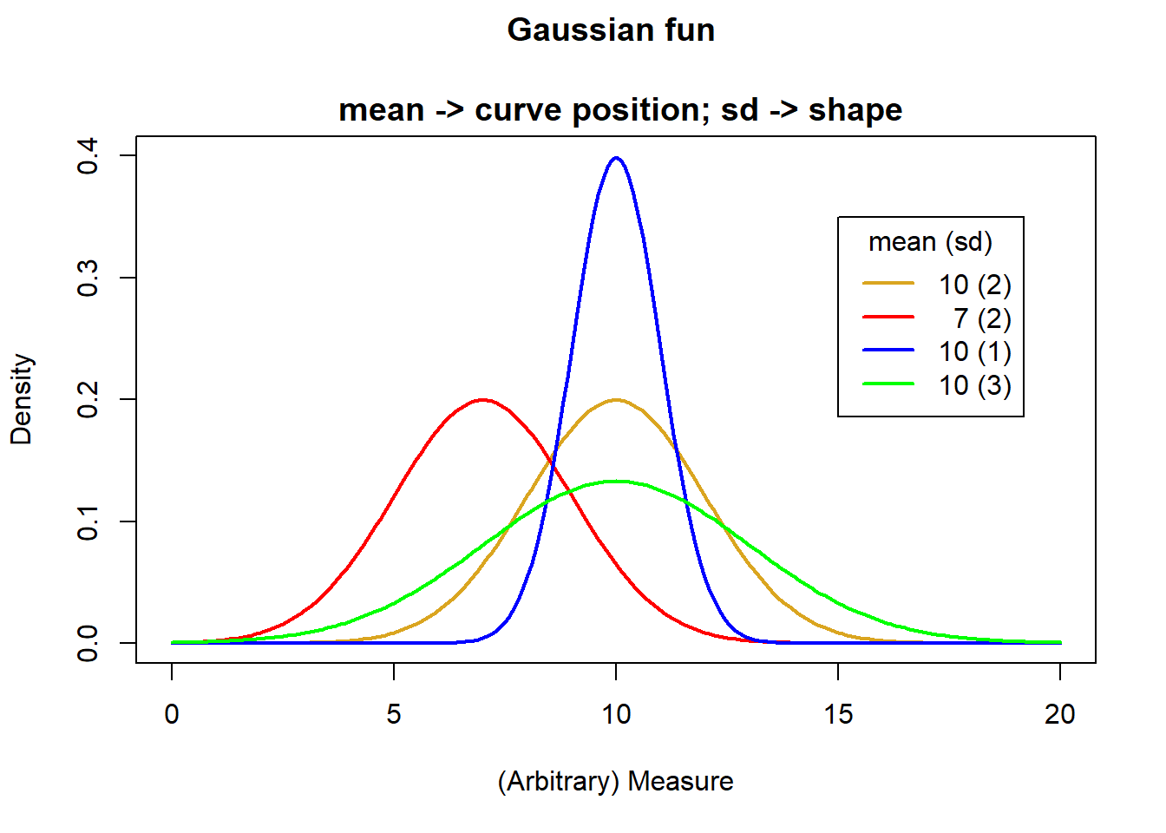
Gaussian histograms - to R!

Slide 12
Back to R!

Slide 13
Quartile-Quartile (Q-Q) plots
Might want a peek or even more formally test whether data are Gaussian
I.e., Do the residuals of a linear model adhere to the assumption of a Gaussian distribution?
Q-Q plots are a common diagnostic plot
To R for some examples

Slide 14
Poisson distribution
Count data of discrete events, objects, etc.
Integers, for example the number of beetles caught each day in a pitfall trap
Poisson data are typically skewed to the right
Described by a single parameter, (lambda), which describes the mean and the variance

Slide 15
Off to R!
Example Poisson data
Density plot for different Poisson lambda values

Slide 16
Binomial distribution
Exactly 2 outcomes: 0 and 1, Yes and No, True and False, etc.
Data are the count of “successes”” in (binary) outcomes of a series of independent events
Data coding can be variable

Slide 17
Let’s do some coding!
Example: Nest boxes
Example: Flipping a coin
Density plot for different Binomial parameters

Slide 18
Diagnosing the distribution
Good practice - a set of steps to adhere to when diagnosing a distribution.
Develop an expectation of the distribution, based on the type of data
Graph the data i.e., histograms and q-q plots
Compare q-q plots with different distributions for comparison if in doubt

Slide 19

Practice Exercises

