Slide 1
CS301 Data Structures & Algorithms
Welcome
8/19/2021

Slide 2
CS301 Data Structures & Algorithms
Review the course syllabus
Course Format
Prerequisites
Textbook
Objectives
Grading
Schedule
Final exam
The syllabus can be found on BlackBoard.

Slide 3
CS301 Data Structures & Algorithms
Resources on BlackBoard
Course Materials
- Assignments
- Lecture slides
- Source code examples
- Syllabus
- Submit assignments on Blackboard
Exams on Blackboard
- Using Respondus Lockdown Browser
- Requires Webcam

Slide 4
CS301 Data Structures & Algorithms
How to do well in this class
Be on-time, present and engaged during lecture
Read the textbook every week
Start assignments early to allow for time to get help
Assignments and exams are discussed during lecture, so please come.
Ask questions in whatever format works well for you
  During lecture, by email, visit office hour
Zoom specific
You are strongly encouraged to share video in Zoom during class meetings.
Sharing video can help create a fair, interactive, open, fun, and collaborative learning environment.
Technical challenges happen. This is ok, too. Do your best.
Use virtual background features in Zoom.
Behave as you would during an in-person college class.

Slide 5
CS301 Data Structures & Algorithms
Attendance
- Attendance is required
- Please share video
- Introduce yourself when called

Slide 6

CS301 Data Structures & Algorithms
Install Eclipse IDE
Download the Eclipse Installer 2021-06 R
Eclipse Download link

Slide 7
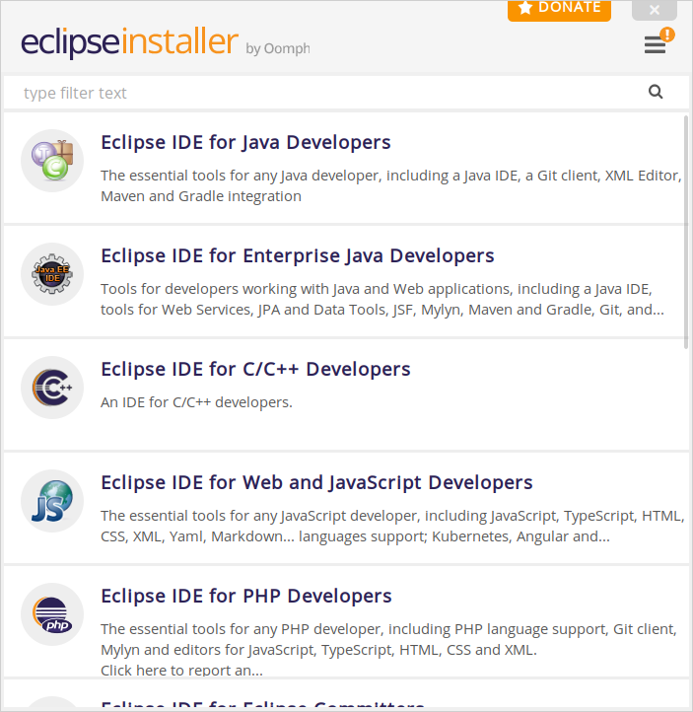
CS301 Data Structures & Algorithms
Select Eclipse IDE for C/C++ Developers

Slide 8

CS301 Data Structures & Algorithms
Schedule

Slide 9
CS301 Data Structures & Algorithms
Before we meet next time:
- Get the textbook
- Read chapter 1-2
- Install Eclipse IDE for C/C++

